Slide 1
Measles & Rubella Initiative Advocacy & Communication
Global Measles and Rubella Partnership Meeting
19 September 2012
ARC, Washington DC

Slide 2
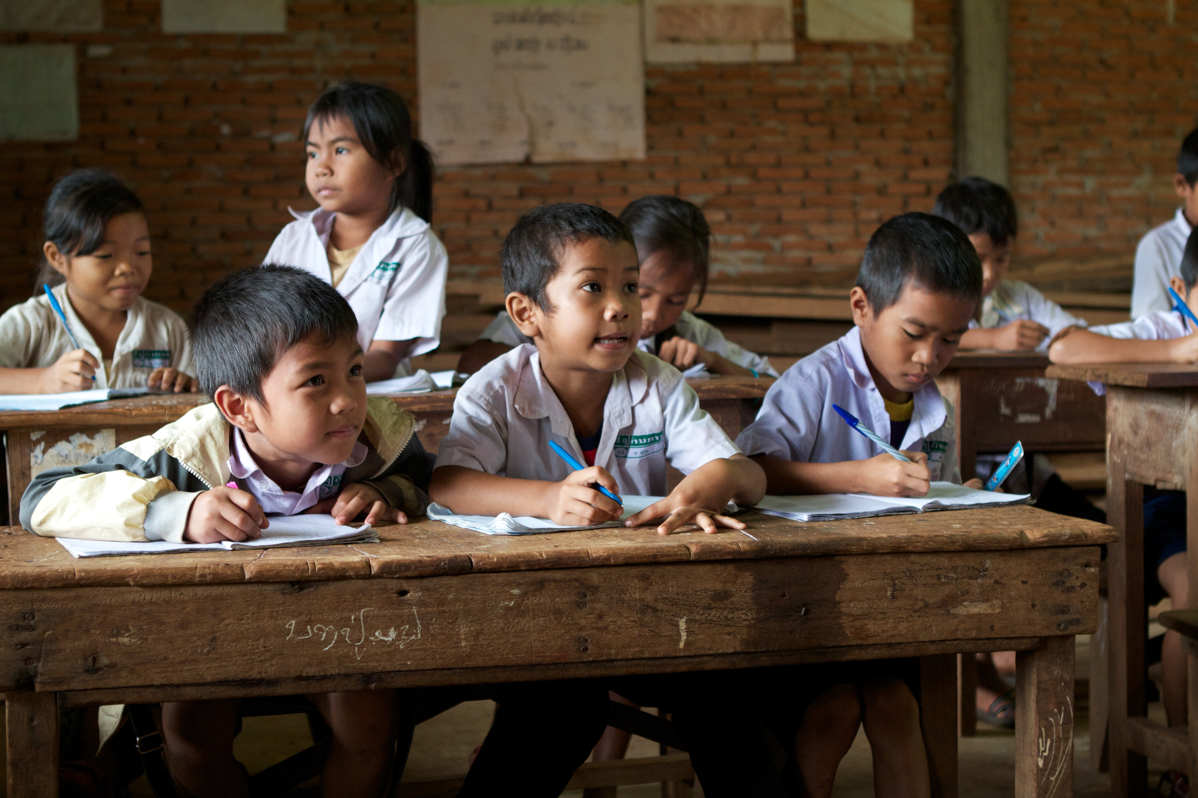
Outline
Objectives, goals, scope
What’s new
Addressing challenges
Next directions

Slide 3
Communications Objective & Goals
Communications Objective:
To support achievement of the 2015 and 2020 goals of the Global Measles and Rubella Strategic Plan 2012-2020
Communications Goals:
To ensure communications strategies and activities help to achieve the M&R Initiative’s programmatic, advocacy and fundraising goals
To ensure the Measles & Rubella Initiative secures and maintains a high profile internationally, regionally and nationally as a founder and leader of global efforts to eliminate measles and rubella.

Slide 4
Scope and role of Communications
Advocacy
To convince: secure policy, program, financial support
Internal, global, country
Public Information/ Risk Communication
To inform: secure an action/behaviour
National
Social Mobilization
To secure partnerships/ alliances for action
National, local
Programme Communication/ Community Engagement
Audience: Leaders, decision-makers
Audience: “The public”
Audience: Organizations, associations, churches
To generate demand, increase coverage
Audience: communities
Local

Slide 5
Audiences, Messages, Channels
Audience | Message | Channel (egs)
Mom and dad donor | “Save a child for just $1.” | Local Red Cross, Unicef Nat Comms
Finance Minister | “Your $2 million a year will bring xx returns” | WHO ADG, UNF CEO
Health Minister | “Measles & rubella vaccination is a low-cost, effective public health intervention.” | IPA, Unicef, Lions
Mom with child | “Vaccination is safe and free” | Health worker, community leader, church leader
A message about messages:
Clear, consistent, powerful.

Slide 6
Communications staffing/resources
Core:
1 dedicated consultant
5 founding partner communications officers (10%)
Plans to hire a full-time specialist
AND collaboration/ amplification through partners:
Eg Lions, GAVI, AAP, BMGF
AND
Massive international network of Unicef, WHO, IFRC, and other partners IF we use it

Slide 7
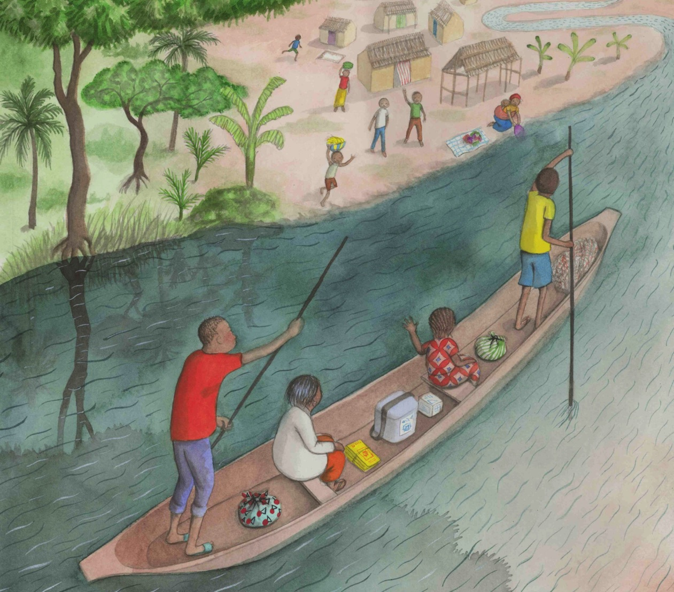
What’s new?

Slide 8
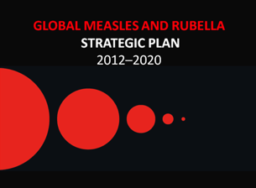
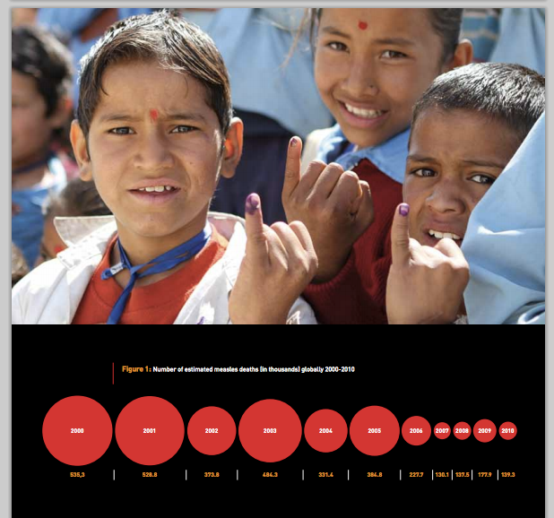
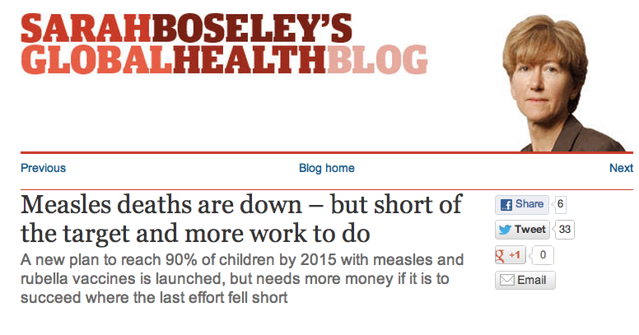
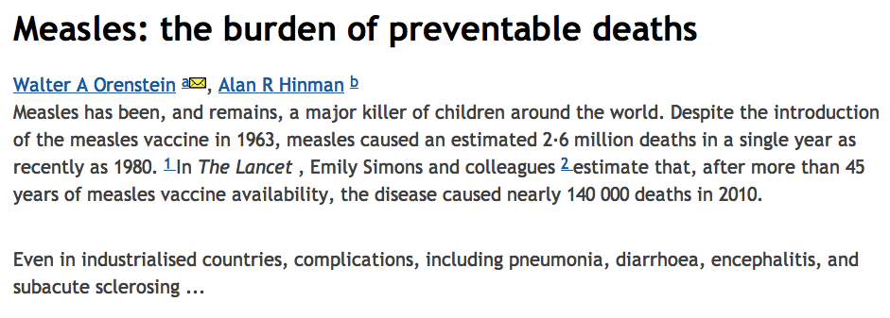
New Strategic Plan
Global launch 24 April 2012 w/ new Lancet mortality figures
Good coverage w/ progress, challenges
Also available for Ipad

Slide 9
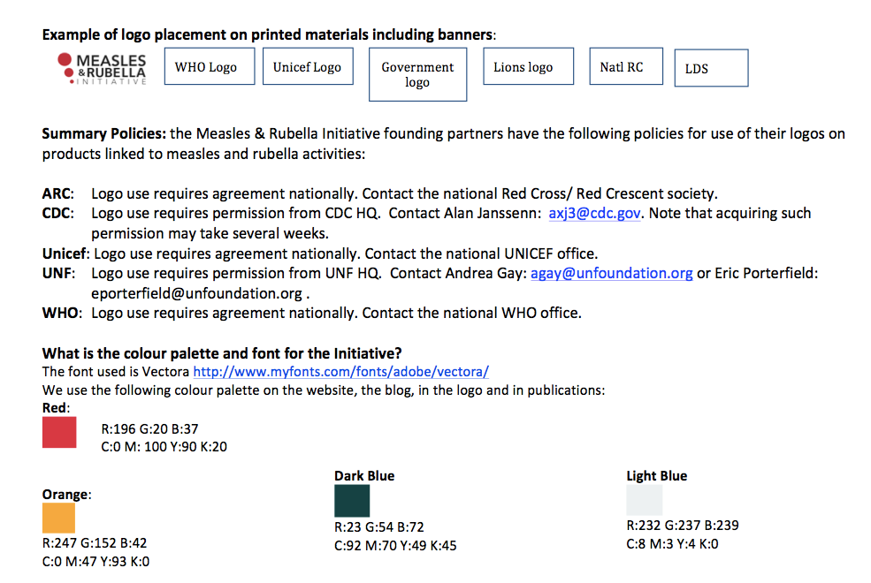
Measles & Rubella Initiative branding guidelines
New logo, with and without strapline
New branding guidelines :
Promote consistent visibility for M&RI and partners (Lions, LDS, etc) globally and in countries

Slide 10
Increase regular outreach
News releases
1 billion doses, Europe outbreaks, Strategic Plan, WPR elimination
Statements
GAVI MCV2, MR, India polio, GVAP resolution
Blog posts (Huff Post, M&R Initiative)

Slide 11
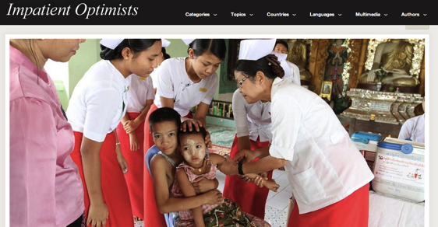
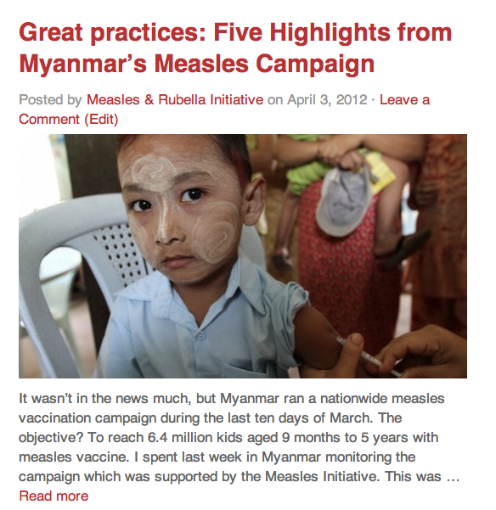
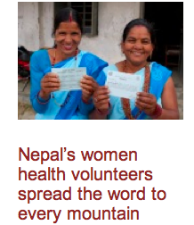
Profiling Country Work
Laos
Myanmar
Nepal

Slide 12
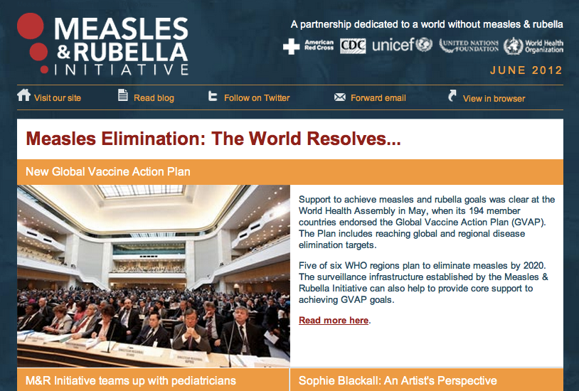
Measles web and new social media platform
M&R I e-newsletter
1800 + subscribers +
Immunization and global health stakeholders, donors, journalists, Red Cross, UNICEF and campus lists
Technical, advocacy, outbreak, SIA and country notes
Welcome regional / country input
Aim for monthly publication

Slide 13
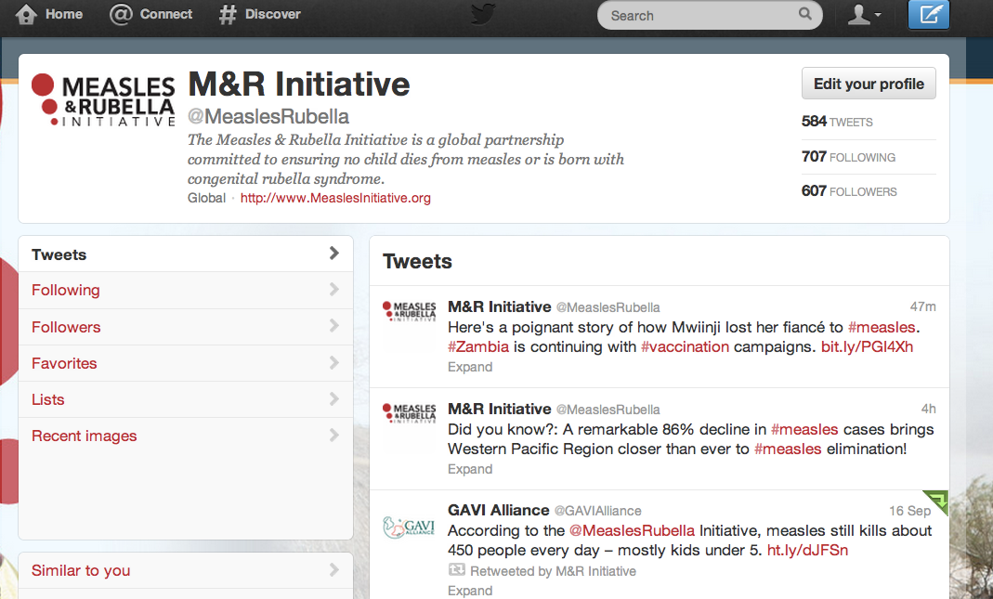
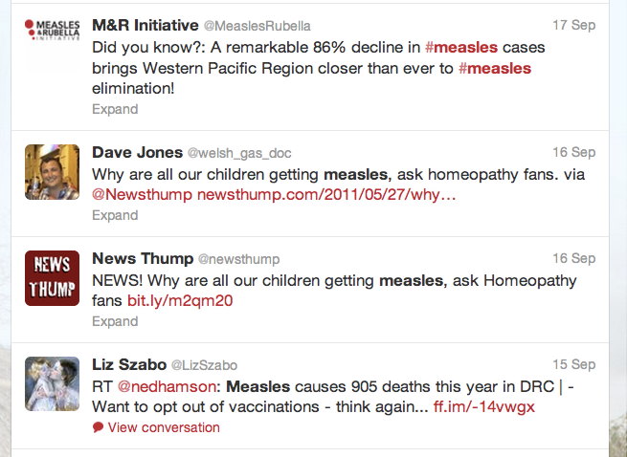
Measles web and new social media platform
Twitter
@MeaslesRubella
600+ followers
Retweets/ engagement by journalists, partners, influential stakeholders
Informal surveillance
Partner cross promotion =2 million+
Celebrities? 5 million+

Slide 14
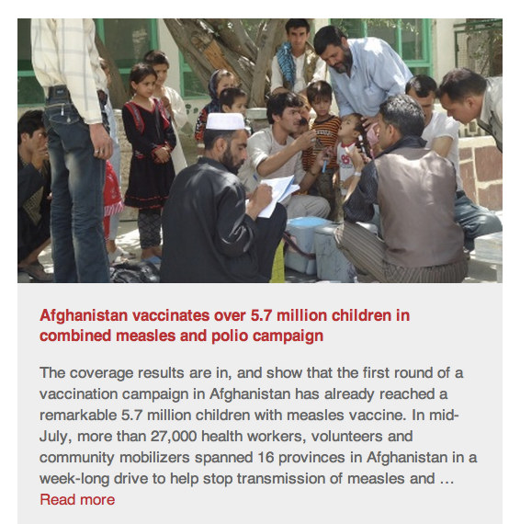
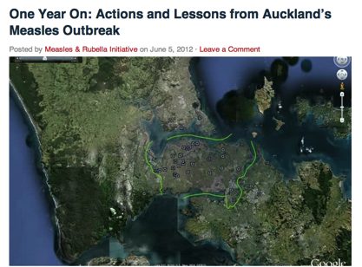
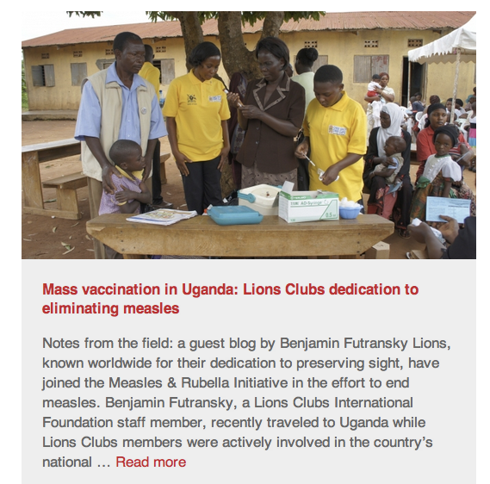
Measles web and new social media platform
Blog:
StopMeaslesRubella.org
About 6,000 views so far and growing
30 posts to date
Guest bloggers
Country stories
Anyone in this room is welcome to guest blog

Slide 15
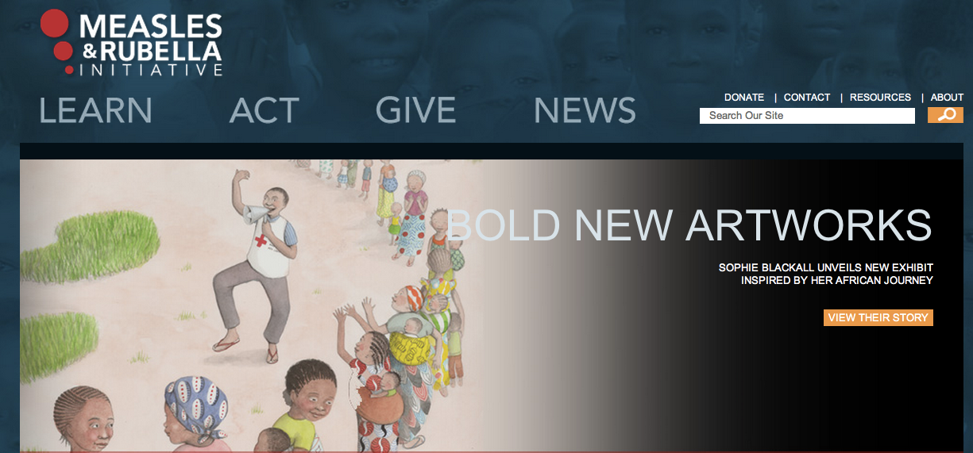
M&RI on the web
www.MeaslesRubellaInitiative.org is prime web portal
Measles info also on WHO, Regional Offices, UNICEF, CDC, ARC, UN Foundation, Lions, GAVI, etc
Will move towards a “one-stop shop” for information

Slide 16
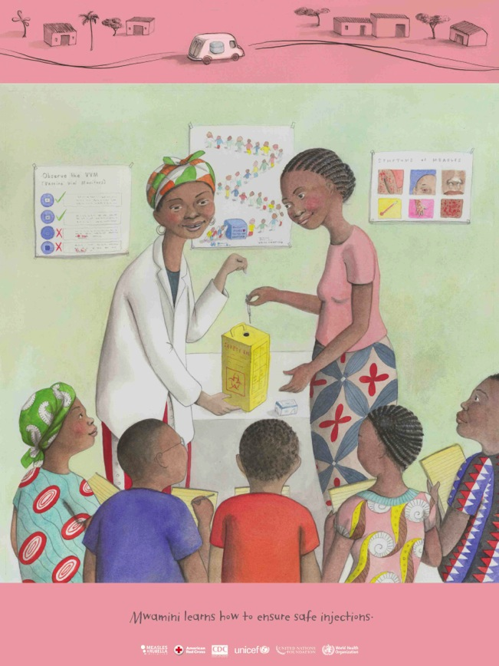
New Project: Illustrator Sophie Blackall
Strong partner effort
To engage audiences in measles & rubella story
Raise public awareness & funds
For use by all partners
Exhibit, interactive website, products for sale
This week: ARC, NY for Social Good Summit, 92nd Y Street Festival, meetings with bloggers, journos
November: New Yorker Passport to the Arts

Slide 17
The potential: as large as our imaginations

Slide 18
Advocacy Achievements
Sierra Leone: $/SIA
Advocacy collaboration within
Country visit by UN Foundation, WHO AFRO
Result: In-country funds for 50% of ops costs
Kenya: Political/$ commitment for SIA
Advocacy collaboration with RC, Lions, Task Force and others to find solution
Result: Funding secured
Niger: $/SIA
Country visit by UN Foundation, WHO AFRO, RC
Met MoH, MoF, MoP& donors
Result: Positive, follow-up occurring

Slide 19
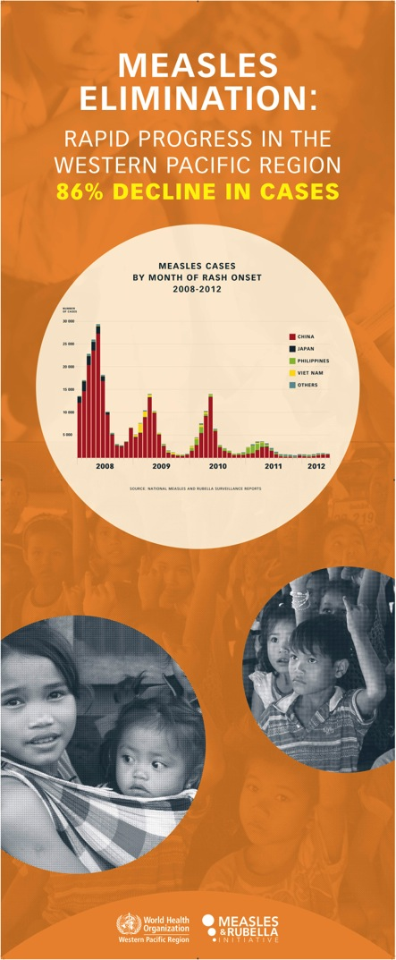
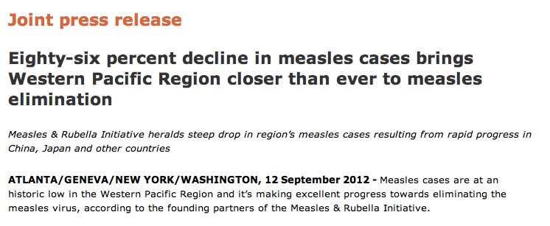
Advocacy Priority
WPR Measles Elimination
Advocacy and Communications Plan; RCM, champions, in-country

Slide 20
Communication Challenges
Challenges
Solutions and Opportunities
Traditional media interest in global health sliding
Positioning a “single-issue” program
Ongoing perception of low threat of measles
Low understanding of rubella and CRS
Reach audiences through social media and other e-channels. Manage expectations.
Emphasis on progress/results for GVAP, child survival, MDG4, equity
Use N. American, Europe outbreaks to show threats
Document, promote story of CRS

Slide 21
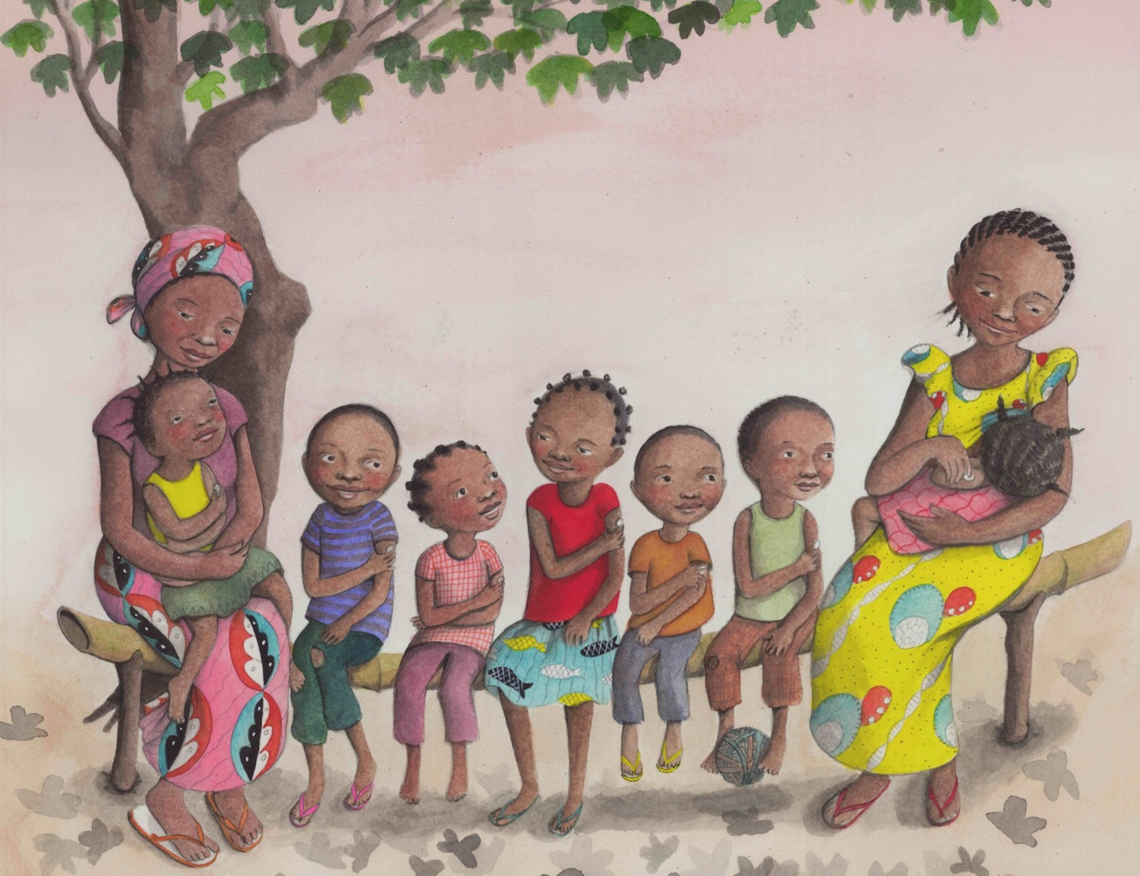
What’s next?

Slide 22
New Communications Strategy Positioning the M&R Initiative
Position the Initiative as global leader, with the experience, expertise and strong partnership to eliminate measles, rubella and CRS
Align M&R more closely with GVAP, MDG4, maternal and child health; & health equity
Work with the extended partnership to promote M&R – eg. Lions, LDS, AAP, GAVI, BMGF

Slide 23
Aligning the Communications Strategy to Strategic Plan
Achieve and maintain high levels of immunity:
At least 1 major event annually to report progress
Priority support to regions approaching elimination goals (WPR, EUR, EMRO)
Comms/Advocacy to priority 2015 countries (DRC, India, Ethiopia, Nigeria, Pak)
Profile priority regional/ country SIA and RI efforts
Document & promote M&R contribution to RI
Identify measles & rubella “champions”
Strategic use of Sophie Blackall illustrations

Slide 24
Aligning the comms strategy contd
Monitor Disease and Evaluate Efforts
Package/promote monthly surveillance updates
Publish annual progress report on SP monitoring indicators
Outbreak and Case Management
Use outbreaks opportunity to promote threat of measles/rubella; and M&RIs response
Profile outbreak prevention (equity)
Promote case management and potential to save lives/ reach 2015 goals (country examples)

Slide 25
Aligning the comms strategy contd
Communication and Engagement
Advocate for larger investment in strategic community engagement for M&R and RI
Finalise best practice soc mob guide for M&R and RI (bringing in experience from polio, measles, rubella, others)
Consider innovation stream for technology and community engagement (mobile, social media)
Global: resistance to MMR vaccination. Need to tackle in a more coordinated manner.

Slide 26
Aligning the comms strategy contd
Research and Development
Publish annual R&D for M&R report
Better publicise and promote research outcomes to key audiences

Slide 27
Opportunities and Key Dates
September onwards: WPR RCM outcomes and advocacy follow-up
December: 2011 measles mortality figures
January: SAGE findings on regional progress
April: World Immunization Week
Cost benefits/eradication (when ready)
Outbreaks/priority countries: Ethiopia, DRC, India, Pak
2012-2013: SIAs, MR introductions
Sept 2013: SEAR RCM
Sept 2013: UN MDGs
Overall: build up rubella/ CRS
\\

Slide 28
Summary:
Invest in communications at all levels.
Communications is changing. We need to be there.
M&R Initiative has something to say. Let’s think big.
You have a role.

Slide 29
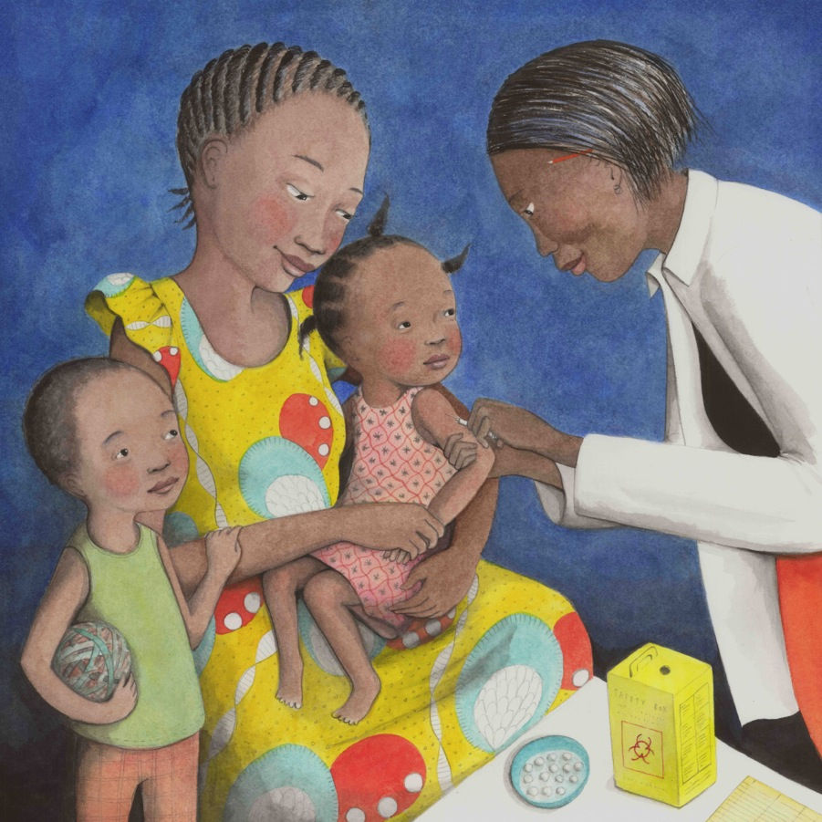
Thank you.

Slide 30
Anne Ray Charitable Trust

