Slide 1
Recording and monitoring in the second year of life
Jan Grevendonk, WHO, grevendonkj@who.int Geneva, 22 June 2016

Slide 2
2YL and monitoring
Measures of success of a 2YL platform
Uptake of doses targeted in 2YL (MCV2 or DTP4)
Proportion of MCV1, DTP3 during 2YL
Some indication of integrated delivery
What is important for MR?
Timely coverage MCV1/2
Total coverage MCV1/2
How do we monitor timely coverage?
What is happening in the second year of life according to surveys?
How do administrative systems deal with timeliness / age range reporting?

Slide 3
Questions
What are we measuring?
Timely coverage (and by what age)?
Complete coverage?
Might monitoring systems influence practice?
What are the best options for monitoring vaccinations in the 2YL?

Slide 4
What is happening now in the 2YL?
Significant activity in second year of life, regardless of schedule
Different yardsticks: MCV1<1 versus MCV1<2: need to harmonize this?

Slide 5
How do MCV1 and MCV2 interact?
8 countries with recent surveys that allowed for meaningful analysis on MCV1 versus MCV2
“MCV2 but no MCV1?” => didn’t seem to be an issue
Often a “long tail” for MCV2, beyond 2YL, less concentrated
Possible explanation: late MCV1 delays MCV2, is not substituted by it
Source: analysis by Colin Sanderson

Slide 6
How do administrative systems deal with age range reporting?
Separate 0-11m and +12m
Some countries with 2YL vaccines add 12-23m
But this is often on top of other disaggregations, and comes at a cost
Workload is high, compliance and monitoring is doubtful
Vaccinations out of target:
Sometimes well recorded
More often recorded “in target”?
Denied? Are monitoring systems sending unintended messages?
Under 1
Over 1

Slide 7
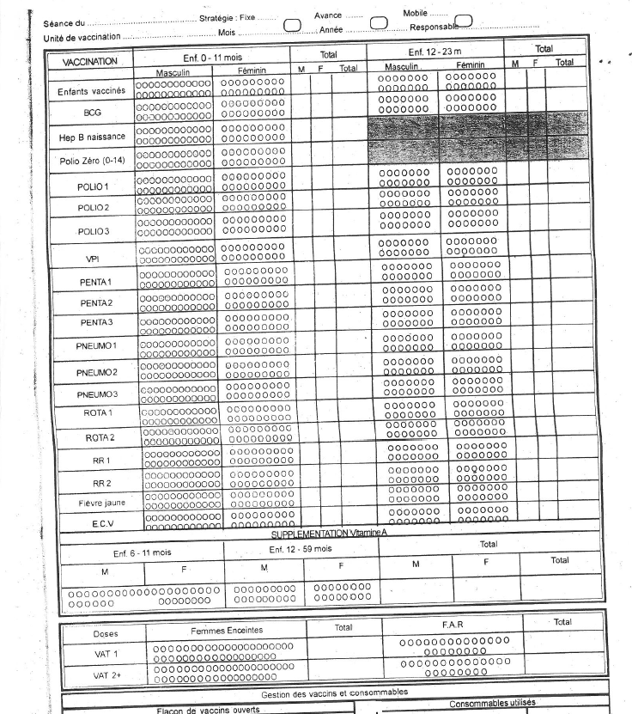
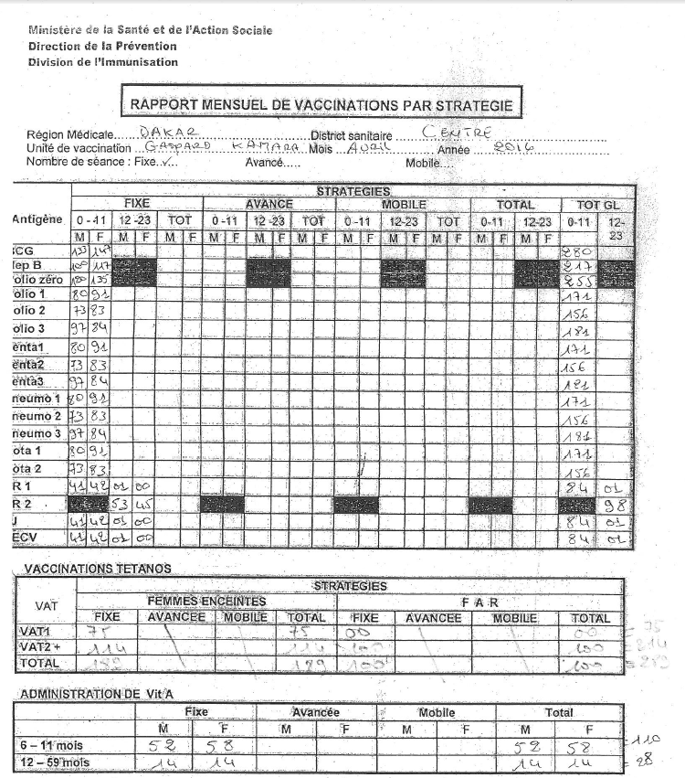
Tally sheets and reports with 3 levels of disaggregation

Slide 8
What are we measuring: coverage or timeliness?

Slide 9
Defaulter monitoring in Panamá
% de Cobertura
68.759
68.364
67.955
67.955
Notes:
9

Slide 10
For discussion
Administrative systems should be designed to match country needs and capacity
Systems should never drive undesired behaviour
Focus mostly on coverage in broader age ranges MCV1<2, MCV2<5*
Consider burden versus granularity
Countries with Electronic Immunization Registries should use these to monitor age related coverage
Perform more systematic analysis of survey data to understand age profiles and to monitoring timeliness, e.g:
Gap between MCV1<1 and MCV1<2
Increase in FIC<1 to FIC<2 would signal ability of 2YL platform to deliver additional doses and vaccines, as well as completing basic schedules

