Slide 1
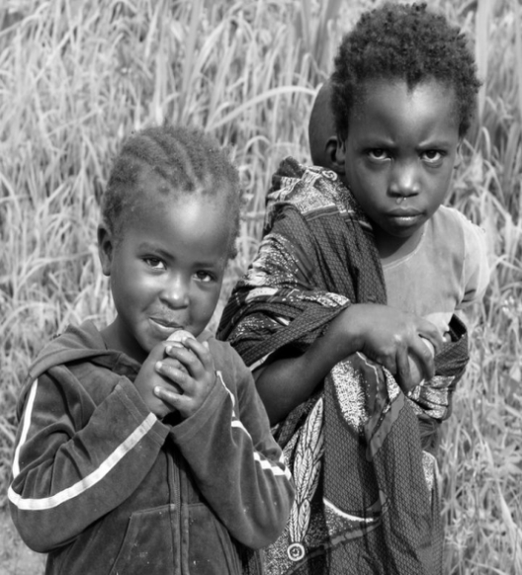
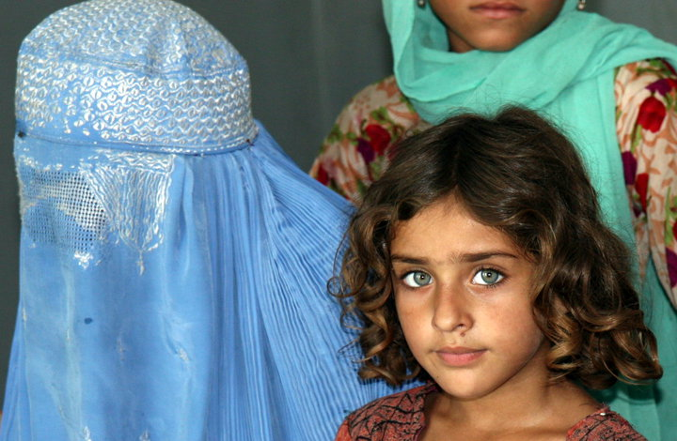
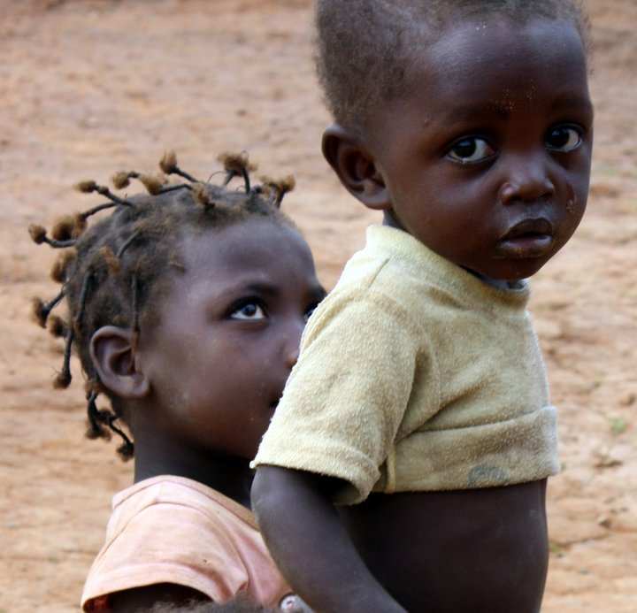
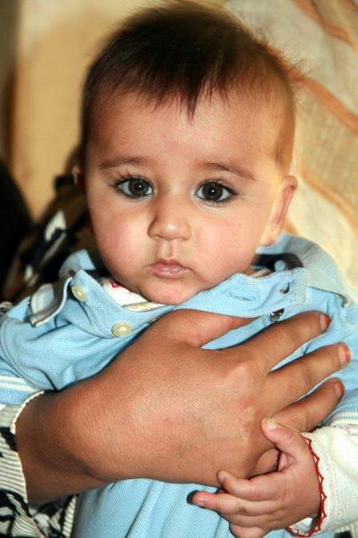
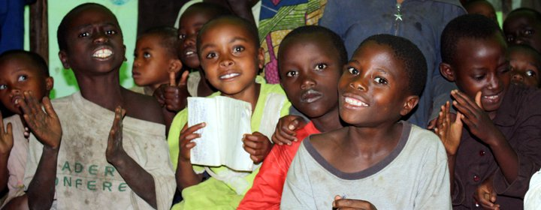
UNICEF Supply Division
GMMM Geneva, Switzerland
15-17 March 2011
Vaccine Supply Update –
UNICEF’s role at global level

Slide 2



The procurement of vaccines and related supplies is UNICEF's largest procurement activity, conducted on behalf of 80 – 100 countries annually
2010:
Immunization Supplies: US$ 750m
2.53 billion doses
1,769 shipments
Immunization Supplies
Vaccines
BCG , DTP, TT/Td/DT, Measles containing, OPV, HepB, YF, DTP-HepB, DTP-HepB/Hib, DTP/Hib, Hib, MR, Meningitis, MMR, IPV, Pneumo, etc.
Safe Injection equipment
Cold Chain Equipment
Countries UNICEF procures on behalf of
All Vaccines
Part of the Vaccines
Source: 2010 vaccine database, UNICEF

Slide 3
UNICEF annual vaccine procurement has increased five fold since 2000 - supporting UNICEF Programmes and on behalf of Partners, Global Programmes, Governments and NGO’s
Scaling up of campaigns, new
vaccine introduction, boosting routine
coverage, price increases
P o l i o
Campaigns, GAVI,
Price Increases
The arrows indicate the main programme drivers for the increased procurement value.
Source UNICEF Supply Division

Slide 4
UNICEF vaccine procurement values on behalf of governments and partners are increasing
GAVI 48%
Procurement Services 33%
UNICE F Programme 19%
GAVI falls under procurement services but is highlighted separately to show the overall portion of GAVI funded procurement
Source UNICEF Supply Division

Slide 5
Major vaccine group volumes by year (2005-2010), in doses
OPV has been # 1 in terms of the procurement volume.
Procurement volume in 2010
OPV: 1,885 million doses
Measles: 169 million doses
TT: 130 million doses
BCG: 106 million doses
DTP-HepB/Hib: 98 million doses
Yellow Fever: 35 million doses
Meningitis: 23 million doses
Source: UNICEF Supply Division

Slide 6
UNICEF’s procurement strategies are focused on achieving Vaccine Security, acknowledging the different forces in the individual markets
The Vaccine Procurement Principles, implemented following the supply crisis in the traditional vaccine markets, are valid for all vaccine markets to ensure a healthy market
A healthy industry is vital to ensure uninterrupted and sustainable supply of vaccines
Procurement from multiple suppliers for each vaccine presentation
Procurement from manufacturers in developing countries and industrialized countries
Paying a price that is affordable to Governments and Donors and a price that reasonably covers manufacturers minimum requirements
UNICEF should provide manufacturers with accurate and long-term forecasts; Manufactures should provide UNICEF with accurate and long-term production plans
As a public buyer, providing grants to manufacturers is not the most effective method of obtaining capacity increases
The option to quote tiered pricing should be given to manufacturers.

Slide 7
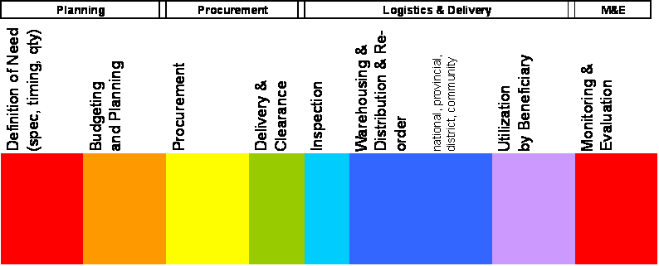
Within Supply, UNICEF activities are focused on 2 core areas to enhance access and delivery
Vaccine Industry
Market Shaping - Global Availability
Market Shaping:
Supporting
Partners,
Strategic Demand
Forecasting &
Financing for
New Vaccine
Introduction
Market Shaping:
Interacting with
Industry;
Establishing the
required supply
Agreements;
Vaccine
Security
Supply Chain Performance Enhancement
Supporting Local Delivery
Countries
Supply Chain Performance Enhancement

Slide 8
Market Shaping within a changing landscape
Increasing complexity within procurement as new products become available
Competition with Industrialised countries for production allocation
Demand reacting to changes and developments in immunization programmes, vaccine development and Donor support
Country preferences on presentation and formulation
Requires balancing with financial sustainability
Need for increased flexibility on tendering strategies, maintaining long time horizons and providing for market flexibility

Slide 9

UNICEF Supply Division’s main roles in the immunization supply chain. Effective forecasting and planning requires supply and logistics be fully integrated into programme planning.
Data
Analysis
Annual
Forecasting
Order
Placement
Supplier
Airport
Management of
the global forecasting
Exercise
-Forecast data
from 2003
-Provisional Plan
-Forecasting accuracy
reports
Operational
Follow-ups
Procurement &
Technical guide
Contracts and
suppliers
management
Shipping management
for on-time delivery
Vaccine Arrival Report
Data analysis
for effective supply
Planning
Sharing
Price information
Vaccine/Device/
Cold chain Procurement
DB from 1997
Monitoring &
Reporting
Immunisation
Health
Centre
District/Regional
Cold Chain Storage
Central Cold
Chain Storage
Capacity building for in-country logistics
Cold chain weight & volume calculator

Slide 10
UNICEF procures Measles containing vaccines on behalf of 80-100 countries annually for Routine and Supplementary Immunization Activities
2009:
2010:
130,914,370 doses
173,632,162 doses
Vaccines
Measles-10, MR-10, MMR-1, MMR-5, MMR-10
Countries UNICEF procures on behalf of
All Vaccines
Part of the Vaccines
Source: Allocation Table Data UNICEF

Slide 11
Measles containing vaccine procurement through UNICEF largely driven by supplementary activities
Measles containing vaccine procurement (2002-2010) and forecast (2011-2012), in doses
Source: UNICEF SD Historical Procurement Database and 2011 Forecast

Slide 12
Supplier Market and 2011 WAP prices
Measles-10:
4 vaccines WHO pre-qualified: 0.24 $ per dose (70% of the vaccine is sourced from 1 supplier)
MMR-1:
2 vaccines WHO pre-qualified: 1.85 $ per dose
MMR-5:
1 vaccine WHO pre-qualified: 0.90 $ per dose
MMR-10:
2 vaccines WHO pre-qualified: 1.183 $ per dose
MR-10:
2 vaccines WHO pre-qualified: 0.534 $ per dose
Source: UNICEF Supply Division

Slide 13
Some facts about vaccine supply
    Planning is Key:
    Production of a dose: 6 -24 months
    Capacity Increase: 2-3 years
    New Plant: 5-7 years
    Lead time for supply 4-8 weeks + transit time
    New regulatory requirements can cause interruptions
    Approx. 65 countries require NRA registration
    UNICEF requests 20 months shelf life for measles vaccine
    Current awards (in doses) based on 2009 forecast
    Additional increases in quantities to meet updated demand are possible but require planning
Source: UNICEF Supply Division

Slide 14
Some facts about vaccine supply
    Planning is Key:
    Production of a dose: 6 -24 months
    Capacity Increase: 2-3 years
    New Plant: 5-7 years
    Lead time for supply 4-8 weeks + transit time
    New regulatory requirements can cause interruptions
    Approx. 65 countries require NRA registration
    UNICEF requests 20 months shelf life for measles vaccine
    Current awards 2011-2012 (in doses) based on 2009 forecast
    Additional increases in quantities to meet updated demand are possible but require planning
Source: UNICEF Supply Division

Slide 15
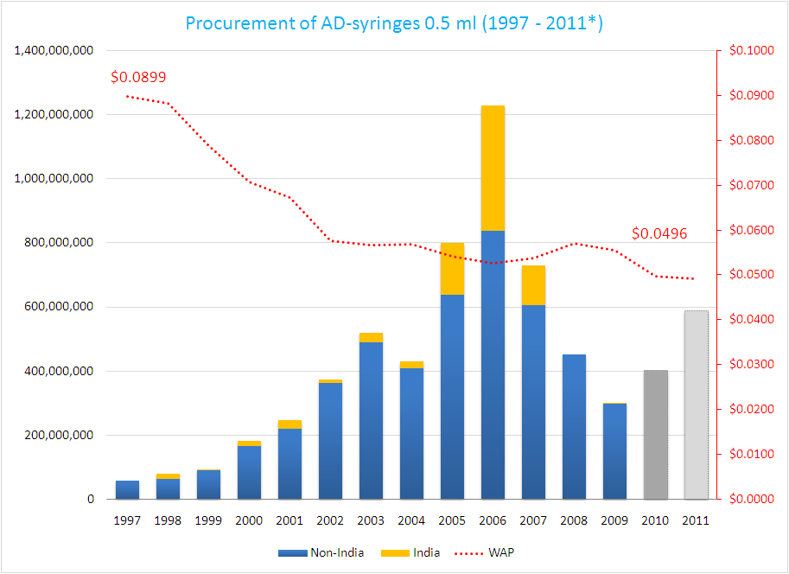
Overview of AD-syringes procurement, 1997-2011*
Current Long Term Arrangements for all devices are up for re-tendering in 2011
Helsinki
Helsingborg
Barcelona
Shanghai
Procuring immunization supplies from the following areas:
Manufacturers of AD syringes
Manufacturers of Safety Boxes
Dubai
Mumbai
Sources: UNICEF SD Historical Devices Procurement Database, and September 2010 allocation tables

Slide 16
Measles Campaigns are the Introduction Window for RUP syringes (5ml)
UNICEF SD delivered RUP syringes for Measles campaigns in:
  Peru
  Nigeria
  Burkina Faso
  Chad
Increased supplier base:
There are at present 14 WHO PQS prequalified suppliers (compared to 6 prequalified in Dec 2007)
Two types of RUP syringes available:
  Regular RUP syringes
  RUP syringes with Sharps Injury Prevention feature (SIP) protecting from needle stick injuries

Slide 17
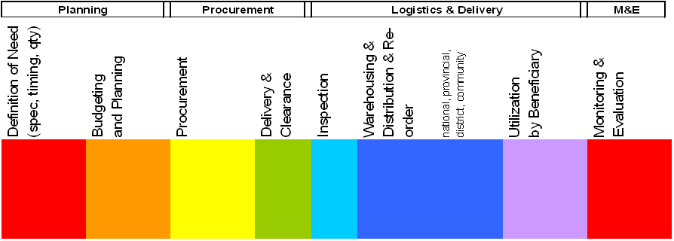
Effective forecasting and planning requires supply and logistics be fully integrated into programme planning
Consider the whole supply chain; it’s capacity and the context
Evaluate the capacity to receive and deliver:
Cold Chain and Logistics Capacity
Parallel products – integrated campaigns
Routine and Campaign activities
Modes of shipment
Lead times

Slide 18
Thank you!
More information: http://www.unicef.org/supply/index_immunization.html

