Slide 1
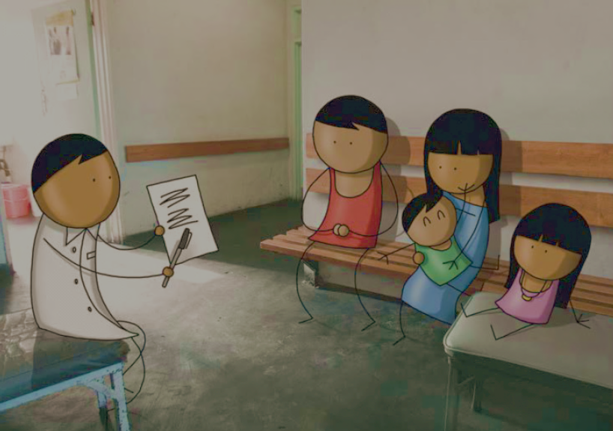
Innovations: Measles Programmatic Risk Assessments
June 21-23, 2016, Geneva, Switzerland
Accelerating Progress towards Measles/Rubella Control and Elimination Goals
James L. Goodson
Global Immunization Division
Centers for Disease Control and Prevention

Slide 2
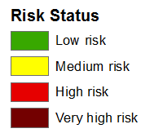
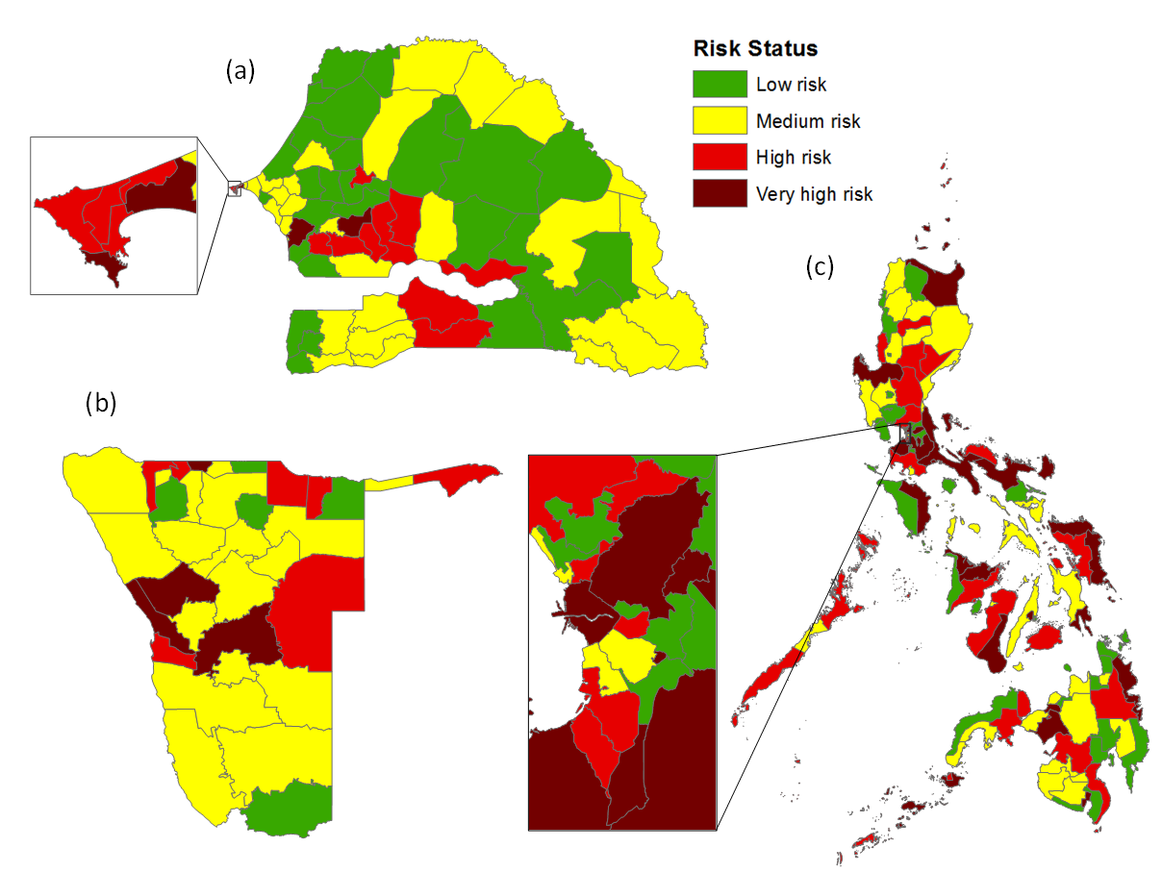
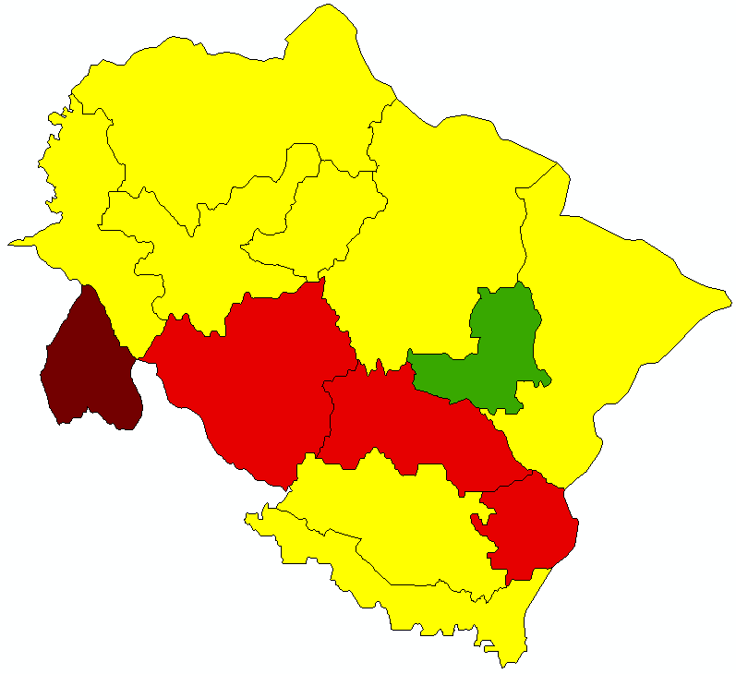
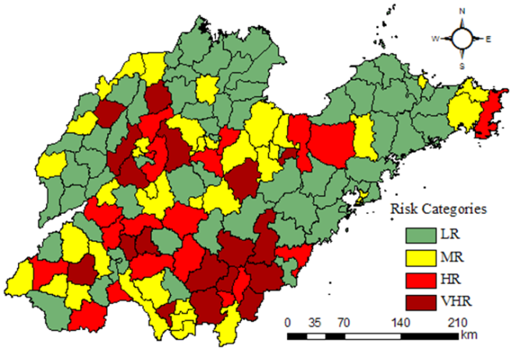
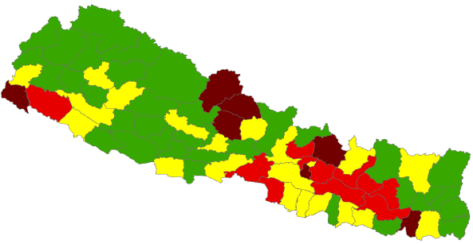
Measles Risk Assessments
Sudan
Namibia
Zimbabwe
Senegal
Philippines
Shan Dong Province
China
Uttarakhand State,
India
Laos
Nepal

Slide 3
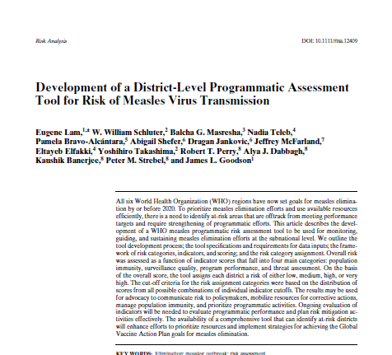
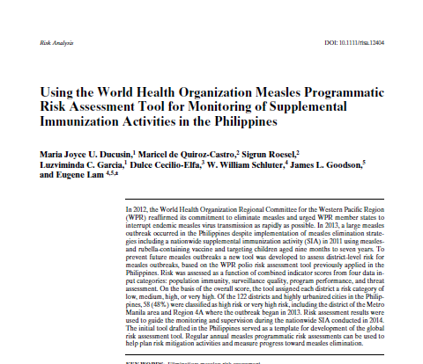
Measles Risk Assessments
Designed to use multiple programmatic indicators to identify areas with programmatic weaknesses.
Not a tool for predicting outbreaks but rather for preventing them

Slide 4
Intended Uses
Can be used annually to monitor progress
Planning and prioritization activities for program
Guide efforts for SIA, ORI planning
VPD surveillance reviews
Immunization Services Delivery and EPI reviews
Advocacy and resource mobilization
WHO Regional Offices and RVCs are advocating for use of the tool
Notes:
Results from the risk assessment tool are intended to be used for planning and prioritization of program response, and targeted immunization response tailored to level of risk. High-risk districts identified by the tool can be prioritized for interventions to strengthen surveillance, increase routine vaccination coverage, as well as recommend detailed micro-planning and supervision during supplemental immunization activities.
Importantly, the risk tool is not meant for predicting outbreaks, but rather for preventing them through strengthening immunization and surveillance programs.
Intended use of the results may include the following: Annual updates to monitor progress, Supplemental immunization activity and outbreak response immunization planning, Measles case-based surveillance reviews, Routine immunization EPI reviews, and advocacy and resource mobilization.

Slide 5
Data Inputs
Routinely-collected and readily-available data
District-level data (3rd administrative level)
  DPT1 (or Penta1) and MCV1, MCV2 coverage data
  SIA and ORI coverage data
  Measles case-based surveillance
  Population density
  Shape files for mapping
  EPI experience and local knowledge of threats in each district
Notes:
Sources of data for the risk assessment are routinely collected and readily available, and available at the 3rd administrative – or district – level, in order to ensure that the end product remains user-friendly. Data inputs include administrative coverage data for measles and other vaccines, SIA or district-wide outbreak response campaign coverage, case-based measles surveillance data, and local knowledge.

Slide 6
Categories of Risk Indicators
Threats
Population immunity
District-level risk calculated based on data inputs in 4 main categories:
Immunization services delivery performance
Surveillance quality
Range of possible scores: 0-100
*Each category has a list of indicators with various
cut-off criteria to assign risk points
Notes:
The measles risk tool includes a range of data inputs, in addition to vaccination coverage. These include indicators for population immunity, surveillance quality, program delivery performance, and threat assessment. The overall risk is assessed as a function of indicator scores from these four main categories. The subtotal scores from the four indicator categories are shown here. A total maximum overall score of 100 was used for easier interpretation and to allow for more transparency with direct scoring.

Slide 7
1. Population Immunity
Population Immunity (40%) | cut-offs (risk points)
MCV1 coverage | ≥95% (0) | 90-94% (2) | 85-89% (4) | 80-84% (6) | <80% (8)
MCV2 coverage | ≥95% (0) | 90-94% (2) | 85-89% (4) | 80-84% (6) | <80% (8)
Percentage of neighboring districts with <80% MCV1 | <50% (0) | 50-74% (2) | ≥75% (4)
Measles SIA conducted within the past 3 years | Yes, ≥95% coverage (0) | Yes, 90-94% coverage (2) | Yes, 85-89% coverage (4) | Yes, <85% covg / no data (6) | No SIA (8)
Target age group of measles SIA conducted within the past 3 years | Wide age group (0) | Narrow age group* (2) |  |  | *<5 birth cohorts
Years since last measles SIA | <1 year (0) | 2 years (2) | >3 years (4)
% suspected measles cases with unvaccinated or unknown vax status | <20% (0) | >20% (6)
Immunization Service Delivery
SIAs
Both
Notes:
Major risk categories and scoring of indicators were developed during a workshop attended by representatives from WHO regional offices and partners as an extension of the Global Measles and Rubella Management Meeting.

Slide 8
2. Surveillance Performance
Surveillance Performance (20%) | cut-offs (risk points)
Non-measles discarded rate (/100,000) | ≥2 (0) | <2 (4) | <1 (8)
% with adequate investigation* rate | ≥80% (0) | <80% (4)
% with adequate specimen collection** (within 28 days of rash onset) | ≥80% (0) | <80% (4)
% with timely availability of laboratory results*** (within 10 days of specimen collection) | ≥80% (0) | <80% (4)

Slide 9
3. Immunization Services Delivery Program Performance
Program Delivery Performance (16%) | cut-offs (risk points)
Trends in MCV1 coverage | Increasing or same (0) | ≤10% decline (2) | >10% decline (4)
Trends in MCV2 coverage | Increasing or same (0) | ≤10% decline (2) | >10% decline (4)
MCV1-MCV2 dropout rate | ≤10% (0) | >10% (4)
DPT1-MCV1 dropout rate | ≤10% (0) | >10% (4)

Slide 10
4. Threats
Threat Assessment (24%) | cut-offs (risk points)
≥1 measles case reported in past year among those aged <5 years | No (0) | Yes (4)
≥1 measles case reported in past year among those aged 5-14 years | No (0) | Yes (3)
≥1 measles case reported in past year among those aged ≥15 years | No (0) | Yes (3)
Population Density (per km²) | 0-50 (0) | 51-100 (1) | 101-300 (2) | 301-1000 (3) | >1000 (4)
≥1 measles case reported in a bordering district in past year | No (0) | Yes (2)
Presence of vulnerable population groups (source: local knowledge) | No vulnerable groups (0) | One risk point for each vulnerable group | range 1-8
Notes:
Evidence of recent measles cases among children <5 / 5-14 / ≥15 years of age Data source: Measles case-based surveillance (latest year). One or more confirmed or measles compatible case reported in a district within the past calendar year among those with various age groups. Include confirmed, epidemiologically-linked, and measles compatible cases. Exclude discarded cases. More risk points are given to those under 5 as they are usually the main group for transmission and have the higher burden of disease.
4. Population density (urban vs rural) Data source: Administrative data from National Statistics Office or local knowledge. Data categorizes each district as urban or rural. Assign risk point for urban districts.
5. Bordering area with measles case in the past 12 months Data source: Measles case-based surveillance (latest year). One or more confirmed or measles compatible case reported in a bordering district within the past calendar year. Include confirmed, epidemiologically-linked, and measles compatible cases. Exclude discarded cases. This indicator is representative of the threat of importation. All land borders should be considered at risk; for island borders, refer to local knowledge whether there is frequent population movement with neighboring district.
6. Presence of vulnerable population groups Data source: Local knowledge. Assign one risk point for each of the following vulnerable population groups present in a district. Presence of chronically unreached due to: Presence of migrant population, internally displaced population, slums, or tribal communities, Resistant to vaccination (i.e., religious, cultural issues, etc.), Security and safety concerns, Frequented by calamities/disasters, Poor access to health services due to terrain/transportation issues, Lack of local political support.

Slide 11
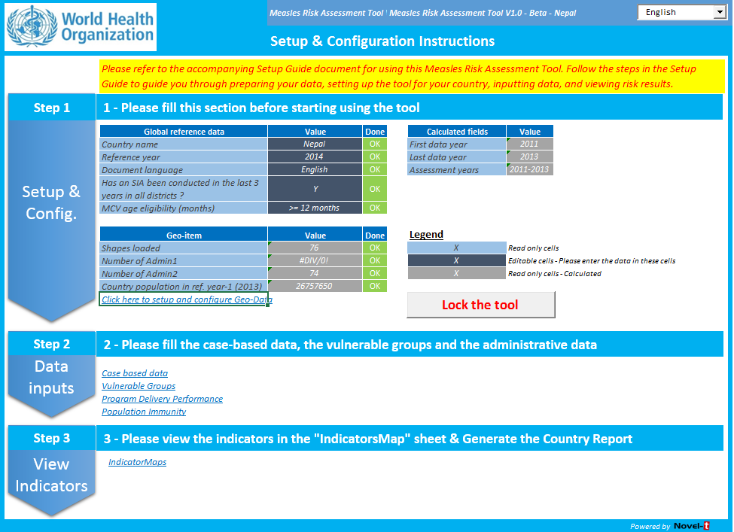
Risk Tool Software Package
Excel-based, electronic formatting
Easy data entry – automation, import from external data sources, user-friendly
User’s guide with more detailed information on indicators and special circumstances

Slide 12
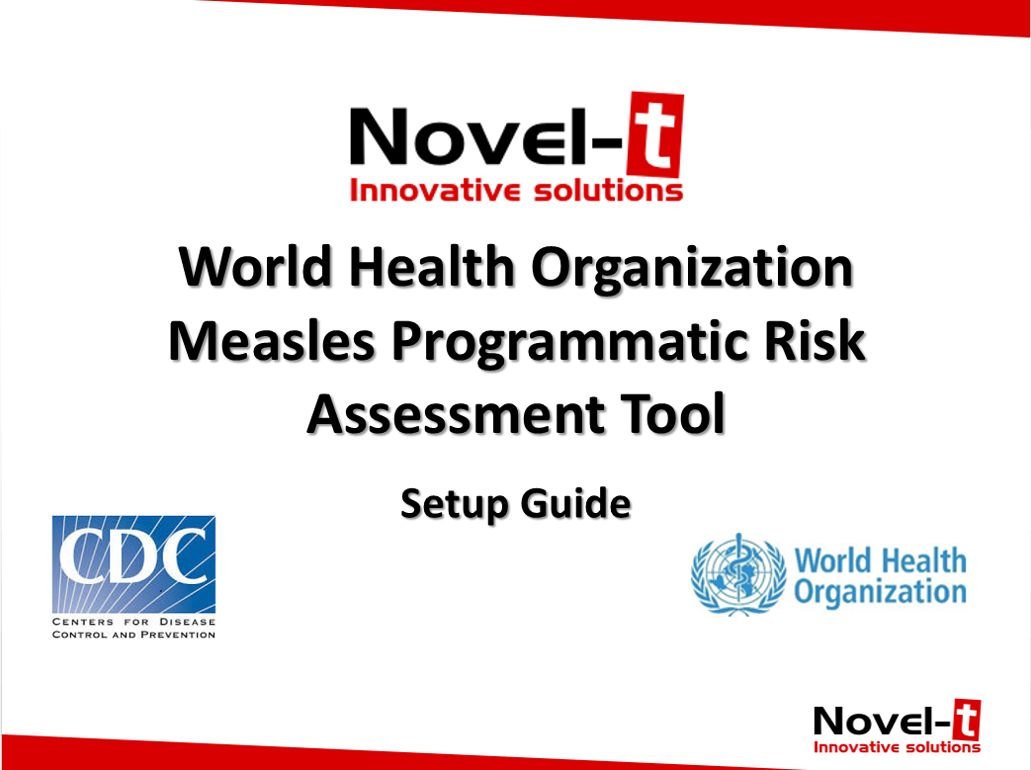
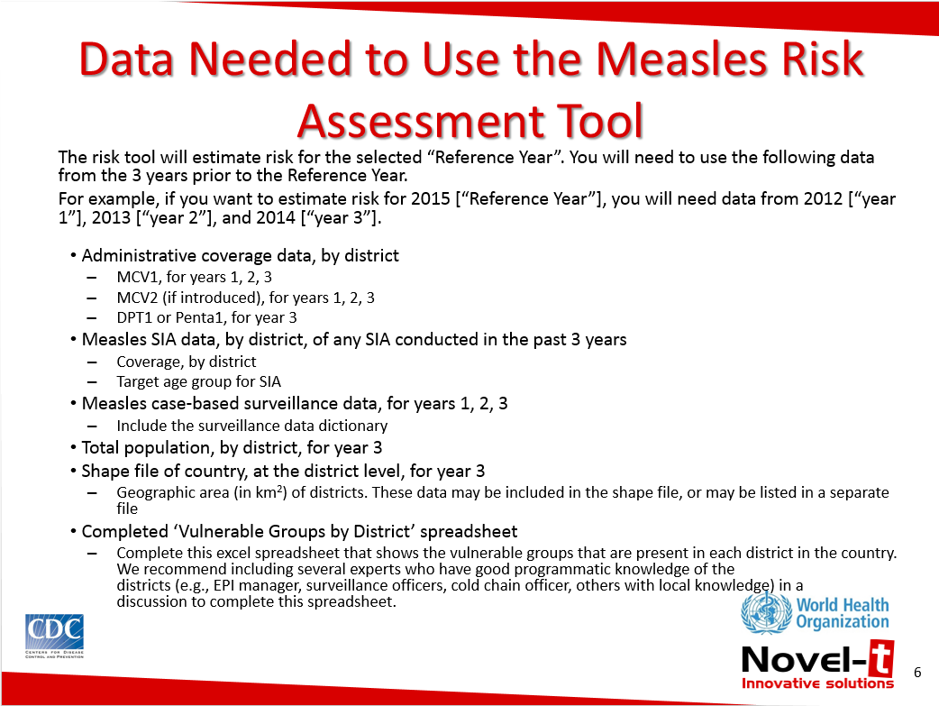
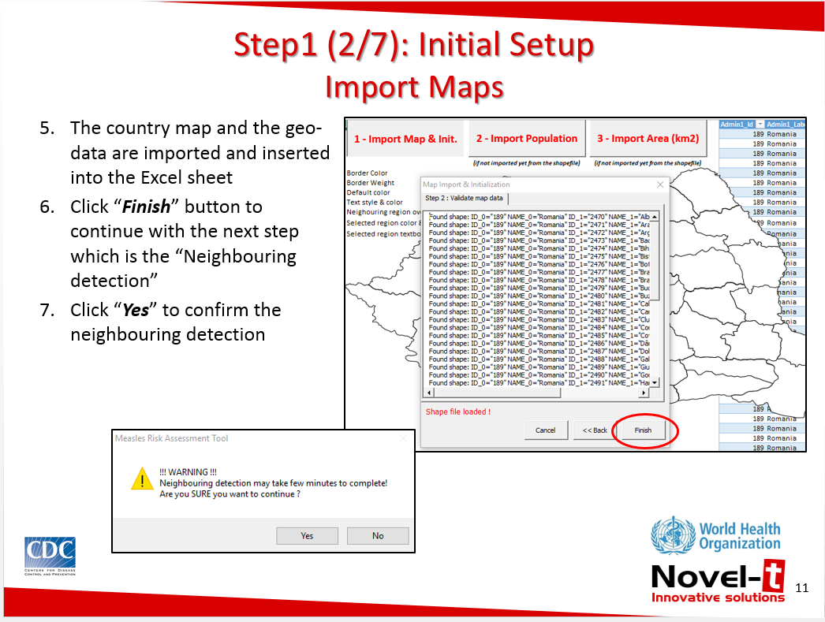
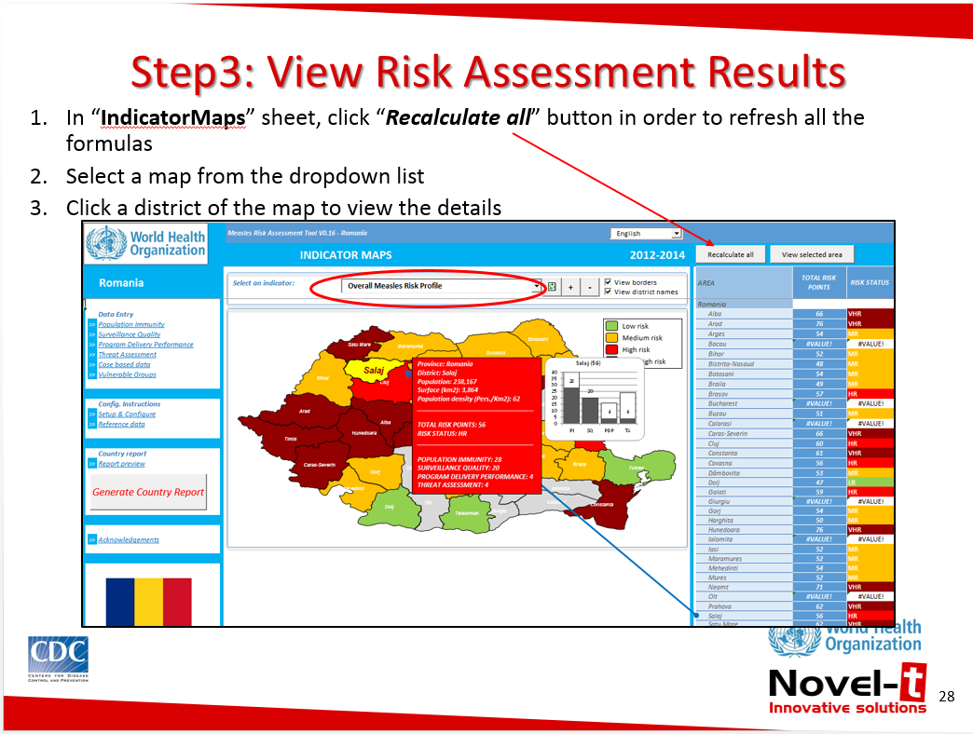
Risk Tool Software Package - Setup Guide

Slide 13
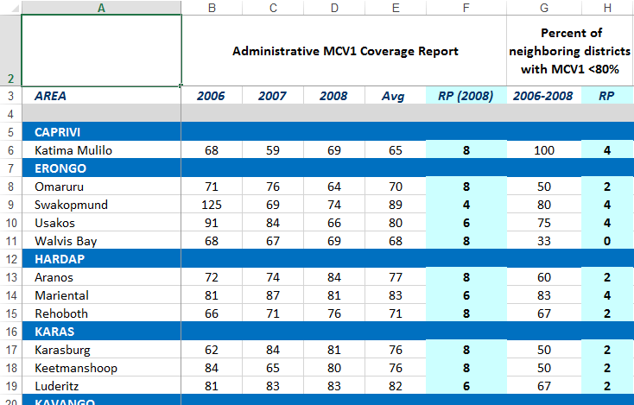
Risk Tool Spreadsheet:
Data Entry

Slide 14
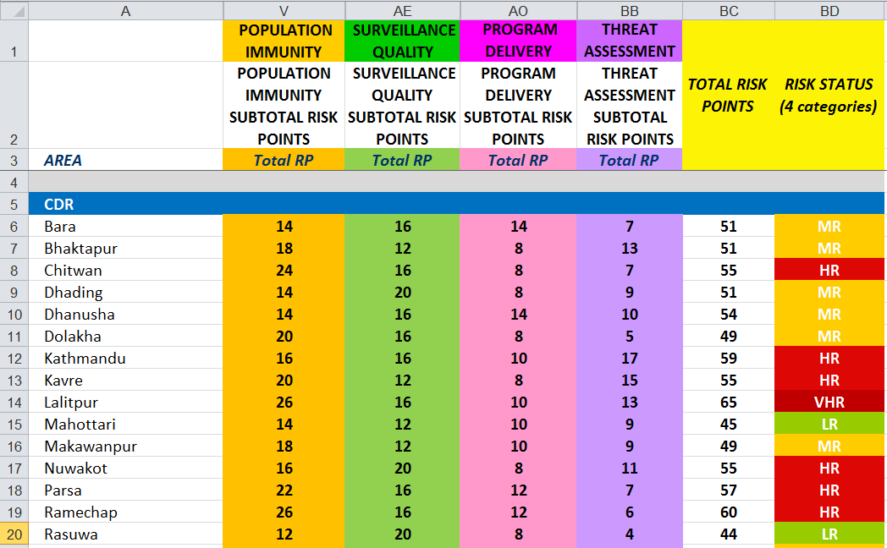
Risk Tool Spreadsheet:
Indicator Categories and Total Risk Points

Slide 15
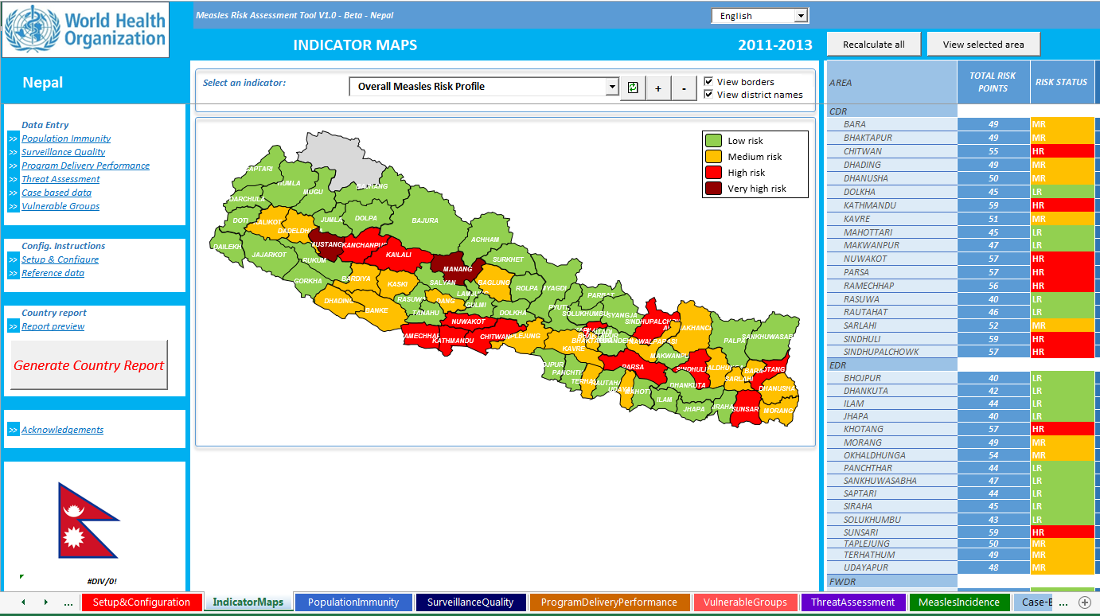
Risk Tool Software Package

Slide 16
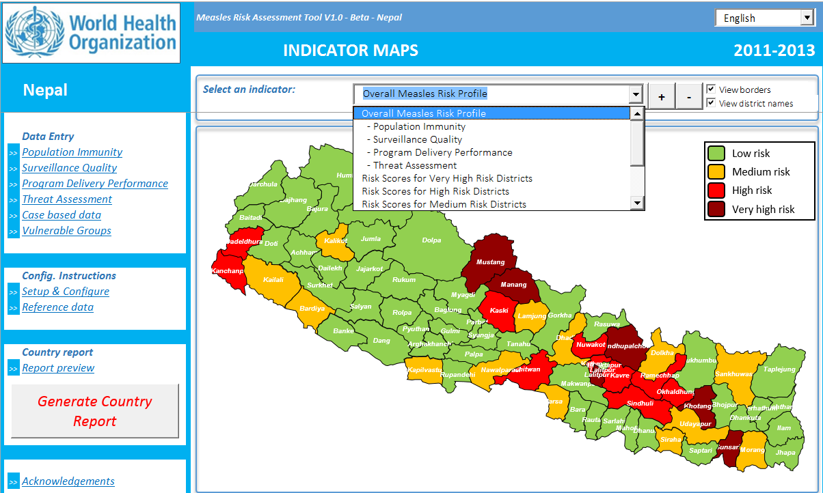
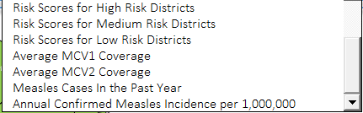
Risk Tool Software Package

Slide 17
Challenges and Lessons Learned
The quality of a risk assessment is only as good as the quality of the data that goes into it
  Coverage data (MCV1, MCV2, SIAs)
  Population estimates
  Case-based surveillance data
Requires basic data management skills to follow the instructions for cleaning and preparing the data
Map files
  Districts may have changed over the years used in the risk assessment
Sources of funding are needed for risk mitigation activities based on the assessment results

Slide 18
Future Next Steps
Complete beta testing of the risk tool software to finalize
Make the tool and user’s guide widely available through a link on the WHO website by end 2016
Develop a E-learning training module
Identify risk mitigation funding opportunities
Consider reporting-up of completed assessments, for regional and global monitoring and use of country-level results (assessing clustering of risks across borders)
Accumulate lessons learned and experience, consider development of version 2.0, and integration into a future global data management system to monitor and guide elimination efforts globally

Slide 19
Thank You

Slide 20
Risk Scores
PI=Population Immunity (Total=40)
Very High Risk Districts
SQ=Surveillance Quality (Total=20)
PDP=Program Delivery Performance (Total=16)
TA=Threat Assessment (Total=24)
Risk Points
Satu Mare (64)
Neamt (71)
Arad (76)
Bacau (64)
Timis (68)
Ialomita (68)
Caras (63)
Constanta (63)

Slide 21
Cut-off Criteria for Risk Categories
Fixed cut-off points based on a theoretical distribution
  Standardization of risk assignments
  Allows for comparisons across countries and regions as well as within a country over time
Risk Categories | Total risk points
Low risk | ≤ 47
Medium risk | 48-54
High risk | 55-60
Very high risk | ≥ 61
Notes:
Scores from each category are combined to assign an overall risk score for each district. The tool uses fixed cut-off points based on a theoretical distribution to categorize the overall risk scores into low, medium, high, or very high risk. Standardizing the risk assignments based on the theoretical distribution does not force every country to have 25% of each risk category and allows for direct comparisons across countries and regions, and also within a country over time.

Slide 22
Limitations
Data quality (what goes in, is what comes out)
  Reliability of results
  However, might be useful to show outbreak areas with low risk that need efforts to improve data quality
WHO tool is generalized for a variety of settings, uses standardized scoring and cut-off values
  However, may be useful to use additional country-specific indicators in addition to the fixed set
  Caution against allowing too much flexibility that might allow manipulation for arriving at desirable results

