Slide 1
Measles Genotype Diversity in SEAR
Accelerating Progress towards Measles and Rubella Elimination
Hotel Royal, Geneva, Switzerland, 21-23 June 2016
Patcha Incomserb
Measles RRL-SEAR
Thai-NIH

Slide 2
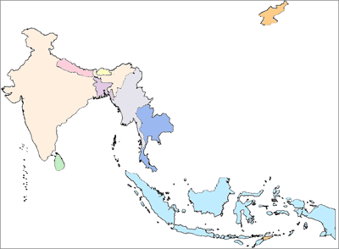
Measles genotypes circulating in SEAR between 2004 and 2016*
DPRK
D8, B3
Bhutan
 | 2004 | 2005 | 2006 | 2007 | 2008 | 2009 | 2010 | 2011 | 2012 | 2013 | 2014 | 2015 | 2016
Bangladesh |  |  |  |  |  |  |  |  |  |  | B3 | B3
Bhutan |  |  |  |  |  |  |  |  |  |  |  | D8,B3 | D8
DPRK
India | D4,D7, D8 | D4, D8 | D4, D8 | D4, D8, D7 | D4,D8 | D4,D8 | D4, D8 | D4, D8 | B3,D4, D8 | D4, D8 | B3, D4,D8 | B3,D4,D8 | D4,D8
Indonesia | G3,D9 | G3,D9 | G3,D9 | G3,D8D9 | D9 |  | D9 | D9,G3 | D8, D9 | D8, D9 | D8,D9
Maldives |  | D5
Myanmar |  |  |  | D5 |  |  | D9 | D9 | D9
Nepal | D4, D8 |  |  |  | D4 | D8 | D4, D8 | D4, D8 | D8 |  |  | D4,D8
Sri Lanka |  |  |  |  |  |  | D8 | D8 |  |  | B3 |  | B3
Thailand | D5 |  | D5 | D5 | D5, D9 | D9 |  | D8, D9 | D8, D9 | D8, D9 | B3 | H1 | H1,B3
Timor Leste
D4, D8
Nepal
D4, D7,B3, D8
Myanmar
India
D5,D9
Bangladesh
B3
Thailand
D5,D8,D9,B3,H1
D8, B3
Sri Lanka
D5
* Data as of 15 June 2016
Maldives
Indonesia
# First record submitted by Indonesia lab
# First detected H1 in Thailand
D8, D9,G3
-Non active
-Active
-New finding
Timor Leste
Source: Measles RRL in SEAR, Nation Institute of Health, Thailand, MeaNS, WHO SharePoint and Intercountry Training on Molecular Technique for the SEAR Measles and Rubella Laboratory Network, Bangkok, Thailand, Feb 2014

Slide 3
Measles genotypes circulating in SEAR between 2004 and 2016*
 | Total | D5 | D7 | G3 | D4 | D8 | D9 | B3 | H1
2004 | 24 | 1 | 3 |  | 9 | 11
2005 | 50 |  |  |  | 7 | 40 | 3
2006 | 79 | 7 |  |  | 22 | 49 | 1
2007 | 71 | 2 | 2 |  | 34 | 33
2008 | 34 | 1 |  |  | 10 | 13 | 9
2009 | 23 |  |  |  | 2 | 16 | 5
2010 | 90 |  |  |  | 20 | 59 | 11
2011 | 69 |  |  |  | 6 | 50 | 15
2012 | 54 |  |  |  | 4 | 24 | 17 | 9
2013 | 50 |  |  |  | 11 | 35 | 4
2014 | 167 |  |  |  | 10 | 133 |  | 24
2015 | 176 |  |  |  | 32 | 131 |  | 9 | 4
2016 | 60 |  |  |  | 3 | 47 |  | 9 | 1
Total | 947 | 11 | 5 |  | 170 | 641 | 65 | 51 | 5
* Data as of 15 June 2016

Slide 4
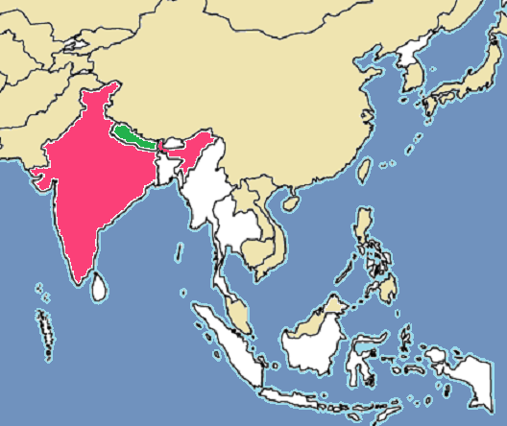
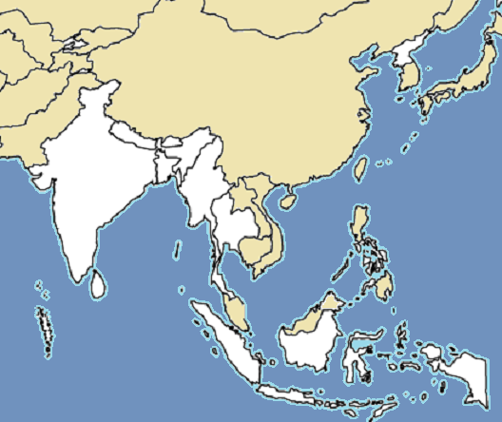
Diversity of Genotype D4
Circulating in India and Nepal since 1990s
Nepal
India

Slide 5
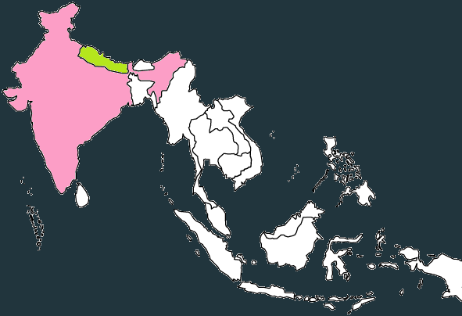
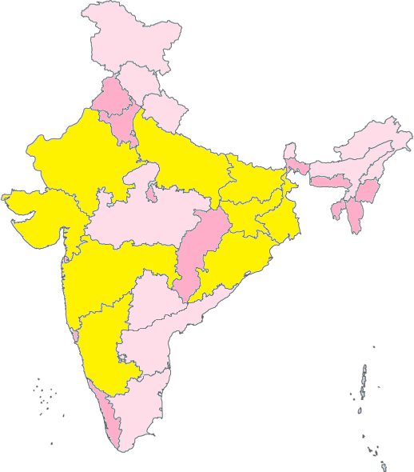
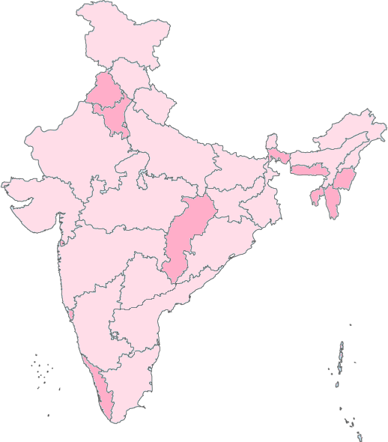
Diversity of Genotype D4
India
Time period: 2004- June 15th,2016
Number of strains: 145 strains from 19 states, 46 cities.
Divided in 3 main groups
Detected MV D4 area during 2014-2016
Detected MV D4 area during 2004-2013
No data

Slide 6
MVs/Dausa.IND/34.14/1-D4-KP221905-Gr5
India: D4
MVs/Junagadh.IND/33.15/1-D4-KT588917-NoM
MVs/Murshidabad.IND/24.14/1-Gr5
MVs/Bellary.IND/10.14-D4-KP056750-Gr5
MVs/Pune.IND/02.14/1-D4-KJ381057-NoM
MVi/Pune.IND/40.13/1-D4-KF850708-Gr5-13-15-IND-NPL-UK
MVs/Dharwad.IND/6.14/1-D4-KP056749-Gr5
MVs/Dhanbad.IND/14.14/1-D4-KM034772-NoM
MVs/Kaimur.IND/50.15/51-OMN14-NZL15
MVs/Bhandara.IND/03.15/1-D4-KT283631-NoM
MVs/Gadchiroli.IND/09.15/1-D4-KT283638-NoM
MVs/Chandrapur.IND/07.15/1-D4-Gr4
MVs/Gadchiroli.IND/2.16/1-D4-Gr4
MVi/Sindhudurg.Ind/07.12/1-D4-JX298083-Gr4-H100-IND
MVs/ORISSA.IND/3.15/2-D4-Gr4
MVi/Amethi.IND/50.14/1-D4-KT222024-NoM
MVi/Pune.IND/50.13/1-D4-KJ381052-Gr4
MVs/GANGTOK.IND/23.08/1-D4-FJ765064-H100
MVs/Koppal.IND/05.11/1-D4-JQ267543-H100-USA
MVi/VALSAD.IND/17.10/3-D4-HM358872-NoM
MVs/Satara.IND/15.05/1-D4-DQ335129-NoM
MVs/Satara.IND/15.05/2-DQ335130-H-3-100
MVi/Kirishnagiri.IND/03.06-D4-DQ917481-NoM
MVs/Dabra.IND/16.07/1-D4-EU812262-NoM
MVs/Pune.Ind/06.11/2-D4-JQ083639-NoM
MVs/PUNE.IND/02.10/1-D4-GU827659-NoM
MVs/Thane.IND/12.13-D4-KF013146-NoM
MVs/Bhavnagar.IND/02.15/1-D4-KT283626-Mumbai15
# The strains circulating during between 2014 and 2016 present in deep blue.
# No exactly matched Named strain
Enfield group:
2005-2007 & 2010
MVi/Kolar.IND/49.06/1-D4-EU812279-Gr2
MVs/Bijapur.IND/16.10-D4-JX469430-NoM
MVs/Raichur.IND/38.06/1-D4-EU812270-Gr2
MVi/Bagalkot.IND/07.09/1-D4-FJ968742-Gr2-Enfield
MVs/Bellary.IND/44.10/1-D4-JQ267541-Gr2-Enfield
MVi/Vellore.IND/50.05/1-D4-DQ917474-Gr1-Pune-2005-07and10-3state
MVs/VALSAD.IND/17.10/1-D4-HM358870-NoM
MVs/VALSAD.IND/17.10/2-D4-HM358871-NoM
MVs/Kargil.IND/25.07/1-D4-EU812259-H-Patna06-07-Jammu06
MVs/Bijnore.IND/07.06/3-D4-EU812311-NoM
Group3: 2005-2016; 19 states
MVs/Leh.IND/25.07/1-D4-EU812261-NoM
MVs/Jammu.IND/05.07/1-D4-EU812256-NoM
MVs/Dibrugarh.Ind/20.09/6-D4-HM626276-NoM
MVs/Papumpare.IND/50.07/1-D4-EU812247-NoM
Group2: 2007, 2010, 2014 ; 4 states
MVs/Bangalore.IND/14.14-D4-KP056751
MVs/Vijayawada.Ind/09.07/1-D4-FJ223135-Gr3-07-Warangal07-4C
MVs/Warangal.IND/09.07/3-D4-EU812267-Gr3
Group1: 2004, 2006, 2010; 3 states
MVi/Gulbarga.IND/50.06-D4-EU812273-NoM
MVs/Nainital.Ind/48.04/1-D4-FJ223162-5st-H100)
U01976 Montreal.CAN/89-D4
MVs/Lohit.IND/12.10/1-D4-HM773266-NoM
Genotype D1-D3 and D5-D11
5

Slide 7
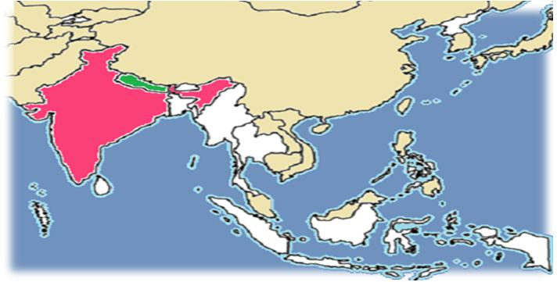
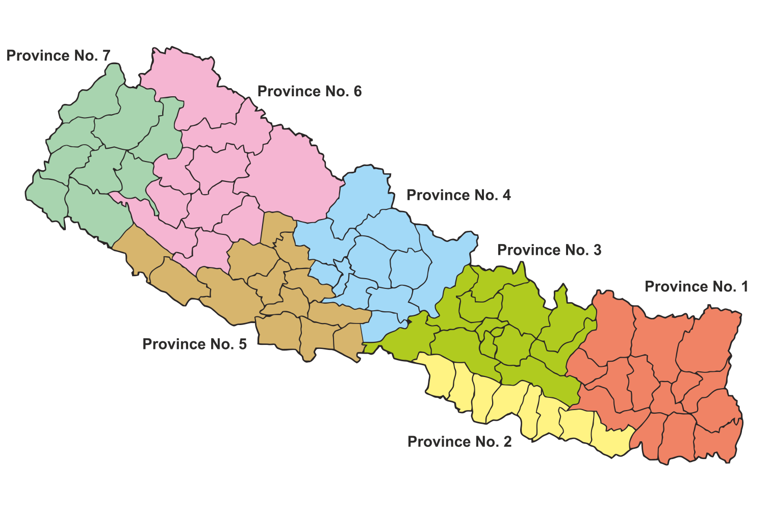
Diversity of Genotype D4
Nepal
The country divided into 7 Provinces, 75 districts
Time period: 2004- June 15th,2016
Number of strains: 25 strains from 4 provinces, 7 districts;
(Bardiya, Mahottari, Parsa, Kathmandu, Sartahi, Banke and Salyan)
2015
https://en.wikipedia.org/wiki/Nepalese_Federal_States#/media/File:Provinces_of_Nepal_2015.png

Slide 8
Diversity of Genotype D4
Circulating D4 viruses areas in Nepal and India
How similar between India and Nepal viruses?
https://en.wikipedia.org/wiki/Nepalese_Federal_States#/media/File:Provinces_of_Nepal_2015.png

Slide 9
MVi/Pune.IND/40.13/1-D4-KF850708-Gr5-13-15-IND-NPL-UK
D4: IND & NPL
2004-2016
MVs/Banke.NPL/12.15/1 D4
MVs/Banke.NPL/13.15/1 D4
MVs/Murshidabad.IND/24.14/1-Gr5
MVs/Bellary.IND/10.14-D4-KP056750-Gr5
MVs/Dhanbad.IND/14.14/1-D4-KM034772-NoM
MVs/Bardiya.NPL/23.15/3-D4
MVs/Bardiya.NPL/23.15/2-D4
MVs/Banke.NPL/13.15/3-D4
# The India viruses circulating during between 2014 and 2016 present in deep blue.
# The Nepal viruses circulating during between 2014 and 2016 present in dark red.
# Most D4 viruses circulating in India and Nepal during 2014 to 2016 are highly similar and identical strains
# No exactly matched Named strain
MVs/Kaimur.IND/50.15/51-OMN14-NZL15
MVs/Junagadh.IND/33.15/1-D4-KT588917-NoM
MVs/Dharwad.IND/6.14/1-D4-KP056749-Gr5
MVs/Bardiya.NPL/23.15/1-D4
MVs/Banke.NPL/13.15/2-D4
MVs/Dausa.IND/34.14/1-D4-KP221905-Gr5
MVs/Pune.IND/02.14/1-D4-KJ381057-NoM
MVi/Sindhudurg.Ind/07.12/1-D4-JX298083-Gr4-H100-IND
MVi/Pune.IND/50.13/1-D4-KJ381052-Gr4
MVs/Chandrapur.IND/07.15/1-D4-Gr4
MVs/ORISSA.IND/3.15/2-D4-Gr4
MVs/Gadchiroli.IND/9.16/1-D4-Gr4
MVs/Koppal.IND/05.11/1-D4-JQ267543-H100-USA
MVs/Salyan.NPL/29.15/1-D4
MVs/Salyan.NPL/28.15/1-D4
MVs/Salyan.NPL/30.15/1-D4
MVs/Thane.IND/12.13-D4-KF013146-NoM
MVs/Bhavnagar.IND/02.15/1-D4-KT283626-Mumbai15
MVs/Pune.Ind/06.11/2-D4-JQ083639-NoM
MVs/PUNE.IND/02.10/1-D4-GU827659-NoM
MVs/Dabra.IND/16.07/1-D4-EU812262-NoM
MVs/Kargil.IND/25.07/1-D4-EU812259-H-Patna06-07-Jammu06
MVi/Mahottari.NPL/32.04/6D4 RRL-MV-6/04 MVi/NPL/41.04/6
MVs/Jammu.IND/05.07/1-D4-EU812256-NoM
MVs/Dibrugarh.Ind/20.09/6-D4-HM626276-NoM
MVs/Raichur.IND/38.06/1-D4-EU812270-Gr2
Enfield group
MVi/Bagalkot.IND/07.09/1-D4-FJ968742-Gr2-Enfield
MVs/Bellary.IND/44.10/1-D4-JQ267541-Gr2-Enfield
MVi/Vellore.IND/50.05/1-D4-DQ917474-Gr1-Pune-2005-07and10-3state
MVi/Kolar.IND/49.06/1-D4-EU812279-Gr2
Group3: 2005-2016; 19 states
MVs/Bijapur.IND/16.10-D4-JX469430-NoM
MVi/Mahottari.NPL/40.04/16D4 RRL-MV-16/04 MVi/NPL/41.04/16
MVs/Satara.IND/15.05/1-D4-DQ335129-NoM
MVs/Satara.IND/15.05/2-DQ335130-H-3-100
Group2: 2007, 2010, 2014 ; 4 states
MVs/Papumpare.IND/50.07/1-D4-EU812247-NoM
MVs/Bangalore.IND/14.14-D4-KP056751
MVs/Sarlahi.NPL/32.11/1D4 RRL-11-326 NPL-MSL-11-1064
MVs/Warangal.IND/09.07/3-D4-EU812267-Gr3
MVs/Vijayawada.Ind/09.07/1-D4-FJ223135-Gr3-07-Warangal07-4C
MVs/Sarlahi.NPL/32.11/3D4 RRL-11-328 NPL-MSL-11-1066
Group1: 2004, 2006, 2010; 3 states
MVi/Mahottari.NPL/32.04/3D4 RRL-MV-3/04 MVi/NPL/32.04/3
MVi/Bardiya.NPL/38.04/9D4 RRL-MV-9/04 MVi/NPL/22.04/9
MVi/Gulbarga.IND/50.06-D4-EU812273-NoM
MVs/Kathmandu.NPL/16.10/1D4
MVs/Kathmandu.NPL/16.10/2D4
MVs/Nainital.Ind/48.04/1-D4-FJ223162-5st-H100)
MVs/Lohit.IND/12.10/1-D4-HM773266-NoM
MVi/Parsa.NPL/14.08/1 D4 RRL-MV-08/1 MVi/NPL/14.08/1D4
U01976 Montreal.CAN/89-D4
MVs/Parsa.NPL/14.08/2 D4 RRL-MV-08/2 MVs/NPL/14.08/2D4
Genotype D1-D3 and D5-D11
5

Slide 10
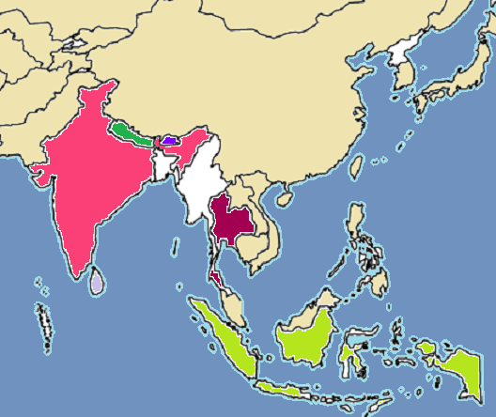
Diversity of Genotype D8
Circulating in 5 countries: Bhutan, India, Indonesia, Nepal, Sri Lanka and Thailand
Nepal
Bhutan
India
Thailand
Sri Lanka
Indonesia

Slide 11
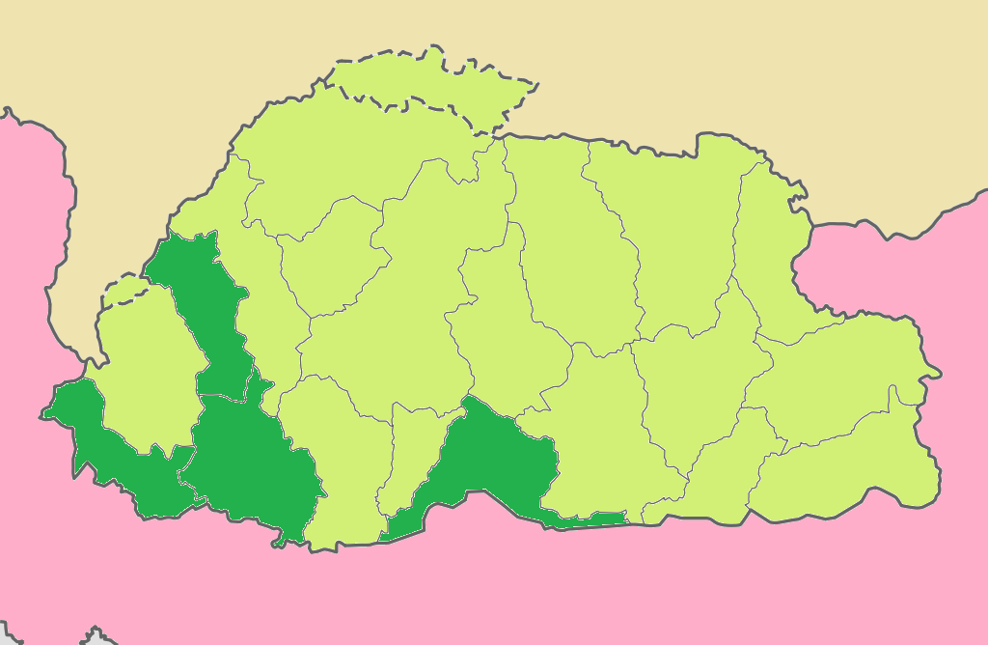
Diversity of Genotype D8
Bhutan
20 districts
Time period: 2015- June 15th,2016
Number of strain : 11 strains from 4 districts
China
Detected MV D8 area during 2015-2016
India
2015:
First detected measles virus in country
Submission in to MeaNS by Bhutan laboratory
Can link with epidemiology data fro tracking chain of transmission.

Slide 12
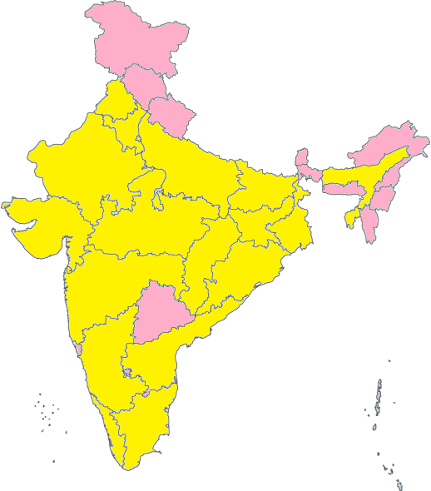
Diversity of Genotype D8
India
Time period: 2004- June 15th,2016
Number of strain: 515 strains from 23 states, 148 cities
Detected MV D8 area during 2014-2016
(313 strains)

Slide 13
MVs/Kapilbastu.NPL/3.12/1D8
D8: BTN, IND, NPL, LKA, THA
MVs/Pune.IND/39.13/1D8-11
MVs/Bilaspur.IND/01.14D8-29
MVs/Moran.NPL/11.12/1D8
MVs/SamutSongkhram.THA/17.13/1D8
MVs/Surin.THA/7.13/1D8
MVs/MaeHongSon.THA/12.12/1D8
Circulating between 2014 and 2016;
Bhutan, India , Nepal, Sri Lanka and Thailand
1
MVi/ChiangMai.THA/46.11/1D8
MVs/Nonthaburi.THA/42.11/1D8
MVs/Maha Sarakham.THA/23.11/1D8
MVs/Phetchaburi.THA/28.11/2D8
MVi/Sundargarh.IND/10.14D8-38
MVi/Nakhon Ratchasima.THA/32.11/1D8
MVi/Lampang.THA/41.11/1D8
MVi/KhonKaen.THA/42.11/1D8
MVs/Kanchanaburi.THA/10.12/1D8
MVs/Krabi.THA/01.13/1D8
MVs/SamutSakhon.THA/12.13/1D8
MVs/Haridwar.IND/06.14/4D8-26
MVs/Phetchabun.THA/21.13/1D8
MVs/Jaipur.IND/23.14/1D8-41
MVi/Sawimadhopur.IND/ 3.15/01D8
MVs/Bardiya.NPL/22.15/1D8
MVs/Bijapur.IND/13.15/13D8
MVs/Kheda.IND/10.16/
BANGALORE/M-13-229-3D8-20
Divided into 4 main groups
Group1: circulating in Thailand, India and Nepal
Group2: circulating in India, Nepal and Sri Lanka
Group3: circulating in India, Nepal and Bhutan, named strain Victoria
Group4: circulated in Nepal
MVs/Haveri.IND/10.16/10
MVs/NPL/9.10/1D8
MVs/Haridwar.IND/06.14/2D8-24
MVs/Kapilbastu.NPL/15.10/2D8
MVi/NewDelhi.IND/26.14D8-47
2
MVs/Kapilbastu.NPL/15.10/5D8
MVs/Kapilbastu.NPL/15.10/1D8
MVs/Pune.IND/11.13D8-3
MVs/Colombo.LKA/23.10/2D8
MVs/Colombo.LKA/24.10/4D8
MVs/Colombo.LKA/22.10/1D8
MVs/Colombo.LKA/23.10/1D8
MVs/Matara.LKA/19.10/1D8
MVs/Colombo.LKA/24.10/3D8
MVs/Colombo.LKA/30.10/5D8
MVs/Colombo.LKA/52.10/7D8
MVs/Mahottari.NPL/23.11/2D8
MVi/Delhi.IND/ 01.15/03D8
MVs/Mahottari.NPL/23.11/3D8
MVs/Moran.NPL/16.11/2D8
MVs/Pune.IND/38.13D8-10
MVs/Jamnagar.IND/09.16/-D8
MVS/Faridabad.IND/22.14D8-45
3
MVs/SouthDelhi.IND/25.14/2D8-46
BANGALORE/M-13-186-4D8-22
MVs/Pune.IND/52.13D8-18
MVs/Banke.NPL/22.15/2D8
MVs/Banke.NPL/13.15/1D8
MVs/Banke.NPL/22.15/1D8
MVs/Banke.NPL/12.15/1D8
MVs/Faridabad.IND/19.14D8-44
MVs/EastDelhi.IND/25.14D8-50
MVs/Panna.IND/34.14/1D8-56
MVs/Bangalore.IND/4.16/4-D8
MVs/Chhukha.BTN/34.15/1D8
MVs/Samtse.BTN/51.15/2D8
MVs/Paro.BTN/3.16/1D8
MVs/Paro.BTN/2.16/1D8
MVs/Paro.BTN/1.16/1D8
MVs/Samtse.BTN/3.16/1D8
MVs/Pune.IND/10.13D8-1
MVs/Pune.IND/17.13/1D8-7
MVi/Pune.IND/13.14D8-35
MVs/Bhavnagar.IND/17.16/-D8
MVs/Sambhal.IND/13.14D8-39
MVs/Bharatpur.IND/22.14D8-43
MVi/Ludhiyana.IND/ 08.15/02D8
MVi/Pune.IND/12.14D8-34
MVi/Paro.BTN/37.15/1D8 RRL-15-360-TS (100 homology with RRL-15-344 MVs ) MR-653
4
AF280803 Mancheter.UNK/30.94-D8
MVs/NPL/9.10/2D8
MVs/NPL/9.10/3D8
MVs/Sunsari.NPL/20.11/1D8
Genotype D1-D7 and D9-D11
MVs/Mahottari.NPL/23.11/4D8
2

Slide 14
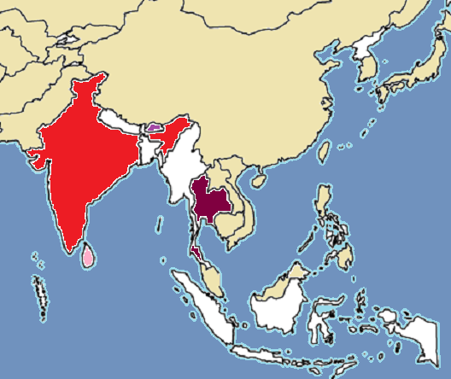
Diversity of Genotype B3
Circulating in Bangladesh, Bhutan, India, Sri Lanka and Thailand since 2012
Bhutan
India
Bangladesh
Thailand
Sri Lanka

Slide 15
Diversity of Genotype B3
MVs/Chitagong.BGD/8.15/3
B3: Bangladesh, Bhutan, India, Sri Lanka, Thailand
MVs/Coxs Bazar.BGD /45.14/2
MVs/Chittagong.BGD /46.14/2
MVs/Khagrachari.BGD/10.15/1
MVs/Chitagong.BGD/8.15/2
MVs/Chitagong.BGD/31.14/1
MVs/Chitagong.BGD/8.15/1
MVs/MVs/Natore.BGD/12.15/1
MVs/Jessore.BGD /45.14/1
MVs/Jessore.BGD /46.14/1
MVs/Satkhira.BGD /41.14/1
MVs/Jhennaidah.BGD /43.14/1
MVs/Phuket.THA/35.14/2
MVs/Phuket.THA/35.14/3
Currently strains circulating during 2014 to 2016 in
Bangladesh, Bhutan, India, Sri Lanka and Thailand
# Separate group from each country
# Belonged to other named strains
MVs/Narathiwat.THA/17.16/3B3
MVs/Narathiwat.THA/19.16/1B3
MVs/Narathiwat.THA/21.16/2B3
MVs/Narathiwat.THA/17.16/2B3
MVs/Narathiwat.THA/17.16/1B3
MVs/Narathiwat.THA/16.16/1B3
MVs/Narathiwat.THA/21.16/1B3
MVi/Thiruvananthapuram.IND/12.12/
MVi/Thiruvananthapuram.IND/15.12/
MVs/Thiruvananthapuram.IND/31.12/2
MVs/Colombo.LKA/49.14/1
MVs/Colombo.LKA/23.14/1
MVs/Colombo.LKA/19.14/1
MVs/Colombo.LKA/19.14/3
MVs/Colombo.LKA/19.14/5
MVs/Colombo.LKA/20.14/1
MVs/Galle.LKA/2.16/1B3
MVs/Mathura.IND/46.14/46
MVs/Colombo.LKA/7.16/1B3
MVs/Colombo.LKA/1.14/1
MVs/Colombo.LKA/19.14/4
MVs/Colombo.LKA/18.14/1
MVs/Galle.LKA/3.16/1B3
MVs/Galle.LKA/6.16/1B3
MVs/Galle.LKA/4.16/1B3
MVs/Bangkok.THA/22.14/1
MVs/Bangkok.THA/21.14/1
MVs/Thimphu.BTN/50.15/1B3
MVs/Samtse.BTN/50.15/1B3
MVs/Trashigang.BTN/46.15/1B3
MVs/Samtse.BTN/48.15/1B3
MVs/Chhukha.BTN/41.15/1B3
MVi/Chhukha.BTN/49.15/1B3 )
MVs/Colombo.LKA/19.14/2
MVs/Colombo.LKA/49.14/2
NY.USA 94 B3
IBADAN.NIE 97 B3
YAOUNDE.CAE 83 B1
ED-WT A
LIBREVILLE.GAB 84 B2
MADRID.SPA 94 F
BRAXATOR.DEU 71 E
TOKYO.JPN 84K C1
JM.USA 77 C2
WTF.DEU 90 C2
Genotype D
Genotype G and H
5

Slide 16
Diversity of Genotype H1
Circulating in Thailand in 2015 & 2016
Thailand

Slide 17
Diversity of Genotype H1
AF243450 Victoria.AUS/16.85-D7
AY037020 Illinois.USA/50.99-D7
GU440571 MVi/Menglian.Yunnan.CHN/47.09-D11
AF280803 Mancheter.UNK/30.94-D8
U01976 Montreal.CAN/89-D4
U01977 Illinois.USA/89/1-Chicago-1-D3
AF481485 Victoria.AUS/12.99-D9
Currently strains circulating during 2015 and 2016 in 3 provinces
Frist detected H1 in Thailand and SEAR
L46758 Palau.BLA/93-D5
AF079555 Bangkok.THA/93/1-D5
U64582 Johannesburg.SOA/88/1-D2
AY923185 Kampala.UGA/51.00/1-D10
D01005 Bristol.UNK/74-MVP-D1
L46750 New Jersey.USA/94/1-D6
L46753 New York.USA/94-B3
AJ232203 Ibadan.NIE/97/1-B3
U01998 Yaounde.CAE/12.83-Y-14-B1
U01994 Libreville.GAB/84-R96-B2
U01987 Edmonston-wt.USA/54-A
X84865 MVs/Madrid.SPA/94-SSPE-F
X84879 Goettingen.DEU/71-Braxator-E
AY043459 Tokyo.JPN/84/K-C1
M89921 Maryland.USA/77-JM-C2
X84872 Erlangen.DEU/90-WTF-C2
MVs/Sukhothai.THA/44.15/1H1-58-17050
Genotype H1
MVs/Chachoengsao.THA/41.15/1H1-58-16023
MVs/SamutSakhon.THA/53.15/1-H1-59-01409
MVs/Chachoengsao.THA/51.15/1H1-58-19864
AF045212 Hunan.CHN/93.7-H1
AF045217 Beijing.CHN/94.1-H2
U01974 Berkeley.USA/83-G1
AY184217 Gresik.INO/18.02-G3
AF171232 Amsterdam.NET/49.97-G2
5

Slide 18
Important events in SEAR
Related to molecular characterization
2008: First detected D9 in Thailand
2011: First detected D8 in Thailand
2012: First detected B3 in India
2014: First record of measles genotype in Bangladesh (B3)
: First detected B3 in Sri Lanka and Thailand
2015: First record of measles genotype in Bhutan (D8&B3) and can tracking chain of transmission
: First submission of nucleotide sequences of Bhutan into MeaNS by country
: First detected H1 in Thailand
2016: First submission of nucleotide sequences of Indonesia into MeaNS by country
: First complete analyze nucleotide sequence and submission of the nucleotide sequences of Nepal into MeaNS by country

Slide 19
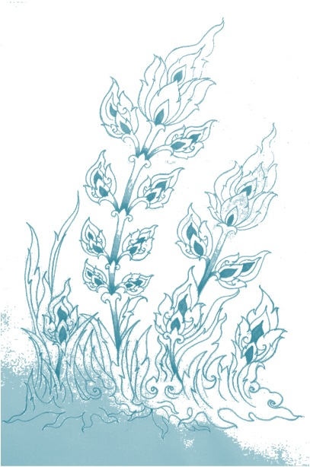
Acknowledgement
WHO/HQ
WHO/SEARO
SEAR measles and rubella lab network
CDC, Atlanta
MeaNS
Department of Medical Sciences and Bureau of Epidemiology, Ministry of Public Health, Thailand

Slide 20
Thank you

