Slide 1
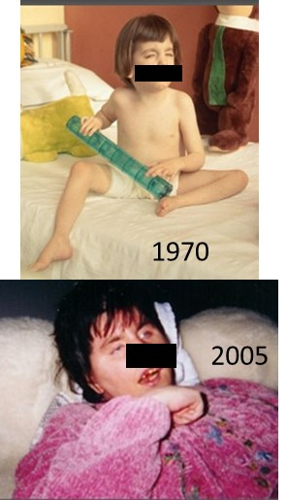
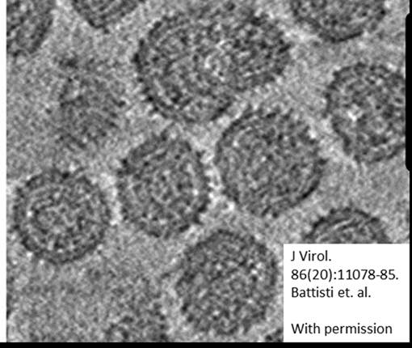

Accelerating Progress towards Measles and Rubella Elimination,
21-23 June 2016, Hotel Royal, Geneva
Evolution of rubella viruses during persistence
Joseph P. Icenogle, the CDC rubella Team, CDC colleagues,
and other collaborators
National Center for Immunization & Respiratory Diseases
Division of Viral Diseases

Slide 2

Outline
Rubella virus persistence in Fuchs’ Uveitis Syndrome (FUS)
  2 case studies from the United States
Rubella virus vaccine strain persistence in immune deficient individuals
  Granulomas
  Case study – encephalitis in the United Kingdom

Slide 3
Evidence for Association between Rubella and Fuchs’ Uveitis Syndrome
Starting in 2004, 7 studies have shown that a high proportion of FUS patients have antibodies directed against rubella virus and/or rubella virus RNA in their aqueous humor
An epidemiological study in the US correlated a sharp decline in the prevalence of FUS with the introduction of a population-wide rubella virus vaccination program
The occurrence of late ocular complications, such as iridiocyclitis, in congenital rubella virus infection (4 studies)

Slide 4
Two FUS cases identified in the United States
A 73 year old man from Pennsylvania (born in 1939)
  Developed heterochromia at age 14; did not remember having rubella
  Rubella RNA was detected in aqueous fluid extracted from his eye in 2013
  Sequence was obtained for 739 nt
A 40 year old California resident born and raised in Germany
  Likely had rubella in Germany in 1993 (clinical diagnosis)
  Developed uveitis in 1999
  Rubella RNA was detected in aqueous fluid removed from his eye in 2014
  Whole genome sequence publication is pending

Slide 5
32 WHO reference virus sequences and the PA eye sequence
MEGA Neighbor Joining with 1000 bootstrap replicates
Comparison of the 739 nt Pennsylvania FUS sequence (black dot, red arrow) with the 32 WHO reference virus sequences
This FUS sequence shares the closest identity with 1a and 2C sequences (blue arrows)
92% similarity
94% similarity
Eye sequence

Slide 6
Analysis of the PA 739 nt sequence
The sole member of a new rubella virus group
Most similar to genotypes 2C and 1a (varies by 6% and 8%, respectively), both of which contain viruses from the 1960’s
Previously published evolutionary rate for rubella is 1.65 x 10⁻³/site/year (Zhu et.al., J Clin Micro, 2012) which would predict 71 nt changes based on a sequence 739 nts in length and a 60 year time period
46 changes were observed between the FUS sequence and the closest 2C virus
44 of the changes occurred in the 3rd codon position
The 2 amino acid changes were to amino acids with similar properties

Slide 7
California virus was genotype 1G
Branch of a 739 nt rubella genotype 1G tree containing the California FUS sequence (black dot, red arrow)
All 23 viruses connected to the circled node are from European countries from 1991-2008.
The closest sequence to the this FUS sequence is a virus from Italy in 1993 (blue arrow).
KT000088.1| RUS C-77_2001
EINVERED.ISR 92
MILAN.ITA 95
AIN-DEFLA.DZA 25 07
LONDON.UK 91
LEICESTER.UK 93
WILTSHIRE.UK 93
BRESCIA.ITA 93
CA-FUS 1993
LEICESTER.UK 93
RVi/Stuttgart.DEU 92
PAVIA.ITA 93
MILAN.ITA 94
PAVIA.ITA 14.94
PAVIA.ITA 20.94
GERMANY 98 696 AY326342
STUTTGART.DEU 92 INS AF039133
RVi/Prahova.ROM/25.03
RVi/Bucuresti.ROM/25.03/1
Ontario.CAN/05 1G WHOref
RVs/BUCURESTI.ROM/25.032 1G
RVi/Bucuresti.ROM/26.03/3
MINSK.BLR 29.04 1
Moscow.RUS 15.08
RVs/London.GBR27.05 1G EF210052
Moscow.RUS 39.06
Moscow.RUS 7.08 1G
0.005

Slide 8
Analysis of the CA 739 nt sequence
Most similar to 1G viruses circulating in Europe in the early 1990’s
21 year time period elapsed from rubella disease to sample collection
12 changes were observed between the CA FUS sequence and the closest sequence (from Italy in 1993)
4 of the changes were synonymous and 8 resulted in amino acid changes
Of the 8 amino acid changes, only 2 were to amino acids with similar properties

Slide 9
Evolutionary rate for persistent RuV
In the Pennsylvania case, since the ancestral sequence and the precise length of time from infection is not known, it is difficult to draw conclusions
In the California case, however, an ancestral sequence and length of persistence are known
The number of changes observed were approximately half of the predicted rate (12 observed vs 25 predicted)
Question: is the rate for persistent viruses different from the rate for human to human transmission or is the predicted rate incorrect?

Slide 10
Evidence for Association between Rubella and Granulomas in Children with PID
Previous study
RA27/3 RV vaccine strain was the only virus sequence found in granuloma biopsies by NGS
(Bodemera C. et al, Clin Microbiol Infect, 2014)
Current study
7 out of 14 PID cases were positive for RV antigen by IHC
RV positive PIDs were largely T cell defects
(Perelygina, Plotkin, Russo, Hautala, Bonilla, Ochs, Joshi, Routes, Patel, Wehr, Icenogle, and Sullivan. Rubella Persistence in epidermal keratinocytes and M2 macrophages in patients with primary immunodeficiencies. The Journal of Allergy and Clinical Immunology, In Press)
Sequence done by classic methods.

Slide 11
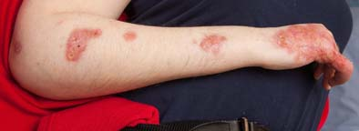
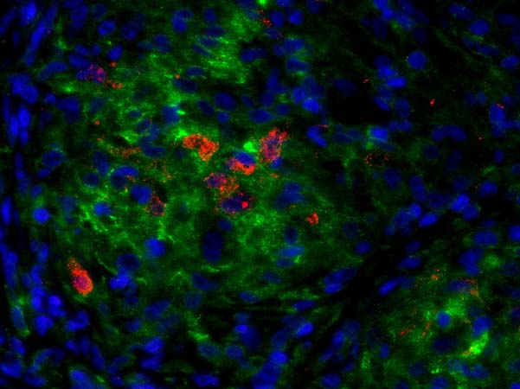
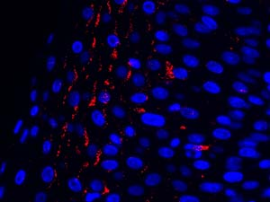
Perelygina et al., In Press
Multiple granuloma lesion on the patient arm
Granuloma: H&E staining
Granuloma IHC: RV capsid/ M2 / nuclei
Lesion epidermis IHC: RV capsid/ nuclei
Female born 1986
Received MMR vaccination in 1991 and 1995
PID: B cell and T cell functions impaired, gene unknown
Persistent granulomas for more than 20 years
Positive cells were M2 macrophages and epidermal keratinocytes in skin samples taken 10 years apart
Rubella virus RNA was detected from skin biopsy and sequenced

Slide 12
TO-336
Phylogenetic tree of RVs/Oulu.FIN/22.15/PID5 genome
RV-Toyama.JPN-67-Vac
RV-TO-336.GMK5.JPN
RVi-Osaka.JPN-66-Vac
RVi-Osaka.JPN-66
RVi-Matsue.JPN-68
RV-Matsuba.GMK3.JPN-69
TO-336
1a
AF435866
AF435865 Ulrike
RV-Toyama.JPN-67-Vac
RVi-NewJersey.USA-61
RV-Cendehill.BEL-63
RV-TO-336.GMK5.JPN
RV-Matsuba-Vac
RVi-Shimane.JPN-68-Vac
RVi-Osaka.JPN-66-Vac
RV-TCRB19.JPN-Vac
RVi-Connecticut.USA-64
RVs/Oulu.FIN/22.15/PID
RVi-Osaka.JPN-66
RVi RA27.USA 64 1a Vac
RVi-Matsue.JPN-68
RVi-California.USA-91
RV-Matsuba.GMK3.JPN-69
RVi-Texas.USA-34.98
RVi-Mexico-97
AF435866
RVi-Brooklyn.NY.USA-15.99
RVi-Cordoba.ARG-88
AF435865 Ulrike
1I-LON
1I-ITA
1H-ORN
RVi-NewJersey.USA-61
1H-RYA
RV-Cendehill.BEL-63
RVi-Stuttgart.DEU-92
1G AL 2124
RV-Matsuba-Vac
RVi-Lebanon.NH.USA-3.05
1G AZ 5967
RVi-Shimane.JPN-68-Vac
1G MD 2085
RVi-Boston.MA.USA-13.07
RV-TCRB19.JPN-Vac
RVi-Dangshan.Anhui.CHN-39.00-3
RVi-Shandong.CHN-15.00-1
RVi-Connecticut.USA-64
1J-MIY
RVs/Oulu.FIN/22.15/PID
1J-KAG
1J-BAH
RVi-DalyCiTy.CA.USA-.97
RVi RA27.USA 64 1a Vac
RVs-JC2.NZL-91DQ388281.1
RVi-California.USA-88
1E-YE
1E NE 0460
1E-NY
RV-BarHarbor.ME.USA-43.08
96.9% nucleotide identity to RA27/3 vaccine
5 out of 7 RA27/3-specific aa residues were preserved and 2 had reverted to WT
No insertions or deletions, ORFs intact
Total 69 aa substitutions, 52 were unique for RVs/Oulu.FIN/22.15/PID
Immunodominant E1 neutralizing epitopes were conserved
CD8+ T cell epitopes (capsid protein) contained single mutations
RVi-Springfield.MA.USA-49.98
RVi-6423.ITA-1997
RVi-Fuyan.Anhui.CHN-52
RVi-Pullman.WA.USA-30.08
RVi-Shenyang.Liaoning.CHN-11.12.1
RVi-Xian.Shannxi.CHN-13.13.1
RVi-Shucheng.Anhui.CHN-25.01.2
RVi-Shandong.CHN-0.02
RVI-DEZHOU.CHN-02-1E
RVi-Changfeng.Anhui.CHN-15
RVi-Yubei.Chongqing.CHN-25.05.1
RVi-Moscow.RUS-1967
RVi-C74.RUS-1997
RVi-Beijing.CHN-79
RV-Beijing.CHN-80
RV-isolate-I-11.ISR-1968
RVi-Anhui.CHN-00-2
RVi-Wanlong.Hainan.CHN-2.08.7
RVi-Anam5.KOR-1996
2B NY 2190
2B AR 0629
RVi-BismarCk.ND.USA-23.08
2B COD 5746
RVi-Seattle.WA.USA-16.00
RVi-Kalamazoo.MI.USA-4.07-1
2B IN 9319
2B MA 1925
RVi-Eagan.MN.USA-13.09
RVi-Huainan.Anhui.CHN-41.11
2B-Chile
Perelygina et al. Unpublished
results
RV-LA.CA.USA-45.08 CRS
0.01

Slide 13
Virus from Rubella encephalitis
(persistent infection after immunization)
Virus (UK 0560) was kindly shared by Dr. Kevin Brown at PHE, UK, initial rubella virus sequence was from CSF
15 year old patient with congenital immunodeficiency (DOCK8 immunodeficiency syndrome, combined severe Band T cell deficiency, had undergone transplant therapy,) diagnosed late in childhood
Only known MMR in 2004 (~ age 4); No known recent contact with anyone with vaccine before illness
Presented with neurological symptoms about 2 months before death
Notes:
The virus was kindly shared by Dr. Kevin Brown at PHE in UK. The patient received MMR vaccine around age 5 and at age 15, the patient developed neurological disorders. Rubella virus was isolated from patient’s cerebrospinal fluid. The virus was close but not identical to RA27/3, the rubella vaccine based on the sequences in the 739-nt genotyping window.

Slide 14
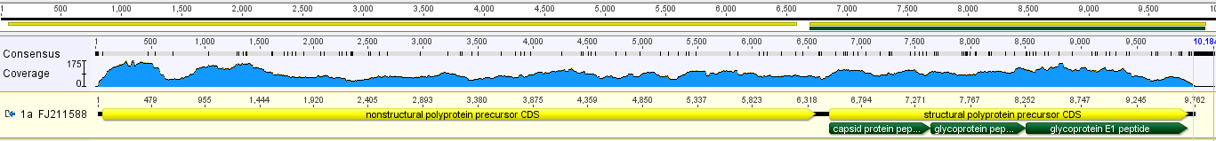
Virus from Rubella encephalitis
(UK 0560)
Virus was sequenced using Illumina MiSeq by both pathogen-independent and –dependent workflows
3700 reads by pathogen-independent workflow :
- 99.71% positions were covered by > 10 reads
- no internal gaps
- low coverage (28 nts in total) only occurs at termini;
- Very few heterogeneous positions (40% of the reads): Y6673; Y8324
>10⁶ reads by pathogen-dependent workflow
The consensus sequences by both workflow are identical (except at the heterogeneous positions)
Notes:
The virus was sequenced using NextGen sequencing platform by both pathogen-dependent and –independent workflows. Totally 3700 reads were mapped to rubella virus and the contigues covered over 99% of the genome by at least 10-fold coverage from the pathogen-independent workflow. No internal gaps were found and regions of low coverage remained at the termini. Two positions in the SP coding region were likely heterogeneous. More than one million rubella specific reads were mapped. The consensus sequences by both workflows were nearly 100% identical except at the heterogeneous positions.

Slide 15
Substitution
NSP |  |  | SP
Nucleotide | Amnio acid | Domain | Nucleotide | Amnio acid | Domain
G48A | R3K | p150 | T6419C |  | IR
T448C | S407G | p150 | C6422T
C511T |  |  | A6445G
A674G |  |  | A6565C
T991C |  |  | A6636G | Q42R | C
G1240A |  |  | C6651G | T47S | C
A1259G | S407G | p150 | T6673C
C1297T |  |  | C6724T
G1320A |  |  | A6769G
T1327C | G427D | p150 | A6841G
G1552A |  |  | C6961T
T1561C |  |  | C7040A | L177M | C
T1662C | V541A | p150 | C7048A
G1691A | A551T | p150 | G7063A
C1732A |  |  | A7234G
T1762C |  |  | G7272A | S254N | C
C1837T |  |  | A7310G | T267A | C
C1984T |  |  | G7346A | G279S | C
A2017G |  |  | T7376C
C2152T |  |  | A7448G | T313A | E2
T2176C |  |  | C7460G | P317A | E2
A2217G | D726G | p150/HVR | A7479C | Q323P | E2
C2259T | S740L | p150/HVR | A7695G | D395G | E2
G2260A |  |  | C7710T | A400V | E2
C2269T |  |  | C7722T | P404L | E2
A2412G | Y791C | p150/HVR | T7725C | L405P | E2
Y2429C | ?797P | p150/HVR | A7727G
C2509T |  |  | C7728T | V406T
C2578G |  |  | G7733A | A408T | E2
T2875C |  |  | A7739G | N410D | E2
C3120G | T1027S | p150/protease | C7760T | P417S | E2
C3226A |  |  | G7812A | G434D | E2
T3247C |  |  | T7815C | F435S | E2
C3331T |  |  | T7818C | L436S | E2
G3389A | V1117M | p150/protease | C7927T
C3595T |  |  | G7941C | G477A | E2
G3716A | A1226T | p150/protease | C7951T
C3769G |  |  | C8079T | S523L | E2
T3796C |  |  | G8156T | V549F | E2
C3853A |  |  | G8260A
C4135T |  |  | T8266C
C4306T |  |  | G8290A
G4324A |  |  | C8324T | L605F | E1
T4366C |  |  | A8351G | I614V | E1
C4396T |  |  | G8431A
T4432A |  |  | A8459G | T650A | E1
T4615C |  |  | T8557C
C4699T |  |  | A8675G | S722G | E1
A4831G |  |  | C8851T
C5011T |  |  | T8879A
T5080C |  |  | T8896C
C5170T |  |  | A8898T | Q796L | E1
C5239T |  |  | T8971C
T5264C |  |  | G9004A
C5329T |  |  | C9061G
T5623C |  |  | T9154C
T5701C |  |  | C9178T
C5890T |  |  | T9376C
T5929C |  |  | C9415T
C5959T |  |  | C9433T
C6088T |  |  | T9550C
T6214C |  |  | C9619T
C6274T |  |  | C9635T | L1042T | E1
 |  |  | C9649T
 |  |  | C9709T
 |  |  | C9716T
 |  |  | C9733T
1a tree (whole genome)
RV/Toyama.JPN/67-Vacc
TO-336 wildproGenitor
RV/TO-336.GMK5.JPN AB588192.1
RVi/Osaka.JPN/66 AB588190.1
RVi/Osaka.JPN/66-vaccine AB588191.1
RVi/Matsue.JPN/68
RV/Matsuba.GMK3.JPN/69 AB588189.1
AF435866 Surkova
AF435865 Ulrike
RVi/NewJersey.USA/61
RV/Cendehill.BEL/63
RV/Matsuba-vaccine AB588193.1
RVi/Shimane.JPN/68Vacc
RV/TCRB19.JPN-vaccine AB588188.1
RVi/Connecticut.USA/64
UK 0560 Encephalitis
RV/Philadelphia.USA/64
RVi/PA.USA/64Vac
0.002
The closest virus: RA27/3 (p-distance = 0.01)
131 nucleotide substitutions:
63 in NSP (40 in p150; 23 in p90);
3 in IR;
64 in SP (15 in C; 20 in E2 and 28 in E1)
41 Amino acid substitutions:
13 in NSP (p150 only);
28 in SP (6 in C; 16 in E2 and 6 in E1)
16 unique aa substitutions were found
3 in C; 8 in E2; 4 in E1 (15 in SP!)
Notes:
When compared the consensus sequence of this virus with other rubella viruses, the closest virus was RA27 with a p-distance of 0.01. However, there were 131 nucleotide substitutions and 41 amino acid substitutions when compared to RA27. Most of amino acid substitutions are clustered in E2 proteins, especially in the middle of the protein. 16 unique amino acid substitutions were found and 15 were in the SP of this virus.

Slide 16
Evolutionary rate for persistent vaccine strain infections
For the Finland granuloma case, the number of changes from the RA27/3 sequence predicted would be 322 for the whole genome for a 20 year time period
  There were 302 observed changes (93% of predicted)
For the UK encephalitis case, the number of changes predicted for the whole genome for an 11 year time period would be 177
  There were 131 observed changes (74% of predicted)
The evolutionary rate of change for the 2 vaccine persistent infections in immune deficient patients was closer to the predicted rate than for the wild-type FUS (48% of predicted)

Slide 17
Acknowledgments
Pennsylvania FUS: Emily Abernathy, Dr. Min-hsin Chen, Dr. H. Namdari
California FUS: Dr. Joe DeRisi (UCSF), California State Health Dept.
Granuloma: Dr. Ludmila Perelygina, Dr. Stanley Plotkin, Dr. Kathleen Sullivan, Dr. Timo Hautala
Encephalitis: Dr. Min-hsin Chen, Emily Abernathy, Dr. Kevin Brown

Slide 18
Accelerating Progress towards Measles and Rubella Elimination,
21-23 June 2016, Hotel Royal, Geneva
Evolution of rubella viruses during persistence
Joseph P. Icenogle, the CDC rubella Team, CDC colleagues,
and other collaborators
The findings and conclusions in this
report are those of the authors and do
not necessarily represent the view of the
United States Centers for Disease Control and
Prevention.
National Center for Immunization & Respiratory Diseases
Division of Viral Diseases

Slide 19
Extra slides

Slide 20
 | Nucleotide substituion |  | Amino Acid substitution
 | Granuloma | Encephalitis | Granuloma | Encephalitis
5' | NA | 0 | - | -
NSP | 188 | 63 | 33 | 13
IR | 4 | 3 | - | -
SP | 101 | 65 | 42 | 31
3' | 0* | 4 | - | -
Total | 293 | 135 | 75 | 44
83
RV/Toyama.JPN/67-Vacc
100
TO-336 wildproGenitor
99
RV/TO-336.GMK5.JPN AB588192.1
86
RVi/Osaka.JPN/66 AB588190.1
100
100
RVi/Osaka.JPN/66-vaccine AB588191.1
RVi/Matsue.JPN/68
100
RV/Matsuba.GMK3.JPN/69 AB588189.1
100
RVi/Bratislava.SVK/74
RVi/Leipzig.DEU/84
100
100
RVi/NewJersey.USA/61
100
RV/Cendehill.BEL/63
77
RV/Matsuba-vaccine AB588193.1
100
RVi/Shimane.JPN/68Vacc
RV/TCRB19.JPN-vaccine AB588188.1
P-distance = 0.015
UK 0560 Encephalitis
55
RV/Philadelphia.USA/64
100
RVi/PA.USA/64Vac
P-distance = 0.031
RVs.Oulu.Fin.22.15.PID
0.005
Notes:
The table summarizes nt and aa substitutions of rubella sequences from granuloma and encephalitis cases with comparison to rubella vaccine strain RA27/3. The tree contains 1a viruses and the two sequences from persistent infection are highlighted. The P-distance was between the sequence to vaccine strain.

Slide 21
Unique Amino Acid Substitutions found in two viruses
Granuloma | Encephalitis | Both | Domain
V203A |  |  | p150
D/E251H |  |  | p150
R/H464C |  |  | p150
A488T |  |  | p150
R507P |  |  | p150
A700V |  |  | p150/HVR-I
P746L |  |  | p150/HVR-I
P757T |  |  | p150/HVR-I
L821I |  |  | p150/X-Domain
H883Y |  |  | p150/X-Domain
P996L |  |  | p150/X-Domain
R1014C | T/A/P1027S |  | p150/Protease
G/D/E1025N |  |  | p150/Protease
M/V1117A |  |  | p150/Protease
R1368C |  |  | p90/Helicase
I1416V |  |  | p90/Helicase
N1883S |  |  | p90/RdRp
H1995Y |  |  | p90/RdRp
P2004S |  |  | p90/RdRp
Granuloma | Encephalitis | Both | Domain
P118S | T47S |  | C
R119H | L177M |  | C
P125S | S/G254N |  | C
L141P | D395G |  | C
E163V |  |  | C
V166T |  |  | C
A228V |  |  | C
T262I |  |  | C
A/T267I |  |  | C
V295L |  |  | C
S/Y/T/F411P | P/S404L | D434G | E2
T/I412M | T406V | L436S | E2
Y465F | A408T | S523L | E2
A530T | N410D |  | E2
L/I535F | F435S |  | E2
A566V | G477A |  | E2
 | V/I549F |  | E2
A/T606V | L605F |  | E1
V/I639A | I614V |  | E1
P652S | S722G |  | E1
Y677H | Q796L |  | E1
I862T |  |  | E1
V911I |  |  | E1
P997A |  |  | E1
T1011I |  |  | E1
Q1019E |  |  | E1
A1026T |  |  | E1
A1027S |  |  | E1
Notes:
Unique aa substitutions found in the two sequences from persistent infections. The two sequences were aligned to 132 NSP and 174 SP sequences. The aa substations in NSP is shown on the left and the substitutions in SP is shown on the right. 19 aa substitutions in the NSP coding region were found in the granuloma case while only was found in the UK encephalitis virus. 23 aa substitutions in the SP coding regions were found in the granuloma case while 15 were found in UK encephalitis case. The aa substitutions in the virus from UK encephalitis are clustered at the N-terminus of E2 proteins while the substitutions in granuloma case spread across the entire genome.

