Slide 1
COMMUNICATING FOR IMPACT
Measles & Rubella Initiative
September 2015

Slide 2
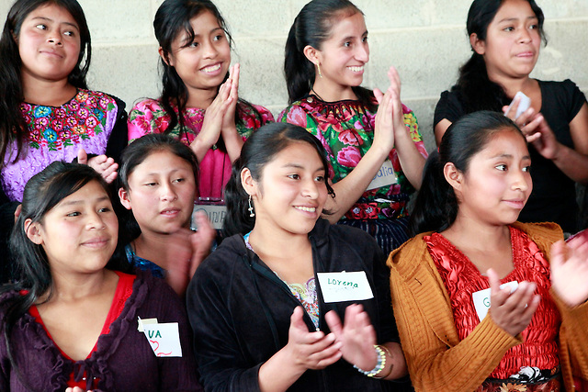

Slide 3
TELL
STORIES

Slide 4
LEVERAGE
AUTHENTIC/
TRUSTWORTHY
MESSENGERS

Slide 5
Notes:
https://www.youtube.com/watch?v=IXWqO1Vcd84

Slide 6
BE OPEN
TO
CO-CREATION

Slide 8
USE ENGAGING,
COMPELLING
IMAGERY

Slide 10
ITERATE

Slide 11
MEASURE
REPORT
LEARN
APPLY
PLAN
DO

