Slide 1
Regional WHO Measles and Rubella Focal Point Meeting
South East Asia Region
21 June 2016
Geneva, Switzerland

Slide 2
Regional Measles and Rubella Goals
66th Meeting of the SEAR Regional Committee in September 2013 in New Delhi resolved to adopt the goal of measles elimination and rubella/CRS control in the South-East Asia Region by 2020
1655 days remaining

Slide 3
SEAR-Measles and rubella reported cases and coverage of MCV1 and MCV2, 1980-2014

Slide 4
Reported Measles Cases and MCV1 and MCV2 Coverage SEAR, 2003–2015
Cases of measles reported to WHO and UNICEF through the Joint Reporting Form to Regional office for South-East Asia Region. Data are from WHO and UNICEF estimates for the South-East Asia Region..

Slide 5
Reported Rubella Cases and RCV* Coverage SEAR, 2003–2015
* RCV not introduced in DPR Korea, India, Indonesia
Cases of measles reported to WHO and UNICEF through the Joint Reporting Form to Regional office for South-East Asia Region. Data are from WHO and UNICEF estimates for the South-East Asia Region..

Slide 6
MCV1 coverage WHO UNICEF estimates, and number of countries reaching > 90% coverage. 2000 – 2015. (N=11)

Slide 7
MCV1 coverage by WHO UNICEF estimates in SEAR countries, 2010 – 2015

Slide 8
Estimated ~5.5 Million Infants Missed MCV1, 2015
Need to vaccinate additional ~4 million to reach 95% coverage with MCV-1
88% live in
India
Indonesia
Poor access
Issues with human resource
Unmapped populations
Social and cultural barriers
Need to enhance transformative investments (GRISP)
Source: Computed from Population data from AERF 205 and WHO/UNICEF provisional estimates for 2015

Slide 9
SIA administrative and survey coverage vs. 95% coverage target (2015)
DHS Ongoing

Slide 10
SIAs done during 2015-2016 ~18 million children reached
Country | Vaccine | Target Age | Admin Cove | Dates | Survey Cov | Survey Notes | Other intervent
India (Flood) | M | 1-14Y | 100% | Dec-15 | - | - | -
Myanmar | MR | 9m-14y | 94% | Jan-15 | - | DHA planned | None
Nepal (EQ) | MR | 6-59m | 91% | Aug-15 | - | CES Planned | tOPV
Nepal | MR | 9m-14Y | - | Feb-16 | - |  | tOPV
Thailand | MR | 2.5-7 Y | 88% | May-15 | - | - | -
Timor Leste | MR | 6m-14y | 97% | Jul-15 | 96% | EPI CES | tOPV
Notes:
890,070 children in flood effected area vaccinate in India .
66017000 children from 10 states in India targetted
Indonesia plans to conduct Measles campaign in 180 selected high risk districts in August 2016. The campaign is fully funded by government of Indonesia and vaccines will be supplied from Biofarma
Indonesia also plans for a nationwide MR campaign in three phases- August 2017 (Java Island with 53% population), February 2018 (Sumatera Island with 24% population) and August 2018 (rest of country with 23% population) integrated with mass distribution of Vitamin A. The campaign will be followed by the introduction of MR vaccine.

Slide 11
Estimated 640 thousand deaths averted in 2015 due to Measles vaccination alone
Country | Deaths averted due to
 | MCV1 | MCV2 | Total
Bangladesh | 61,271 | 6,744 | 68,015
Bhutan | 202 | 23 | 225
DPRK | 5,527 | 618 | 6,145
India | 379,224 | 34,521 | 413,745
Indonesia | 70,851 | 4,113 | 74,964
Maldives | 114 | 14 | 127
Myanmar | 12,838 | 1,379 | 14,217
Nepal | 8,536 | - | 8,536
Sri Lanka | 5,440 | 664 | 6,104
Thailand | 11,203 | 1,238 | 12,441
Timor-Leste | 487 | - | 487
SEAR RI | 555,692 | 49,314 | 605,006
SIA | NA | 34,946 | 34,946
16.5 deaths averted per 1000 population vaccinated with MCV-1 and 1.9 deaths averted per 1000 population vaccinated with MCV-2
(GRISP)
Source: GRISP 2015 and JRF data on number of children immunized

Slide 12
Local funding for measles SIAs, 2015-2016
Country Year Target Pop | Total Budget $ | Amount Raised Locally $ | Locally-raised amt $ / child
India 2015 75.0 mil | 105.750 mil | Nil | Nil
Myanmar 2015 35.101 mil | 18.473 mil | Nil | Nil
Nepal 2015 2.807 mil | 4.127 mil | 4.127 mil | $1.47
Timor Leste 2015 0.490 mil | 0.970 mil | 0.225 mil | $0.46
India 2016 224.489 mil | 329.999 mil + Vaccines by GAVI | 329.999 mil | $1.47
Indonesia 2016 3.901 mil | 6.085 mil | 6.085 mil | $1.56
Nepal 2016 2.877 mil | 4.228 mil | 1.021 mil | $0.35
Totals | 469.632 mil | 341,457 mil
A total of
$341.5 million raised locally by these countries in 2015-2016
Source: UNF Proposals for 2015 and 2016

Slide 13
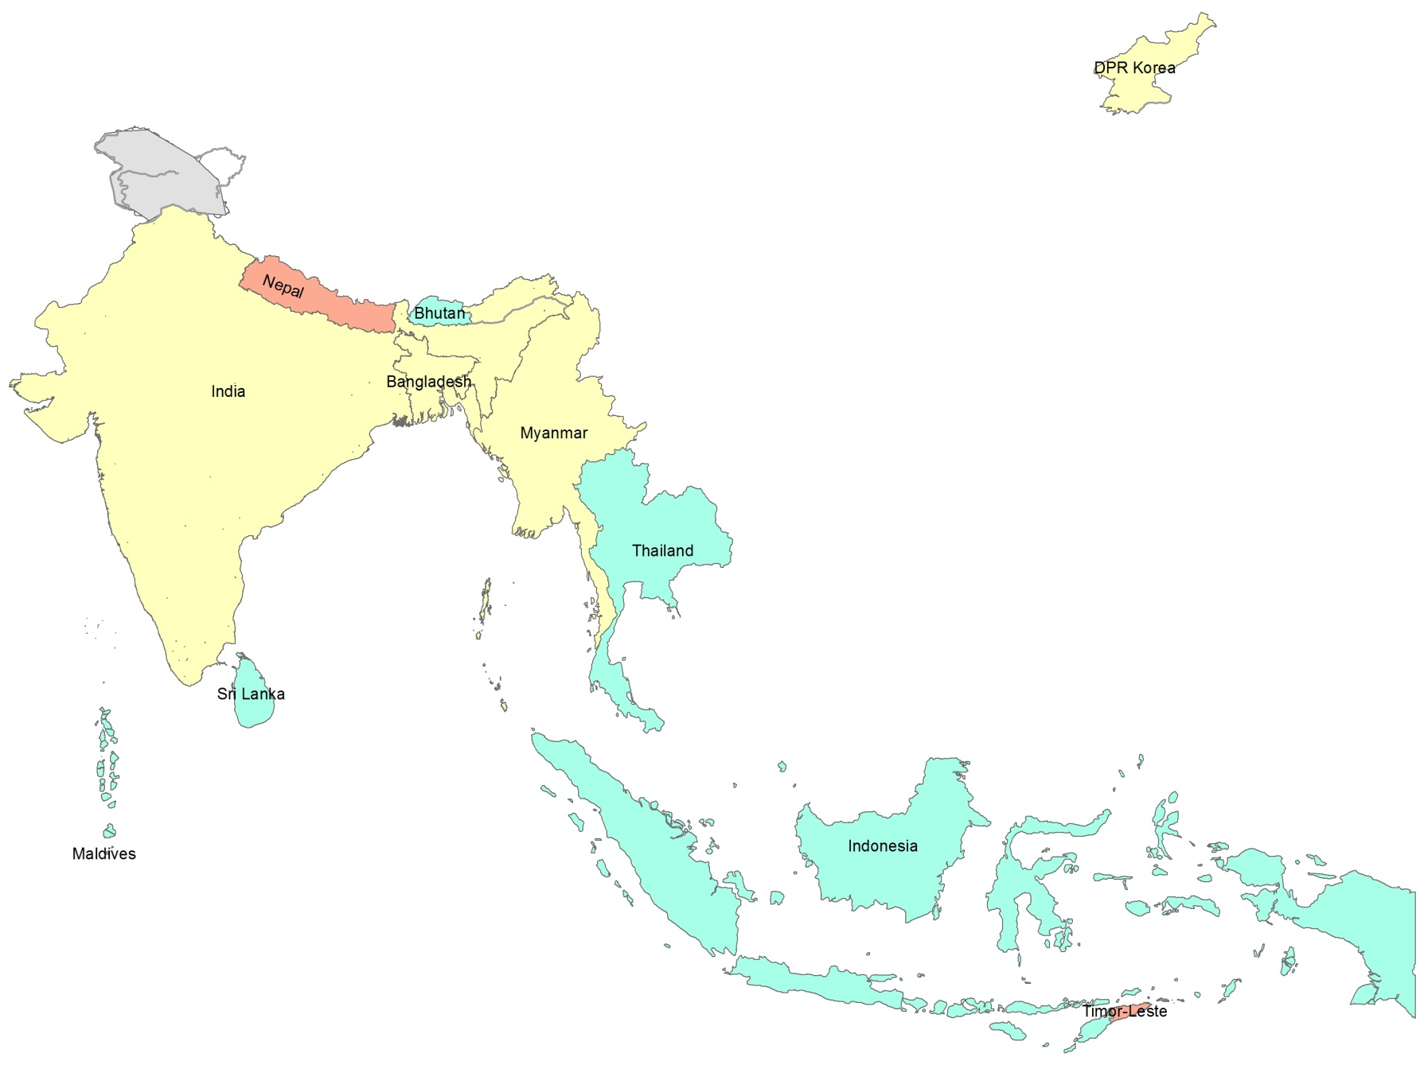
MCV2 introduction into routine EPI in (region) 2015-2016
 | MCV-2 intro date
Bangladesh | 2012
Bhutan | 2006
DPRK | 2008
India | 2010
Indonesia | 2004
Maldives | 2006
Myanmar | 2008
Nepal | 2015
Sri Lanka | 1996
Thailand | 1996
Timor Leste | 2016
MCV2 already in EPI schedule
Introduced 2007-2014
Introduced after 2014
All eleven countries have introduced MCV2 by February 2016

Slide 14
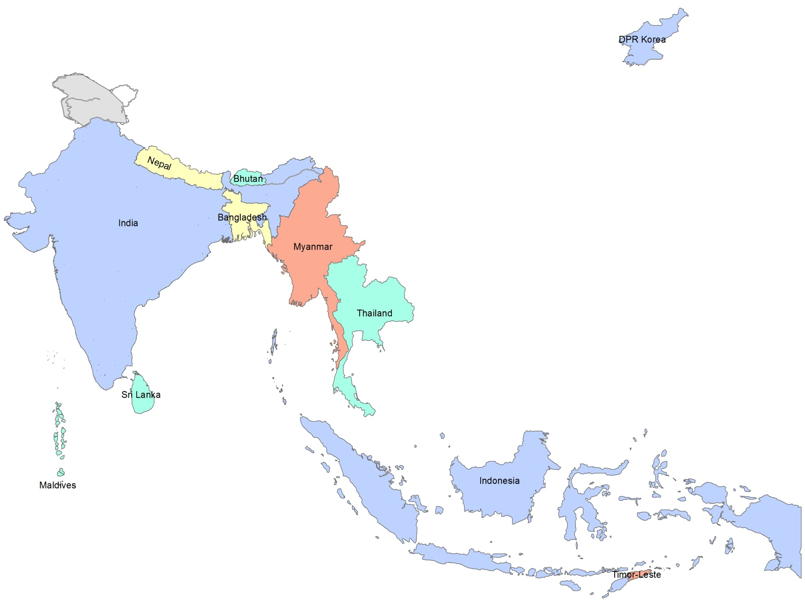
Rubella-containing vaccine introduction in (region) 2015
 | RCV-2 intro date | Remarks
Bangladesh | 2012
Bhutan | 2006
DPRK | N | 2017
India | N | 2017
Indonesia | N | 2017
Maldives | 2006
Myanmar | 2015
Nepal | 2013
Sri Lanka | 1996
Thailand | 1993
Timor Leste | 2016 | Feb-16
RCV already in EPI schedule
Introduced 2011-2014
Introduced in 2015
Introduction planned after 2015
All countries are expected to introduce RCV by end 2018.

Slide 15
Indicators of Progress Towards Measles (and Rubella) Elimination SEA Region 2000-2015
Category | Target 2020 | 2015 | 2014 | 2013 | 2012 | 2011 | Baseline 2000
Incidence (% countries < 5 per million population) | 100% | 55% | 55% | 45% | 36% | 27% | 9%
Incidence of confirmed measles (confirmed by lab, epidemiologic linkage or clinically) per million population | 0 | 16 | 22 | 16 | 26 | 38 | 70
High Quality Surveillance
National reporting of discarded measles cases (goal: ≥2 per 100,000 inhab) | >2 | 0.55 | 0.52 | 0.34 | 0.42 | ND | ND
% of 2nd level admin units reporting ≥ 2/100 000 discarded measles cases | 80% | ND | ND | ND | ND | ND | ND
% of suspected cases with adequate blood specimens | 80% | 32% | 24% | 22% | 17% | ND | ND
High Population Immunity
% countries with MCV1 >90% | 100% | 45% | 45% | 45% | 45% | 45% | 27%
% countries with MCV1 >80% in all dist | 100% | 64% | 64% | 64% | 45% | 55% | ND
% SIAs with all districts >95% | 100% | 0 | 0 | 0 | 0 | 0 | 0
Data: WHO/UNICEF JRF
ND=No data
Notes:
Adapt to regional targets as necessary
suggested shading for incidence:
% countries: 90% or higher, yellow = 70-90%, red =<70%
reg incidence: green <5, yellow 5-50, red >50
surveillance quality:
green = 80% or higher, yellow = 70-80%, red = <70%
coverage:
green = 90% or higher, yellow = 70-90%, red =<70%

Slide 16
Measles Surveillance 2016
Laboratory supported case-based surveillance for MR gradually evolving in the Region , though great challenges remain
Approximately 2700 suspected outbreaks reported in the region with only 57% investigated
Sample collection and transportation is a challenge due to need of specialized skills and cold chain

Slide 17
Measles-Rubella Surveillance Indicators - 2015
Country | Proportion of all suspected measles and rubella cases that have had an adequate investigation initiated within 48 hours of notification | Discarded non-measles non-rubella incidence per 100,000 total population | Proportion of subnational administrative units reporting at least two discarded non-measles non-rubella cases per 100,000 total population | Proportion of sub-national surveillance units reporting to the national level on time
Bangladesh | 91 | 1.85 | 38 | 92
Bhutan | 83 | 0.67 | - | -
DPR Korea | 96 | 0.30 | - | 100
India | - | 0.38 | - | 92
Indonesia | 44 | 0.62 | - | 38
Maldives | 82 | 2.34 | - | 100
Myanmar | 57 | 0.39 | - | -
Nepal | 17 | 0.85 | 12 | 89
Sri Lanka | - | 4.00 | - | 100
Thailand | 30 | 0.58 | 9 | -
Timor Leste | 94 | 1.4 | - | 100
Of expected ~37,000 non-measles non rubella, only 9,800 reported-
26% capture rate
Not met
Close
Fully met
No data
Source: SEAR Weekly VPD bulletin and JRF as of 15 June 2016

Slide 18
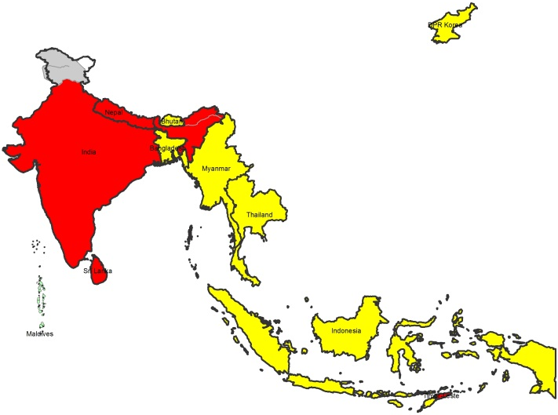
Measles-Rubella Surveillance 2015- Incidence by country
Incidence per million → | Measles | Rubella
Bangladesh | 1.5 | 24.4
Bhutan | 14.5 | 0.0
DPRK | 0.0 | 0.0
India* | 19.9 | 38.5
Indonesia* | 3.2 | no data
Maldives | 0.0 | 0.0
Myanmar | 0.1 | 5.8
Nepal | 57.7 | 257.8
Sri Lanka | 74.8 | 4.8
Thaliand | 2.3 | no data
Timor-Leste | 38.6 | 8.3
SEAR | 15.9 | 38.7
Measles Incidence –
>5/million; <5 per million, zero cases
*Note: India and Indonesia are yet to fully expand the case-based surveillance nationwide.

Slide 19
Suspected Measles Outbreaks, SEAR, 2015
Country | Total Outbreaks | Investigated | Lab Confirmed Measles | Lab Confirmed Rubella | Lab Confirmed Mix (Measles & Rubella) | Negative (Measles & Rubella)
Bangladesh | 68 | 68 | 4 | 3 | 2 | 50
Bhutan | 2 | 2 | 1 | 1 | 0 | 0
DPR Korea | 0 | 0 | 0 | 0 | 0 | 0
India | 2569 | 1425 | 974 | 91 | 33 | 179
Indonesia | 68 | 46 | 19 | 7 | 1 | 5
Maldives | 0 | 0 | 0 | 0 | 0 | 0
Myanmar | 1 | 1 | 0 | 0 | 0 | 1
Nepal | 9 | 9 | 6 | 0 | 0 | 3
Sri Lanka | 1 | 1 | 1 | 0 | 0 | 0
Thailand | 11 | 11 | 1 | 3 | 0 | 7
Timor Leste | 0 | 0 | 0 | 0 | 0 | 0
SEAR | 2729 | 1563 | 1006 | 105 | 36 | 245

Slide 20
Distribution by age and vaccination status, from measles outbreaks in SEAR countries, 2015-16

Slide 21
Distribution by age and vaccination status, from measles outbreaks in selected countries, 2015-16
Confirmed measles, India, 2015 (N= 23,728)
Confirmed measles, Bangladesh, 2015 (N= 78)
Confirmed measles, Sri Lanka, 2015 (N= 1297)
Confirmed measles, Maldives, 2015 (N= 0)

Slide 22
Confirmed Rubella cases by age and vaccination status, selected countries, 2015
Confirmed Rubella, India, 2015 (N= 2,590)
Confirmed Rubella, Indonesia, 2015 (N= 108)
Confirmed Rubella, Bangladesh, 2015 (N= 48 )
Confirmed Rubella, Nepal, 2015 (N= 0)

Slide 23
Routine strengthening activities
Stand alone activities to increase MCV1 coverage-
AI approach in Nepal to declare Fully Immunized Villages
Indradhanus approach in India-PIRI
Accountability frame work as DTFI and STFI in all states of India
MLM trainings targeting districts with low MCV1 coverage in Bangladesh
Enhancing micro plans in Timor Leste
Regular routine immunization monitoring and feedback
Activities as part of ongoing measles activities (SIAs or MSD introduction)
Strengthening Cold chain in Nepal and Timor Leste
MSD at 15 months replaced with MR 2nd dose in mid 2015 in Bangladesh
Plans for Regional Immunization Week
Others

Slide 24
Regional and National Verification
Status of RVC
Formed in April 2016
First meetings planned for 1-4th August 2016
Status of NVC
10/11countries with NVC
Reporting of countries to RVC not started, planned to start from August 2016.

Slide 25
Challenges to achieving regional goals
Increasing routine immunization coverage to >95%
Can’t rely on repeated SIAs as in polio eradication
No greater challenge
Surveillance quality- Having elimination standard surveillance
Care seeking behavior
Challenges with reporting and sample collection
Challenges with testing
The large countries – India and Indonesia
Cross boarder movements
Ensuring adequate vaccine supply
Only one WHO pre-qualified MR manufacturer, Serum Institute of India
Ensuring adequate funding, and trained staff

Slide 26
Programme Plans 2017-2018

Slide 27
2017-2018 SIA plans and budget
Country | Vaccine | Target Age | Dates | Geographic Extent | Other intervent | Funding source
Indonesia | Measles | 9m-14y | Oct-16 | High risk approach |  | Self
India | MR | 9m-14y | 2016-17 | Phased nation wide | In 4 phases | GAVI/Self/others
Indonesia | MR | 9-59m | Q4 2017 | Phased nation wide | In 3 phases | Self
Notes:
66017000 children from 10 states in India targetted ,
Indonesia plans to conduct Measles campaign in 180 selected high risk districts in August 2016. The campaign is fully funded by government of Indonesia and vaccines will be supplied from Biofarma
Indonesia also plans for a nationwide MR campaign in three phases- August 2017 (Java Island with 53% population), February 2018 (Sumatera Island with 24% population) and August 2018 (rest of country with 23% population) integrated with mass distribution of Vitamin A. The campaign will be followed by the introduction of MR vaccine.

Slide 28
2016-2017 GAVI application and introduction plans for MSD, MR, measles
Country | Vaccine (MSD, MR, M) | Year of Intro (or Measles SIA) | MCV1 coverage (2012) | Year of planned GAVI application | Budget ( excluding surveillance and TA cost)
India | MR | 2016 |  | 2015 | $329,998,548.00
Indonesia | MR | 2017 |  | 2016 | $12,074,661.00
DPR Korea | JA ongoing now, discussion on MR introduction

Slide 29
Support for Rubella and MSD introduction plans and SIAs in 2017
India plan still under discussion
GAVI has provided indication of support for 50% of vaccines
Indonesia funding self
Applied for funding with GAVI
DPRK may be funded by some regional INGOs
Joint Appraisals with GAVI
Bangladesh - August 16 onward
DPRK- Ongoing
India - scheduled for August, dates not yet finalized
Indonesia- 25th July to 2nd August
Myanmar : 27 June to 5th July . No RO participation,
Nepal- 8-13 May done
Timor Leste-25th July to 2nd August

Slide 30
2016-2017 measles and rubella/CRS surveillance plans and budget
Trainings/Workshops:
Surveillance guidelines revision workshop
Orientation of members of Regional and national verification committees
Country capacity building on Molecular epidemiology for MR
Introduction of alternate sampling technique countries
Operational studies/Pilots-
Point Of Care Testing (POCT) devices
PIEs, programme, surveillance and lab reviews, etc
EPI and VPD surveillance review plans –Myanmar; CRS surveillance review in Bangladeshi and Nepal
MR lab accreditation- On going
CRS surveillance review in Bangladesh and Nepal (under discussion)

Slide 31
2016-2017 Advocacy Plans
Nationwide wide age range MR campaign in DPRK, India, Indonesia.
Strengthen case-based MR surveillance and quality reporting to SEARO
Establishment of Verification committees in DPRK
Quality and affordable MR vaccine availability for SEAR
Advocacy with manufacturers
Advocacy with countries for Advance market Commitment (AMC)

Slide 32
Technical Assistance needs 2016-18
International monitors and consultant to support SIA in India, Indonesia.
TA to revise the VPD surveillance standards
TA to conduct post MR campaign CES in Nepal using new methodology
TA to orient the verification committees on their roles
Others as per programmatic need on ad hoc basis

Slide 33
Resource gaps 2017-2018
Support the surveillance network in Bangladesh, India, Nepal and Timor Leste
Laboratory Support
Technical assistance to the countries
To strengthen/expand laboratory supported case-based surveillance
Introduction of POCT and alternate sampling technique using DBS
Expansion of CRS surveillance in selected countries
R&D

Slide 34
Thanks!
Merci! ¡Gracias! धन्यवाद! Terima kasih! Jërëjëf! Murakoze!
بہت بہت شکر …یہ شكرا
The boundaries and names shown and the designations used on the maps do not imply the expression of any opinion whatsoever on the part of the World Health Organization concerning the legal status of any country, territory, city or area or of its authorities, or concerning the delimitation of its frontiers or boundaries. Dotted lines on maps represent approximate border lines for which there may not yet be full agreement.
© WHO 2015. All rights reserved

Slide 35
SEAR Measles and Rubella Labs Regional Office Budget Projections for 2016
Budget Line | Annual Requirement* | Funding Available | Implementation 15 Jun 2016 | Funding Source | Funding Gap
Lab Staff
Scientist (50% staff time) | 123,250 | 123,250 | 61,625 | CDC-Polio | Nil
MO-Measles (10% staff time) | 20,200 | 15,500 | 7,750 | CDC-Measles | 4,700
Lab Technologist (Timor Leste) | 93,250 | 93,250 | 46,625 | WHO Flexi funds | Nil
Support Staff (50% staff time) | 11,250 | 8,625 | 4,312 | CDC-Measles | 2,625
Totals | 247,950 | 240,625 | 120,312 |  | 7,325
Lab Activities**
Technical Assistance | 52,000 | 52,000 | 46,024 | WHO Flexi funds | Nil
Supplies, Reagents & Equip | 722,250 | 289,200 55,250 | 41,078 110,249 19,916 | CDC-Measles WHO Flexi Funds UNF/MRI | 377,800 Nil Nil
Training, Meetings & Workshops | 220,000 | 59,800 | 2,559 7,500 8,136 | CDC-Measles UNF/MRI WHO Flexi funds | 60,200 100,000 Nil
Accreditation reviews / visits | 40,000 | 11,960 | 8,001 Nil 42,636 | CDC-Measles UNF/MRI WHO Flexi FUNDS | 8,040 20,000 Nil
Totals | 1,034,250 | 468,210 | 286,099 |  | 566,040 CDC-Msls - $ 446,040 UNF/MRI - $ 120,000
Grand Total (Staff + ACT) | 1,282,200 | 708,835 (55% of annual Req) | 406,411 (57% of Resources) (32% of Annual Req) |  | 573,365 (45% of Annual Req)
* Annual Requirement is drawn from donor proposals. Projected Requirement of USD 565,000 under PB 2016-17 for IVD Regional Office has not been considered for this summary. This is because the planned costs in the activity plans are understated due to budget space limitations
** Does not include USD 325,000 budgeted by countries in support of laboratory network, requested under UNF/MRI proposal for 2016
Notes:
On Staff – note that I have taken part time of select staff. For implementation, I assume 6 months, or 50% of the annual budget is implemented. We are okay with staff funding but lab activities, other than supplies and equip, have a significant gap.
On activities – the overall budget is USD 1.034 mil . This includes 70% towards supplies, reagents and procurement….the implementation under this supply line is USD 171K, or 24% of the annual budget projection of USD 722,500. You need to review whether the current levels of MR surveillance and case load in the labs justifies this budget.
Training line looks fine, and I think there are planned activities that will occur later in the year.
The above annual requirement is what is planned at the regional office level…it will be difficult to pull out information for countries….there is hardly any measles specific funding to countries in support of labs, except some UNF/MRI carry over which is minimal. In view of this, I have just put a foot note to indicate what the countries requested under the UNF 2016 proposal in support of labs. Which is USD 325,000. Hope this si good enough to explain. India may be receiving some measles lab funding but I need to check.
Also, note that there is a missing piece on regional surveillance activities…..I have briefed Sudhir.
Again, just as the country lab requirement has not been reflected above, the surveillance budget needs in SEAR countries (HR+field network running costs, direct and indirect) aren’t captured.

