Slide 1
American Red Cross Domestic Outreach
Notes:
Over the past year since we last met the American Red Cross has been involved in multiple opportunities to highlight the work of the Measles Initiative and reach out to our domestic audiences. I’d like to share some of the highlights of the year with you now.

Slide 2
Project Basics
Multi-Year
Social and Digital
Team Based
Flexible and Creative
Notes:
Last year told you about the launch of our new Vaccinate a Village toolkit.
Just to recap the project:
We planned this tool to be a Multi-year project;
It contains social and digital components;
It’s team-based initiative ; and
flexible and creative, offering our advocates the opportunities to use their own creativity while providing them with a structure to channel it though. We’ve seen the best ideas come from our advocates throughout the US.
We developed multiple creative items to include in the toolkit such as posters, fliers, print invitations and dye cut figures. We also created an imaginary generic story about a village to be used in promotional items. We set a minimum goal for participants of $500 that would vaccinate one small village.

Slide 3
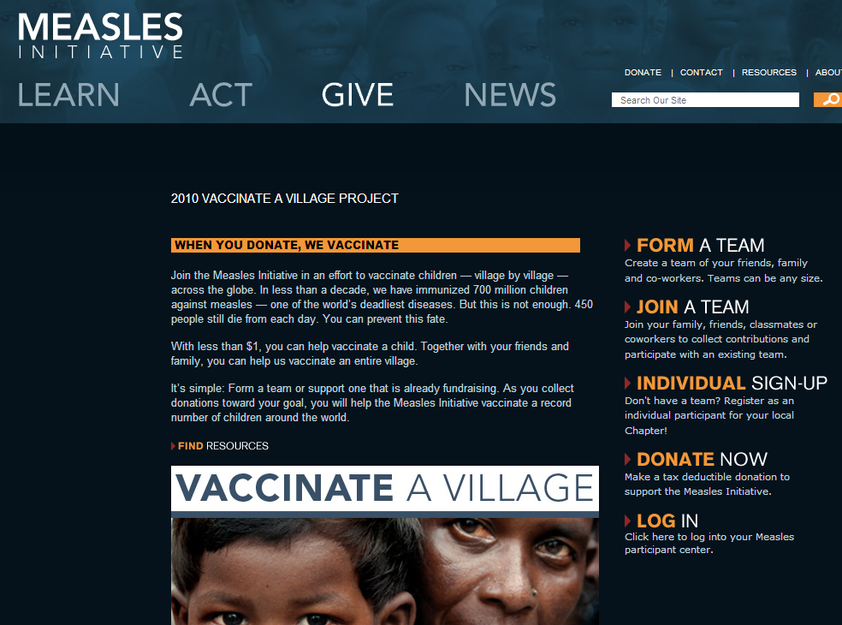
Digital Engagement
Notes:
Although the toolkit for vaccinate a Village contains many hands on grassroots tactics, the project featured a digital or online engagement strategy. Over the past year we engaged 65 teams across the country to host a Vaccinate a Village fundraising event though the on line fundraising component called Teamraiser.
With this online fundraising tool our advocates:
Set goals
Built personal fundraising websites
Promoted their fundraising activities using e-mails, widgets and ecards
And tracked progress toward their goal
We found that teams often combined both digital and grassroots fundraising components to reach their fundraising goals.

Slide 4
WNBA Cares
Final Partnership Evaluation
August to November 2010
Notes:
4
Last year, I also shared with you our exciting plans to partner with WNBA and today, I have the pleasure of sharing the results
Just to give you a little background about what I am about to present, the American Red Cross developed a marketing partnership with WNBA Cares to promote the Measles Initiative during the leagues’s playoff games which ran through the Fall 2010.

Slide 5
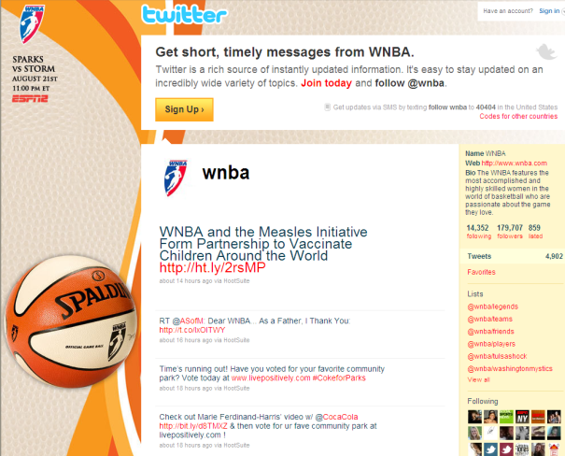
Overview
Public Service Announcement
Display Ads
Celebrity Involvement
Social Media
Team Activation
Fundraising Email
Notes:
Here are some of our activities that occurred during that period:
Public Service Announcement
PSAs ran on NBA TV & ESPN 2 during WNBA Playoffs, garnering more than 3 million impressions for each airing
We also received three bonus airings during NBA pre-season games with additional 1.5 million impressions each
The PSAs also ran inside the arena during the WNBA Playoffs in Atlanta, Phoenix and Seattle
The PSAs were posted to YouTube.com, generating nearly 5,750 views, Just to compare - most Red Cross videos generate less than 500 views.
Display Ads
Four separate ads were posted on NBA.com and WNBA.com, generating 5.5% of MeaslesInitiative.org traffic
Four separate ads went out in the WNBA e-newsletter, reaching 750,000 people
Celebrity Involvement
Candace Parker tweeted about the partnership twice, generating more than 200 retweets
Other celebrities, athletes and high profile sports journalists followed suit
NBA legend Dikembe Mutombo recorded a series of seven video messages near the holidays and spoke on behalf of the Measles Initiative at a well-attended reception for Members of Congress and their staff.
Social Media
Received 5 promotions on Facebook and Twitter from the WNBA, garnering 2,500 pass-along messages from fans and 8.4 million impressions each time as well as positively impacting PSA views and website traffic
Team Activation
WNBA teams in Atlanta, Phoenix and Seattle promoted the Measles Initiative Vaccinate a Village program. The local teams each donated $2,500 and handed a check, center court, to the local ARC chapter during half time. The local ARC chapters set up information booths during the game a collected additional donations.
Two fans who attended helped promote the team activation events via Facebook, sharing their positive experience with their social networks
Fundraising Email
Distributed two email messages to 200,000 past donors featuring Candace Parker and Dikembe Mutombo, generating donations of over 27,000 dollars. ARC Marketing informed us that these e-mails resulted in the highest grossing international email outside of disasters.
Other
WNBA Cares donated $25,000 to the Measles Initiative
We identified 8 new chapters to support the Vaccinate a Village project based on social media promotion
We secured a print advertisement for no additional cost in Ladies Home Journal that reached 11 million women
Tactics from this partnership generated 21.5% of website traffic to MeaslesInitiative.org
Looking ahead, we are exploring opportunities and ideas for the next stage of this partnership. We have asked the WNBA to help us identify a sponsor to underwrite the investment.

Slide 6
ONE Campaign
Initial Partnership Evaluation
November 2010 to Present
Notes:
6
As the initial marketing partnership with the WNBA was drawing to a close, the American Red Cross formalized its partnership with the ONE Campaign
Through this partnership, we hoped to leverage each organizations’s activities and draw more attention and resources to vaccine initiatives

Slide 7
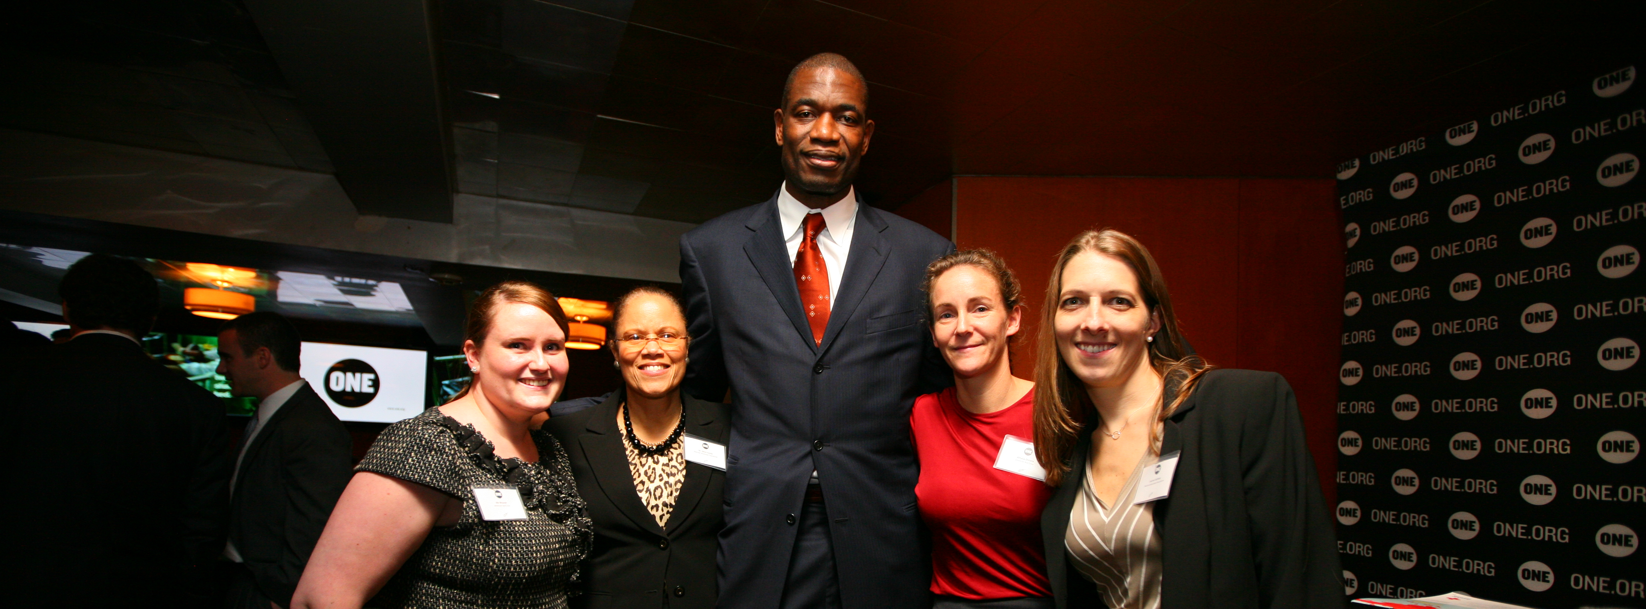
Overview
Social Media
Events
Advocacy
Notes:
7
Here are some of our activities:
Social Media
We cross-posted more than 5 stories and news between the ONE blog and the American Red Cross blog as well as between our Twitter and Facebook accounts
Events
We secured Dikembe Mutombo to speak on behalf of the Measles Initiative at a well-attended reception for Members of Congress and their staffs hosted by ONE
Advocacy
Looking ahead, we hope that we can partner with ONE on a joint call to action to our current member base as well as to the world’s policy makers to achieve continued and increased funding for vaccine initiatives. This could take the form of an email campaign, more events or other creative ideas.

Slide 8
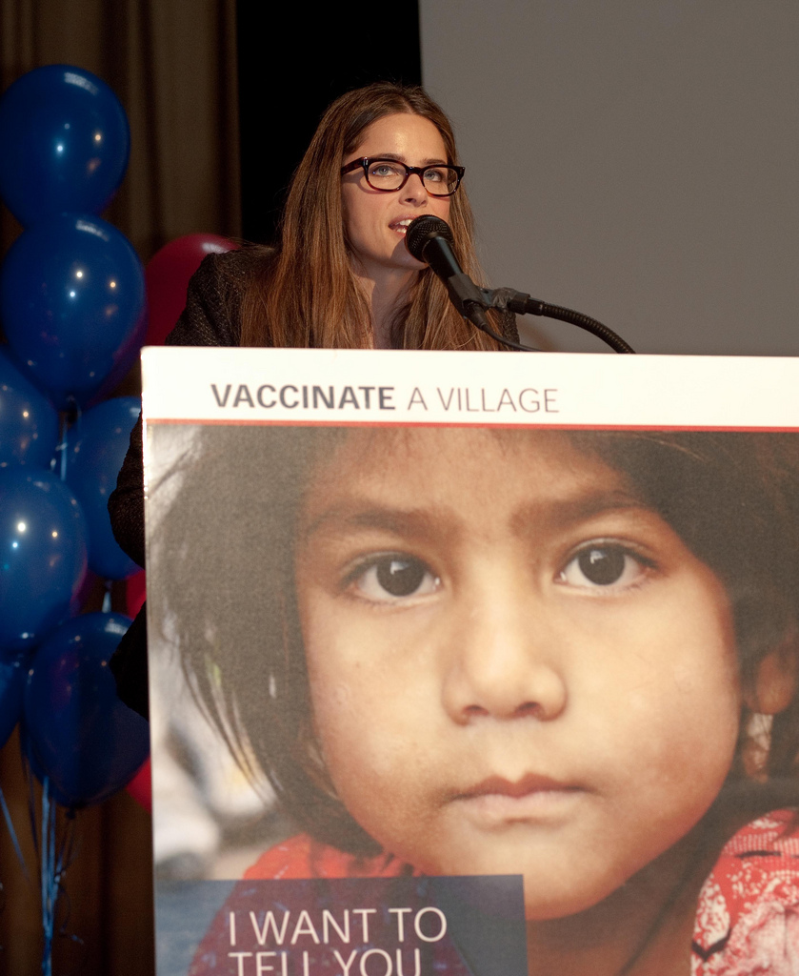
Celebrity Engagement
9 May 2011 event featuring Amanda Peet at Nest+M school in NYC
Notes:
8
Last year the American Red Cross secured a commitment from the actress Amanda Peet to support the Measles Initiative. With the cooperation of the American Red Cross chapter in New York City we were able to create an opportunity for Amanda speak directly to young people about the Measles Initiaitve and the importance of supporting this program.
Amanda Peet surprised 500 middle and high school students at the Nest+M school in NYC, thanking them for raising enough money to vaccinate two villages against the disease and encouraging them to keep up the fight. Following this event the school continued to raise funds to support their Vaccinate a Village project.

Slide 9
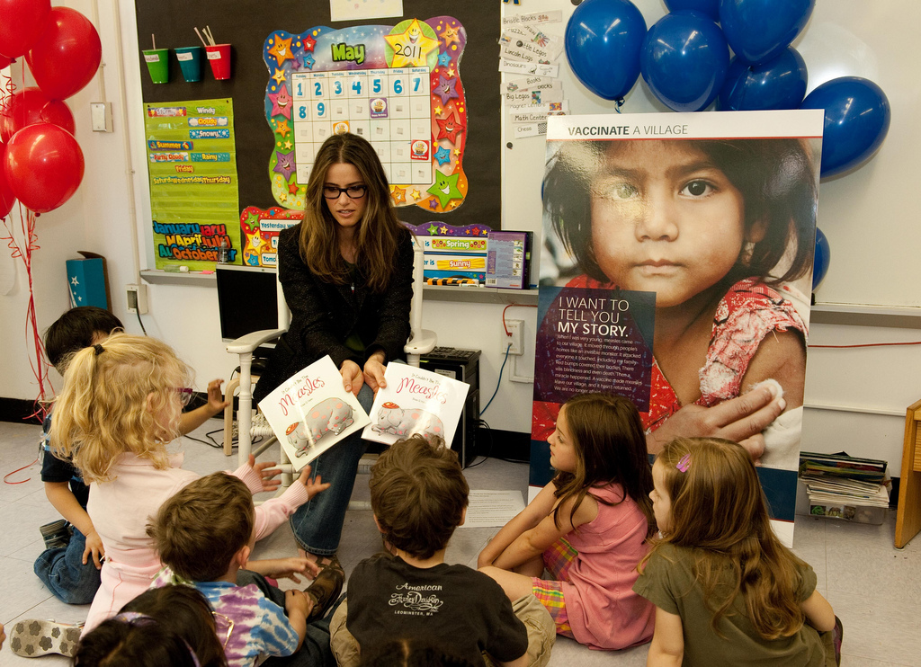
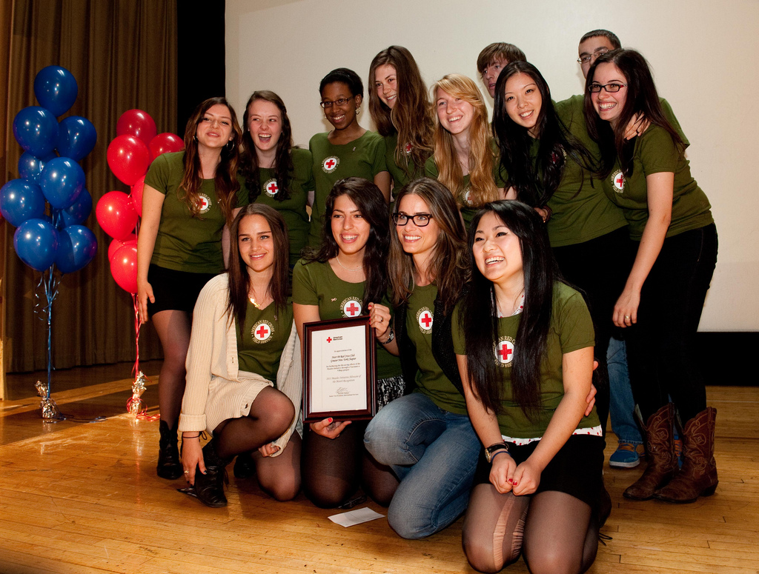
Celebrity Engagement
Educating children and honoring youth advocates
Notes:
9
In addition, Amanda named the school's Red Cross club Measles Initiative Advocates of the Month. She made time to sign autographs and conduct a lengthy on-camera interview with an aspiring teen reporter, who posted the video on Facebook.
Following her presentation to the older students, Amanda then read a child-friendly story about measles to a kindergarten class and talked to them about the importance of vaccines. Following these events Amanda taped four video messages for the Red Cross which can be viewed on YouTube.

Slide 10
Birmingham
Eau Claire
Greater Cleveland
Central Alabama
Seattle
Northwest Alabama
Monterey Bay Area
Alaska
Greater New York
Grand Canyon
Central New York
Southern Arizona
Los Angeles
Badger
Orange County
Thank You!
Central Valley
Long Beach
Capital Region
San Gabriel Pomona Valley
San Luis Obispo County
Santa Barbara
Greater Columbus
Connecticut
Silicon Valley
Ventura County
Mile High
Central South Carolina
Bay Area
Cincinnati Area
National Capital Region
Tampa Bay
Greater Miami & the Keys
Martin County
Greater Palm Beach Area
Metropolitan Atlanta
Greater Chicago
Quad Cities Area
Northeast Indiana
Dearborn and Ohio County
Greater Indianapolis
Greater Lehigh Valley
Gateway Area
Central Maryland
Greater Grand Rapids
Lower Shore
Mid Michigan
Washtenaw County
Northern Nevada
Granite
Saint Louis Area
Dallas Area
Greater Manchester County
Jersey Coast
Sussex County
Northern New Jersey
Colonial Crossroads
Greater Salt Lake
Burlington County
Central New Jersey
Greater Richmond
Mohawk Valley
Northern Livingston County
Notes:
10
This is just a snapshot of some of our big projects from the past year. I’d also like to mention that we continue to advocate with congress for CDC’s measles budget and American Red Cross chapters across the country continue to raise awarenewss. An enormous thank you goes out to our many chapters that speak about the Measles Initiative and raise funds to help support the program every day.
The American Red Cross continues to work on finding new partners and opportunities to bring the work of the Measles Initiative to the forefront. We have some new partnerships in the works right now that I hope will grow and next year we will be able to report back on their successes.
Thank you.

