Slide 1
Measles pre-elimination in the African Region.
Presentation to the MI 10th annual meeting
Sept 2011
B Masresha
WHO AFRO

Slide 2
Outline
Regional goal
Routine immunisation
SIAs
Surveillance
Measles outbreaks in 2010 and 2011
Challenges
Summary and lessons learnt
TAG recommendations
RC 61 resolution on measles elimination

Slide 3
Regional measles pre-elimination goal; targets to be met by end 2012.
98% mortality reduction by 2012 compared to estimates for 2000
Measles incidence <5 cases/10⁶ per year in all countries;
  >90% MCV1 national level coverage in all countries, and >80% in all districts;
  >95% SIAs coverage in all districts;
  All countries meeting the 2 main surveillance performance indicator targets
    80% districts reporting > 1 suspected measles case with a specimen per year
    Non measles febrile rash illness rate of > 2:100,000 per year

Slide 4
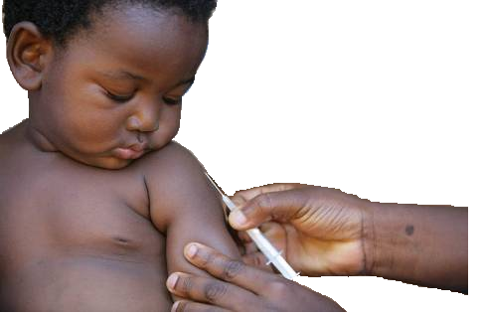
Routine immunisation

Slide 5
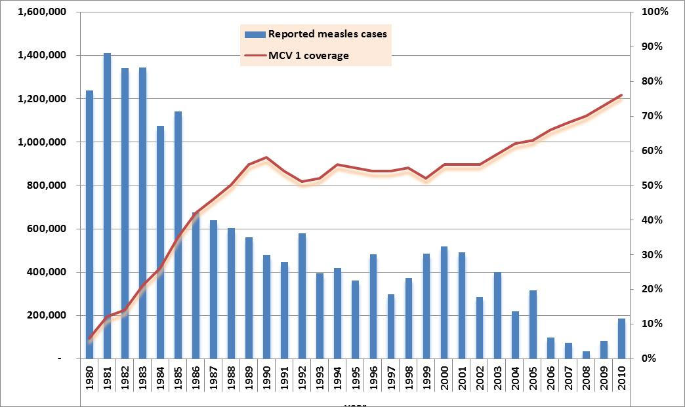
Measles coverage and case reports. AFR. 1980 - 2010

Slide 6
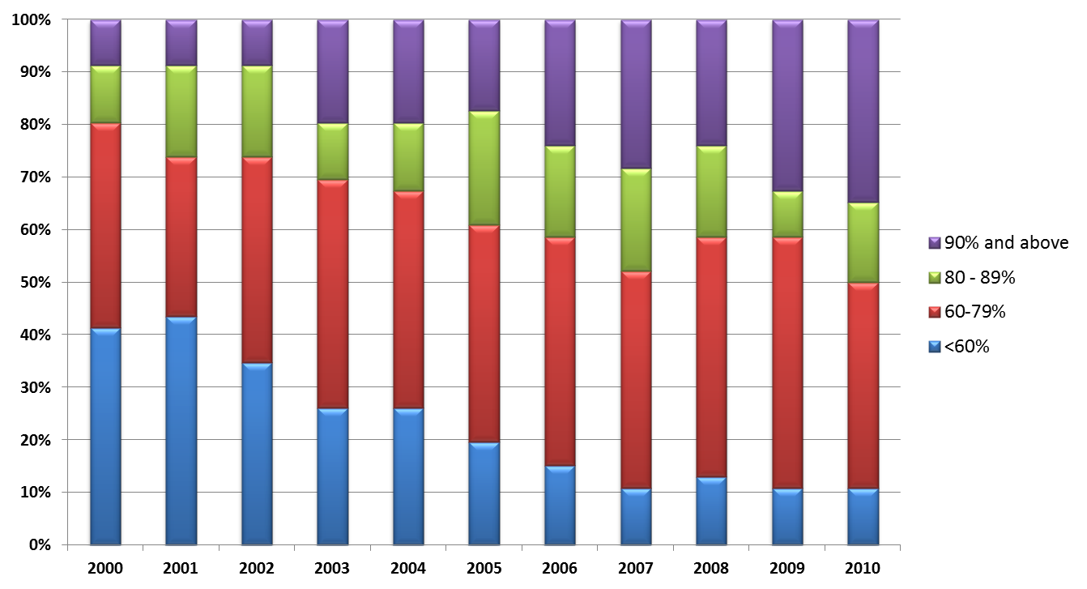
Proportion of countries in AFR according to MCV1 coverage category. 2000 - 2010

Slide 7
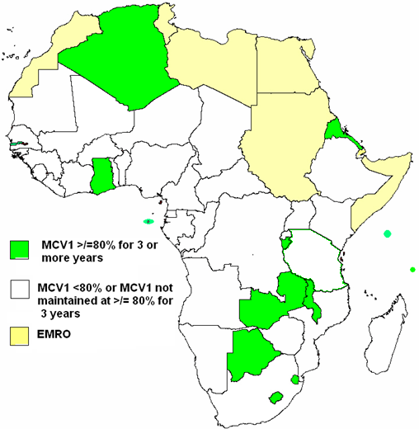
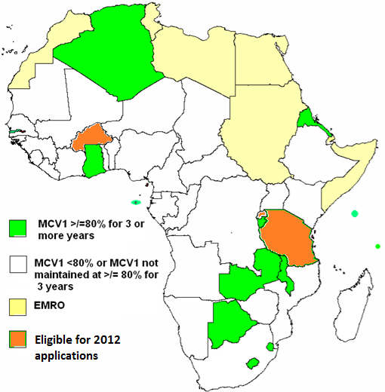
MCV1 coverage > 80% (WHO UNICEF estimates) for > 3 years including 2009. AFR
Already introduced MCV2:
  Algeria
  Lesotho
  Swaziland
  Seychelles
  Mauritius
GAVI applications - May 2011
  Burundi
  Ghana
  Gambia
  Eritrea
  STP
  Zambia
Eligible for 2012 applications:
  Tanzania
  Burkina Faso
  Rwanda

Slide 8
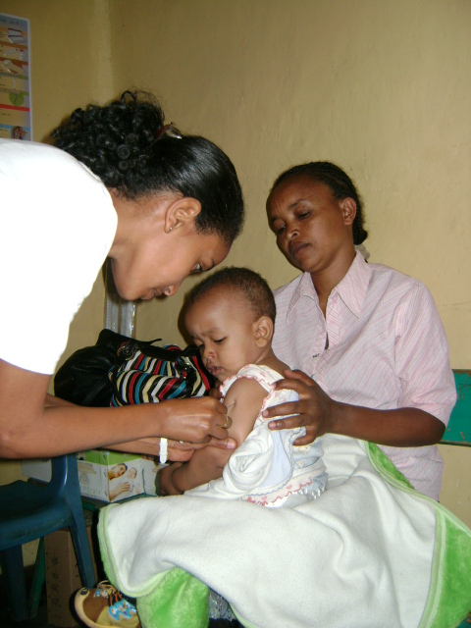
Second opportunity measles vaccination through SIAs

Slide 9
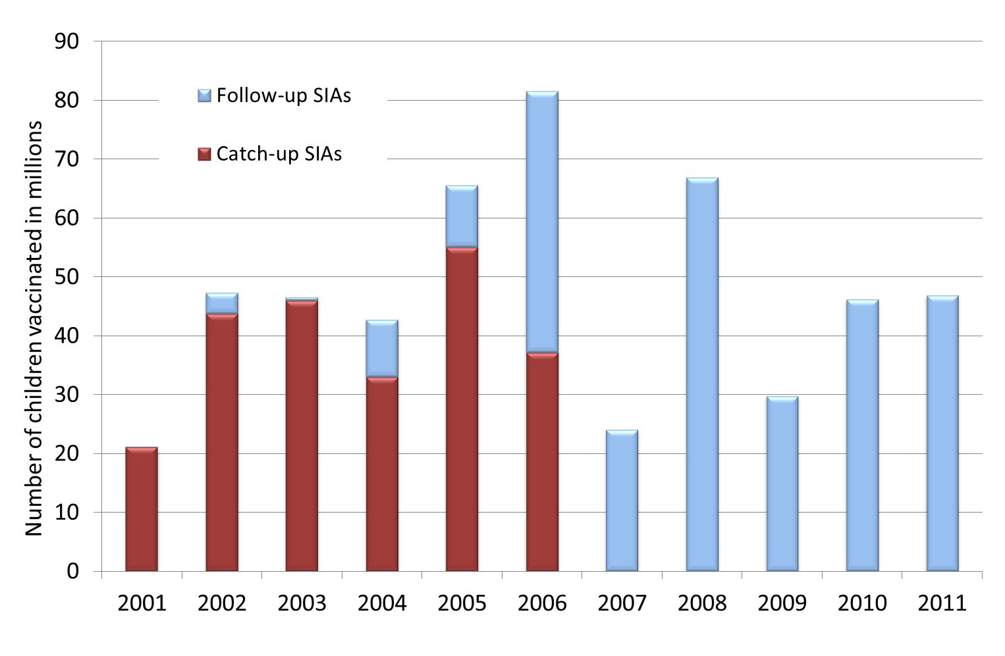
Measles SIAs. 2001 – 2011. AFR.
A total of 518.4 million children reached to date, and an additional 26.4 million to be reached by end 2011.

Slide 10
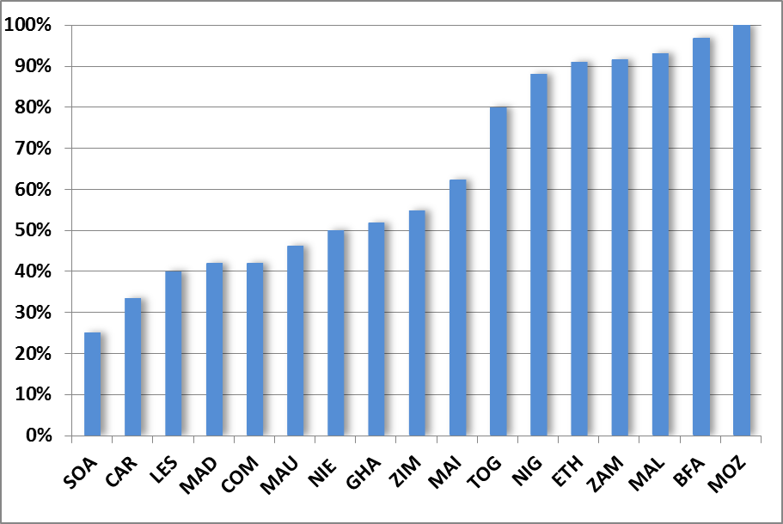
Proportion of districts attaining 95% coverage in SIAs. AFR. 2010 – Aug 2011.

Slide 11
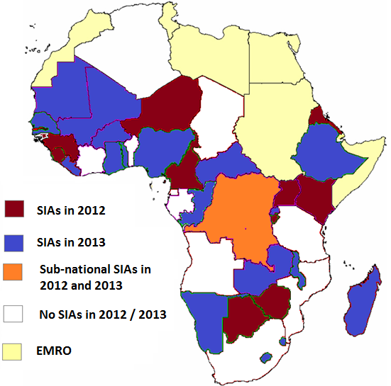
Measles SIAs. AFR. 2012 and 2013
Estimated target pop’n:
  2012
    ~ 38.4 million [9-59 months of age]
  2013
    ~ 83.6 million [9-59 months of age]

Slide 12
Measles surveillance

Slide 13
Measles case based surveillance performance. AFR. 2010 – 2011.
Year | Performance indicator | Target | Regional performance | # countries met target
2010 | % districts reporting suspected cases | >80% districts by end of year | 86% | 15/40
 | Non measles febrile rash illness rate | > 2.0 per 100,000 population | 4.1 | 30/40
2011 (as of end August) | % districts reporting suspected cases | >80% districts by end of year | 74% | 18/42
 | Non measles febrile rash illness rate | > 2.0 per 100,000 population | 3.4 | 24/42

Slide 14
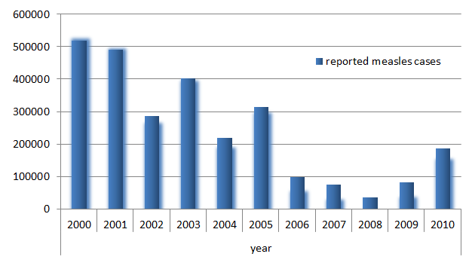
Number of reported measles cases. JRF. AFR. 2000 - 2010

Slide 15
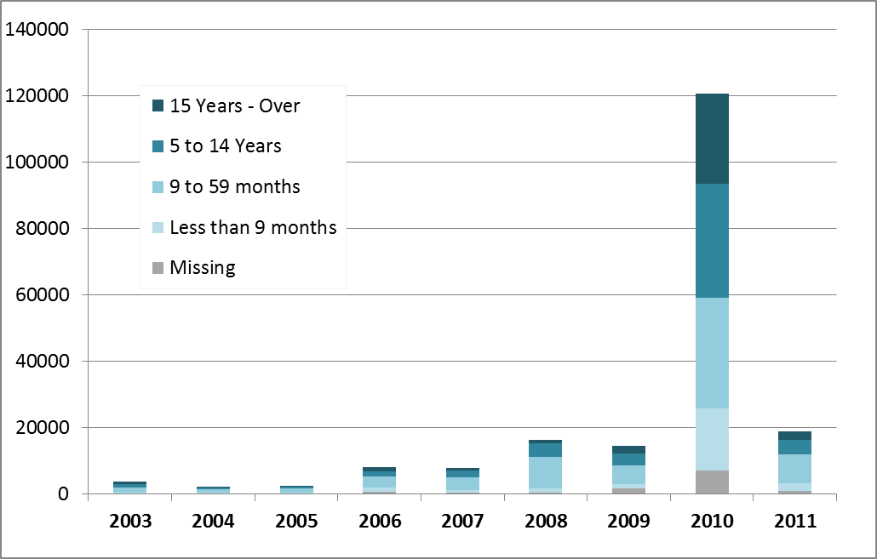
Confirmed measles. Case based surveillance data. AFR. 2003 – July 2011

Slide 16
Measles case reports 2010 and 2011
A total of 133,412 confirmed measles cases in 2010
  109,000 cases (82%) from MAL, SOA, ZAM, ZIM
A total of 20,060 confirmed measles cases in 2011, as of week 33, 2011
  16,500 cases ( 82%) from ZAM, TAN, DRC, NIE, ETH
In 2011, as of week 33, DR Congo reported 103,400 measles cases in aggregate weekly reports (not included in the case based surveillance database)

Slide 17
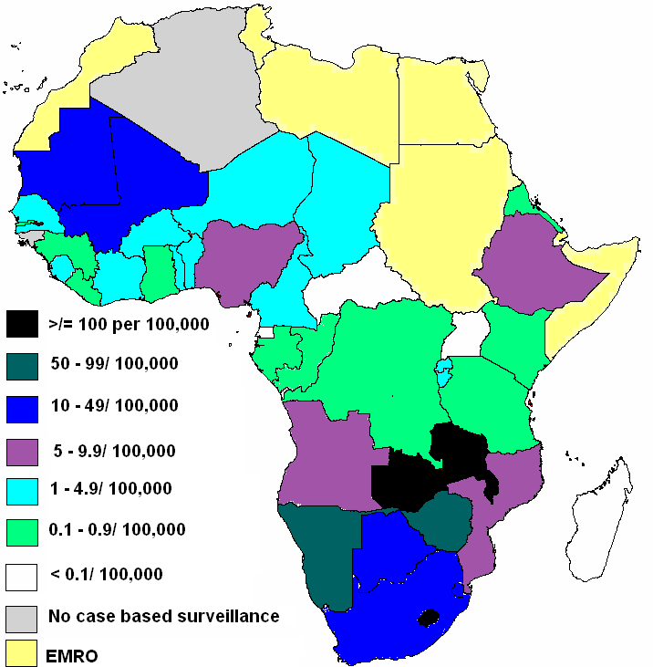
Incidence of confirmed measles per 100,000 population. AFR. 2010
Regional incidence: 17.4 per 100,000 population
10 countries (112.6 million total population) have measles incidence of >10 cases per 100,000

Slide 18
Schedule of Measles SIAs in DR Congo, by province. 2002 - 2012
Province | 2002 | 2003 | 2004 | 2005 | 2006 | 2007 | 2008 | 2009 | 2010 | 2011 | 2012
KOR
NKV
KOC
KAT
MAN
SKV
POR
EQU
BAN
BAC
KIN
Catch up SIAs
Follow-up SIAs
Scheduled follow-up SIAs as of May 2011

Slide 19
Schedule of Measles SIAs in DR Congo, by province. 2002 - 2012
Province | 2002 | 2003 | 2004 | 2005 | 2006 | 2007 | 2008 | 2009 | 2010 | 2011 | 2012
KOR
NKV
KOC
KAT
MAN
SKV
POR
EQU
BAN
BAC
KIN
Catch up SIAs
Follow-up SIAs
Scheduled follow-up SIAs as of Sept 2011

Slide 20
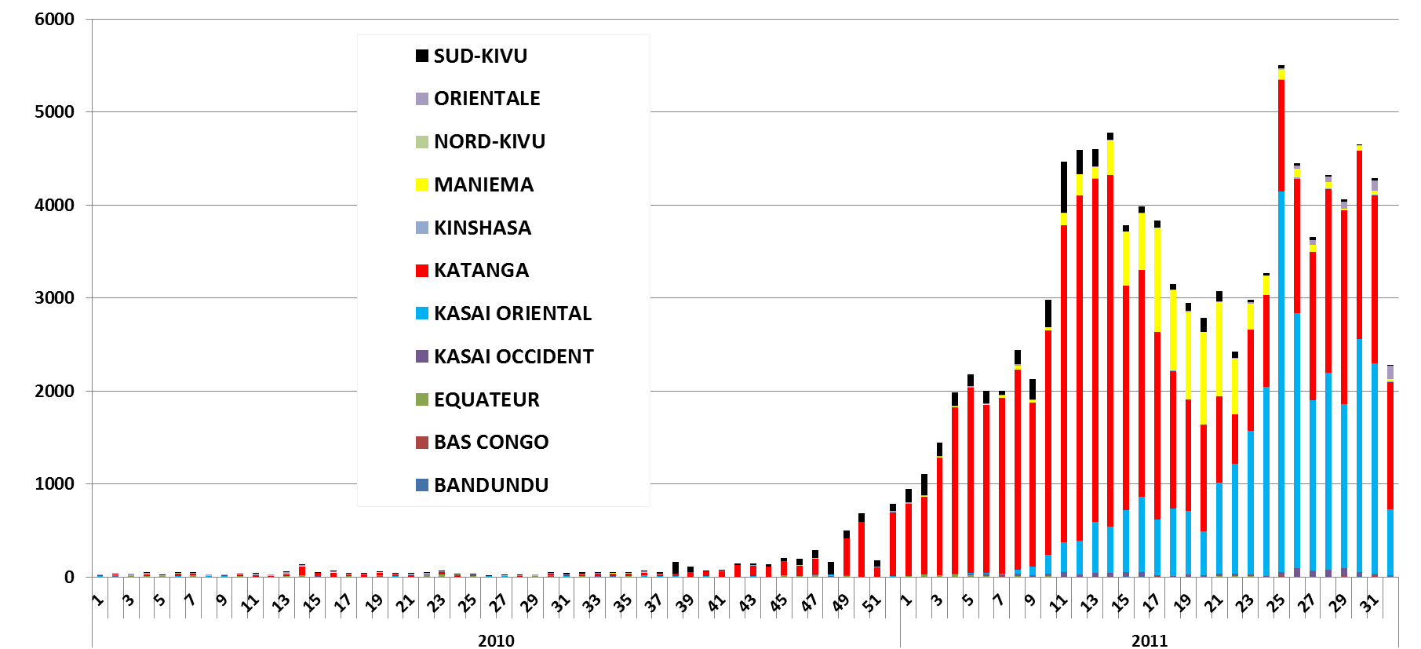
Suspected measles case reports by epi week by province. 2010 – epi week 32, 2011. DR Congo.
Missed SIAs schedule
A total of 106,433 cases reported in 2011, with an attack rate of 499/100,000 in children under 5, and 35/100,000 in persons above 5 years of age.

Slide 21
Age proportion of measles cases as of epi week 19. 2011. DR Congo.
Notes:
21

Slide 22
Reasons for measles outbreaks in AFR.
gaps in routine immunization coverage (all countries)
suboptimal coverage during recent SIAs (ZIM, NAM, ANG, BOT)
Pockets of unvaccinated & resistant populations (ZIM, MAL)
Critical accumulation of susceptibles in older age groups
too long (> 3 yrs) interval between follow-up SIAs (DRC, ZAM, LES, SEN)
Failure to vaccinate in all instances!!!!

Slide 23
Regional measles pre-elimination goal; targets to be met by end 2012.
98% mortality reduction by 2012 compared to estimates for 2000
Measles incidence <5 cases/10⁶ per year in all countries;
    Only 15 /40 countries in 2010, and 27 /42 countries in 2011
  >90% MCV1 national level coverage in all countries, and >80% in all districts;
    16/46 countries with >90% MCV1 national level in 2010
  >95% SIAs coverage in all districts
    Only 5 of 18 countries had more than 90% districts with admin. coverage of > 95%.
  All countries meeting the 2 main surveillance performance indicator targets
    only 24 /40 countries in 2010, and 15 /42 on track for 2011

Slide 24
Challenges
Limited capacity for outbreak investigation
Epidemiological shift of susceptibility to older age groups
Resistant groups not adequately addressed
Mobilizing adequate funding for SIAs / outbreak response from local sources
Drought and refugee situation requiring wide measles vaccination response in HOA

Slide 25
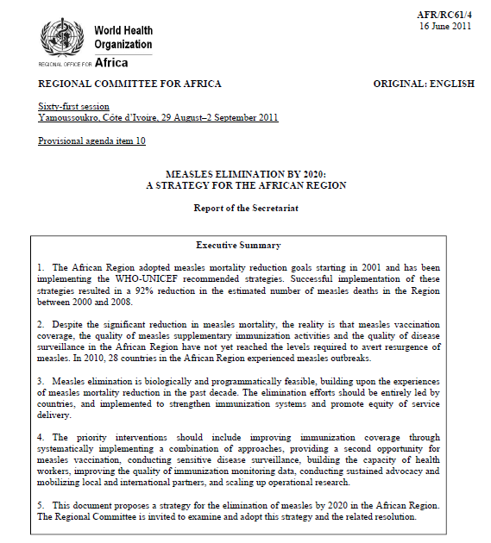
RC 61, Yamassoukouro, Cote d’ivoire
Resolution calling for measles elimination in the African Region by 2020:
  Countries to:
    develop and implement national plans for the elimination of measles by 2020
    provide adequate financial and human resources
    to mobilize national and international stakeholders and communities
  WHO and partners to
    develop a strategic plan
    provide evidence-based technical guidance
    advocate for additional resources

Slide 26






Thank you
Japanese
Government

