Slide 1
Lions Measles Pilot Project Review and Next Steps
LIONS CLUBS INTERNATIONAL FOUNDATION

Slide 2
About Lions Clubs International
Lions Clubs International is the world’s largest service organization.
1.35 million members
More than 46,000 clubs
206 countries worldwide
Lions Clubs International Foundation (LCIF) supports the efforts of Lions Clubs worldwide in serving their local community and the world community as they carry out essential humanitarian service projects.
We Care. We Serve. We Accomplish.
Notes:
Founded in 1917

Slide 3
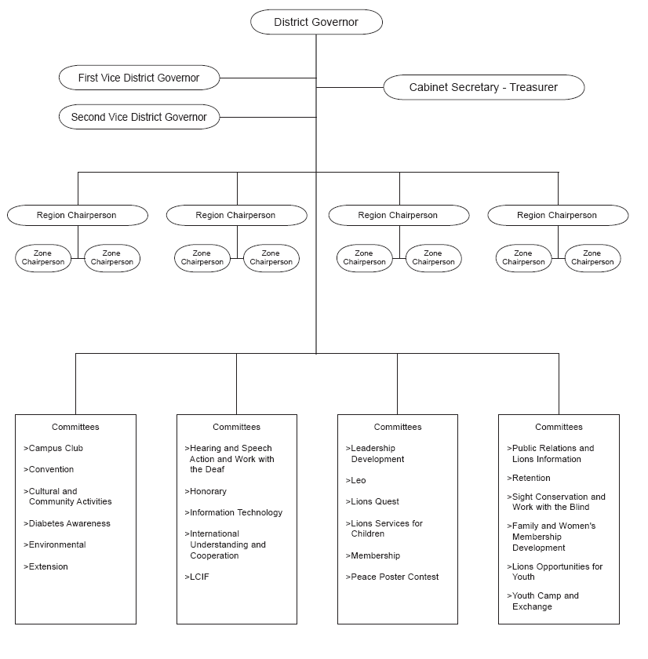
District Organizational Structure
We Care. We Serve. We Accomplish.

Slide 4
2010-2011 Pilot Project
2010-2011 Pilot Project
The BMGF grant of US$400,000 was matched with US$300,000 from LCIF to support two primary activities:
Conduct Lions’ advocacy & social mobilization in 4 countries.
Conduct a worldwide feasibility study.
Pilot countries: Nigeria, Mali, Madagascar and Ethiopia.
We Care. We Serve. We Accomplish.
Notes:
Lions supported measles immunization campaigns ( also known as SIA’s – supplemental immunization activities ) with advocacy and social mobilization were Nigeria, Mali, Madagascar and Ethiopia.

Slide 5
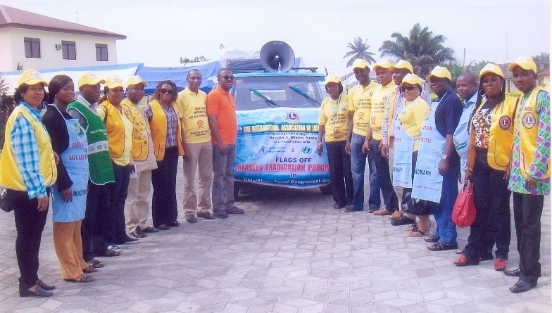
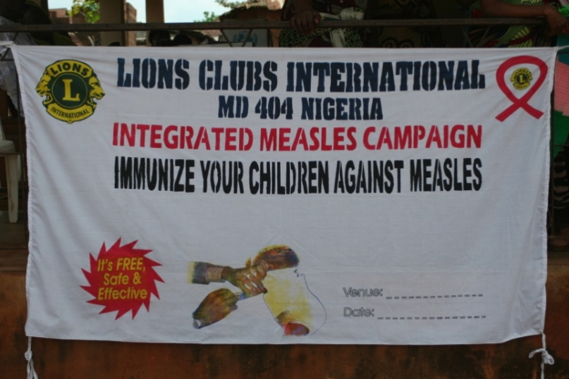
2010-2011 Pilot Project
Lions’ 2010-2011 Pilot Project Efforts:
Establish social mobilization and advocacy plans with:
National SIA Campaign Committees
Local World Health Organization offices
Local Ministries of Health
We Care. We Serve. We Accomplish.
Notes:
Local Lions developed wide-ranging, country-specific strategies to support the SIA vaccination campaign with advocacy and social mobilization.
Each of the four Lions’ measles pilot programs included the following components:

Slide 6
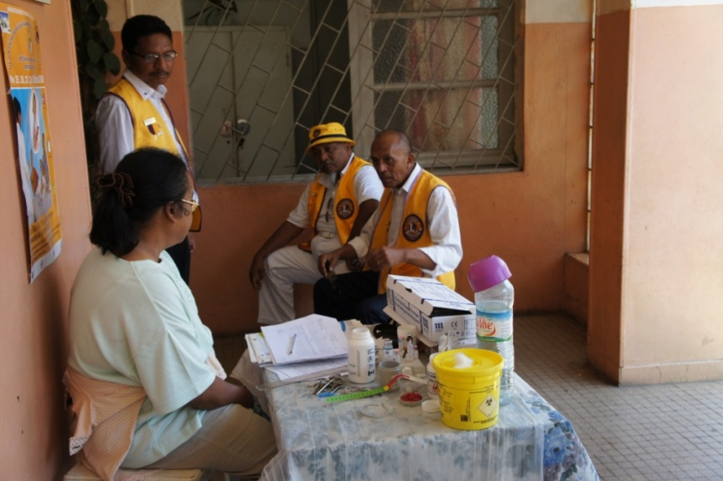
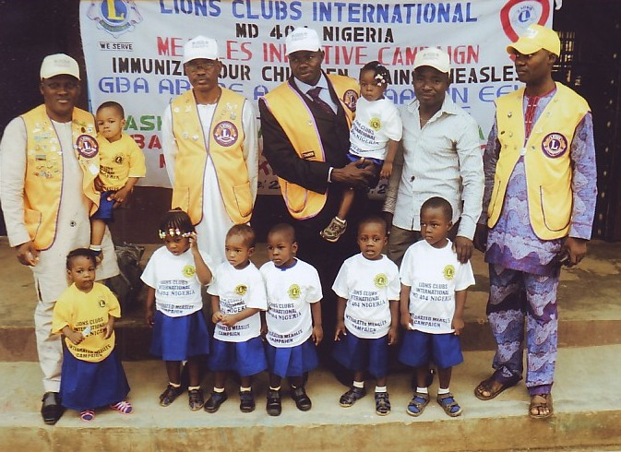
2010-2011 Pilot Project
Lions’ 2010-2011 Pilot Project Efforts:
Enlisted the support of local, regional and national leaders in support of a measles control agenda.
Worked to secure in-country funding of SIAs.
We Care. We Serve. We Accomplish.
Notes:
Countries should demonstrate ownership of the program with a commitment of 50% of funding for campaign.

Slide 7
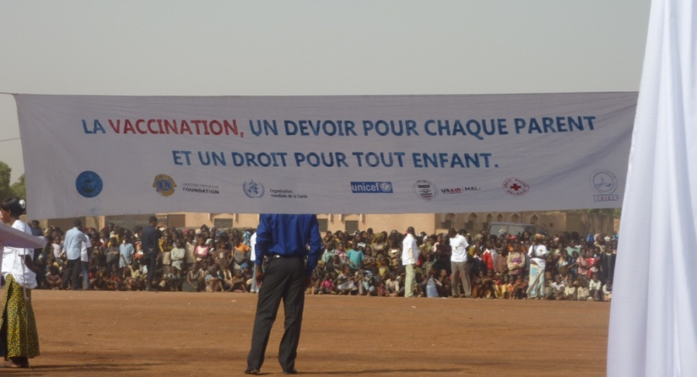
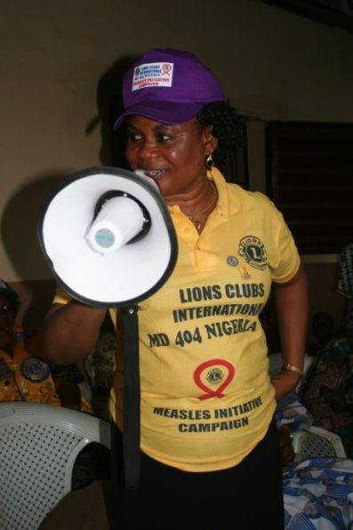
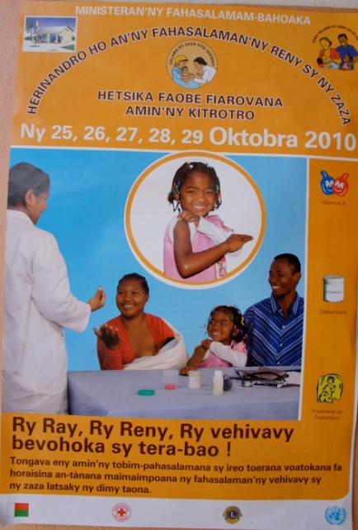
2010-2011 Pilot Project
Lions’ 2010-2011 Pilot Project Efforts:
Facilitated production and dissemination of locally appropriate educational and publicity materials.
Funded and produced public service announcements.
Active in hands-on, grass-roots social mobilization.
We Care. We Serve. We Accomplish.

Slide 8
2010-2011 Pilot Project
Feasibility Study
125 Personal Interviews with Lions Leaders, as well as 1,500 survey respondents
88% approved of expanding Lions’ involvement with the Measles Initiative
82% were confident that Lions could mobilize $10 - $15 million in support of measles control

Slide 9
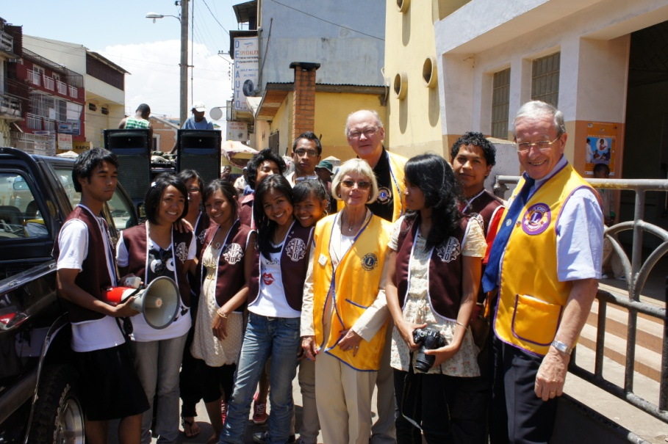
2011-2012 and beyond
Building on current LCIF – BMGF partnership.
$5 million challenge grant proposal to BMGF.
If approved, LCIF will work to mobilize an additional $10 million in support of the Measles Initiative’s 2012 campaigns.
We Care. We Serve. We Accomplish.

Slide 10
2011-2012 and beyond
Continued Lions advocacy & social mobilization
Continued Lions support for measles advocacy & social mobilization in Africa and Asia.
Indian Lions invited to participate in their country’s SIA’s.
Lions in the four pilot countries to advocate for and promote routine immunization.
Lions to become more active in MI and similar organizations.
Notes:
5,000 clubs in India.
More than 175,000 members

