Slide 1
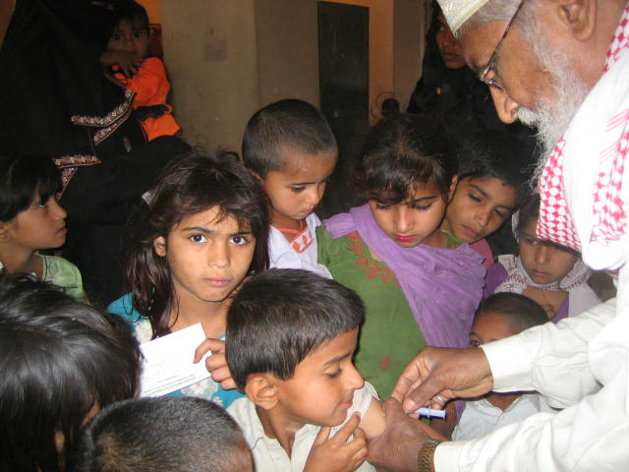
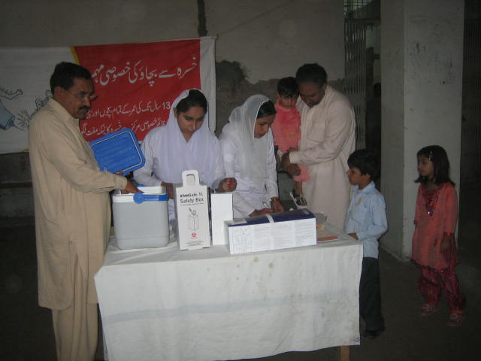
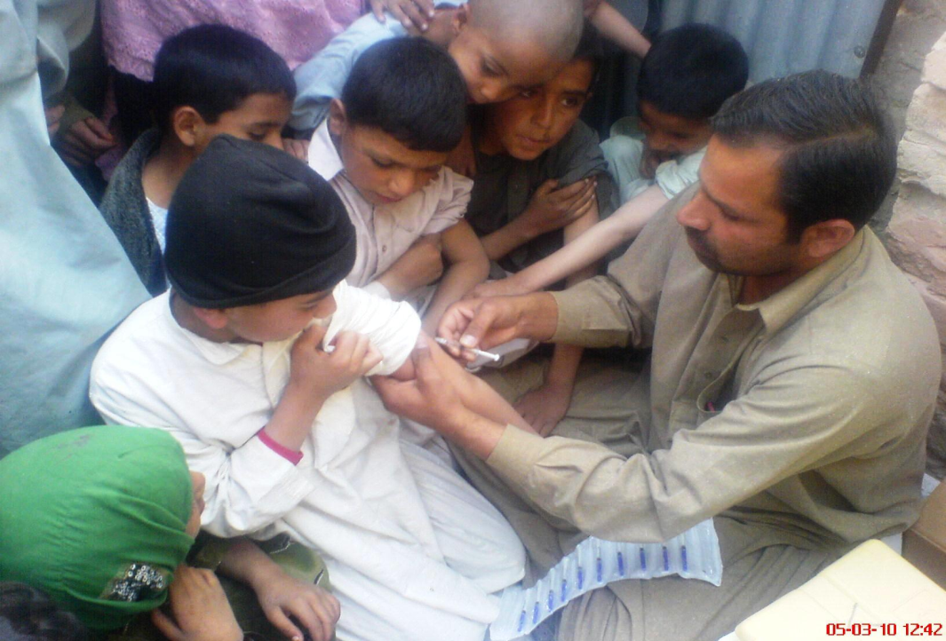
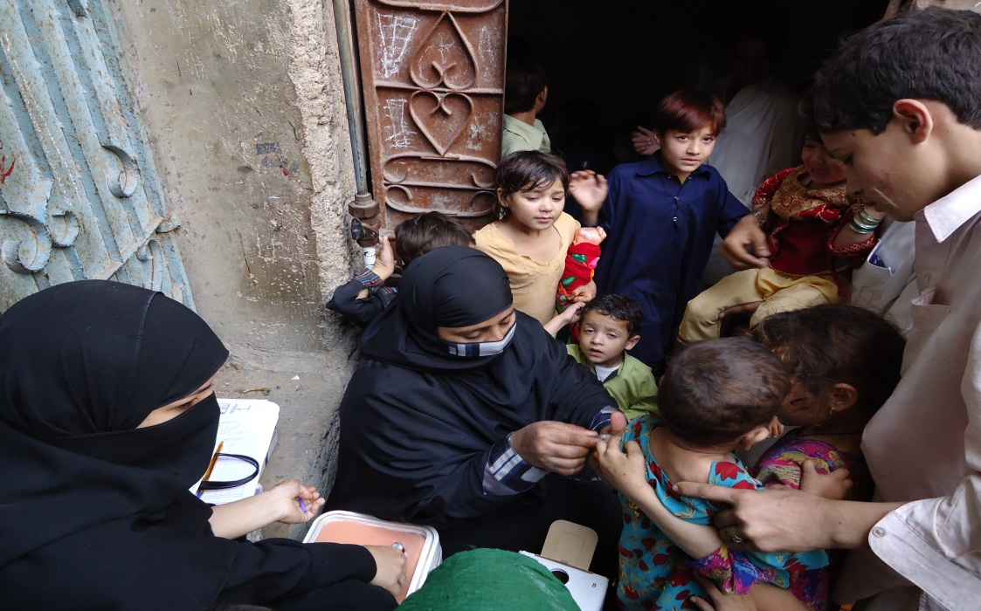
Measles elimination in Pakistan
Dr. Azhar Abid Raza
Washington 13-14 Sept 2011

Slide 2
Presentation Outline
Background & situation analysis
Commitment from the Government of Pakistan
Pakistan Progress
Routine Immunization
Surveillance
Second Opportunities
Plans for 2011-12
Key Challenges
Way Forward

Slide 3
Background & Situation Analysis
2.1 million measles cases occur annually in Pakistan and approximately 21,000 children die from measles and its complications annually
National Measles coverage is 62.6%
Measles catch-up campaign (2007-08) vaccinated 64 million children
2010 flash floods impelled follow-up campaign in all flood affected districts (Phase 1 & 2) and subsequently in non-flood affected districts (Phase 3)

Slide 4
Commitment from the Government of Pakistan
Endorsed the measles mortality reduction goal set at the UN special session on Children in May 2002 and World Health Assembly in 2003
Adopted a National Plan of Action for Measles control based on WHO regional plan that includes:
Continue efforts to Strengthen Routine EPI
Second dose of Measles at the age of 15 Months (Mid-2007)
Measles Catch-up Campaign (2007-08)
Measles Follow-up campaign (2010-11)

Slide 5
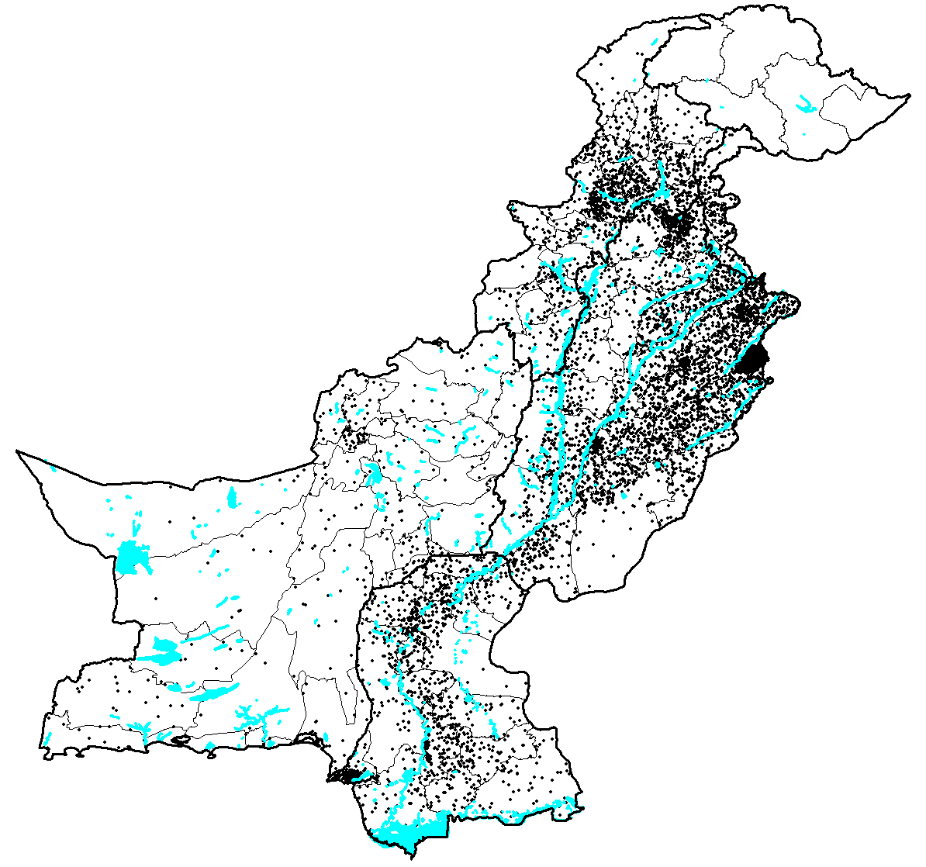
Map of Pakistan & Population Density
CHINA
180 million people in 796,095 Sq. Km.
FANA
Peshawar
AJK
KPK
FATA
Islamabad
AFGHANISTAN
Gujranwala
Lahore
Quetta
PUNJAB
Faisalabad
Multan
BALOCHISTAN
INDIA
Major populations
IRAN
Larkana
SINDH
Hyderabad
1 Dot = 20,000 people
Rivers/Lakes
Karachi
District’s Boundary
Provincial Boundary
ARABIAN SEA
*Projected population from 1998 census of Pakistan. Source: Pakistan Statistical Year Book. Federal Bureau of Statistics, Statistics Division of Pakistan, April 2001.
Notes:
5

Slide 6
Pakistan Progress a. Routine Immunization

Slide 7
% Coverage
*Data Source = Federal EPI , 2011 data is till April

Slide 8
Pakistan Progress b. Surveillance

Slide 9
Suspected Measles Cases Pakistan 2003-10
No. of Reported Cases
Notes:
PUNJAB 480 SINDH 1650 NWFP 1919 FATA 109 BALOCHISTAN 52 AJK 4 GB 17 ICT 0 PAKISTAN 4231

Slide 10
Improving Measles Case Based Surveillance Pakistan 2008-10

Slide 11
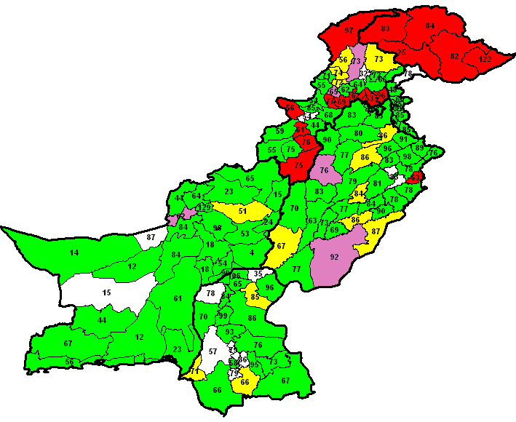
Measles Incidence Rate 2006.
The Map shows different districts in Pakistan showing a range of measles incidence/100000 population. Each range is color coded. Numbers in each district indicate the % coverage of measles vaccine in that district.
No Data
< 2
3-5
6-10
≥ 11

Slide 12
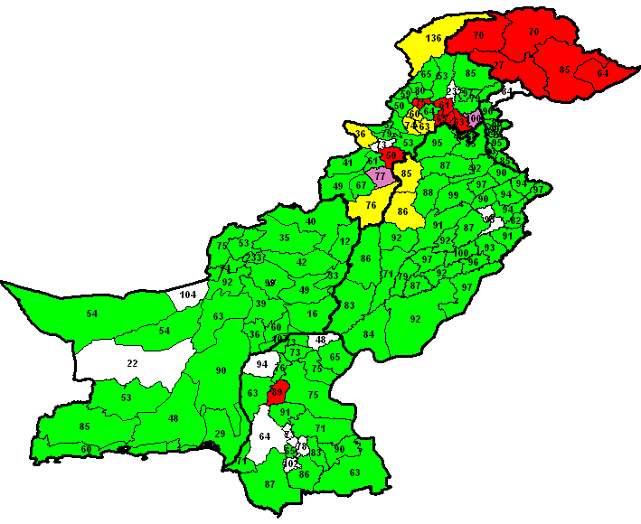
Measles Incidence Rate 2007.
The Map shows different districts in Pakistan showing a range of measles incidence/100000 population. Each range is colour coded. Numbers in each district indicate the % coverage of measles vaccine in that district.
No Data
< 2
3-5
6-10
≥ 11

Slide 13
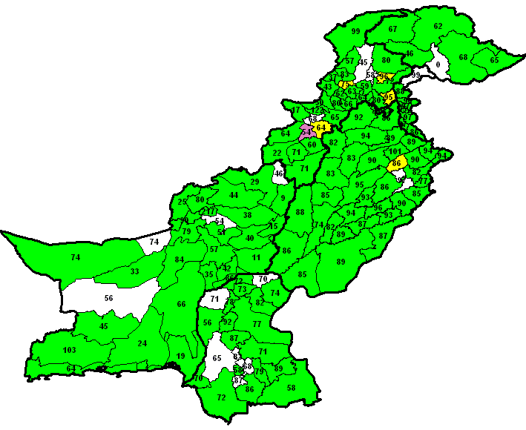
Measles Incidence Rate 2008.
The Map shows different districts in Pakistan showing a range of measles incidence/100000 population. Each range is color coded. Numbers in each district indicate the % coverage of measles vaccine in that district.
No Data
< 2
3-5
6-10
≥ 11

Slide 14
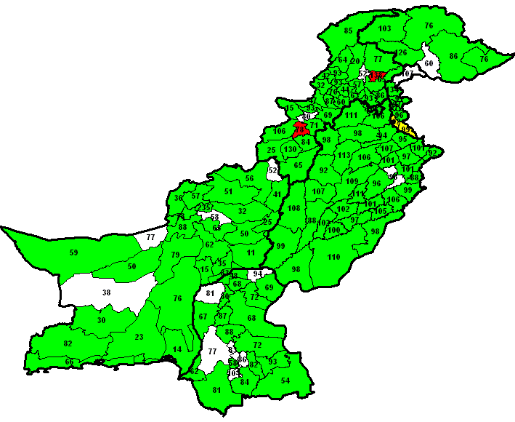
Measles Incidence Rate 2009.
The Map shows different districts in Pakistan showing a range of measles incidence/100000 population. Each range is color coded. Numbers in each district indicate the % coverage of measles vaccine in that district.
No Data
< 2
3-5
6-10
≥ 11

Slide 15
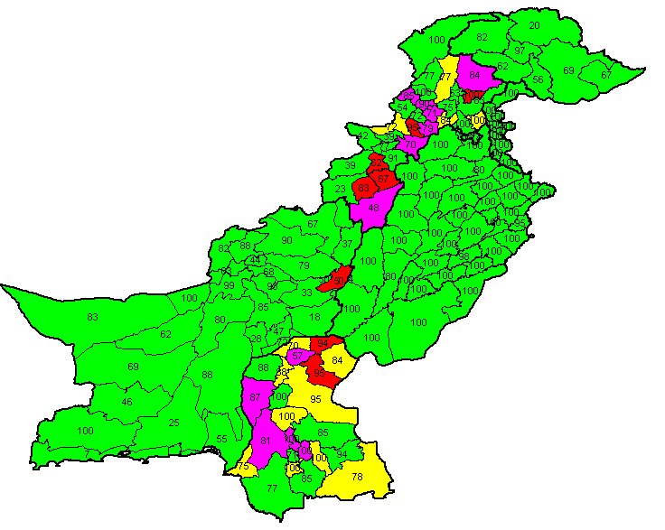
Measles Incidence Rate 2010.
The Map shows different districts in Pakistan showing a range of measles incidence/100000 population. Each range is color coded. Numbers in each district indicate the % coverage of measles vaccine in that district.
No Data
< 2
3-5
6-10
≥ 11

Slide 16
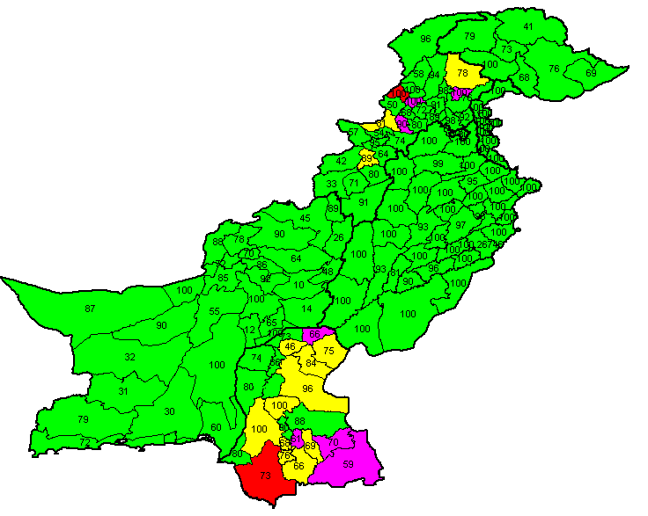
Measles Incidence Rate 2011*
The Map shows different districts in Pakistan showing a range of measles incidence/100000 population. Each range is color coded. Numbers in each district indicate the % coverage of measles vaccine in that district.
No Data
< 2
3-5
6-10
≥ 11
* Data till June 2011

Slide 17
Pakistan Progress c. Second Opportunities / SIAs

Slide 18
2nd dose through routine EPI - MCV 2
Added to routine in 2007
At the age of 15 months
National Coverage 52%

Slide 19
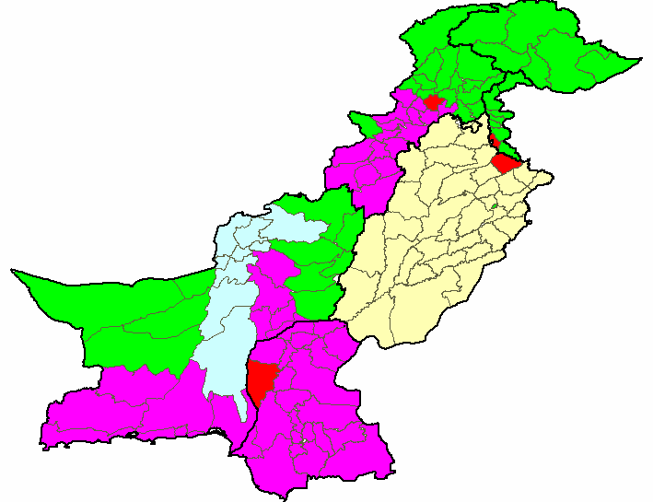
Measles Catch-up Campaign 2007-08
64 million children vaccinated
Phase 1 (01-18 March) 4 districts
Phase 2 (02-18 July) 8 districts
Phase 3 (20 Aug to 5 Sep) 37 districts
Phase 4 (05-21 Nov) 48 districts
Phase 5 (Feb to March 2008) 35 districts

Slide 20
Pakistan - Rationale for Measles Follow-up Campaign
5,500,000 newborns annually
Measles vaccine coverage = 63%
3,465,000 vaccinated
2,035,000 unvaccinated
vaccine efficacy = 85%
+
519,750 vaccinated
but not protected
2,945,250 protected
2,409,750 protected
2,554,750 susceptible
Population Immunity = 53.55%
Susceptible accumulates in less than 2 years equal to a birth cohort

Slide 21
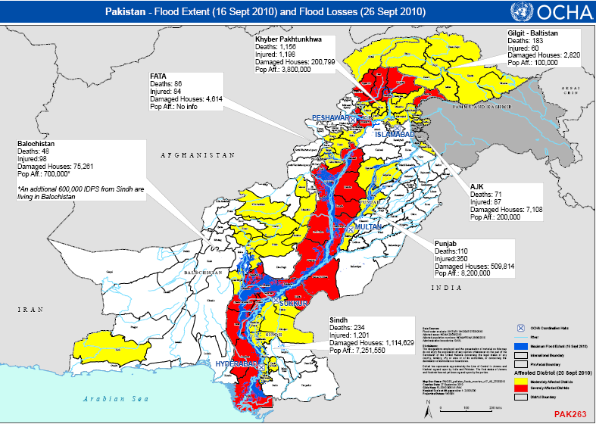

Slide 22
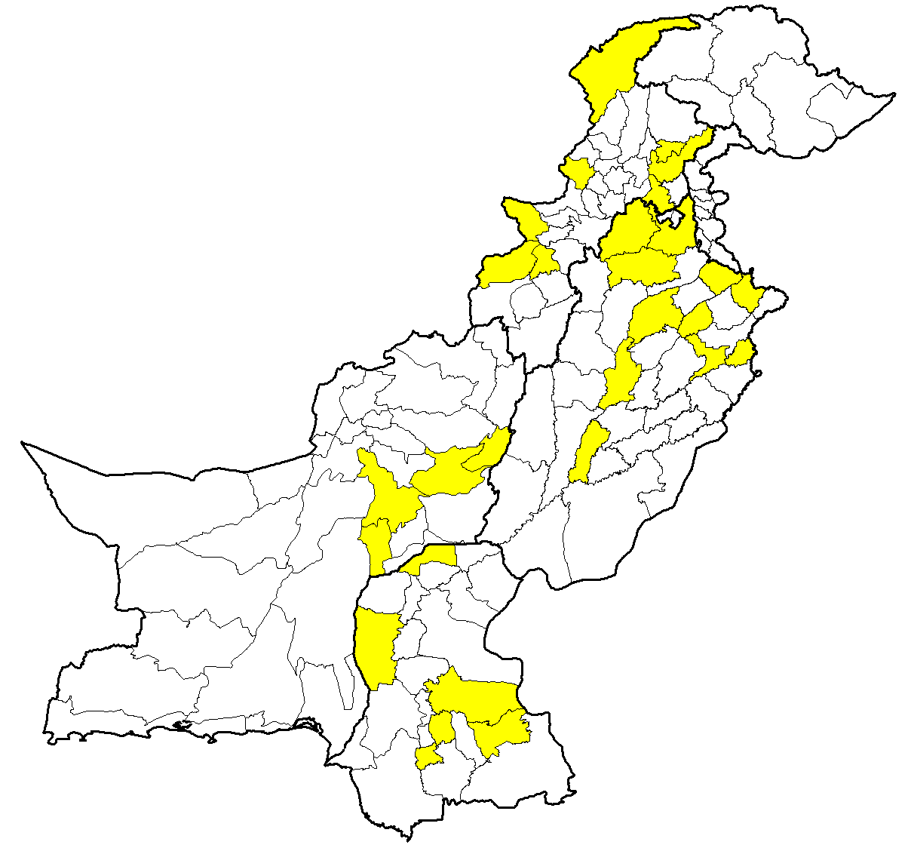
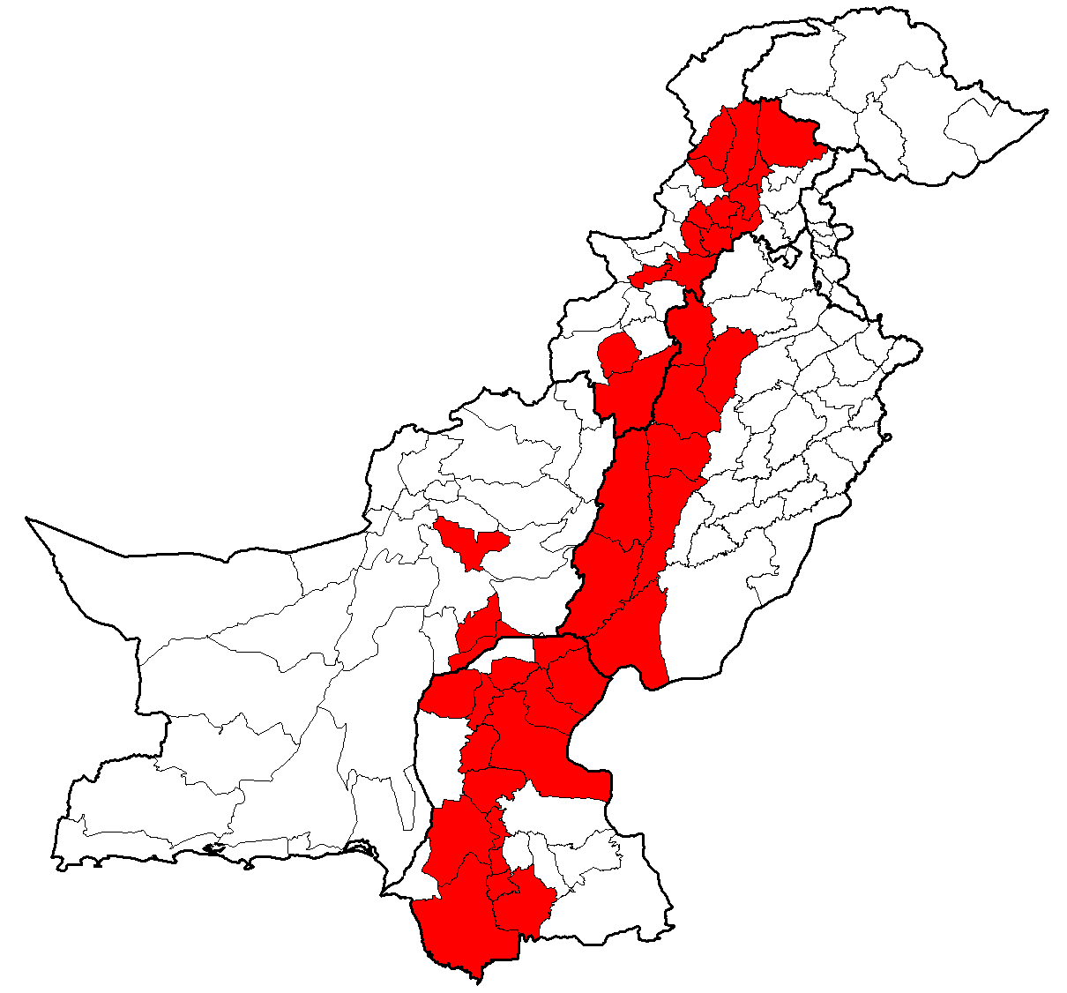
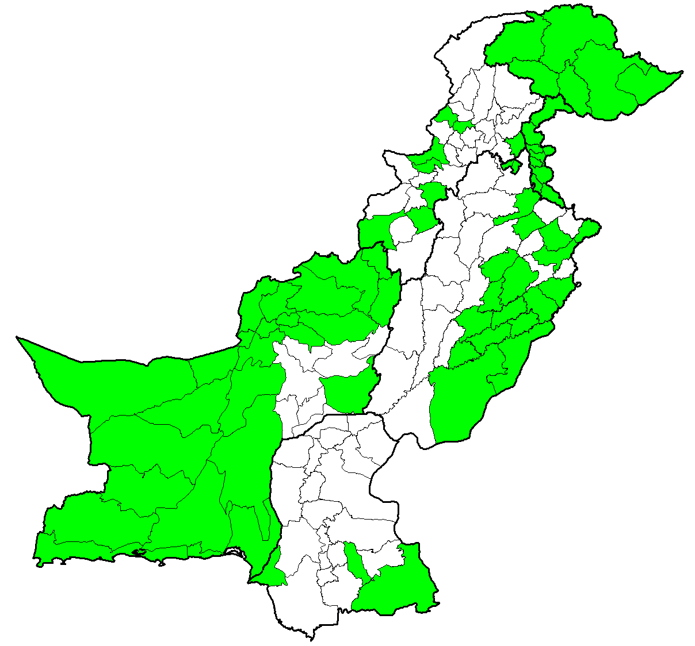
Vaccination during Measles Follow-up Campaign / Flood Emergency Response 2010
15 million children vaccinated in 70 flood affected districts
Estimated target: 30 million
Phase 1 = 40 Districts
Phase 2 = 26 Districts
Phase 3 = 73 Districts

Slide 23
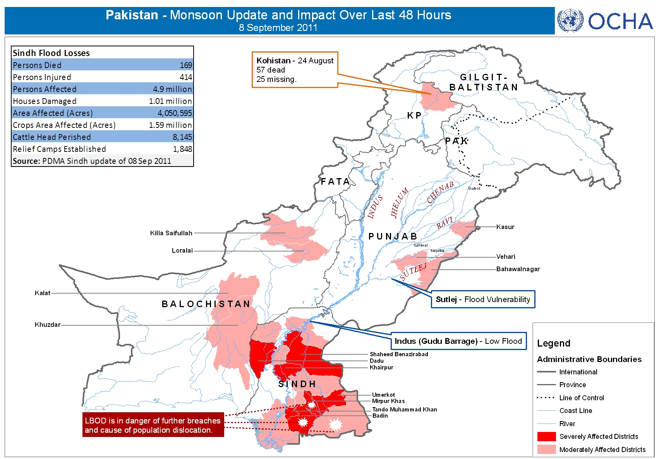

Slide 24
Plans for 2011 - 12

Slide 25
Measles Follow - up Campaign Phase - 3
2.5 million children vaccinated in 8 districts - 2011
Remaining 8.5 million children in 67 districts still unreached
Target age; 9 months up to 5 years; irrespective of their vaccination status and the disease i.e. the children:
who previously received measles vaccine
already suffered measles infection
Need an estimated cost of US$ 6 million

Slide 26
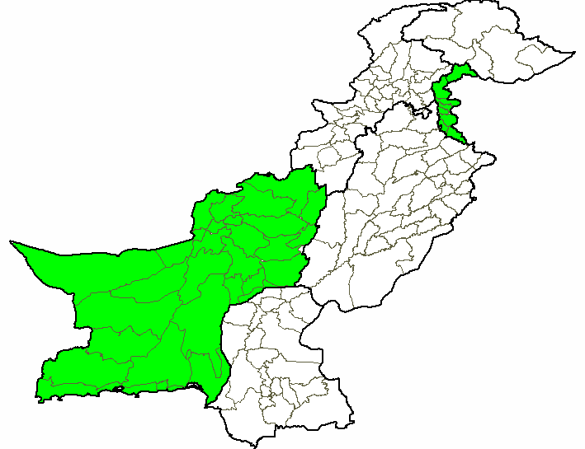
Immediate Action / Plan for rest of 2011
Flood emergency response
Sindh, Balochistan and Punjab
Nearly 2 million children up to 15 years
Multi-antigen campaign with Vitamin ‘A’ Supplementation
Complete Follow-up Campaign in PAK (AJ&K) and Balochistan
Half a million children in 10 districts of AJK
One million children in 23 districts of Balochistan
Measles Follow-up Sept-Dec 2011

Slide 27
Campaign Strategy
Timeline:
Find gap/opportunity between polio SIAs
Campaign implemented in a phased manner.
Each phase will continue for six consecutive days.
Multi-antigen Campaign
To reach all due & defaulters of routine EPI
Vaccination Sites:
Educational Institution - School/madrassa
Community outreach vaccination stations
Fixed vaccination center - all government health facilities
Notes:
Timeline:
Find gap/opportunity between polio SIAs
Campaign implemented in a phased manner.
Each phase will continue for six consecutive days.
Multi-antigen Campaign
To reach all due & defaulters of routine EPI
Vaccination Sites:
school/madresa will be vaccinated in their respective school/madresa
Community outreach session will be undertaken in each locality on a specific date according to microplan
All government health facilities will serve as a fixed center and will provide measles vaccine to any target aged children daily for 6 days throughout the campaign period

Slide 28
Key Challenges
Funding gap; need nearly 6 million US$ to complete last phase of follow-up campaign.
Limited resources and capacity; to integrate VPD surveillance and institutionalize / strengthen measles case based surveillance.
Variable commitment and motivation; in achieving / maintaining >90% MCV-1 coverage.
Variable provincial capacities; to take responsibilities after 18th constitutional amendment.

Slide 29
Way Forward
Using all opportunities to reach the unreached
Multi-antigen campaign
Combining Measles and MNTe supplementary vaccination
Approaching donors to bridge funding gap
Continue advocacy & strong social mobilization
To maintain federal commitment and enhance district motivation.
To ensure community participation and support from line departments and ministries.
Building alliance and partnership
For better case management with Vitamin A Supplementation

Slide 30
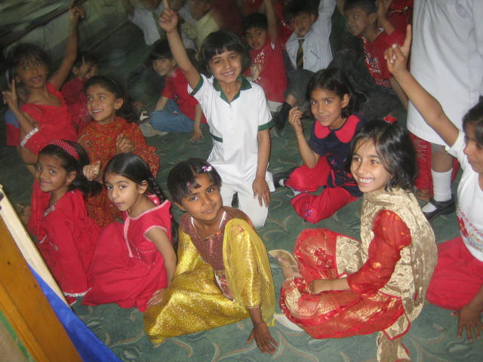
Thank you

