Slide 1

Measles and rubella investment cases: Stakeholder analysis and update
Dr. Kimberly M. Thompson
11th Annual Measles and Rubella Partners Meeting
September 19, 2012

Slide 2
Acknowledgments
World Health Organization (WHO) Contract PO 200470477 APW
Radboud Duintjer Tebbens, Emily Simons, Cassie Lewis Odahowski
Ann Levin, Colleen Burgess, David Bishai
Anindya Sekhar Bose, Casey Boudreau, Lisa Cairns, Daniel Carter, Lou Cooper, Katie Cuming, Thomas Cherian, Susan Chu, Stephen Cochi, Alya Dabbagh, Messeret Eshetu, David Featherstone, Marta Gacic-Dobo, Andrea Gay, Tracey Goodman, Jim Goodson, Mark Grabowsky, Christopher Gregory, L. Homero Hernandez, Edward Hoekstra, Joseph Icenogle, Suresh Jadavh, Sam Katz, Apoorva Mallya, Rebecca Martin, Balcha Masresha, Chris Morry, Walt Orenstein, Mark Pallansch, Robert Perry, Tim Petersen, Susan Reef, Kuotong Nongho Rogers (Tambie), Paul Rota, Emily Simons, David Sniadack, Peter Strebel, Maya van den Ent, Maya Vijayaraghavan, Steve Wassilak, Wang Xiaojun, Laura Zimmerman, and anonymous participants in our stakeholder consultation process

Slide 3
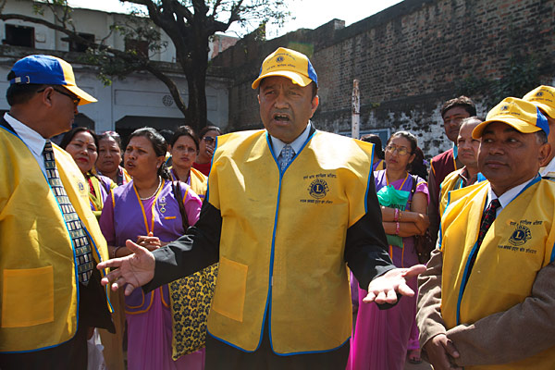
Topics
Context
Investment case development process
Input from stakeholders
Discussion of alternatives under consideration
Cost modeling
Disease modeling
Integration
Insights

Slide 4
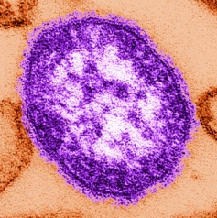

Context
Measles and Rubella Strategic Plan, 2012-2020
  “With strong partnerships, resources and political will, we can, and must work together to achieve and maintain the elimination of measles, rubella and CRS globally.”
Global Vaccine Action Plan (GVAP)
  Aspires to create a world “in which all individuals and communities enjoy lives free from vaccine-preventable diseases” by extending the full benefits of immunization to all people by 2020 and beyond
  Includes achievement of the existing disease eradication and elimination goals for polio, neonatal tetanus, measles, and rubella by 2020
  Translating the vision into reality will require significant investments, and “expenditures must be linked to outputs and impacts, showing a clear investment case for immunization”

Slide 5
Investment case development process
Systematic and comprehensive synthesis of available evidence
Quantitative estimates of impacts of investment options
Engagement of stakeholders in analytic-deliberative process
  Synthesize and characterize information
  Request input
    Presentations, survey, discussions, and interviews
    Share draft manuscripts and iterate
Progress
  Investment case contents
  Options for consideration for in investment cases
  Cost and disease modeling

Slide 6
Investment case contents
Five sections
  Context
  Current situation
  Alternatives
  Considerations
  Conclusions
Biggest challenges
  Synthesis of vast literature
  Forecasting
    Changes in baseline routine immunization, impact of GIVS/GVAP
    Sustainability of prior achievements and funding commitments
    Impact of other efforts (polio eradication)
  Characterization of options

Slide 7
National and global options
What are WHO member states doing now?
How does this aggregate to the global level?

Slide 8
National measles and rubella routine immunization choices*
None (n=51)
0.75
1 (n=4)
1.1 (n=2)
1.1-4.9
>1.1
1.1-2
1.2
1.25 (n=7)
1.25-1.9 (n=2)
1.25-2
1.3-2
1.5 (n=20)
1.5 or 4-6
1.75
2 (n=6)
2-5
3 (n=4)
3-5
3-6 (n=2)
3.25
3.75
4 (n=10)
4-5 (n=3)
4-5 or 11
4-6 (n=5)
5 (n=12)
5-6 (n=2)
5-7
5-12
5-14 or 6
Grade 1
6 (n=24)
6 or 11
6-7
6-8
6-12
7 (n=7)
9
10 (n=3)
10-13
11 (n=2)
12 (n=2)
13
>14
18
>50 risk groups
Others
Number of doses Vaccine(s) MCV1 age (months) MCV2 age (years) MCV3 age (years)
None (n=0)
M (n=47)
MR (n=2)
MMR (n=2)
Others
1
6
6-11 or 12
6-59
8
9 (n=70)
9-12
11-14
12 (n=82)
12-15 (n=7)
12-23 (n=2)
12-24 (n=2)
13 (n=3)
13-14
13-15
14 (n=2)
14-18
15 (n=14)
18 (n=3)
Others
M-M (n=16)
M-MR
M-MMR (n=3)
MR-MR (n=7)
MR-MMR
MMR-MR (n=4)
MMR-MMR (n=91)
MMRV-MMR
MMR[V]-MMR[V]**
M+R or MR-M+R or MR
M or MMR-M or MMR
MR-MR or MMR-MMR
M +M or MM or MMR- M+M or MM or MMR
Others
None (n=181)
1.5
4-5
4-6 (n=3)
>5
11-12
12 girls
13+ risk groups
13-39
15 (n=2)
>19
Adults born after 1970
WCBA***
Post pregnancy
Others
2
M-MMR-MMR (n=4)
MMR-MMR-MR (n=3)
MMR-MMR-MMR (n=5)
MMR[V]-MMR[V]-MMR
MMR[V]-MMR[V]-MMR[V]
Others
3
Others
*194 WHO member states total, n=1 unless otherwise indicated
** MMR[V] means MMR or MMRV
*** WCBA means women of child bearing age

Slide 9
National measles and rubella supplemental immunization activity (SIA) choices
Vaccine
Years between
Age
Gender
Scope
None
>4
<5 years
Both
National
M
4
< 10 years
R
3
< 15 years
Sub-national
2
MR
All ages
Females
Mixed
1
MMR
<1
Specific age (yr)
12
13-14
14
15-49
>19
Others
Specific risk group
WCBA*
Seronegative WCBA
Susceptible women
Others
MMRV
One time/ catch up
Others
Others
Others
Males
Others
* WCBA = women of child bearing age

Slide 10
National and global options
What are WHO member states doing now?
How does this aggregate to the global level?
What are the options for the “global minimum” goal?
  Global achievements constrained by the minimum – elimination depends on weakest links (big lesson from polio eradication)
  Coordination critical (regional/national governments, other stakeholders)
Insights from stakeholder comments
  General agreement that for vaccine-preventable diseases like measles and rubella, global efforts should ultimately move toward complete prevention
  Significant diversity of opinion about timing, best path, and the ability to develop, pursue, and achieve global measles and rubella eradication goals in the context of polio eradication and limited resources

Slide 11
Global measles and rubella management options

Slide 12
Key questions
Focus on characterization of risks, costs, and benefits:
What path do we expect based on the current situation, noting that we are currently not on track to meet existing goals?
What is required to get on track to meet existing goals?
What is required to meet the GVAP goals?
Is eradication better than control?
What is the impact of the speed of eradication efforts (i.e., aggressive vs. delayed eradication)?
What happens to the economics if we pursue eradication only through strengthening routine immunization (assume possible by 2040)?

Slide 13
Options under consideration
Option | Measles | Rubella
Current expected | Achieve 95% reduced mortality by 2020 and existing national and regional goals 5 years later than target date then maintain | Introduce at least one dose in 75% or more of countries yet to introduce RCV by 2020 and achieve existing national and regional goals 5 years later than target date
Achieve existing goals on time | Achieve 95% reduced mortality by 2015 and existing national and regional goals (eliminate in 4 regions by 2015, 5 regions by 2020) | Introduce at least one dose in 75% or more of countries yet to introduce RCV by 2018 and achieve existing national and regional goals (eliminate in 2 regions by 2015)
Achieve GVAP goals | Achieve 95% reduced mortality and elimination in at least four WHO regions by 2015, and eliminate measles in at least 5 WHO regions by 2020 then maintain | Eliminate rubella in at least two WHO regions by 2015 and in at least 5 WHO regions by 2020 then maintain
Accelerated eradication | Achieve 95% reduced mortality by 2015 and eradication by 2020 then maintain | Eradicate rubella by 2020 then maintain
Delayed eradication | Achieve 95% reduced mortality by 2020 and eradication by 2030 then maintain | Eradicate rubella by 2030 then maintain
Eradicate through routine immunization | Achieve 95% reduced mortality by 2030 and eradication by 2040 then maintain | Eradicate rubella by 2040 then maintain
Control | Coordinated control associated with continued use of MCVs in all countries | Uncoordinated control associated with one or more countries not choosing to use a RCV

Slide 14
Cost modeling
Insights from prior studies
  Measles and rubella immunization highly cost-effective and/or net beneficial nationally (Axnick, 1969; Albritton 1978; Wiedermann 1979; Stray-Pedersen 1982; Gudnadottir 1985, Schoenbaum 1985, White 1985; Shepard 1994; Hinman 2002; Takahashi 2011), including as implemented in EPI (Shepard 1986)
  Combined MR or MMR vaccine more cost-effective than giving M and R vaccines separately (Schoenbaum 1976)
  Second dose of measles cost-effective (Ginsberg, 1990; Pelletier 1998; Zhou 2004)
  Revaccination for measles cost-effective (Mast 1990; Robertson 1992; Watson 1996)
  Measles campaigns cost-effective (Uzicanin 2004; Vijayaraghavan 2006; Bishai 2011)
  Outbreaks very expensive (Chavez 1996, Chen 2011, Dayan 2005, Parker 2006), appear to exceed costs of prevention (Andersson 1992, Filia 2007)

Slide 15
Cost modeling
Insights from prior studies (continued)
  Measles elimination cost-effective nationally (Ekblom 1978; Miller 1998; Carabin 2003, Babigumira 2011) and regionally (PAHO: Acharya 2002, EURO: Beutels 2003)
  Measles eradication cost-effective globally (Levin 2011; Bishai 2012)
  “High control” not optimal economically if eradication is feasible (Geoffard 1997, Barrett 2004, Thompson 2007)
  Timing important in the context of managing portfolio of eradicable diseases (Thompson 2007; Duintjer Tebbens 2009; Fitzpatrick 2011)
Key gaps
  Economic evaluation of GVAP goals for measles and rubella
  Rubella DALY
  CRS treatment costs as function of income level
  Economics of rubella eradication

Slide 16
Benefits of preventing rubella/CRS – DALY and treatment cost savings
Characterize distribution of pregnancy and birth outcomes associated with rubella infection in pregnancy as f(time of infection, income level)
Approximately 4,000 articles on CRS identified, 500 reviewed, extracted data from 35 studies with pregnancy outcomes and 84 studies with birth outcomes
Grading evidence, applying criteria to characterize limitations of studies that meet inclusion criteria and coding all data in standardized template
Lack of consistency in study design/definitions/methods
Life trajectory for individuals with CRS complicated, children in developed countries get treatments that may not exist in developing countries (i.e., different trajectories and utility weights)

Slide 17
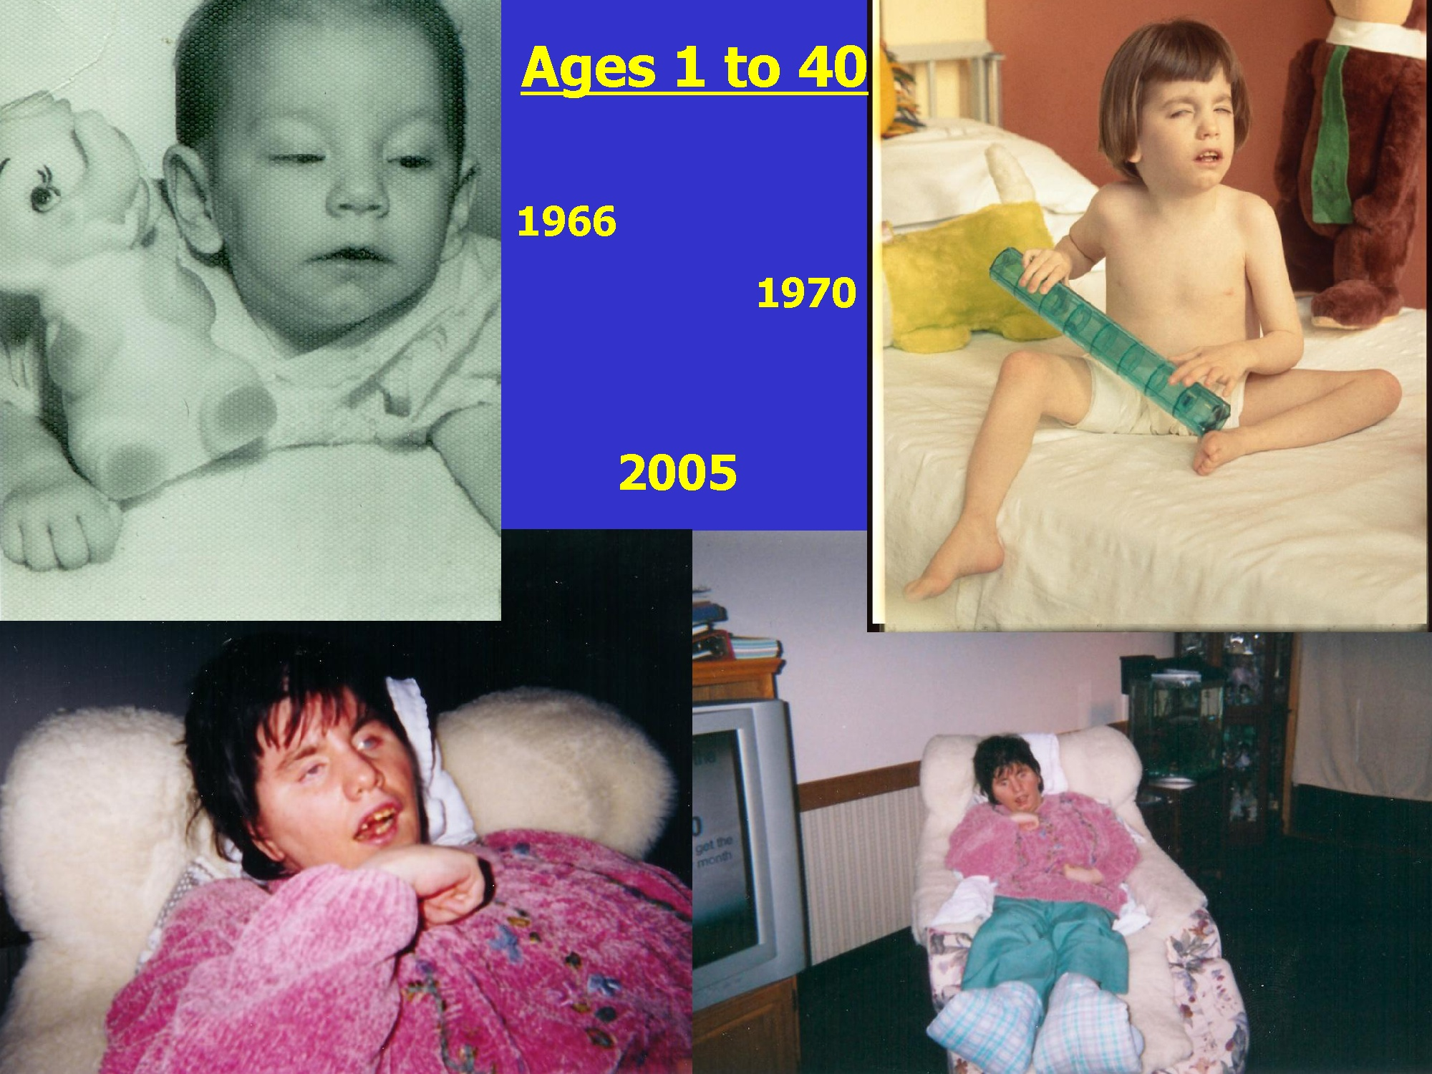

Slide 18
Disease modeling
Recent studies suggest missed global measles goal measles of 90% reduced mortality compared to 2000 by 2010 (estimate achieved 74%) (Simons 2012) and high burden of rubella in areas yet to introduce vaccine (Vynnycky 2012)
Regional assessments related to vaccine coverage suggest not currently on track for achieving all 2015 measles and rubella goals
Lesson learning from polio eradication
    slowly approaching the unknown threshold required to stop transmission is not ideal (Thompson 2007, 2012)
    use models with coverage and serological studies to manage population immunity such that we expect no cases (Thompson 2012)
Existing models for global analyses focus on measles, need dynamic model that helps countries model their population immunity for both measles and rubella at the same time
Developing model that builds on prior work (Bishai 2012) and tracks population immunity for both measles and rubella

Slide 19
Preliminary dynamic insights
Routine immunization not sufficient to stop and prevent transmission in many countries (i.e., achieve and maintain)
  Outbreaks reveal problems with population immunity AFTER it is too late to prevent them
  Places with lowest quality routine need greater coordination to manage population immunity, but poor routine immunization partly consequence/reflection of poor coordination
Prevention
  Requires ongoing management of population immunity, which we cannot easily observe
  Often undervalued, no credit for avoiding bad outcomes
Perceptions matter

Slide 20
Preliminary dynamic insights
Faster is better
  Elimination goals
    Easier to achieve epidemiologically if immunization starts big and fast (better to go way over the threshold required to stop viral transmission quickly and maintain than to slowly creep up to threshold) (Thompson 2007; Thompson 2012)
    But… implementation often easier to start slow with phase in and pursue gradual creep toward threshold and better to make slow progress (save as many lives as you can) than no progress
    Will save more lives and more money with bigger up front investment if possible, but management ongoing and need commitment to sustain and maintain progress
  Outbreak response - same old tune (Thompson 2006; Grais 2008)

Slide 21
Preliminary dynamic insights
Outbreaks expensive
  Once countries shift from net exporting to importing, perspective about “acceptability” of infections may change (“could and should have been prevented”)
  Perceptions about MR vaccines matter A LOT – decrease in burden of measles allows concerns about vaccines to dominate in some places, rubella largely invisible unless/until outbreaks occur, but consequences of failing to prevent transmission very real and very costly (human and financial costs)
Elimination of rubella good option given measles goals
  Could potentially occur simultaneously with measles elimination, if countries seize the opportunity to introduce MR vaccine
  Sharing delivery costs implies big savings (rubella as incremental to measles relatively low cost, including rubella reduces costs for measles)

Slide 22
Integration and insights
Accounting tricky
  How should we attribute costs (assumptions about routine immunization baseline, impact of MR and GPEI activities on each other and on routine immunization)?
  Need to provide clear statements about the benefits of past, current, and future investments in measles and rubella prevention
  Valuation difficult, but necessary (implicit or explicit or both)
All about timing, availability of resources, and priorities
  Current GAVI opportunities providing significant opportunities for many of the countries most in need
  Will need to ensure sustainability and change expectations of “normal” (i.e., expecting health instead of living with disease)

Slide 23
Full circle
We really are all in this together
  MR viruses spread rapidly and create outbreaks, weak links matter
  Stakeholder commitments and expectations very important
    Aspire vs. realistic expectations
    Coordination and incentives
  Ultimately achieving the vision of the MR Initiative Strategic Plan and GVAP will require all countries to shift into prevention mode
  Legacy of GPEI and MR Initiative – can we move the world to one that sufficiently values prevention of horrible diseases enough to get rid of them and keep them out?
  Do we need to wait to finish polio first, or can we find ways to help the countries with the biggest challenges to go farther much faster?

Slide 24
Road ahead
We invite your input on this presentation
We will soon request your input on
  Cost model
  Dynamic disease model
  Initial integration results
Please stay tuned and engaged
Thank you!

