Slide 1
Molecular EQA for GMRLN: Year Two
Measles and Rubella Teams, CDC
ACCELERATING PROGRESS TOWARDS MEASLES AND RUBELLA CONTROL AND ELIMINATION MEETING, 20-24 JUNE 2016, GENEVA, SWITZERLAND
National Center for Immunization & Respiratory Diseases
Division of Viral Diseases

Slide 2
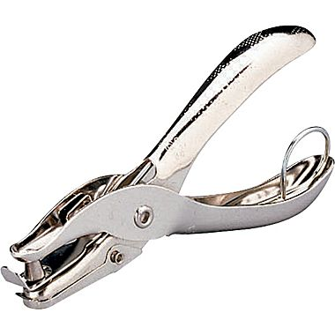
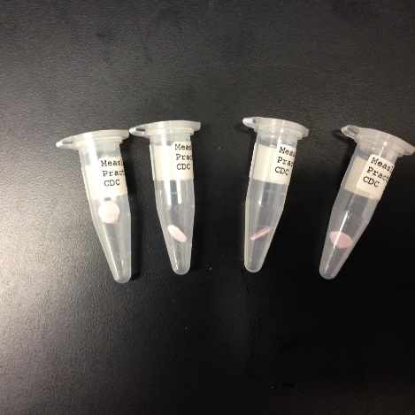
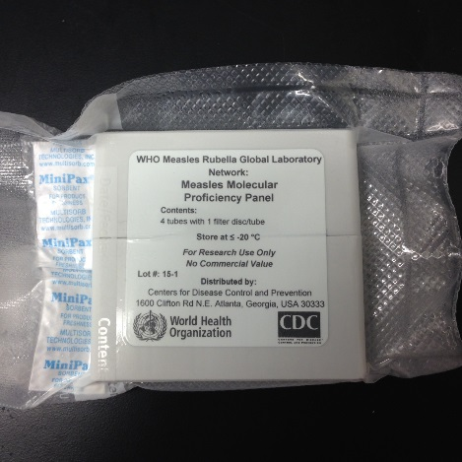
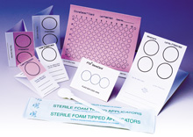
FTA cards, Practice Panels and Proficiency Panels
FTA cards inactivate virus. Virus isolates are loaded on the card and dried. Can be shipped as non-infectious material.
FTA cards stabilize RNA. Can be stored at room temperature with desiccant. We recommend -20 ◦C when possible.
Practice panels are distributed after molecular workshops (homework!).
Years of experience with practice panels.
First molecular external quality assurance (mEQA) testing was done in 2014.
National Center for Immunization & Respiratory Diseases
Division of Viral Diseases

Slide 3
Measles and Rubella Molecular Proficiency Testing Program: 2014
Each panel included FTA disks that contained lysates of cells infected with wild-type measles or rubella viruses or blank (negative) discs.
The panels contained 4 disks in duplicate samples. One set of four disks was tested; the second set served as a backup.
All discs are non-infectious and have been tested by three passages in cell culture.
The extracted RNA was tested in molecular assays that were routinely used in the laboratory. These included detection by RT-qPCR or RT-PCR as well as genotyping RT-PCR and sequencing.
Results were reported using the Proficiency Panel Report form via e-mail to the Regional Coordinator, the Global Coordinator and CDC.
22 panels were shipped from CDC in March 2014, 21 countries sent reports. 20 passed immediately, one country passed after re-test. Feedback reports were sent from CDC in June 2014.
National Center for Immunization & Respiratory Diseases
Division of Viral Diseases

Slide 4
Changes for 2015
For 2015, only one set of samples (4 tubes) were distributed. Retesting required shipping an additional panel.
For 2015, included all RRL and selected national and sub-national laboratories.
Number of participating laboratories expanded to 49
Panels were shipped to Regional Laboratory Coordinators, who organized further distribution. Panels were distributed at MR training courses and during conferences.
Distribution and reporting expected to be concluded by end of 2015.
Results should have been reported within 6 weeks.
National Center for Immunization & Respiratory Diseases
Division of Viral Diseases

Slide 5
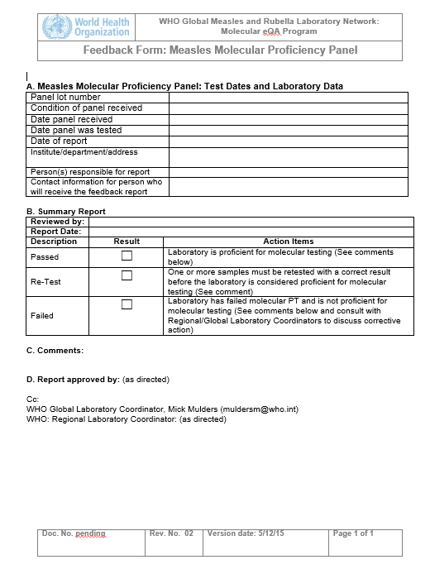
2015 Proficiency Panel Feedback Form
Measles panel: Pass/Retest/Fail
Rubella panel: Pass/Retest/Fail
Conditions for pass (all must apply):
Correct detection measles or rubella RNA (or negative reaction) in all of the samples
No false positive results
Positive and negative controls on PCR reactions are adequate
Correct identification of the measles or rubella genotypes in each positive sample
Ability to amplify and sequence the entire sequencing windows for measles (N-450) and rubella (739nt).
No more than 1-2 nt errors.
National Center for Immunization & Respiratory Diseases
Division of Viral Diseases

Slide 6
2015 results: AFR
Laboratory | Turnaround (days) | Real-time | Real-time Machine | RNAseP | Endpoint RT-PCR | Sequencing | Methods | CDC result | Date result sent | Comments
Country 1 | 42 | yes | 7500 | yes | yes | yes | WHO* | R/P | 3/29/2016 | *no details for real-time
Country 2 | 81 | yes | 7500 | yes | yes | yes | WHO | P/P | 2/25/2016
Country 3 | 37 | yes | abi2720 | yes | yes | yes | WHO | P/P | 2/2/2016
Results:
P=Pass
R=Retest
F=Fail
P/P: passed for measles/rubella
Panels received 11/16/15 -11/21/15
Reports received 12/28/15-2/5/16
Turnaround time 37-81 days
One retest
National Center for Immunization & Respiratory Diseases
Division of Viral Diseases

Slide 7
2015 results: EMR
Laboratory | Turnaround (days) | Real-time | Real-time Machine | RNAseP | Endpoint RT-PCR | Sequencing | Methods | CDC result | Date result sent | Comments
Country 1 | 40 | yes | 7500f | yes | yes | yes | WHO | R/P | 5/5/16
Country 2 | 32 | yes | 7500 | ? | yes | yes | WHO* | P/R | 2/2/16 | *No details for endpoint RT-PCR
Country 3 | 31 | yes | ABIStepOne | ? | yes | yes | ? | P/P | 2/2/16
Country 4
Country 5 | 126 | yes | 7500f | No | yes | yes* | WHO* | P/P | 5/5/16 | *Sequencing by RRL
Country 6 | 18 | yes | 7500 | ? | yes | yes | WHO | P/P | 2/2/16
Country 7 | 66 | yes | 7500 | Yes | yes | yes | WHO | P/P | 2/25/16
Country 8 | 13 | Yes | 7500 | No | nd | nd | ? | F/F | 2/25/16
Country 9 | 42 | yes | 7500 | yes | yes | yes | WHO | R/R | 2/25/16
Country 10
Panels received 12/04/15-12/07/15
Reports received 12/17/15-04/09/16 (very last)
Turnaround time 13 to 126 days (longest)
Two countries dropped out
One country failed for both measles and rubella due to problems with real-time RT-PCR.
Two retests for measles and two for rubella
National Center for Immunization & Respiratory Diseases
Division of Viral Diseases

Slide 8
2015 results: PAHO
Laboratory | Turnaround (days) | Real-time | Real-time Machine | RNAseP | Endpoint RT-PCR | Sequencing | Methods | CDC result | Date result sent | Comments
Country 1 | 48 | yes | Lightcycler | no* | yes | yes | WHO* | P/P | 12/22/2015 | *additional real-time for H, beta-actin
Country 2 | 97 | yes | 7500 | no | yes | yes | WHO | P/R | 2/25/2016
Country 3 | 42 | yes | 7500 | ? | yes | yes | WHO | P/P | 2/25/2016
Country 4 | 38 | yes | 7500f | ? | yes | yes | WHO?* | P/P | 12/22/2015 | *‘similar' to CDC for genotyping, no info for real-time
Country 5 | 40 | yes | 7500 | yes | yes | yes | WHO | R/P | 12/22/2015
Country 6 | 34 | yes | 7500 | yes | yes | yes | WHO | P/R | 2/2/2016
Country 7 | 46 | yes | ? | ? | yes | nd | WHO | P*/P | 6/16/16
Country 8 | 22 | Yes | 7500 | yes | yes | yes | WHO | P/P | 2/2/2016
Panels received 10/14/15 (very first)-12/11/15
Reports received 12/01/15-02/04/16
Turnaround time 22 to 97 days
One retest for measles and two for rubella
*One laboratory only partially proficient for measles (detection but not sequencing)
National Center for Immunization & Respiratory Diseases
Division of Viral Diseases

Slide 9
2015 results: SEAR
Laboratory | Turnaround (days) | Real-time | Real-time Machine | RNAseP | Endpoint RT-PCR | Sequencing | Methods | CDC result | Date result sent
Country 1, National 1 | 25 | no | na | na | yes | yes | WHO | R/P | 2/25/2015
Country 1 , National 2 | 45 | no | na | na | yes | yes | no info | P/R | 2/25/2016
Country 1, National 3 | 49 | no | na | na | yes | yes* | WHO | P/P | 2/25/2015
Country 1, National 4 | 44 | no | na | na | yes | yes* | WHO | P/P | 2/25/2015
Country 1, National 5 | 80 | no | na | na | yes | yes* | WHO | P/P | 3/29/2016
Country 1, National 6 | 60 | no | na | na | yes | nd | WHO | P/P | 3/29/2016
Country 1, National 7 | 102 | yes | ABI StepOne | ? | yes | nd | no info | F/R | 5/5/2016
Country 2, National 1 | 49 | yes | 7500 | yes | yes | yes | WHO | P/P | 12/22/2015
Country 2, National 2 | 56 | yes | CFX-1000 | ? | yes | yes | WHO | P/P | 2/2/2016
Country 2, National 3 | 32 | yes | 7500 | yes | yes | nd | WHO | P/P | 12/22/2015
Country 2, National 4 | 54 | no | na | na | yes | nd | WHO | P/P | 2/2/2016
Country 3 | 61 | yes | BioRadiQ5 | yes | nd | nd | no info | P/P | 2/25/2016
Country 4, National | 35 | yes | 7500f | yes | yes | yes | WHO | P/P | 12/22/2015
Country 4, Subnational 1 | 28 | no | na | na | yes | yes* | WHO | P/P | 12/22/2015
Country 4, Subnational 2 | 35 | no | na | na | yes | yes* | WHO | P/P | 12/22/2015
Country 4, Subnational 3 | 36 | no | na | na | yes | yes* | WHO | P/P | 12/22/2015
Country 4, Subnational 4 | 26 | no | na | na | yes | yes* | WHO | P/P | 12/22/2015
Panels received 10/30/15-01/01/16
Reports received 12/04/15-3/01/16
Turnaround time 25 to 102 days
One country failed for measles (genotyping RT-PCR negative for two positive samples, problems with real-time RT-PCR interpretation)
One retest for measles, two for rubella
*Many countries provided sequencing results from the national laboratory.
National Center for Immunization & Respiratory Diseases
Division of Viral Diseases

Slide 10
2015 results: WPR
Laboratory | Turnaround (days) | Real-time | Real-time Machine | RNAseP | Endpoint RT-PCR | Sequencing | Methods | CDC result | Date result sent | Comments
Country 1 | 22 | yes | 7500f | no | yes | yes | Theirs | P/P | 12/22/2015 | H/N endpoint RT-PCR
Country 2 | 31 | yes | 7500f | ? | yes | yes | WHO | P/P | 2/2/2016 | N gene primers for real-time (WHO?)
Country 3 | 20 | yes | Rotor geneQ | ? | Yes# | yes | Theirs | P/P | 12/22/2015 | N/H gene primers for real-time, genotyping WHO nested
Country 4 | 40 | yes | 7500 | no | yes | yes | WHO | P/P | 3/29/2016
Country 5 | 11 | yes | 7500f | ? | yes | yes | WHO | P/H | 5/13/2016 | On hold for Rubella
Country 6 | 58 | yes | 7500 | ? | Yes# | yes | WHO | P/P | 2/2/2016
Country 7 | 21 | yes | 7500f | ? | Yes# | yes | WHO | P/P | 2/2/2016
Country 8 | 50 | yes | ? | yes | yes | yes | WHO | P/P | 2/2/2016
Country 9 | 39 | yes | RotorgeneRG3000 | ? | Yes# | yes | WHO | P/R | 2/2/2016
Country 10 | 26 | yes | 7500 | no | Yes# | yes | WHO | P/P | 2/2/2016
Country 11 | 17 | yes | ? | ? | yes | yes | WHO | P/P | 12/22/2015
# no gel photo
Panels received 11/6/15-2/2/16
Reports received 11/23/15 (very first)-3/13/16
Turnaround time 11 (record low!) to 58 days
One country on hold for rubella, one retest for rubella
National Center for Immunization & Respiratory Diseases
Division of Viral Diseases

Slide 11
Retests: Measles
WHO Region | Laboratory | Repeated assays | CDC result | Date result sent
SEAR | Country 1, National 1 | seqence analysis | Pass | 5/5/2016
PAHO | Country 5 | sequencing and sequence analysis | Pass | 5/5/2016
EMR | Country 1 | Real-time (cross-contamination) | Pass | 6/16/16
EMR | Country 9 | sequencing and sequence analysis | Pass* | 6/16/16
AFR | Country 1 | real-time (cross-contamination) | Pass | 3/25/2016
*One laboratory only partially proficient for measles (detection but not sequencing)
Retests: Rubella
WHO Region | Laboratory | Repeated assays | CDC result | Date result sent
WPR | Country 9 | Sequencing and sequence analysis | Pass | 3/28/16
SEAR | Country 1, National 2 | Sequence analysis | Pending
SEAR | Country 1, National 7 | Genotyping RT-PCR | Pending
PAHO | Country 2 | Real-time (cross-contamination) and sequence analysis | Pass | 4/25/16
PAHO | Country 6 | Genotyping RT-PCR | Pass | 3/28/16
EMR | Country 2 | Sequence analysis | Pass | 2/25/16
EMR | Country 9 | Sequencing and sequence analysis | Pass | 6/6/16
National Center for Immunization & Respiratory Diseases
Division of Viral Diseases

Slide 12
Summary of 2015 proficiency panel results (1)
 | Measles | Rubella
Panels shipped | 49 | 49
Countries dropped out | 2 | 2
Countries not proficient | 2 | 1
Reports on hold | 0 | 1
Re-tests | 5 (4 passed, 1 partial) | 7 (5 passed, 2 pending)
Countries passed | 45 | 43 (3 pending)
Turnaround time | 43 days (11-126) | 48 days (14-128)
36/47 laboratories use real-time assays. 27 use ABI7500/7500 fast. 14 perform RNAse
National Center for Immunization & Respiratory Diseases
Division of Viral Diseases

Slide 13
Successes
Distribution (easy for CDC but slow)
Very few problems with detection
Most countries produce sequences of high quality
Everyone correctly identified the genotypes
Challenges
Turnaround times.
Back-and-forth emails to get all necessary data.
E-mail delivery. CDC e-mail system does not accept rar files.
Missing supporting information (gel photos, text files for sequences, supporting data for real-time assay)
Many different file formats
National Center for Immunization & Respiratory Diseases
Division of Viral Diseases

Slide 14
2016 mEQA panel
Panel
Merge measles and rubella panels into one.
Include backup samples for re-testing. Scramble?
Report
Re-design to separate detection and genotyping.
Firm deadline. How do we deal with late submissions?
Regional coordinators keep track of delivery dates and share this information with CDC.
Detailed description of required supporting data and acceptable file formats
No (or much reduced) support by email
Distribute example report
Feedback
Re-design to separate detection and genotyping
Do not accept any nucleotide errors
National Center for Immunization & Respiratory Diseases
Division of Viral Diseases

Slide 15
Going forward
Assessing sensitivity of detection
The mEQA samples have relatively high copy numbers, especially for rubella and are not representative of more challenging patient specimens.
Emphasis on controls in real-time RT-PCR assays to assess sensitivity of detection
CDC kits have high/low control that should be within the range of Cts described in the insert.
RNAse P or other reference gene (but what to do with the blank disks?)
QA plan for reagents/kits
Sequencing: Do we want sequences from RRL?
Additional activities
Include submission to MeaNS/RubeNS
Web-based reporting
National Center for Immunization & Respiratory Diseases
Division of Viral Diseases

Slide 16
Thank you
CDC
Paul Rota
Joe Icenogle
Yvonne Villamarzo
Elena Lopareva
Emily Abernathy
Min-hsin Chen
Adebola Adebayo
WHO
Mick Mulders (Global)
Gloria Rey Benito (PAHO)
Sirima Pattamadilok (SEARO)
Myriam Ben Mamou (EURO)
Yan Zhang (WPRO)
Annick Dosseh (AFRO)
Charles Byabamazima (AFRO)
National Center for Immunization & Respiratory Diseases
Division of Viral Diseases

Slide 17
Room for improvement
No or wrong report form
Gel images
No positive control on gel
Marker bands are almost never labeled
Real-time assay
No Ct values in report
Neg sample was real-time positive
No supporting data
Phylogenetic tree
Phylogenetic tree branch lengths do not reflect distance
Genotyping
Unable to generate all fragments for genotyping
Low quality sequences
Consensus sequences not cropped to sequencing window
Sequencing and reporting by RRL
National Center for Immunization & Respiratory Diseases
Division of Viral Diseases

Slide 18
Summary of 2015 proficiency panel results (2)
Real-time assays
36/47 laboratories use real-time assays.
27 laboratories use ABI7500/7500 fast.
14 laboratories use RNAse P as reference gene, one uses beta-actin.
6 laboratories do not use reference genes.
15 laboratories did not provide information about reference genes.
Sequencing
40 laboratories provided sequence information, 7 did not.
32 laboratories performed their own sequencing.
8 laboratories sent PCR products to RRL.
4 laboratories had 1 or 2 nucleotide errors in their sequences.
Methods
34 laboratories used WHO methods
2 laboratories use WHO methods plus other methods
4 laboratories use WHO methods but did not provide details for all methods
2 laboratories use their own methods
5 laboratories did not provide information
National Center for Immunization & Respiratory Diseases
Division of Viral Diseases

