Slide 1

National Institute of Infectious Diseases
- Update
Makoto Takeda
Accelerating Progress towards Measles and Rubella Control/Elimination Goals
22 June 2016

Slide 2

Members
National Institute of Infectious Disease
Department of Virology 3
    1 director, 1 secretary
    Measles Laboratory
    7 members (1 lab head, 5 staffs, 1 technician)
    Rubella Laboratory
      5 members (1 lab head, 3 staffs, 1 technician)
    Mumps Laboratory
    4 members (1 lab head, 2 staffs, 1 technician)
    Acute Respiratory Virus and Cytokine Laboratory
      3 members (1 lab head, 1 staff, 1 technician)

Slide 3
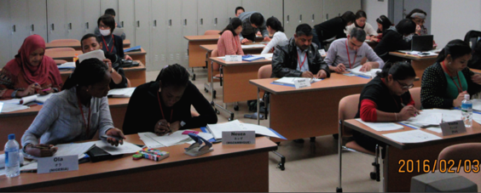
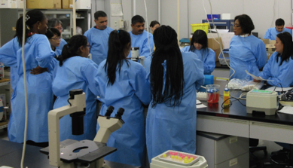
NIID training Course cooperated with JICA:
Laboratory Diagnosis Techniques for the Control of Vaccine Preventable Diseases, including Poliomyelitis and Measles
January 15 - February 12, 2016
Training course
Countries of trainees
Philippines
Viet Nam
Fiji
Afghanistan
Pakistan
Mozambique
Nigeria
Sudan
(14 trainees in all)
Slide by Dr. Komase K
Notes:
----- 会議メモ (15/05/26 17:47) -----
Every year NIID cooportaed with JICA (Japan Internatinal cooperation Associtaion ) held training course for measles and rubella diagnosis. Here we show some snap shots of the training course.

Slide 4
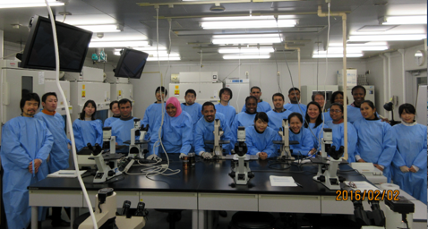
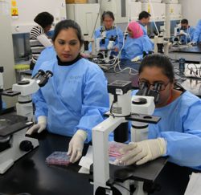
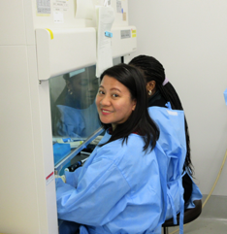
NIID training Course cooperated with JICA:
Laboratory Diagnosis Techniques for the Control of Vaccine Preventable Diseases, including Poliomyelitis and Measles
January 15 - February 12, 2016
Training course
Training program
Lecture
RNA extraction (M&R)
RT-PCR (M&R)
IgM ELISA (M)
Virus inoculation &
propagation (M&R)
ABC staining (R)
RT-LAMP (M, demonstration)
(M: Measles R : Rubella)
Slide by Dr. Komase K
Notes:
----- 会議メモ (15/05/26 17:47) -----
Every year NIID cooportaed with JICA (Japan Internatinal cooperation Associtaion ) held training course for measles and rubella diagnosis. Here we show some snap shots of the training course.

Slide 5
Virus detection
Evaluation of molecular diagnostic methods for measles
(Promotion of the use of real-time PCR)
Comparison of genome detection ability among
the molecular diagnostic methods used in Japan
Usage of real-time
RT-PCR method
(Measles, 2015)
Genotype
32%
1042
tests
68%
Detection ability in 5 copies of genome/reaction (%)
Slide by Dr. Komase K

Slide 6
Virus detection
Evaluation of molecular diagnostic methods for rubella
(Promotion of real-time PCR for local public laboratories)
Percentage of local public laboratories which can detect the positive control (50 copies/reaction) by Real-time RT-PCR
Percentage of local public laboratories which have already introduced Real-time RT-PCR for rubella detection
No
Yes
Yes
No
75 local public laboratories, as of Aug 2015
Slide by Dr. Mori Y

Slide 7
Virus detection
RT-LAMP method for Rubella virus detection
F3
F2
F1
B1c
LB
5’
3’
3’
5’
LF
F1c
B1
B2
B3
Loop-mediated isothermal amplification method (Notomi et al., Nucleic Acid Res., 2000)
One temperature (60~65℃)
Rapid (~60min)
One step (RT to LAMP)
 |  | Rubella virus standard RNA copies/reaction
 |  | 5×10⁴ | 5×10³ | 5×10² | 5×10¹ | 5×10⁰ | 5×10⁻¹ | 5×10⁻² | 0
Fluorescent RT-LAMP | 1 | + | + | + | + | - | - | - | -
 | 2 | + | + | + | + | - | - | - | -
 | 3 | + | + | + | + | - | - | - | -
Real-time RT-PCR* | 1 | + | + | + | + | + | - | - | -
 | 2 | + | + | + | + | - | - | - | -
*Okamoto et al., J.Virol.Methods, 2010
Slide by Dr. Mori Y

Slide 8
Virus detection
Future plan for Direct Fluorescent RT-LAMP
Dried form reagents
Slide by Dr. Mori Y

Slide 9
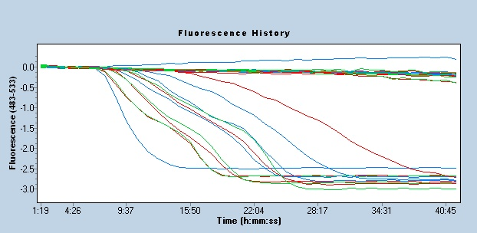
Virus detection
Future plan for Direct Fluorescent RT-LAMP
Negative samples
Positive samples
Slide by Dr. Mori Y

Slide 10
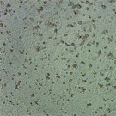
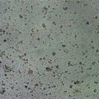
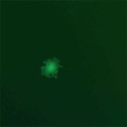
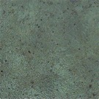
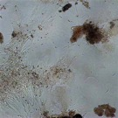
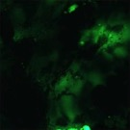
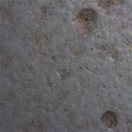
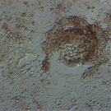
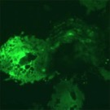
Virus isolation
Development of the cell clones for MV and RuV isolation
Susceptible cell lines
to RuV
(-)
CPEs of MV-EGFP
RK13
/hSLAM
RK13
BHK21
JEG3
expressing SLAM
BHK21
/hSLAM
JEG3
/hSLAM
Slide by Dr. Seki F

Slide 11
Antibody detection
Evaluation of new Measles IgM ELISA kit
manufactured by Denka Seiken
IgM positivity by days after rash onset
Number
of cases
IgM positve
IgM negative
-2 | -1 | 0 | 1 | 2 | 3 | 4 | 5 | 6
6
4
2
Days after rash onset
Sera were collected from measles patients confirmed by RT-PCR
Slide by Dr. Komase K

Slide 12
Antibody detection
Evaluation of Rubella antibody detection kits (Enzygnost vs others)
Denka Seiken Rubella
VIDAS RUB IgG
Access Rubella IgG
Runpia Latex Rubella
Results of samples
 | HI (%) | Denka (%) | Deter-miner (%) | VIDAS (%) | Access (%) | Enzygnost (%) | Runpia (%)
Negative | 10 (8.62) | 9 (7.76) | 10 (8.62) | 12 (10.3) | 13 (11.2) | 10 (8.62) | 11 (9.48)
Equivocal | - | 4 (3.45) | 3 (2.59) | 4 (3.45) | 5 (4.31) | 2 (1.72) | 4 (3.45)
Positive | 106 (91.4) | 103 (88.8) | 103 (88.8) | 100 (86.2) | 98 (84.5) | 103 (88.8) | 101 (87.1)
Determiner CL Rubella
IgG
The chosen-cut off value was the one recommended by the manufacturer
Slide by Dr. Okamoto K

Slide 13

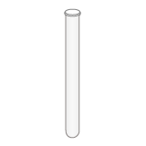
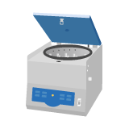


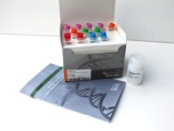
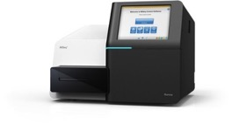

Method
Next generation seq
Supernatant
30% Sucrose
Vero/hSLAM
Ultracentrifuge:
42,000 rpm 4C
2 hours
RNA extraction:
Viral RNA Mini Kit
MiSeq
MiSeq Reagent Kit v2
(300-cycles)
NEXT Ultra RNA library prep kit
Analysis
‘Map to Reference’ command
Slide by Dr. Shirogane Y

Slide 14






Next generation seq
Max
coverage
genotype
H2
2281
H1
834
D4
920
D8
579
D5
1331
H1
509
Slide by Dr. Tahara M

Slide 15
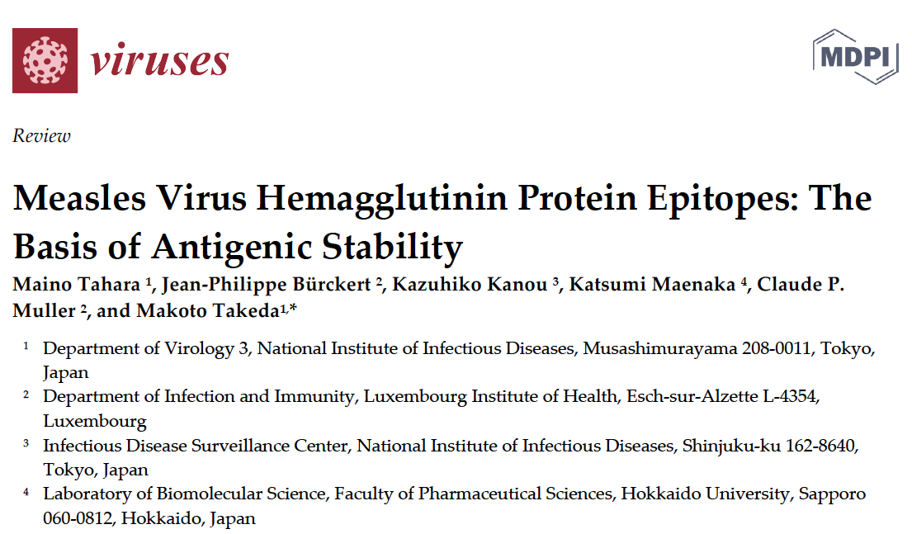
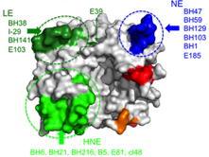
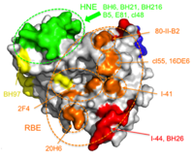
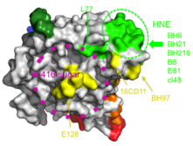
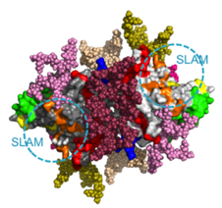
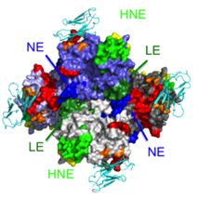
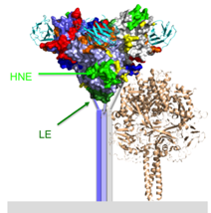
Epitopes

Slide 16



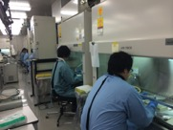




Seroepidemiology
International cooperation activity
Seroepidemiology for measles and rubella among general population in Lao PDR
Results from Nationwide Multistage Cluster Sampling Survey
Nationwide multistage cluster sampling
2,184 participants
DBS (Whatman 903 sheets)
by NCGM & MOH, Lao PDR
IgG ELISA for Measles and Rubella
at NIID

Slide 17
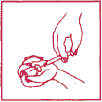
Vaccine stability
Study design
Stability of viruses in a freeze-dried vaccine
４℃
1, 3, 7, 14, 21, or 28 days
25℃
Potency tests of MV and RV
MR
-Vac
35℃
Stability of viruses in a reconstituted vaccine
４℃
1, 3, 6, 12, 24 hours,
2, 4, or 7 days
Potency tests of MV and RV
25℃
35℃
Slide by Dr. Mori Y
Notes:
We conducted two kinds of experiments.
One is
In this experiment, freeze-dried vaccines were incubated at three different temperatures, 4, 25, or 35 degree and for various incubation times until 28 days. And then they were reconstituted, and potencies of both components were determined.
Another is
In this experiment, first vaccines were reconstituted and incubated at three different temperatures for various incubation times until 7 days.

Slide 18
Vaccine stability
Slide by Dr. Mori Y

Slide 19
NIID – update
Summary
Currently 12 members in measles and rubella laboratories
Training course for laboratory diagnosis of measles and rubella for staffs in developing countries (supported by JICA)
Introduction of RT-real-time PCR for measles and rubella surveillance and EQA for prefectural laboratories
Development of RT-LAMP methods for RuV detection
Development of new cell lines available for isolation of both MeV and RuV
Evaluation of measles and rubella IgM and IgG detection kits
Next generation sequence analysis of MeV
Detailed analysis of MeV hemagglutinin epitopes (collaboration with Claude’s lab)
International co-operation for seroepidemiology
Study of vaccine stability

