Slide 1
Measles and Rubella in WHO Region of Europe:
Regional Update
Dr. Abigail Shefer
Technical Officer
Accelerated Disease Control and Elimination
Vaccine-preventable Diseases and Immunization

Slide 2
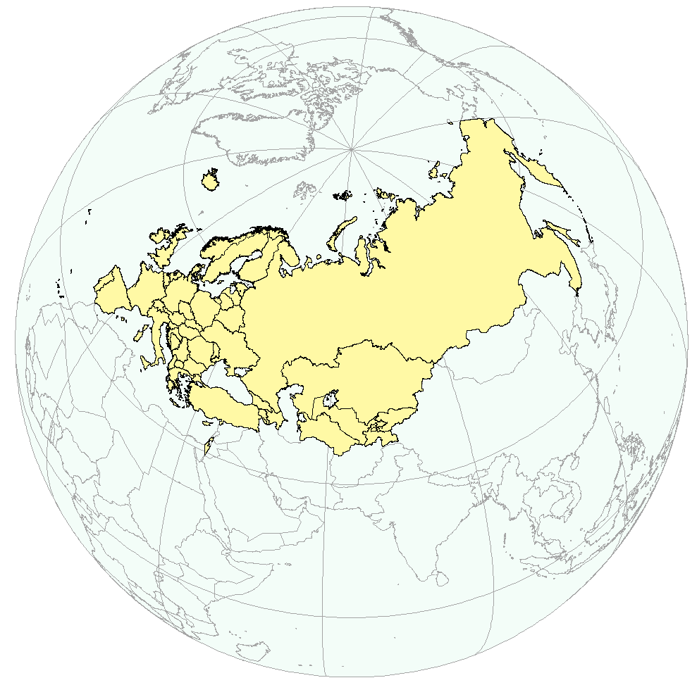
WHO Region of Europe
53 member states
12 time zones
4 official languages
Measles & Rubella/Polio
elimination/eradication goals

Slide 3
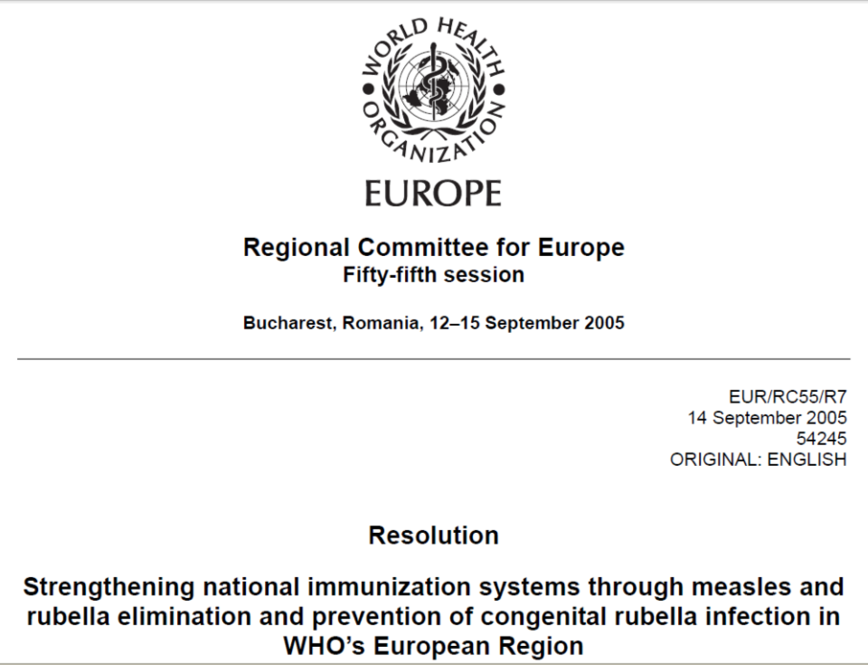
Elimination Goals
http://www.euro.who.int/__data/assets/pdf_file/0003/88086/RC55_eres07.pdf

Slide 4
Events in the WHO European Region, 1980–2013
Vaccination coverage
Lowest number of measles cases recorded: 6936
Elimination goal reset to 2015
All 53 Member States have
2-dose MCV schedule
Accelerated package of action

Slide 5
Measles in the WHO European Region,
1993–2013*
341 982
France,
14 949
Bulgaria,
22 004
Ukraine,
12 744
Lowest measles cases recorded
Turkey,*
6 547
37 073
30 625
98 %
REDUCTION
25 022
20 601 *
6 936
1993 |  | 2007 | 2008 | 2009 | 2010 | 2011 | 2012 | 2013*
* Provisional data for January–June 2013.

Slide 6
Rubella in the WHO European Region,
2000 and 2011–2013*
621 039
Poland,*
35 740
Romania,
20 812
Ukraine,
3 667
36 097*
30 509
98 %
REDUCTION
9 672
2000 |  | 2011 | 2012 | 2013*
* Provisional data for January–July 2013.

Slide 7
Percentage of reported measles cases by age group
January-June 2013
Turkey (n=6533)
Georgia (n=5783)
WHO European Region (n=20 533)
United Kingdom (n=1750)
Germany (n=1097)

Slide 8
Progress towards goal
All Member States use 2 doses of measles containing vaccine
All Member States adopted rubella immunization programme
Regional immunization coverage levels remained high
Supplementary immunization activities (2005-2012)
>>> 44.6 million doses with measles-containing vaccines
67 national and subnational laboratories are fully accredited
Surveillance tools for evidence-based decision making are available
e.g. immunization registries, genotyping data, seroprevalence studies, vaccine supply

Slide 9
Challenges to Achieving Goals
Suboptimal coverage and immunity gaps at subnational level
Lack of national case-based surveillance for measles and rubella*
Continued outbreaks and lack of comprehensive response
Political, public, and health professional complacency
Resources for low and middle income countries to address gaps in coverage
* In 2012, 13 Member States lacked national case based surveillance for Measles and 29 for Rubella

Slide 10
Root causes
Awareness and risk/benefit perceptions at all levels
Public
Health Professional
Health care systems
in transition
Funding, organization, and availability of services
Government

Slide 11

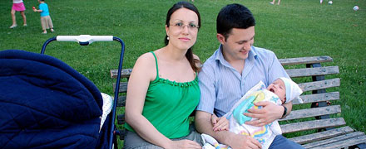
Advocacy and communication by WHO and national health authorities
Target audiences
    Parents, health care providers, underimmunized teenagers and adults, immunization programme managers
    Diverse national, regional, and local cultures
    Range of views on immunization: supportive, hesitant, anti-vaccination, complacent, uninformed
Objectives
    Educate about vaccine-preventable diseases and vaccines
    Change immunization behaviour
    Maintain or restore confidence in existing vaccines
    Introduce and create demand for new vaccines
    Inform on vaccine-related events, disease outbreaks
    Interact – to influence as well as understand public’s views and motivations

Slide 12

Accelerated package of action for the elimination of measles and rubella in the WHO European Region
OUTBREAK PREVENTION AND RESPONSE
COMMUNICATIONS, INFORMATION AND ADVOCACY
3
4
RESOURCE MOBILIZATION AND PARTNERSHIPS
SURVEILLANCE
2
5
STRENGTHENING OF VACCINATION AND IMMUNIZATION SYSTEMS
VERIFICATION OF MEASLES AND RUBELLA ELIMINATION
1
6
http://www.euro.who.int/en/what-we-do/health-topics/disease-prevention/vaccines-and-immunization/publications/2013/measles-and-rubella-elimination-2015.-package-for-accelerated-action-2013-2015

Slide 13
1. Strengthening of Vaccination and Immunization Systems
National programmes
  Training of coordinators/mid level management on RED/Immunizations (1-2 sub-regional/yr)
  Training and follow-up missions to improve vaccine management (1-2 MS/yr)
  Assessment and follow-up missions on implementation on national regulatory authority improvement plans (4 missions total/yr)
  Training to improve immunization information systems (2 sub-regional/yr)
National immunization technical advisory groups (NITAGs)
  Impact assessment of existing NITAGs and dissemination of results (by 2014)
  Promotion of NITAG establishment in 18 MS still lacking (visits to 2-4 MS/annum)
  Publication of guidance and best practice document (by June 2014)
Guide to tailoring immunization programs (TIP) – see next slide

Slide 14
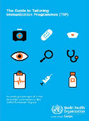
Guide to Tailoring Immunization Programmes (TIP)
Innovative Guide to assist Member States in tailoring vaccination responses to unique needs of most vulnerable populations
  Diagnose problems and define subpopulations through quantitative and qualitative methods
  Deliver targeted campaigns and services
  Increase demand for vaccination
Launched in April 2013
Status – Implementation in at least 2 Member States per year
  In use 4 Member States by end 2013
Evaluation and resource requirements – Qualitative through online surveys, key informant interviews, focus groups
http://www.euro.who.int/__data/assets/pdf_file/0003/187347/The-Guide-to-Tailoring-Immunization-Programmes-TIP.pdf

Slide 15
2. Surveillance
Case-based surveillance
  Technical assistance plan to achieve case-based rubella reporting (2-4 MS/yr)
  Technical assistance plan to develop monthly CRS reporting (6-8 MS/end 2014)
  Implementation of MRSM* to improve surveillance reporting (4-6 MS/2013-15)
Lab and epi data integration
  MS: Implementation of pilot to integrate lab/epi data (2-4 MS/by end 2014)
  Regional: MRLDMS* to integrate lab/epi data (by end 2013)
Vaccine safety
  Publication of manual on vaccine safety risk management (2014); sub-regional trainings (3/ yr); training package for CME accreditation (mid 2014)
* MRSM = Measles Rubella Surveillance Module; MRLDMS = MR Laboratory Data Management System

Slide 16
3. Outbreak response and preparedness
Regional Guidelines for Outbreak Response (2013)
  Publication Sept 2013
Verification process for MR elimination
  Change to include requirement for submission of national outbreak response plans for review as part of annual status reporting (2014)
Coordination of response to outbreaks in Region
  Measles outbreak in Caucasus and Turkey started in 2012
  Sub-regional meeting attended by AZR, GEO, ARM (July 2013, Tblisi, GA)
  Consensus to conduct catch-up or SIAs – plans under development

Slide 17


  4. Communication and advocacy, 2013
Tools for HCWs and imm. programme managers – talking with parents about vaccines, TIP, managing response to vaccine safety events, etc.
Tools for parents – decision-making guides, smartphone immunization-reminder app
In-country communication capacity building – 3 sub-regional training programmes, national comms reviews, establishment of vaccine comm. working group (first in Estonia, template for other MS), high-level measles advocacy meeting, outbreak comms support in specific countries
Internet – “Gold standard” website template on imm. and vaccine-preventable diseases for public health authorities
Social media – smartphone apps, FaceBook, YouTube, Twitter, email, blogs, peer-sharing on EIW campaign site (increasingly important – governments at various stages of implementation and engagement with the public)
Public events – European Immunization Week (all 53 Member States participating), campaigns to introduce new vaccines, catch-up campaigns
Traditional media – high-profile M&R media interviews, op eds (Lancet)

Slide 18
5. Resource mobilization and partnerships
Regional: Enhance cross border collaboration between Regions for outbreak response
  Secure funding source for revitalization of MECACAR* platform (by June 2014)
  Organization of cross-border (European and Eastern Mediterranean regions) coordination meeting (to be held by June 2014)
    Revitalize MECACAR
    Develop and endorse Joint MR Activity Plan
* MECACAR = Middle East and Caucasus and Central Asian Republics

Slide 19
6. Verification of measles and rubella elimination
National Verification Committees
37 established 16 pending
Framework for the verification process
  Importance of high quality data
  Necessary information available at: www.euro.who.int
33 Annual Status Reports
(2010-2012)

Slide 20
MRI Support Needed
Middle income countries (not GAVI eligible)
  Support for any kind of supplemental immunization activities
Support for outbreak response
  Vaccine supply, with consideration of legal regulation in affected countries (vaccines registered for use)
Developing new strategies to address susceptible population
  Adults
  HCWs
  Migrant population (diversity of groups and characteristics)
Developing MS capacities to implement new strategies
  Legal
  Advocacy and communication
  SOP for health system (institutions and HCW)

Slide 21
Supplementary slides

Slide 22
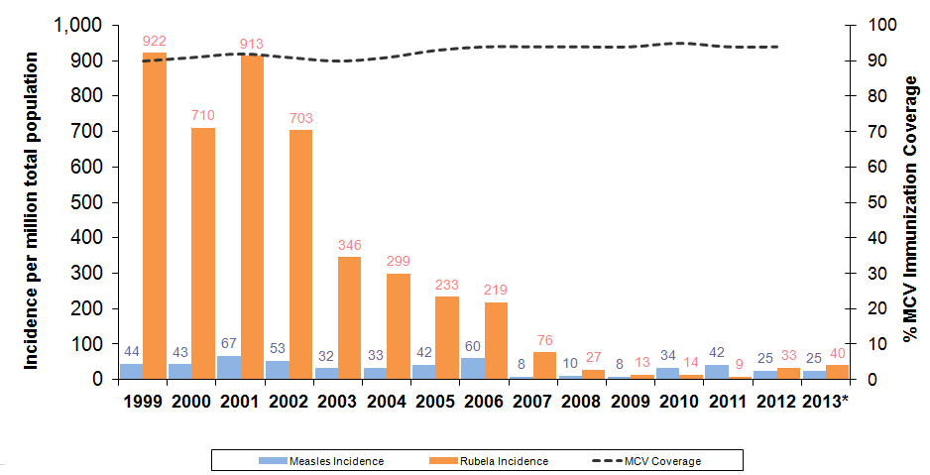
Measles and rubella incidence per million total population and MCV1 Coverage, WHO European Region, 1999-2013
SIA conducted in selected Countries
* Monthly MR reporting to WHO European region until July 2013
Source: Source: WHO/UNICEF JRF and month MR reporting to WHO European region
Update : 05-Sep-2013

Slide 23
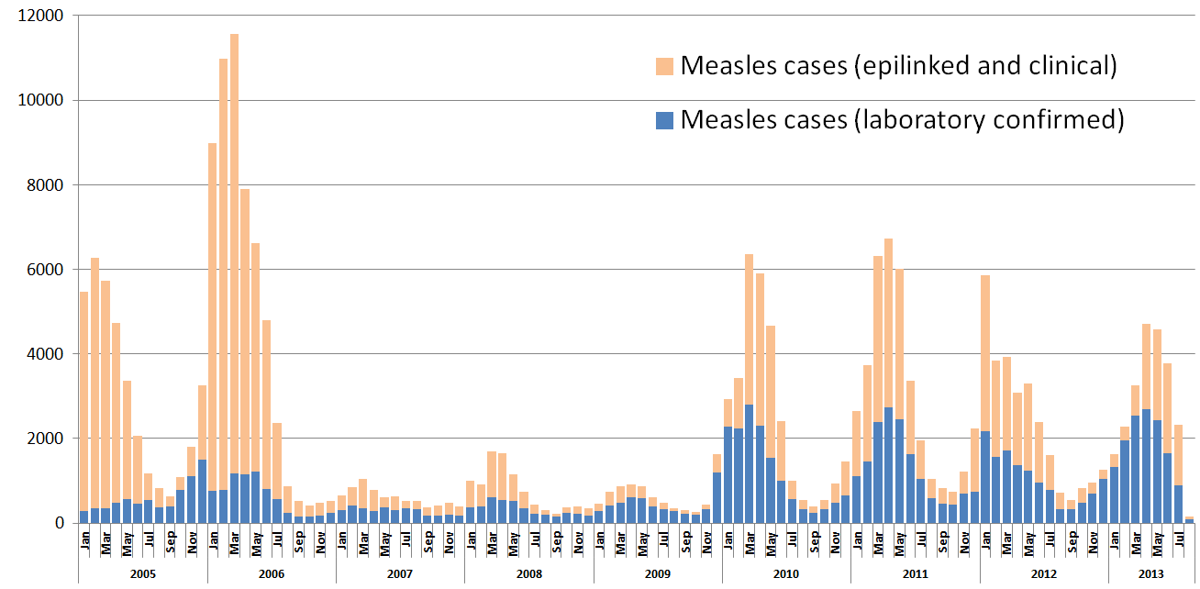
Confirmed measles cases by month,
WHO European Region, 2005-Jul 2013
Source: Monthly MR reporting to WHO European region
Update: 05-Sep-2012

Slide 24
Countries with highest number of measles cases in the WHO Europe, 2010 - 2013
Data as of 05 Sept 13; Source – CISID monthly measles and rubella surveillance, WHO Europe

Slide 25
Countries with highest number of rubella cases in the WHO Europe, 2010 - 2013
Data as of 05 Sept 13; Source – CISID monthly measles and rubella surveillance, WHO Europe

Slide 26
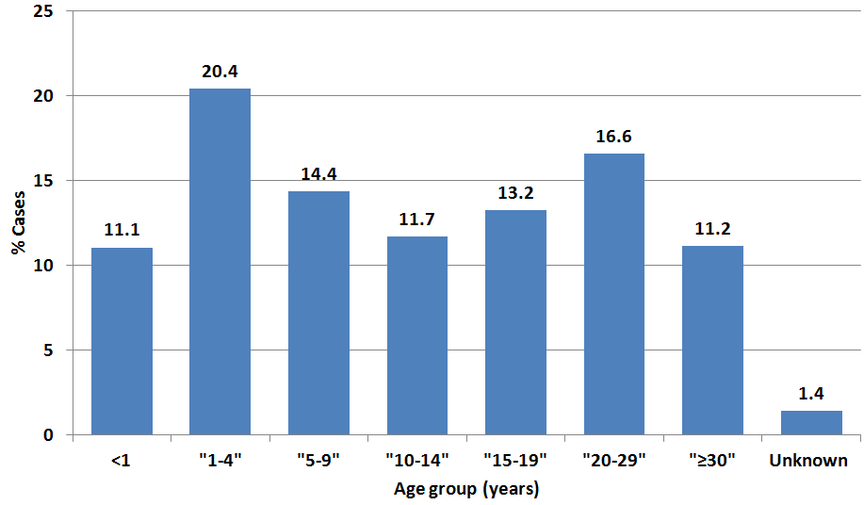
Proportion of measles cases by age groups,
WHO European Region 2010-2013
52.7%
(>95 000 Cases)
Data Source: Monthly MR reporting to WHO European Region
*Data as of 05 Sep 2013

Slide 27
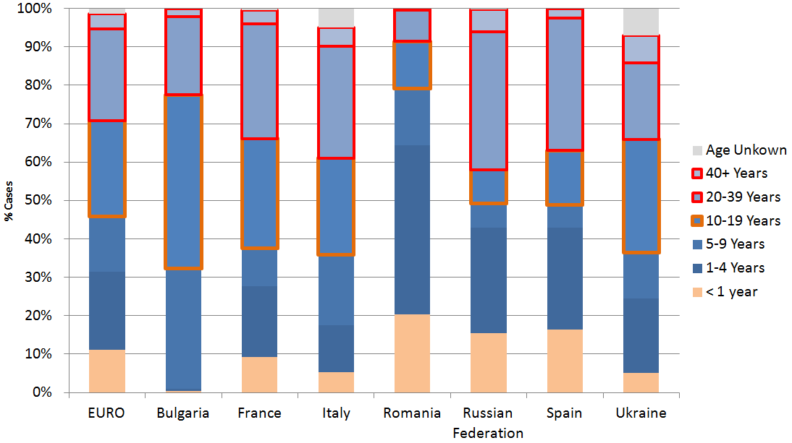
Proportion of measles cases by age groups, seven countries and the Region, 2010-2013
(>95 000 Cases)
Data Source: Monthly MR reporting to WHO European Region
*Data as of 05 Sep 2013

Slide 28
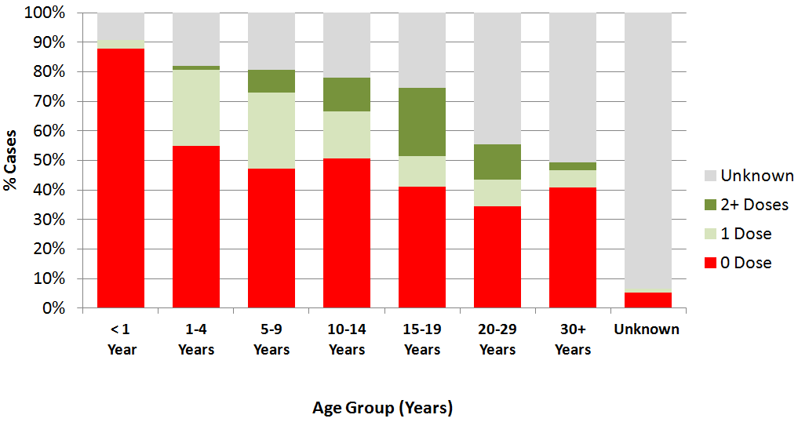
Immunization status as a percentage of measles cases, by age group, WHO European Region 2010-2013*
(>95 000)
Data Source: Monthly MR reporting to WHO European Region
Data as of 05 Sep 2013

Slide 29
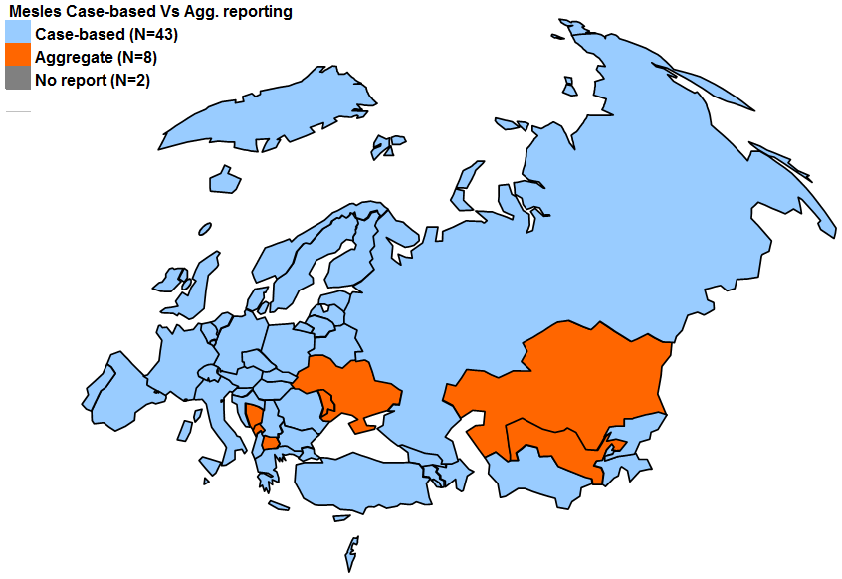
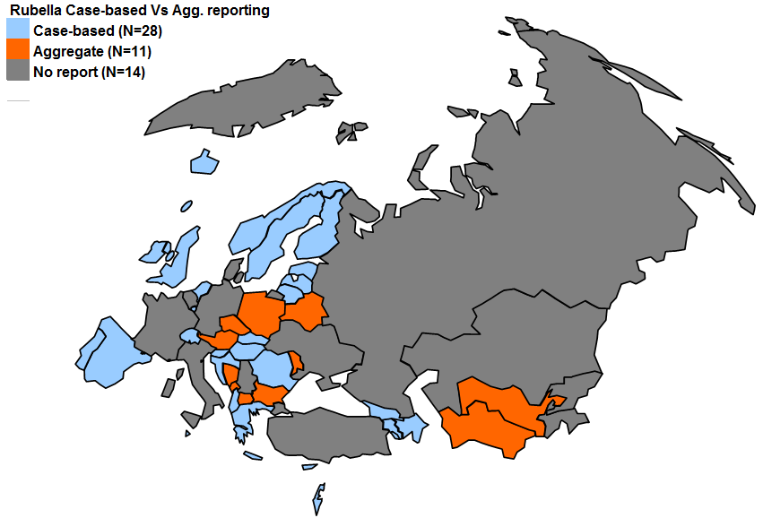
Case-based surveillance, European Region 2013
CASE- BASED REPORTING
IS
CRITICAL
FOR ELIMINATION

Slide 30
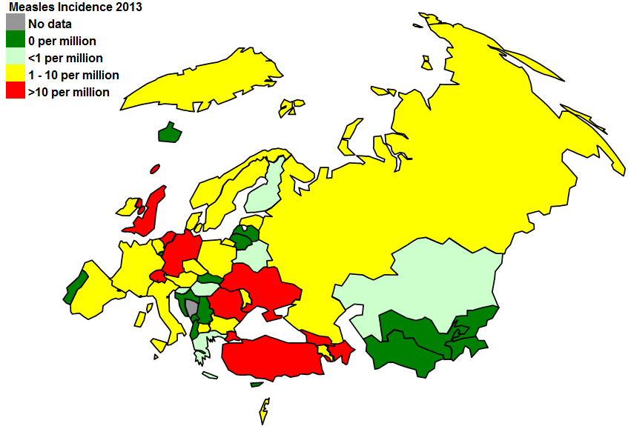
Measles incidence Jan-Jun 2013 and major outbreaks in the European Region
Measles outbreaks in 2013
Azerbaijan
Georgia
Germany
Netherlands
Romania
Turkey
Ukraine
United Kingdom

Slide 31
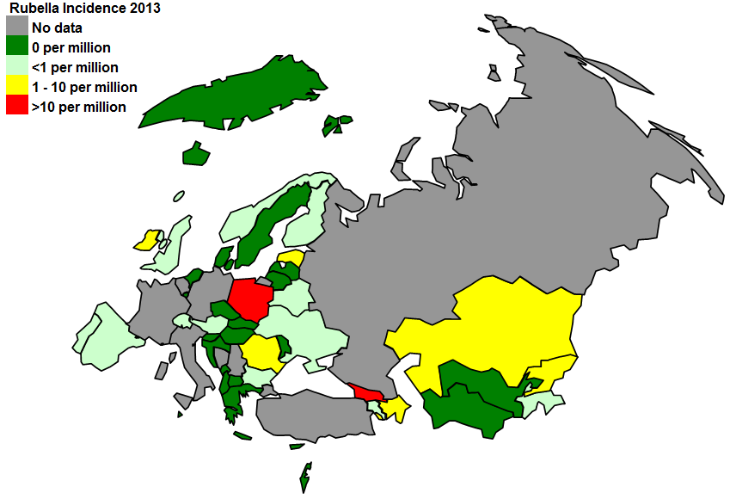
Rubella incidence in Jan-Jun 2013 and major outbreaks in the European Region 2008-2013
Rubella outbreaks (2008 – 2013)
Austria
Bosnia and Herzegovina
Georgia
Italy
Kyrgyzstan
Malta
Netherlands
Poland
Romania
Russian Federation
Ukraine
?
?
?
?

