Slide 1
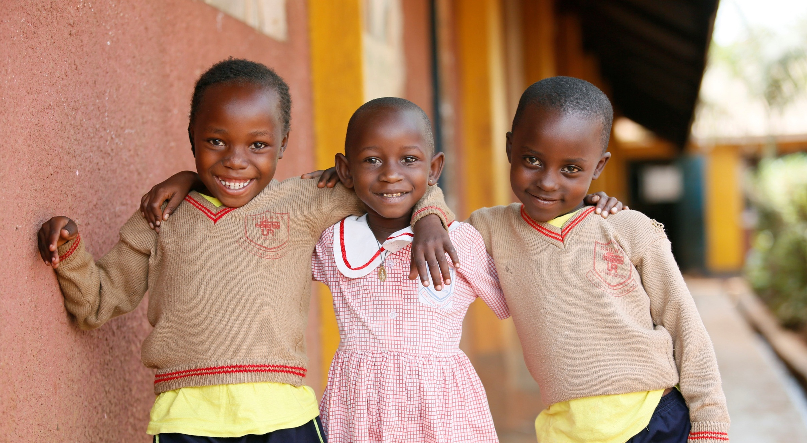
One of the most cost-effective way to make a difference in a life of a child.
Notes:
Welcome. We’re wait just a few more minutes as more people join.
As we wait for everyone else to join, I’m going to keep people muted, but I do want to call your attention to the left slide of your screen where you should see a chat box. Use that chat box to tell us your name, where you’re from and why you’re excited to become a S@L Champion.
Great. So we’re going to start recording our call no, so welcome and I want to introduce you to slides like this next one…

Slide 2
The Power of the Movement
Strong and growing...
270,000
Online supporters
47,000
Social media followers
550
Grassroots Champions
Notes:
Shot@Life rallies the American public, members of Congress, and civil society partners around the fact that together, we can save a child’s life every 20 seconds by expanding access to vaccines.

Slide 3
One person can make a difference
Talk to your
Give the Gift of Life
members of
Become a Champion
Congress
shotatlife.org/champion
Tell your friends
Sign up for emails
shotatlife.org
Notes:
We encourage you to edit and adapt this slide to give your audience easy and appropriate ways to get involved.

Slide 4
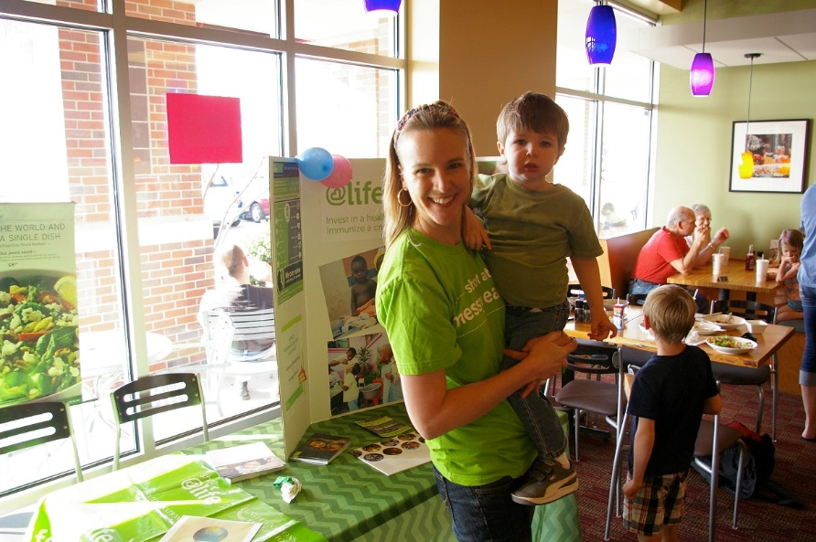
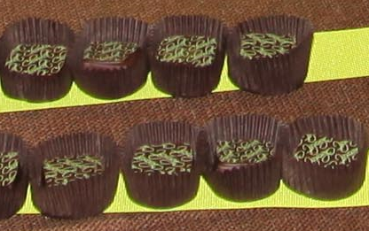
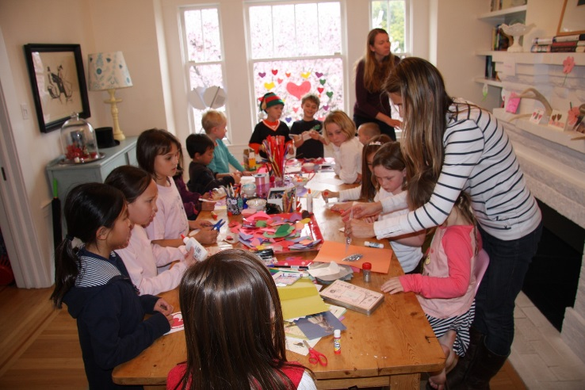
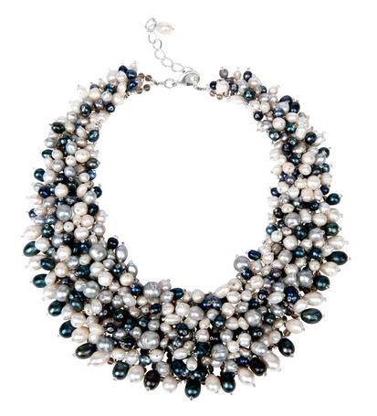
Building & Tapping the Passion
Shots for Shots
(Mini-desserts, of course!)
Give a Little Love
Cause Marketing
60 in 60

Slide 5
Thank you!

