Slide 1
Measles and Measles Outbreaks in China
Accelerating Progress towards Measles/Rubella Control and Elimination Goals Meeting
Geneva, Switzerland
June 19, 2016
Lance Rodewald
WHO China Country Office

Slide 2
Measles and Rubella Vaccination Schedule
8 months
MR vaccine
18 – 24 months
MMR vaccine
2-dose MCV schedule started 1986
RCV added in 2008

Slide 3
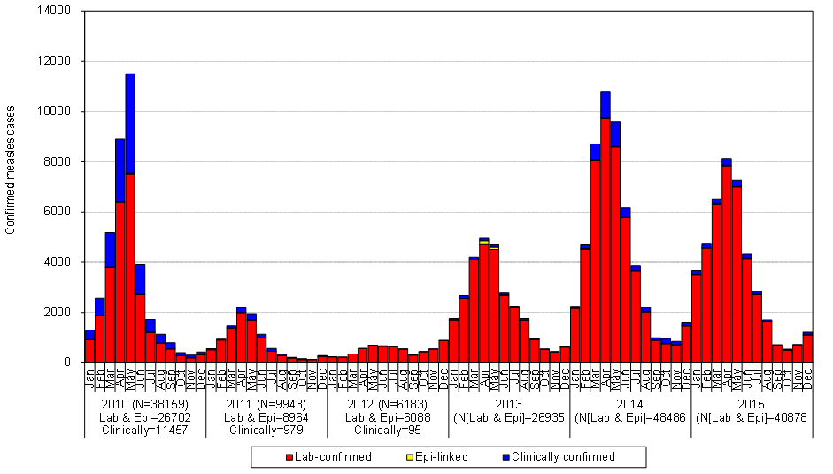
Provincial MV SIAs to risk areas
2014 – 13 M children
2015 – 9 M children
Nationwide MV SIA
103 M children
Draft Annual Progress Report on Measles Elimination 2014-2015

Slide 4
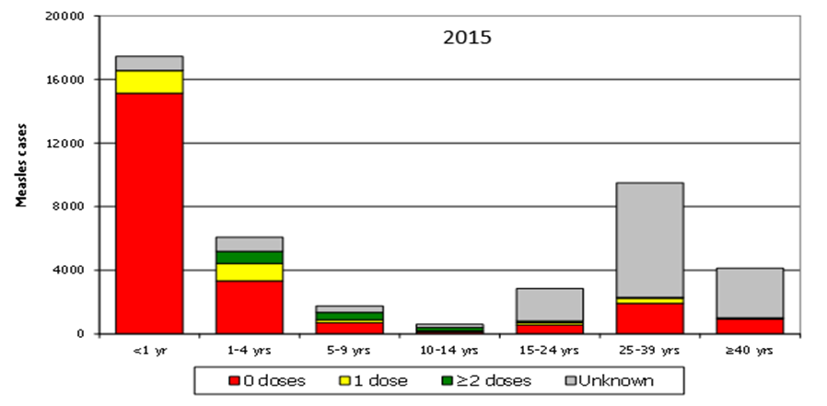
Draft Annual Progress Report on Measles Elimination 2014-2015

Slide 5
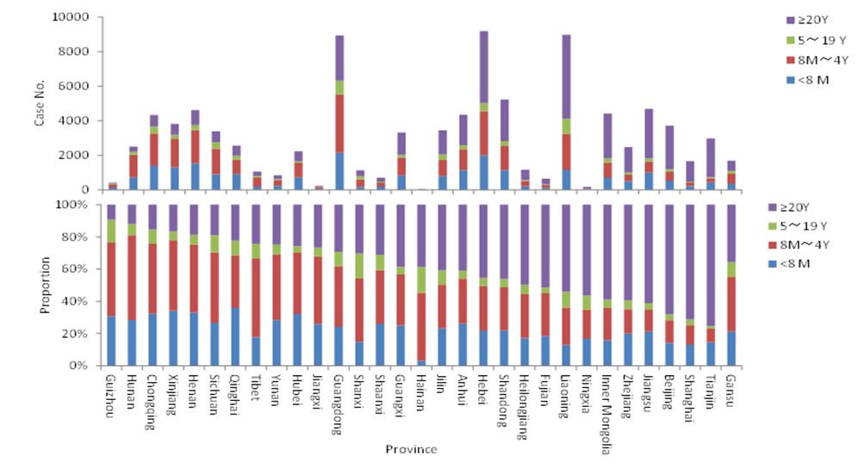
Draft Annual Progress Report on Measles Elimination 2014-2015

Slide 6
Number, Size, and Duration of Outbreaks 2009-2015
No. of Outbreaks | 1,426 (avg 204/yr)
No. of Outbreak-related Measles Cases (ORC) | 8,696
% of ORC among Yearly Measles Cases | 4%
% of Measles Outbreak with ≤5 Case | 78%
Median No. of cases per outbreak (IRQ) | 2 (2,278)
Median duration of outbreak, days (IQR) | 8 (1,245)
% of Lab confirmed | 99%
% with Genotype Results | 8%
Draft Annual Progress Report on Measles Elimination 2014-2015

Slide 7
Selected Measles Outbreaks, 2014-2015
Province | Outbreak Setting | Cases | Cases / 100,000 | Duration (days) | Age distribution (%)
 |  |  |  |  | <8 M | 8M-4Y | 5-19Y | 20-49Y | ≥50Y
Shanxi | Community | 281 | 87 | 66 | 6 | 46 | 28 | 19 | 1
Hebei | Community | 355 | 87 | 74 | 9 | 22 | 12 | 57
Liaoning | Community | 248 | 10 | 199 | 9 | 19 | 7 | 57 | 8
Inner Mongolia | Community | 122 | 27 | 169 | 23 | 19 | 3 | 55
Inner Mongolia | Community | 280 | 157 | 173 |  |  | 12 | 89
Jilin | University | 25 | 195 | 41 |  |  | 9 | 91
Beijing | Office bldg, adults | 24 | 896 | 20 |  |  |  | 100
Beijing | Hospital, HCWs | 11 | 1,342 | 9 |  |  |  | 100
Gansu | Hospital, HCWs | 91 | 2,528 | 88 |  |  | 4 | 94
Gansu | Hospital, HCWs | 29 | 805 | 41 |  |  |  | 100
Source: China CDC - Ma Chao, et al. Manuscript in preparation

Slide 8
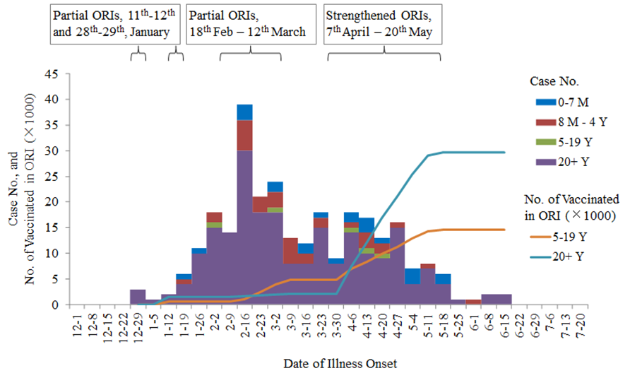
Ma Chao, et al. Vaccine, accepted for publication 2016

Slide 9
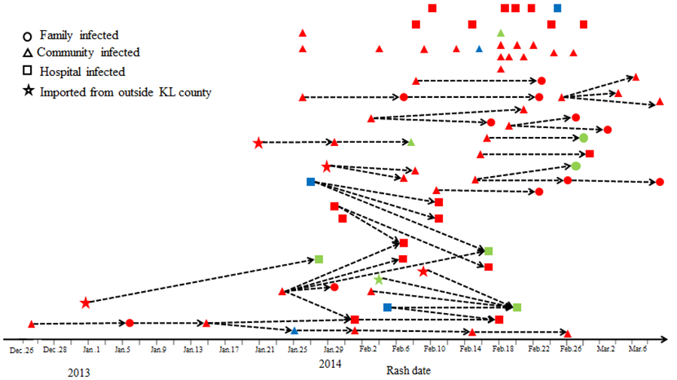
Ma Chao, et al. Vaccine, accepted for publication 2016

Slide 10
Reported MCV1 and MCV2 Coverage, 2006-2016
Draft Annual Progress Report on Measles Elimination 2014-2015

Slide 11
MCV2 Coverage by Province; County-Level Survey, 2013
Cao L, et al. Chinese J Vaccine Immunization 2014;20(6):486-491

Slide 12
Measles Conundrum in China
30 years of a 2-dose measles vaccination policy
Very high reported routine MCV1 and MCV2 coverage
Large, nationwide measles SIA in 2010
Numerous provincial measles SIAs conducted annually
Excellent, case-based surveillance that meets WHO indicators
World class measles/rubella laboratory expertise
Yet, the H1 measles genotype has circulated continuously for at least 25 years, and in every province

Slide 13
Ma Chao, et al. BMC Infect Dis 2015:15:23

Slide 14
1st Dose Measles Vaccine Coverage Estimates 首剂麻疹疫苗估算接种率
Ma Chao, et al. BMC Infect Dis 2015:15:23

Slide 15
1st Dose Measles Vaccine Coverage Estimates 首剂麻疹疫苗估算接种率
Ma Chao, et al. BMC Infect Dis 2015:15:23

Slide 16
School Entry Check and Vaccination Results in 3 Provinces, 2014 入学接种证查验和接种结果—3个省，2014年
Source: China CDC, unpublished data from school entry record check pilot project

Slide 17
China Program Plans
Develop more accurate coverage assessment methodology
Identify more effective methods to reach migrant population
Streamline vaccines (MMR and MR only in the program)
Strengthen and standardize school vaccination record check with MoE
Consider nationwide selective preschool SIA for children not able document receipt of 2 MCV doses
Consider province-specific adult vaccination campaign

Slide 18
Upcoming Analyses and Activities
Analysis with modeling of nationwide M/R serological survey
Conducted November 2014
Ages 1 through 29 years
Sample size ~31,000, nationally representative
Results available in July 2016
National and international consultation on measles and rubella
Follow 2013 measles consultation and 2014 rubella consultation
Probably early November 2016

Slide 19
Thoughts
China is a large, densely-populated country with the world’s largest internal migration (275 million)
Measles has been reduced by over 99%; few measles deaths occur; however, elimination of measles remains elusive
China’s program has participated fully in WHO measles elimination activities and takes recommendations seriously
The current program plans are sound, but will be challenging to implement without significant new resources

Slide 20
Data and presentation sharing
Parts of this presentation are based on the Annual Progress Report on Measles Elimination in The People’s Republic of China, 2014-2015
This report is still in draft form and so these slides should not be published or shared

Slide 21
Extra slides

Slide 22
Number, Size, and Duration of Outbreaks 2009-2015
 | 2009 | 2010 | 2011 | 2012 | 2013 | 2014 | 2015 | Total
No. of Outbreaks | 319 | 310 | 63 | 13 | 109 | 283 | 329 | 1,426
No. of Outbreak-related Measles Cases (ORC) | 2,071 | 1,993 | 237 | 32 | 436 | 2,080 | 1,847 | 8,696
% of ORC among Yearly Measles Cases | 4 | 5 | 2 | 1 | 2 | 4 | 4 | 4
% of Measles Outbreak with ≤5 Case | 76 | 75 | 81 | 100 | 79 | 77 | 79 | 78
Median No. of cases per outbreak (IRQ) | 3 (2,203) | 3 (2,88) | 2 (2,15) | 2 (2,5) | 2 (2,29) | 3 (2,271) | 2 (2,278) | 2 (2,278)
Median duration of outbreak, days (IQR) | 8 (1,114) | 8 (1,163) | 7 (1,56) | 4 (1,13) | 8 (1,44) | 7 (1,158) | 8 (1,245) | 8 (1,245)
% of Lab confirmed | 98 | 99 | 100 | 100 | 97 | 99 | 100 | 99
% with Genotype Results | 0 | 0 | 0 | 0 | 0 | 12 | 26 | 8
Draft Annual Progress Report on Measles Elimination 2014-2015

