Slide 1
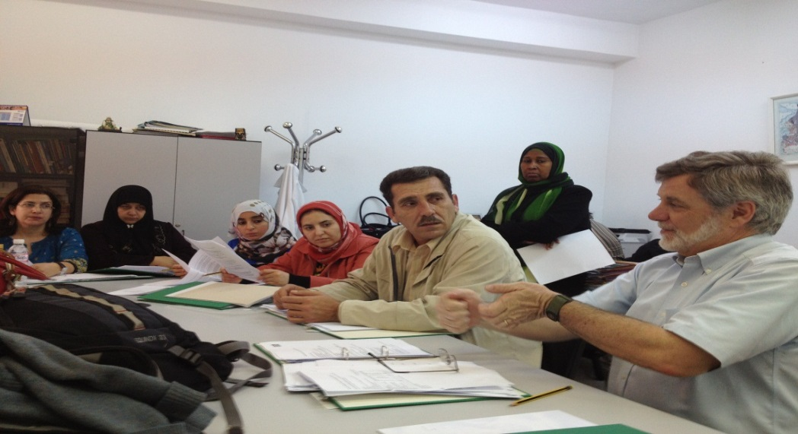
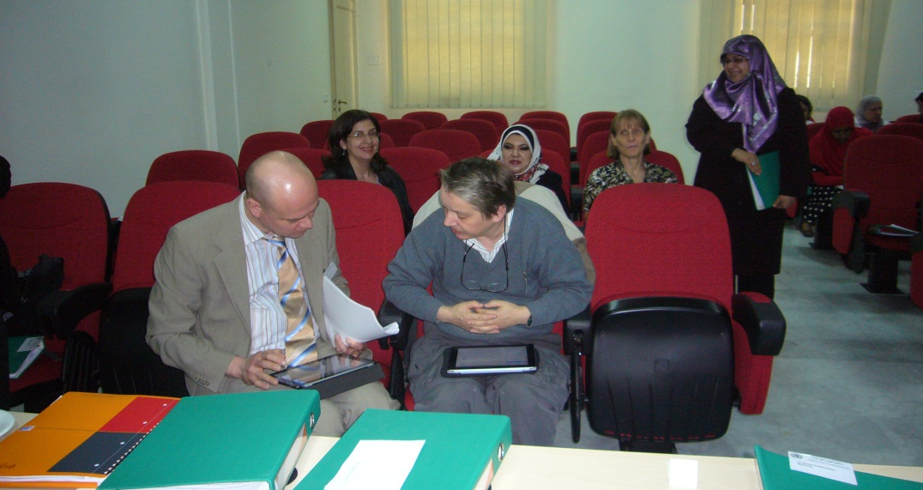
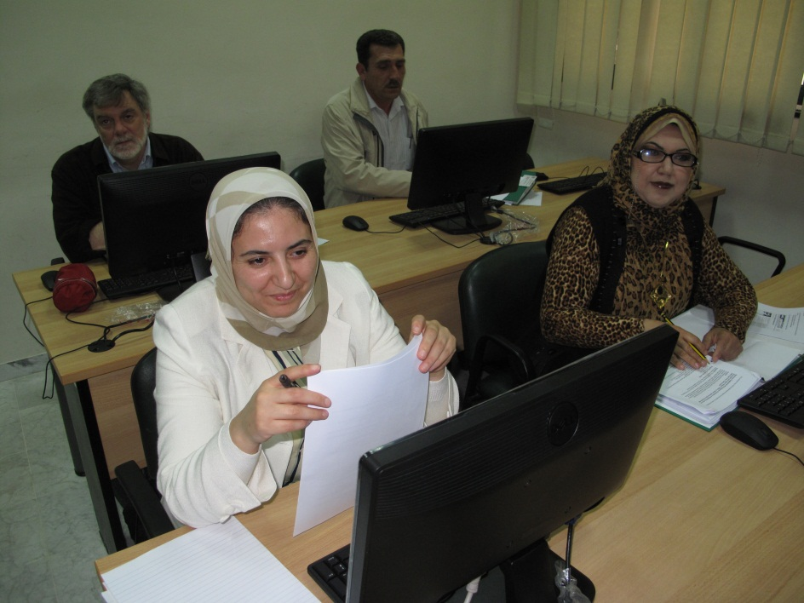
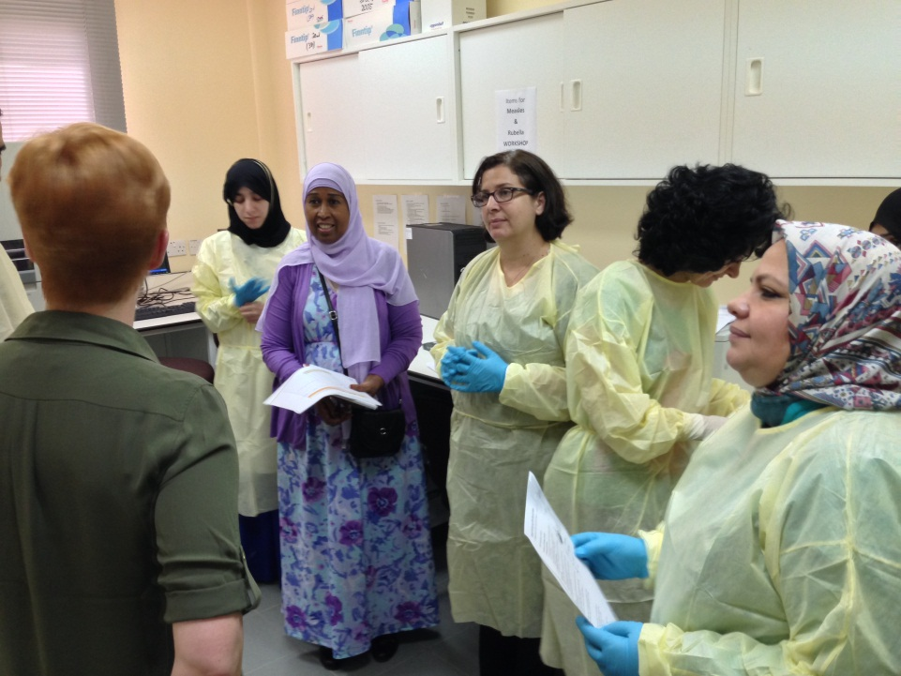
Accelerating Progress Towards Measles and Rubella
Hotel Royal, Geneva, Switzerland, 21-23 June 2016
Measles/Rubella Laboratory Network in the EMR: Progress and challenges
Dr Hinda Ahmed,
STC-EMRO, VPI/DCD

Slide 2
Outline
Brief Measles and Rubella situation in EMR
Performances on Quality Assurance
EMR Measles-Rubella laboratory surveillance Network
Challenges and Way forward

Slide 3
Regional Measles Goals
Measles elimination from all countries of the EMR
Resolution EM/RC44/R.6 – 1997: elimination by 2010
Resolution EM/RC58/R.5 – 2011: elimination by 2015
Regional framework for implementation of GVAP-2015:
Proposing: interruption of endemic transmission by 2017, verification of elimination by 2020

Slide 4
Measles and Rubella Reported Cases and Coverage of MCV1 and MCV2, 1980-2014

Slide 7
Number of Measles Cases
Number of Measles Cases

Slide 9
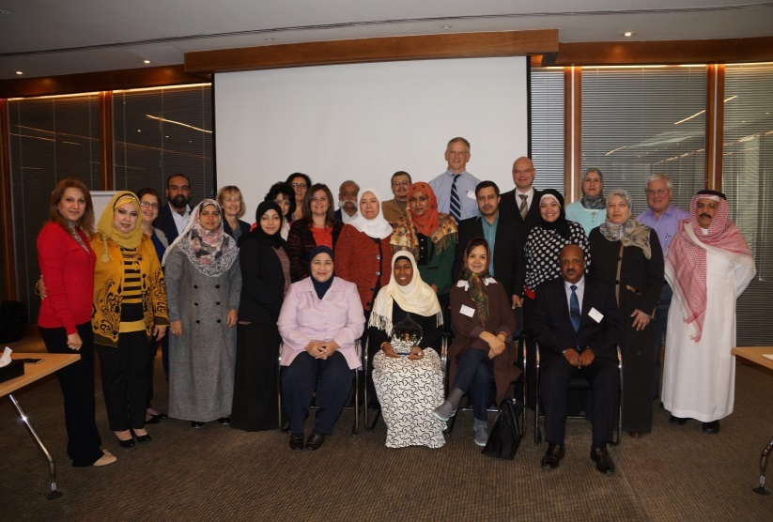
Capacity Measles/Rubella Laboratory Network in the EMR, 2015
Palestine
Bahrain
MRL : 22 countries
1 NML per country
Serology capacity only (4)
EMR MRL Meeting, 2015
Serology and virus detection/isolation capacity (8)
Serology and virus detection/isolation and sequencing
capacity (10)
Regional Reference Laboratories (2)

Slide 10
EMR Measles and Rubella Laboratory Quality assurance

Slide 11
EMR Results of Measles Global Proficiency Panel 2013 and 2015
EMR Results of Rubella Global Proficiency Panel 2013 and 2015

Slide 12
Update of Quality Assurance in MRL Network, 2014 and 2015
IgM test validation for measles and rubella
In 2014: 18/22 labs participated all achieved >90% concordant
In 2015: 17/22 Participated with >90% concordant
External Molecular Quality Panel for Measles and Rubella,
In 2014, four labs participated: two National labs Iran and Pakistan and the two RRLs in Oman and Tunisia.
Results were reported in a timely manner
Correctly identified the genotypes and passed
In 2015, 10 labs participated: 2 RRL and 8 National Labs 2 of the 8 declined and all participating labs passed except one
2 labs were offered retest and then passed

Slide 13
Accreditation Review
2014: Visits for accreditation review and passed: Afghanistan, Bahrain, Iran, Jordan, Kuwait, Morocco, Oman, Pakistan, Qatar, Sudan Tunisia and Yemen.(four countries IHC not well implemented)
2015: Physical/Online review: Afghanistan, Bahrain, Egypt, Jordan, Iran, Iraq, Lebanon, Morocco, Pakistan, Palestine, Somalia and Syria
2016 accreditation review conducted Kuwait (very weak coordination EPI and Lab: impact data and collection of specimen for detection/genotyping)
Pending more than two years: Djibouti, Libya, Qatar, Saudi Arabia UAE (did not permit in 2015),
Djibouti frequent staff turn (no focal points for MR surveillance and Lab).

Slide 14
Measles and Rubella Laboratory Surveillance and indicators

Slide 15
Number of specimens suspected for Measles cases, Number tested for Mmeasles IgM and Number specimens Confirmed for Measles IgM, 2010-March 2016
Number of specimens tested for Rubella IgM and Number specimens Confirmed for Rubella IgM, 2010-March 2016

Slide 16
Proportion of Specimen Tested for Measles from Measles Suspected Cases,
in EMR, 2014- March 2016, Target ≥80%
Proportion of Measles & Rubella Results Reported to EPI Programme within 4 Days
in EMR 2014-March 2016, Target ≥80%

Slide 17
Proportion of Specimens Received at the Testing Lab within 5 Days
in EMR 2014-March 2016, Target ≥80%
Proportion of Specimens with adequate Condition, in EMR 2014-March 2016, Target ≥80%

Slide 18
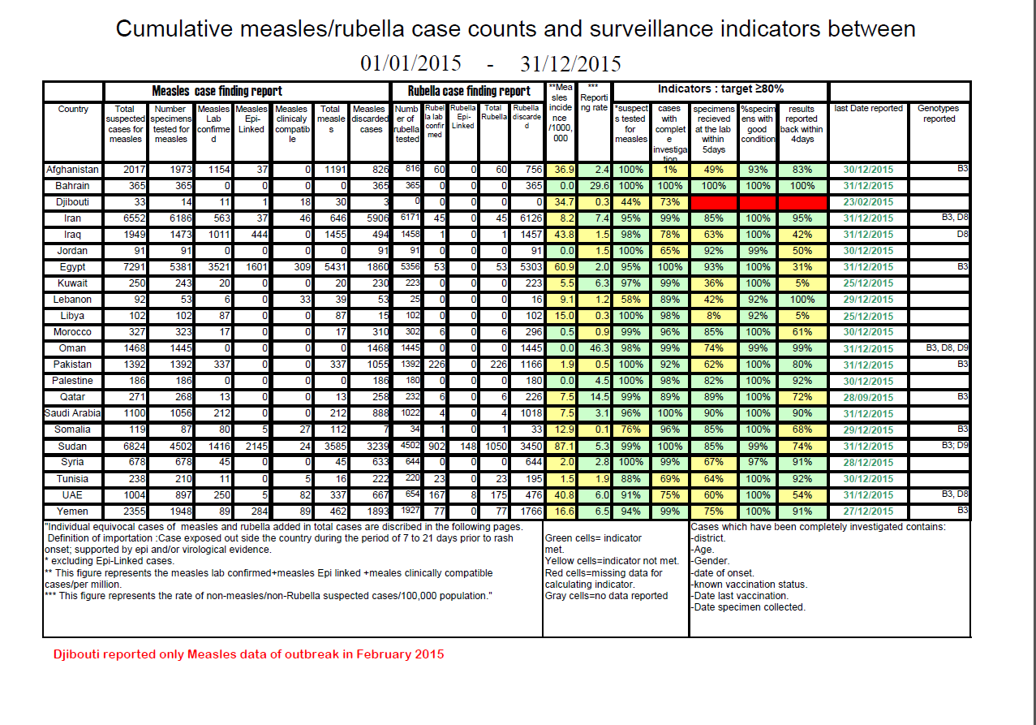
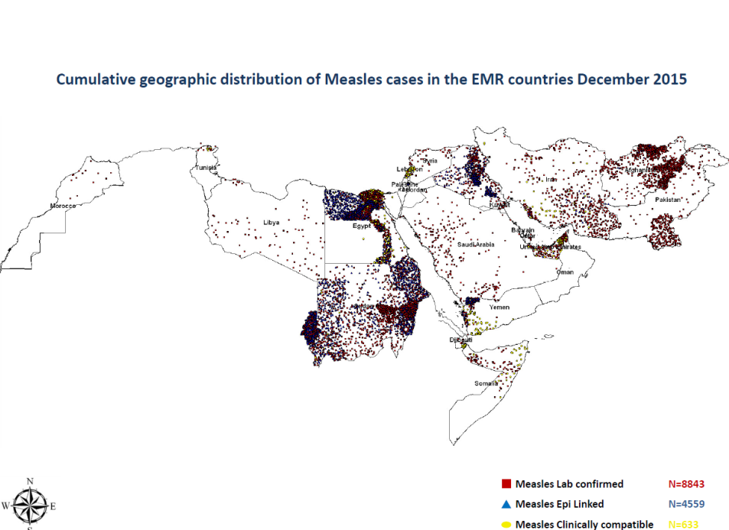
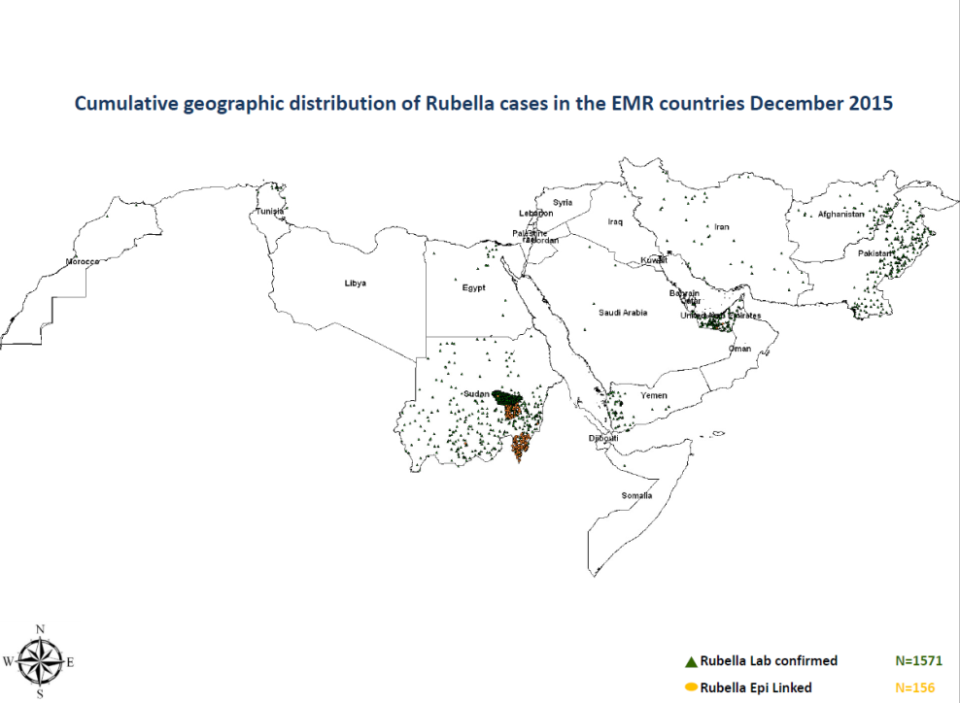
Feedback of Measles and Rubella Surveillance and Data 2015

Slide 19
Measles And Rubella Virus Genotypes in EMR, 2005-2015

Slide 20
EMR Reported Measles Genotypes in MeaNS WHO Data Base, 2005-2015
255 genotypes
D9
9 (1%)
763 genotypes
H1
27 (4%)
D8
94 (12%)
D4
120 (16%)
B3
513 (67%)
Improved virus genotyping and reporting. Change of the dominating genotype and replacement
There are many more identified genotypes but not reported to MeaNS

Slide 21
EMR
D8 sequences
As of Nov 2015
MVs/Dhofar.OMN/07.14/
RV22-14_MVi/.KWT/.14/
MVi/Baghdad.IRQ/6.13/
MVs/Q Dunieh.LBN/5.13/
MVs/Damascus.SYR/16.14/
MVi/Dahuk.IRQ/52.12/
MVs/Minieh.LBN/8.13/8
MVs/Bekaa.LBN/13.14/2
MVi/Dahuk.IRQ/50.12/
KWT
OMN
SYR
IRQ
LBN
IRN
MVs/Kserwan.LBN/12.13/13
MVi/Dahuk.IRQ/49.12/
MVs/TRIPOLI.LBN/8.14/90
MVs/Chouf.LBN/11.13/11
MVs/Tripoli.LBN/8.14/89
MVs/ZAHLEH.LBN/14.13/15
MVs/Baabda.LBN/10.13/10
MVs/Tripoli.LBN/6.14/99
MVs/ALEY.LBN/10.13/10
MVs/Tal Abyad District.SYR/11.14/
50
MVs/Saida South.LBN/7.13/11/
MVs/Aleppo.SYR/17.13/
MVs/Tal Abyad City.SYR/12.14/
MVs/Azaz.SYR/20.14/
RV22_MVi/.KWT/.14/
MVs/SAIDA.LBN/7.13/11
MVs/Swieda.SYR/11.14/
MVs/Hasakeh.SYR/12.14/
RV3-15_MVs/Bekaa.LEB/13.14/
RV20_MVs/Saida.LBN/06.13/
MVs/Q.DUNIEH.LBN/5.13/5
99
MVs/Hama.SYR/10.14/
MVi/KIRKUK.IRQ/2.14/2
66
MVs/Karaj.IRN/28.14/
RV5-15_MVs/Baabda.LEB/7.14/
MVs/BAABDA.LBN/13.14/160
53
MVs/Baabda.LBN/7.14/
MVs/Beirut.LBN/13.14/
RV2-15_MVs/ Beirut.LEB/13.14/
RV42-14_MVi/.KWT/.14/
RV125_MVi/Baghdad.IRQ/6.13/
MVs/Q.Dunieh.LBN/5.13/5
MVi/Barka.OMN/41.15/
MVs/Atmah.SYR/15.14/
RV116-14_MVs/.KWT/21.14/
61
MVs/Bah.OMN/18.15/
63
MVs/Nakhal.OMN/35.15/
69
MVs/Barka.OMN/36.15/
MVs/Nakhal.OMN/38.15/
Suwaiq.OMN 48.07/1
Sohar.OMN 50.07/1
Rustaq.OMN 05.08/1
FJ008131.Saham.OMN/48.07/3
75
FJ008127.Rustaq.OMN/05.08/1
35
FJ008130.Sohar.OMN/50.07/1
21
FJ008128.Suwaiq.OMN/05.08/1
FJ008132.Suwaiq.OMN/07.08/1
Suwaiq.OMN/07.08/1
FJ008129.Suwaiq.OMN/48.07/2
Al Ahsa.SAA/15.10
MVs/Nizwa.OMN/41.14/
MVs/Nizwa.OMN/42.14/
95
MVs/Nizwa.OMN/39.14/
MVs/Nizwa.OMN/37.14/
MVs/Ibri.OMN/43.14/
MVs/Ibri.OMN/41.14/
FJ361901.Barka.OMN/21.08/1
96
KWT/20.2010
49
HQ395676.Sistan.IRN/23.10/2
JN254655.Muscat.OMN/16.11
JN254653.Muscat.OMN/06.11
JN254654.Muscat.OMN/05.11
RV109-14_MVs/.PN1/.14/
61
MVs/Sohar.OMN/23.12/
JN254656.Muscat.OMN/19.11
64
Manama.BHR/9.10
85
Ibra.OMN/34.09
Manama.BHR/19.10
KWT/13.2008
FJ361900.Mirbat.OMN/21.08/1
MVi/Manchester.GBR/30.94 (D8)
MVi/Bastak.IRN/21.14/
MVs/Rustaq.OMN/18.14/
2015
2014
2013
2012
Previous years
MVs/Bandarabbas.IRN/27.15/
MVs/Mct.OMN/17.15/
82
RV46-14_MVi/.KWT/.14/
RV47-14_MVi/.KWT/.14/
RV110-14_MVs/.KWT/2.14/
RV111-14_MVs/.KWT/5.14/
66
RV112-14_MVs/.KWT/6.14/1
RV113-14_MVs/.KWT/3.14/2
RV45-14_MVi/.KWT/.14/
RV114-14_MVs/.KWT/6.14/3
81
DQ779222.BenniMellal.MOR/.05/3
50
DQ779220.BenniMellal.MOR/.05/1
DQ779221.BenniMellal.MOR/.05/2
DQ779206.Tanger.MOR/16.04
FJ217705.Meknes.MOR/8.07/1
99
FJ217706.Meknes.MOR/9.07/1
FJ217711.ElHajeb.MOR/11.08/1
FJ217709.Kenitra.MOR/15.07/1
76
FJ217710.Kenitra.MOR/18.07/1
FJ217707.Meknes.MOR/10.07/1
FJ217712.Zagora.MOR/13.08/1
FJ217708.Meknes.MOR/10.07/2
FJ217704.Meknes.MOR/7.07/1
2
MVi/Maryland.USA/0.54 (A)

Slide 22
Yazd.IRN/17.14/
Zabol.IRN/11.15/2
Sistan.IRN/12.12/1
Muscat.OMN/38.11
Amman.JOR/12.12/1
EMR
B3 sequences
KWT/16.14/
Zahedan.IRN/19.15/
Yazd.IRN/1.15/
Rustaq.OMN/06.12
Zahedan.IRN/16.15/7
RV23-14/KWT/.14/
RV28-14/KWT/.14/
IRN YEMKWT
OMNJOR SOM SDN EGY LBY TUN SUD
SAU
Yazd.IRN/16.15/5
Tehran.IRN/24.14/
Zahedan.IRN/27.14/4
Zahdan.IRN/50.14/
Saravan.IRN/7.15/9
Iranshahr.IRN/29.15/
Saravan.IRN/6.15/2
Sayhot.YEM/10.12
Behara.EGY/7.14/7
Alshaiq Othman.YEM/09.12
Rey.IRN/14.14/
Bandarabas.IRN/28.14/2
Iranshahr.IRN/27.15/3
Konarak.IRN/17.15/5
Jiroft.IRN/14.15/
Bint Jbeil.LBN/11.13
RV66-2015SDN
Hargiesa.SOM/15.13/1
Ainabo.SOM/09.12
RV21-15_MVs/.YEM/.15/
Erigavo.SOM/3.15/2
Erigavo.SOM/3.15/1
Garowe.SOM/9.14/9
Garowe.SOM/10.14/10
RV92-2015 EGY
RV25-15_MVs/.YEM/.15/
RV93-2015 EGY
RV31-15_MVs/.YEM/.15/
RV94-2015 EGY
Dhu.OMN/17.15/
RV44-15_MVs/.YEM/.15/
RV36-15_MVs/.YEM/.15/
RV54-2013_JOR
RV46-15_MVs/.YEM/.15/
RV62-2013_JOR
RV49-15_MVs/.YEM/.15/
Arhab.YEM/29.14/
Kuhlan Afar.YEM/23.14/
Manujan.IRN/26.15/6
Tehran.IRN/4.15/
Muscat.OMN/21.14/
Bandarabbas.IRN/29.15/2
Mashhad.IRN/16.15/6
Mashhad.IRN/26.15/5
Qeshm.IRN/43.14/
Saravan.IRN/18.14/3
Rafsanjan.IRN/15.15/
Yazd.AFG/33.15/
Zahedan.IRN/16.15/2
Isfahan.IRN/52.14/
Waxaracadde.SOM/15.11
Isfahan.IRN/3.15/
Jeddah.SAA/32.10
Hail.SAA/31.10
Tunis.TUN/11.13/
Makkah.SAA/19.10/
Alrhibat.LBY/16.12
Abuhamad.SDN/9.11/1
Sabha.LBY/22.11/1
Muscat.OMN/21.10
Makkah.SAA/15.10
South Darfour.SDN/18.13
Sabha.LBY/23.13/2
Sabha.LBY/25.13/1
Tunis.TUN/42.13/1
Sabha.LBY/25.13/2
RV95-2015 EGY
Benghazi.LBY/1.14/
Benghazi.LBY/52.13/
Jizan.SAA/33.10/1
AF532928.MVi/Sfax.TUN/02
Jizan.SAA/49.10
Salalah.OMN/52.10
JN254657.OMN/19.11
Alqurayyat.SAA/31.10
DJI/43.08/1
Galbed.SOM/40.10/2
Salalah.OMN/17.09/1
Najran.SAA/02.11
Riyadh.SAA/49.10/
Riyadh.SAA/03.11/2
Zliten.LBY/8.09/2
3488-BHR/11
Gezeira.SDN/18.13/
Sfax.TUN/11.09/1
Abeiy.SDN/02.2007
KWT/8.2007
Zliten.LBY/9.10
Abuhamad.SDN/10.11
RV22-2012-SDN
Sert.LBY/51.10
Sabha.LBY/22.11/2
Gherian.LBY/52.10
Elgenainah.SDN/02.09
KWT/14.11/1
FurBranga.SDN/47.09
Serba.SDN/3.10
Zliten.LBY/45.08
Zliten.LBY/14.09/4
Tunis.TUN/14.09
AY456409.SDN/03
Sfax.TUN.09.09
AY456408.SDN/03
AY456405.SDN/02
AY456407.SDN/02
AY456396.SDN/01
Khartoum.SDN/28.00/6
Khartoum.SDN/28.00/5
Khartoum.SDN/17.02
Khartoum.SDN/28.00/2
2015
2014
2013
2012
Previous years
AY456397.SDN/01
Khartoum.SDN/28.00/4
AF311812.SDN/99
Sabha.LBY/7.07/1
DQ023696.SDN/04
AY456403.SDN/02
Zliten.LBY/10.07
Omdurman.SDN/44.04
AY456406.SDN/02
Khartoum.SDN/28.00/1
AF311797.SDN/98
MVi/Ibadan.NGE/0.97/1 (B3)
Sfax.TUN/18.02
AF311792.SDN/97
Msaid.LBY/18.03
AF311789.SDN/97
AF149064.SDN/97
AF311799.SDN/98
AF311816.SDN/28.00
MVi/New York.USA/0.94 (B3)
AF311793.SDN/97
DQ779219.MOR/04
DQ779216.MOR/04
DQ779208.MOR/04
2
Tetouane.MOR/31.04/1
MVi/Maryland.USA/0.54 (A)

Slide 23
Rubella Identified
genotypes 2003-2016
Except Oman and Iran data many of measles
and rubella genotypes have not yet been
submitted to MeaNS and RubNS
Labs still face problems in identification of
rubella genotype
Some countries are still not meeting >80%
of laboratory-confirmed chains
of transmissions have adequate samples
for detecting Measles/Rubella virus
TUN (21)
1E : 2003 - 2008 – 2010 – 2011
2B: 2011 – 2012 - 2013
YEM (3) 1E : 2008 , 2B: 2008
SDN (2) 1E - 1G – 2005, (1) 2B-2015
OMN (1) 2B: 2012
MOR (1) 2B : 2013
IRN (2) 2B : 2011 - 2014
UAE (3) 2B: 2015

Slide 24
Challenges
Interrupt endemic transmission of measles virus
Security situation in increasing number of EMR countries
Regional laboratory coordinator vacant from Jan 2016
Getting impossible Shipment of lab supplies from the Regional Stock to support stock-out of kits and for outbreaks
Collection adequate specimens for viral detection and genotype for identification of each outbreak
Timely sharing and reporting Measles virus Genotype data to WHO Genotype data base -MeaNS
Continue maintaining LabNet core capacity building to meet the requirements of the Program
In Few countries weak EPI and Lab coordination

Slide 25
Moving Forward
More efforts are needed to reach measles elimination goal
Establishing measles validation commission and moving forward on documentation elimination to countries already reaching elimination
Strengthen collaboration between lab & surveillance
Improve genotyping surveillance, particularly for rubella
Ensure to sustain the high quality of the Lab Network
refresher training, EQA: accreditation review, genotyping capacity, reporting timeliness and completeness and participation of EQCs
Filling the vacant post of Lab coordinator
Keeping annual Inter-country EPI, Surveillance and Lab Net meeting on Measles/Rubella elimination

Slide 26
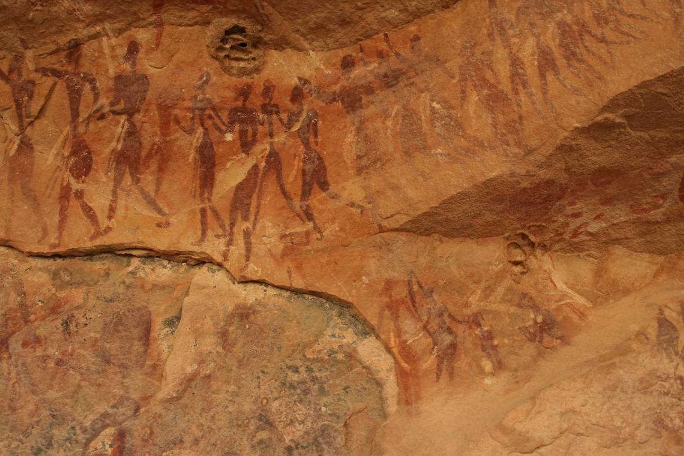
Acknowledgements
To all EMR national MR staff:EPI/LabNet
WHO/HQ
UNICEF
CDC Atlanta
MRI
EMR RRLs
VIDRL Australia
THANK YOU

