Slide 1
Strengthening Routine Immunization in Urban Poor Communities- the Philippine Experience
Carla Ante-Orozco, MD,MPH
Health PS Specialist
UNICEF Philippines
Notes:
Good morning everyone and thank you for the opportunity of sharing the work that we are doing in the Philippines to strengthen routine immunization in urban poor communities

Slide 2
The Philippines
An archipelago in Southeast Asia, with 7,107 islands
Population: 101 million (2015 PSA)
Divided into three island groups and 17 administrative regions
Lower Middle Income Country with a fast growing economy
One of the highest GINI coefficient in SEA
Notes:
The Philippines is an archipelago with more than 100M population. It is rapidly urbanizing, the twelfth most populous country in the world, with Metro Manila as one of the world’s megacities.

Slide 3
The Philippines has many unvaccinated children..
Notes:
In 2015 the Philippines was among the top 10 countries in the world with the highest number of unvaccinated children for DPT3

Slide 4
Confirmed Measles Cases, 2013 and 2014
Yr. 2013
Yr. 2014
1 Dot =1 case
Dots are placed at random within the corresponding province, and might not reflect the exact location of the case.
Notes:
As a result of declining coverage for most antigens including measles, there were wide-scale measles outbreaks in many provinces and cities in 2013 & 2014 .The measles outbreak of 2014 resulted in 23,708 confirmed measles cases affecting mostly urban communities with the highest case load in Metro Manila …And it maybe worth mentioning that many of the measles cases in the U.S. in 2014 were associated with cases brought in from the Philippines.

Slide 5
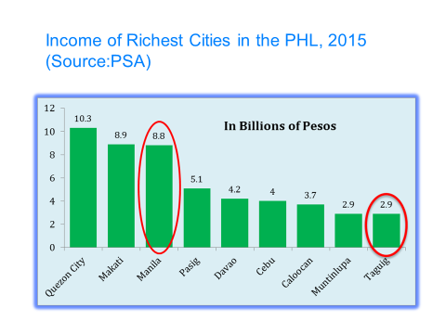
Challenges that lead to inequities
Communities
Densely populated urban poor communities
Cities with high income but with high number of poor households
Highly mobile population
High number of unregistered migrants and transients from other places
Low demand for immunization services
Health systems
Decentralized health care delivery system
Weak leadership, governance and accountability mechanisms
Inadequate number of health facilities
Inadequate health workforce
Immunization services
Vaccine stock outs
Limited outreach immunization activities
Inadequate tracking of defaulters
Notes:
What were the challenges?The Philippines has many densely populated urban poor communities. In Metro Manila alone an estimated 1.8M people live in slums. Ironically many of the 10 richest cities in the country has the highest number of poor households. There are many mobile population and many unregistered migrants from other regions because of armed conflict, disaster or the desire to find better working opportunities . This poses a challenge in tracking of children for immunization. The health care system is decentralized to local government units with varying level of support for health services.There are inadequate number of health facilities and health workers, with one health center (1 doctor) catering to as many as 75,000 people.Added to this are frequent vaccine stock outs, limited outreaches and inadequate defaulter tracking

Slide 6
Actions and innovations
Notes:
In June 2016 UNICEF Philippines with funding support from UNF and technical assistance from HQ and RO, partnered with the Department of Health and the Cities of Manila and Taguig in a project to reduce inequities in immunization in the urban poor communities of Metro Manila

Slide 7
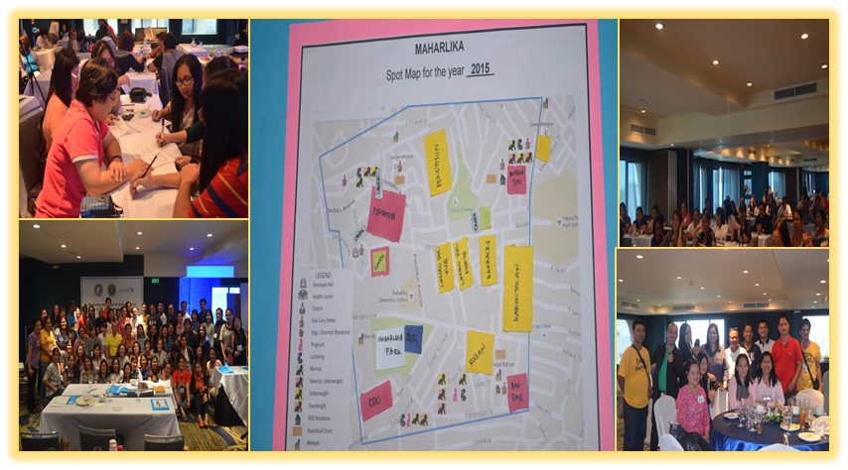
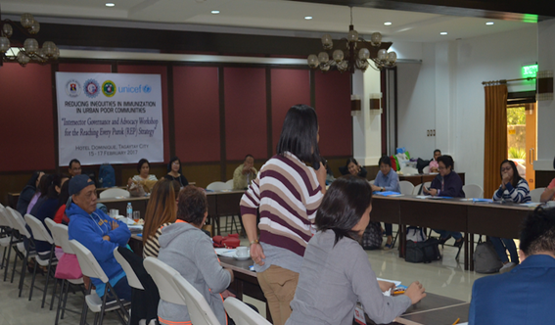
Improving Leadership and Governance
Joint EPI Microplanning Workshops
Health personnel and local officials were convened for a thorough discussion of immunization concerns in their localities and plan for improvement
Intersectoral Governance and Advocacy Meeting
attended by participants from different non-health agencies: Social Welfare, Interior and Local Government, Budget/Treasury, Commission on Audit, Metro Manila Development Authority
Fostered a better understanding of the roles /contributions of different stakeholders including mobilizing resources to support immunization
Notes:
We started with establishing partnership with key stakeholders in the community. In a decentralized health system these are the local officials at the barangay (village) level who has the power and resources that can be tapped . We organized joint EPI Microplanning Workshop, where for the first time local officials and health staff were gathered together to discuss the issues/concerns behind low immunization coverage, identified high risk areas and developed joint microplans which are revisited every quarter. Recognizing as well that other non health stakeholders of should be involved , we organized intersectoral workshops for this purpose. This was a practical strategy to better understand the roles /contributions of different stakeholders including mobilizing resources to support immunization

Slide 8
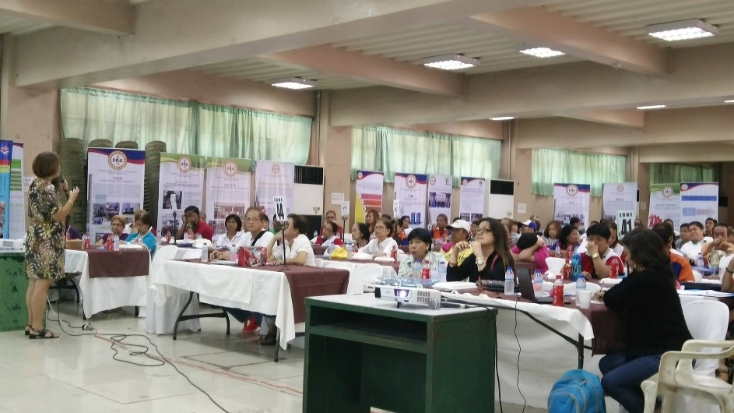
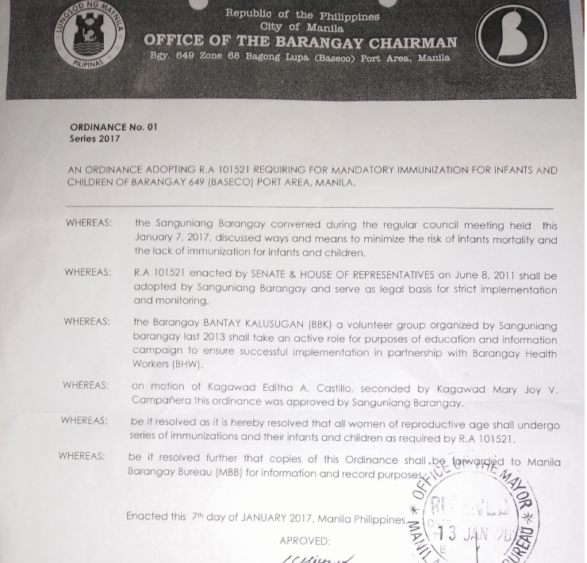
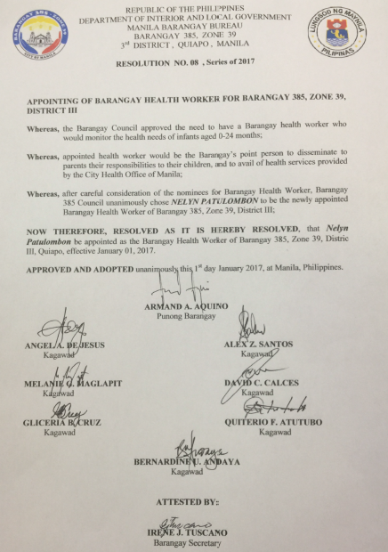
Improving Leadership and Governance
Advocacy meeting with Barangay Officials to support immunization led by the Department of Interior and Local Government of the City of Manila, Barangay Bureau and the Budget Office.
Attended by barangay captains, councilors for health from 896 barangays (villages)
Outcome :
167 barangay captains hired Barangay Health Workers for the first time using their own funds
To date 300 local ordinances were passed in support of immunization
Notes:
In the City of Manila there are 896 barangays (villages) and onlyp around 200 Barangay Health Workers paid by the city to support the health centers. To address this gap in manpower, a series of Governance and Leadership Advocacy Workshops were organized with the goal that all the Barangays of the city will hire their BHW from their own local budget for immunization and other health services. As a result to date an additional 167 BHWs were hired and 300 policies in support of immunization were passed

Slide 9
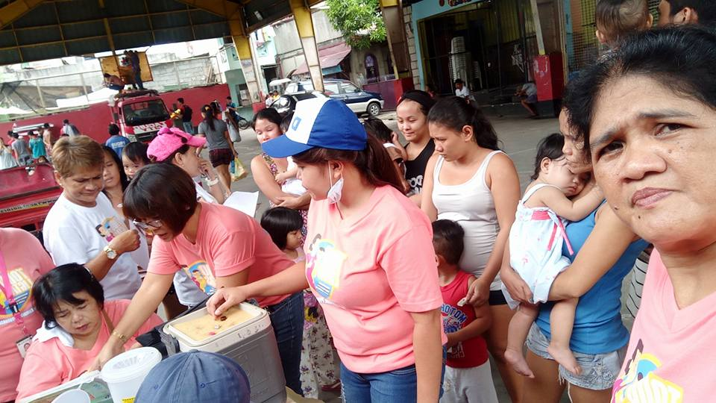
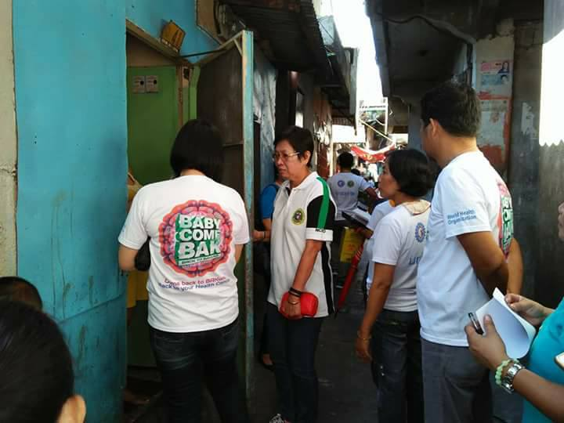
Improving Service Delivery
Capacity building of health workers on basic EPI and cold chain
Regular outreaches
Quarterly rapid coverage assessment of high risk puroks (zones) to check for missed children
Development of an Electronic Target Client List (eTCL)
An online tool using Google sheets that can be accessed, created and encoded anytime by health center staff.
For special reminder, each antigen that is due for giving per child will be automatically highlighted in red and will disappear as soon as data is entered.
Notes:
With large number of population and one health center, regular outreaches were done with support from local officials in terms of mobilizing the guardians and caregivers of children, transport and security for the vaccination team. A quarterly rapid coverage assessment is done for high risk puroks (zones/streets) to check progress. For a more efficient data management we developed an electronic version of the Target Client List which uses a simple excel worksheet which soon will be online using google sheets. This will do away with the use of paper based recording and reporting and has a special reminder where each antigen that is due per child will be highlighted in red for easy tracking

Slide 10
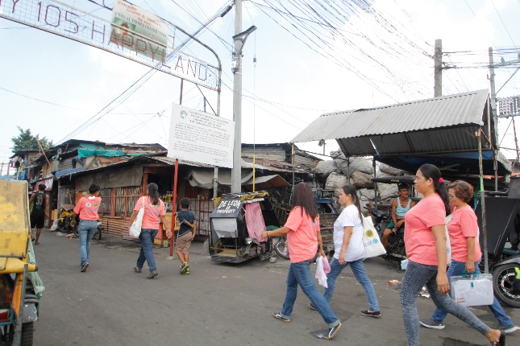
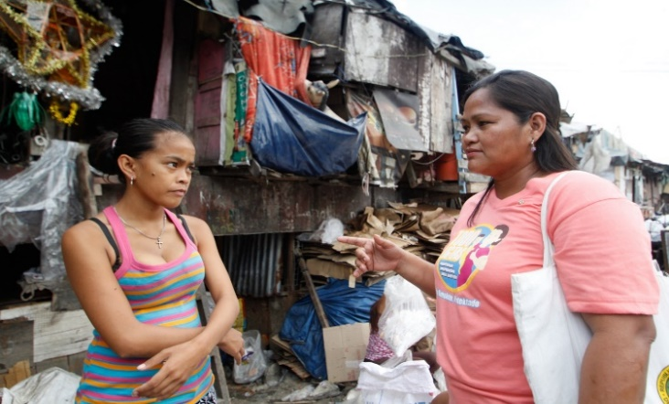
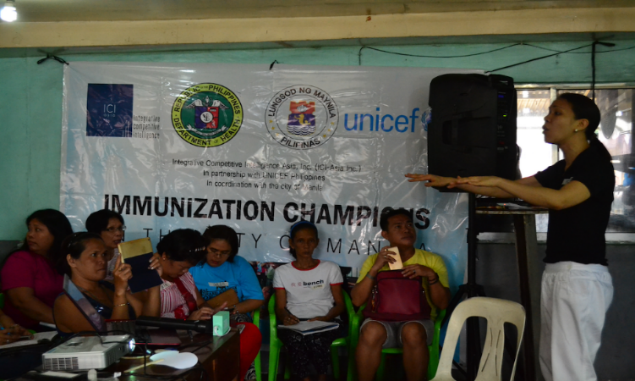
Community Engagement
Recruitment and training of non traditional barangay health volunteers (at least one per street) for masterlisting and defaulter tracking
- Consist of students, housewives, youth leaders, parent leaders, street sweepers and other community members who were first time volunteers for health- related activities
EPI champions for social mobilization
Recruitment of ordinary folks in the village to complement ongoing initiatives of barangay officials and health workers in promoting immunization.
Notes:
After the Micro Planning Workshop barangay chairmen were encouraged to recruit volunteers, at least one for each for their street/zones to do masterlisting and defaulter tracking. The volunteers came from all walks of life, there are students, parents and even street sweepers with ages ranging from 16-64 years old. EPI Champions were also recruited, and their main task is to complement ongoing initiatives of barangay officials and health workers in promoting immunization.

Slide 11
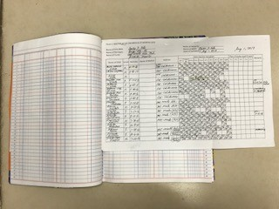
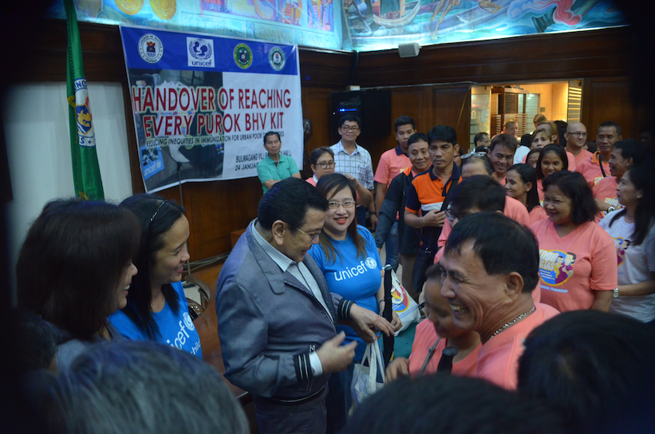
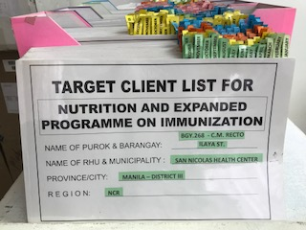
Barangay Health Volunteer's Tools for Masterlisting and Defaulter Tracking
Volunteer’s kit(bag,notebook,tshirts,umbrella)
Barangay map indicating high risk areas
Immunization registry by street
Notes:
These are the tools of the health volunteers to do masterlisting and defaulter tracking. The masterlist is shared with the nurse/midwives for entry in the immunization registry

Slide 12
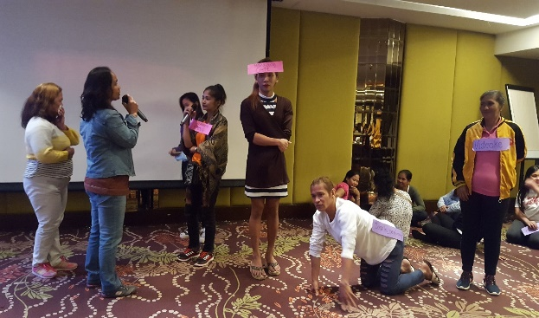
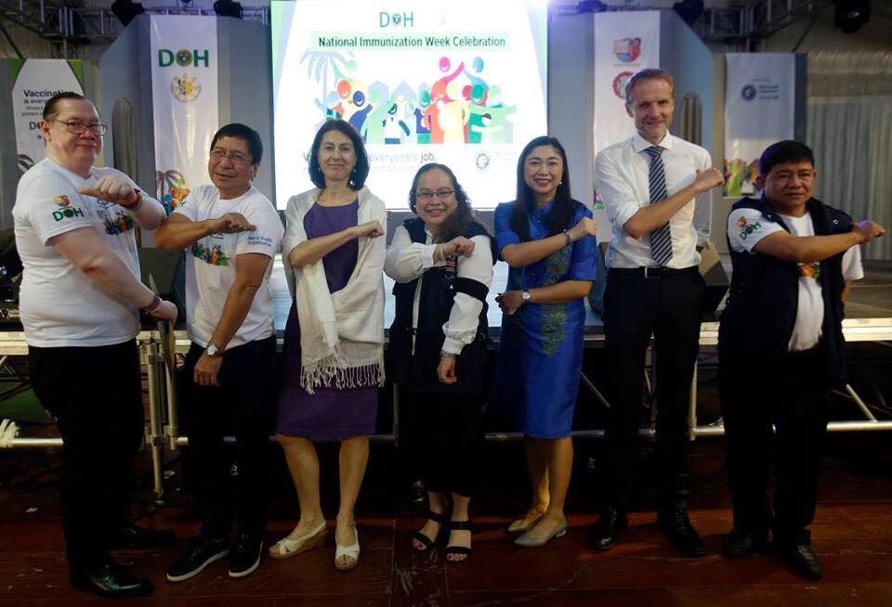
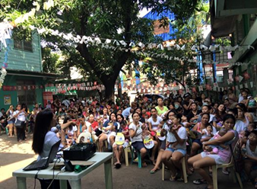
Advocacy and demand generation
Qualitative Research
Ongoing study to understand the Knowledge Attitude Practices of caregivers, health workers, local leaders and other stakeholders on immunization
Capacity building of Barangay Health Workers on Interpersonal Communication and Counseling (IPCC)
BHWs trained in the proper technique of communicating with mothers/caregivers to bring their children for immunization
World Immunization Week Celebrations
Notes:
We partnered with ICI Asia in the conduct of a qualitative research to understand the reasons behind low immunization uptake from the perspective of caregivers, health workers and local leaders. This will then feed into development of effective social mobilization strategies At the same time we trained existing barangay health workers in Interpersonal Communication and Counselling to encourage mothers/caregivers to bring their children for immunization

Slide 13
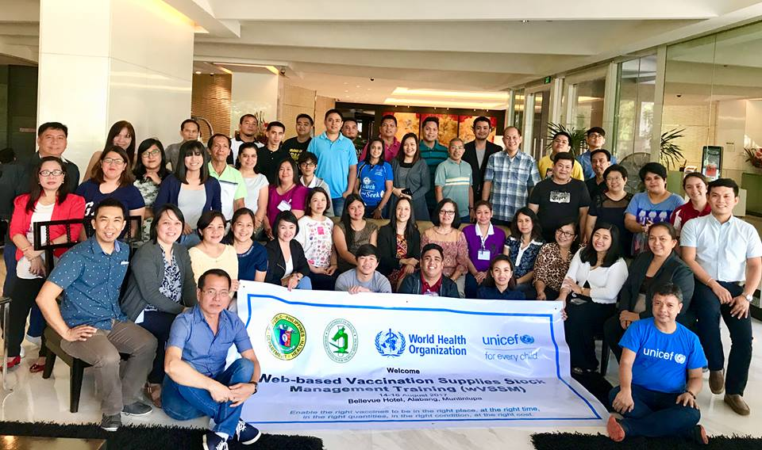
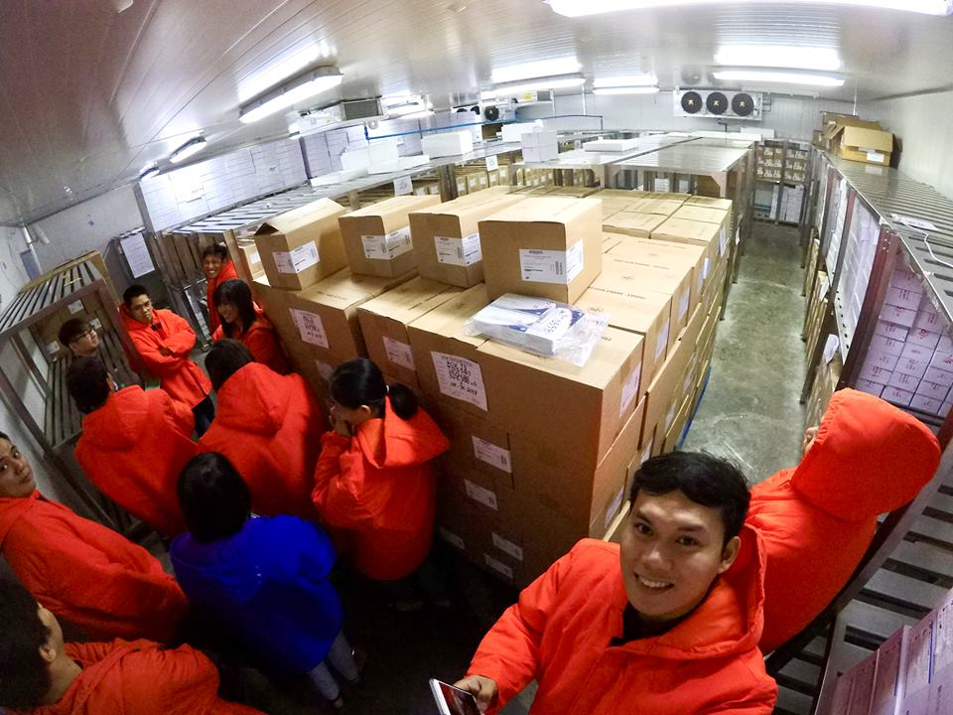
Improving the supply chain
Technical support to MOH to improve vaccine forecasting and procurement process
Training of MOH Subnational Offices in the use of the web based Vaccination Supplies and Stock Management for a more efficient inventory and distribution
Notes:
To improve the supply chain and prevent stock outs we provide technical support to MOH National Level in vaccine forecasting and procurement process. We also trained the 17MOH subnational offices in the use of the web based vaccination supplies and stock management

Slide 14
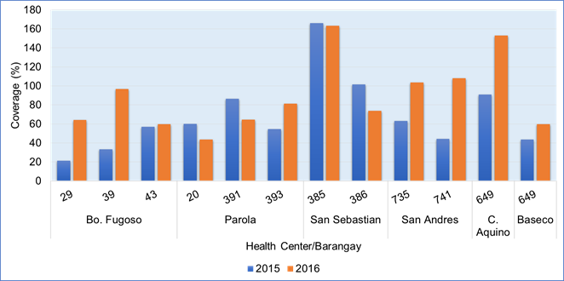
Promising Results: More children vaccinated with MCV1 and MCV2, less measles cases in the City of Manila
MCV1 and MCV2 Coverage 2015-2016 in Project Sites
Total confirmed measles cases City of Manila, 2014 to 2017
Notes:
The urban immunization project in Metro Manila is a work in progress and we face continuous challenges but we are encouraged because we know we are contributing to promising results- more children being vaccinated and lesser number of measles cases

Slide 15
Way Forward
Barangay Health Leadership Program for barangay captains
Advocacy (establishment of partnership) with private sector, other government agencies and academe
Creation of interlocal barangay health zones for service delivery network and sharing of resources
Leadership Training Course for doctors and public health workers
Reach Out and Read initiative: children will be given at least two books, one for MCV1 and another for MCV2
Hiring of program officers to support the national MOH EPI team and 2 subnational MOH offices
Notes:
We still have a lot to do this year and the next years perhaps. We want to think out of the box and innovate more with the hope that the strategies will be sustained and scaled up. We will be training local leaders and doctors in leadership programs, create interlocal barangay health zones, implement the Reach Out and Read Initiative and advocate for inclusion of MCV2 in the FIC indicator. And with funding support form HQ, we will be fielding 3 program officers to work with the DOH in measles elimination and strengthening the immunization program at the national and subnational level. Our vision is for an urban immunization strategy that works and owned by the community

Slide 16
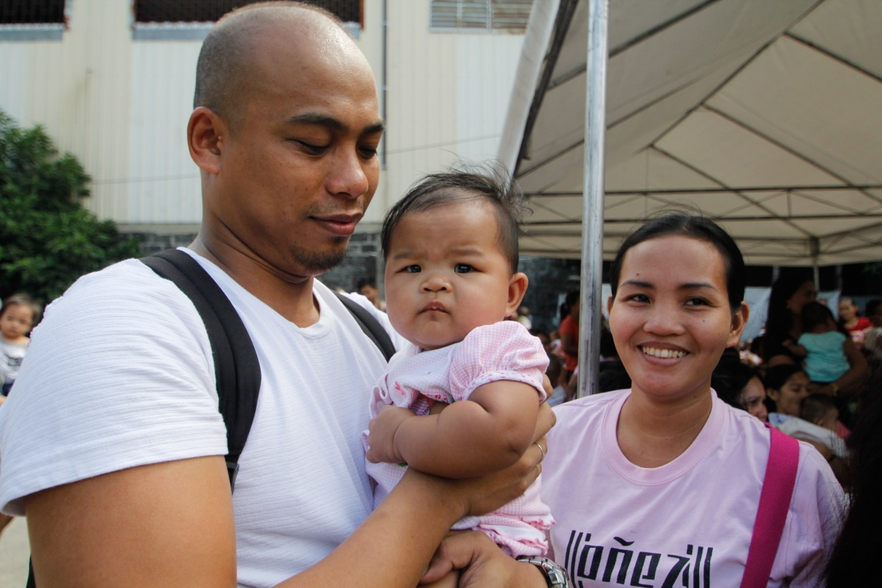
Thank you!
Notes:
On behalf of my team in the CO we want to say thank you to UNICEF Headquarters , RO and DOH for the support to this initiative and our donors as well. We will continue the work and reach every child for immunization. THANK YOU!

