Slide 1
Mobile data collection
For rapid convenience monitoring and social mobilization
Taonga Nyekanyeka, Malawi Red Cross Emily Eros, American Red Cross

Slide 2
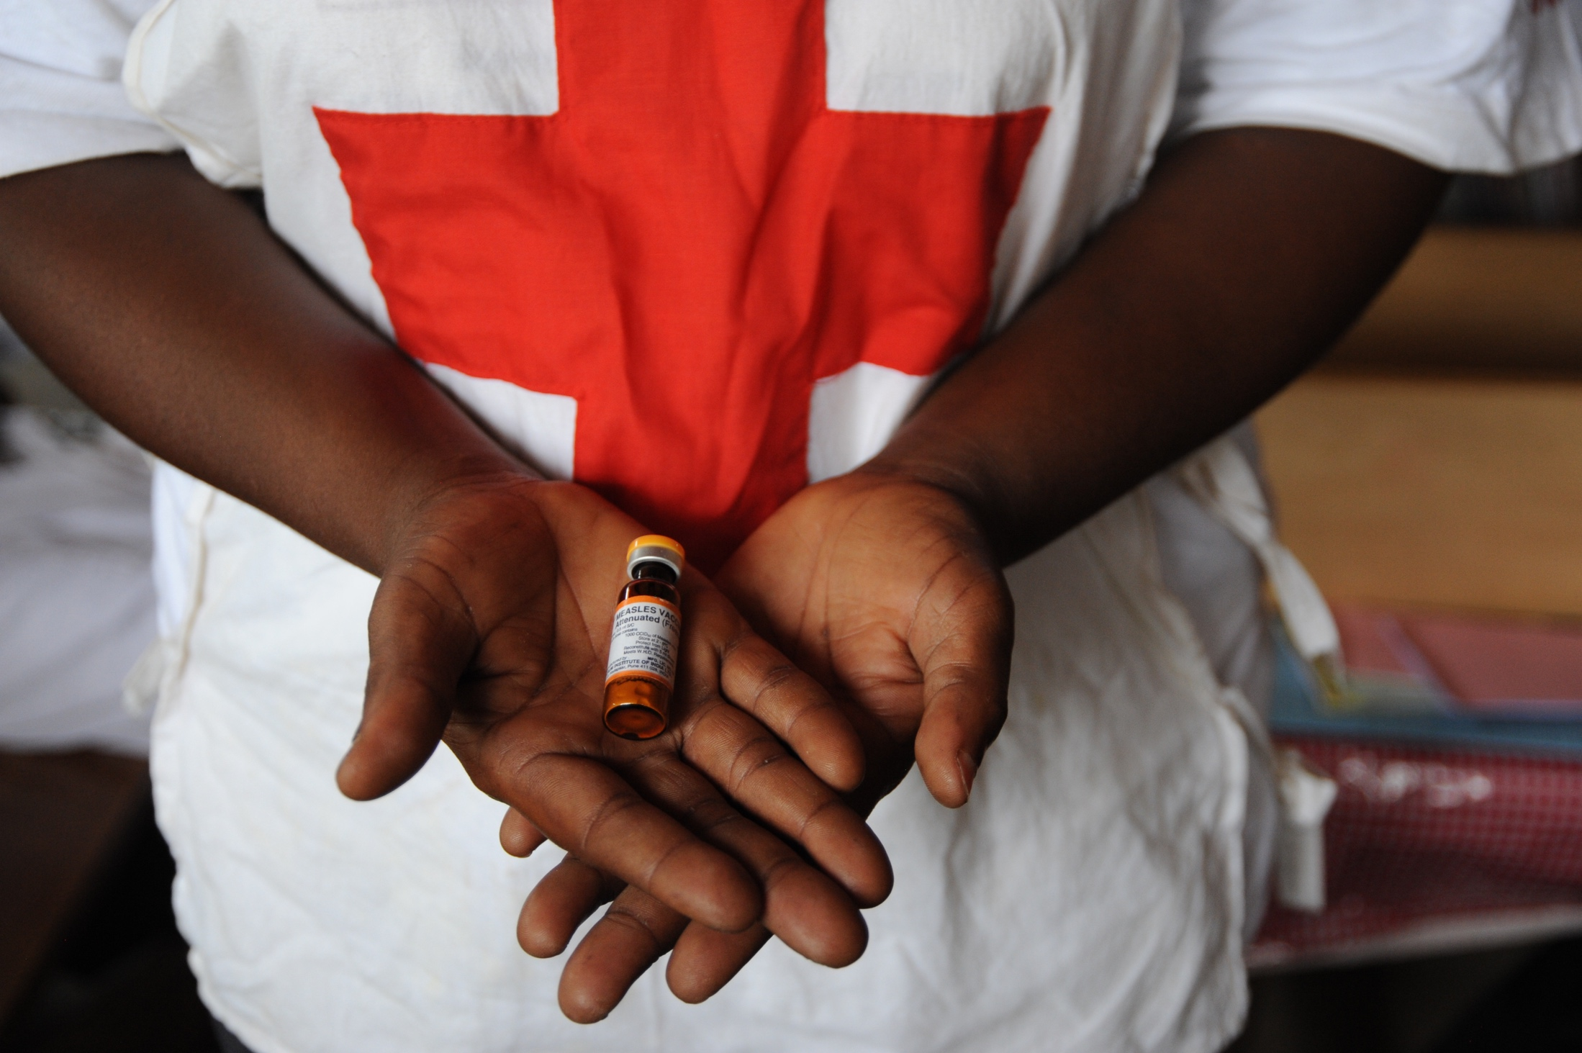
Outline
Role of Red Cross
Social mobilization pilot
3. Rapid convenience monitoring
4. Challenges and ways forward

Slide 3
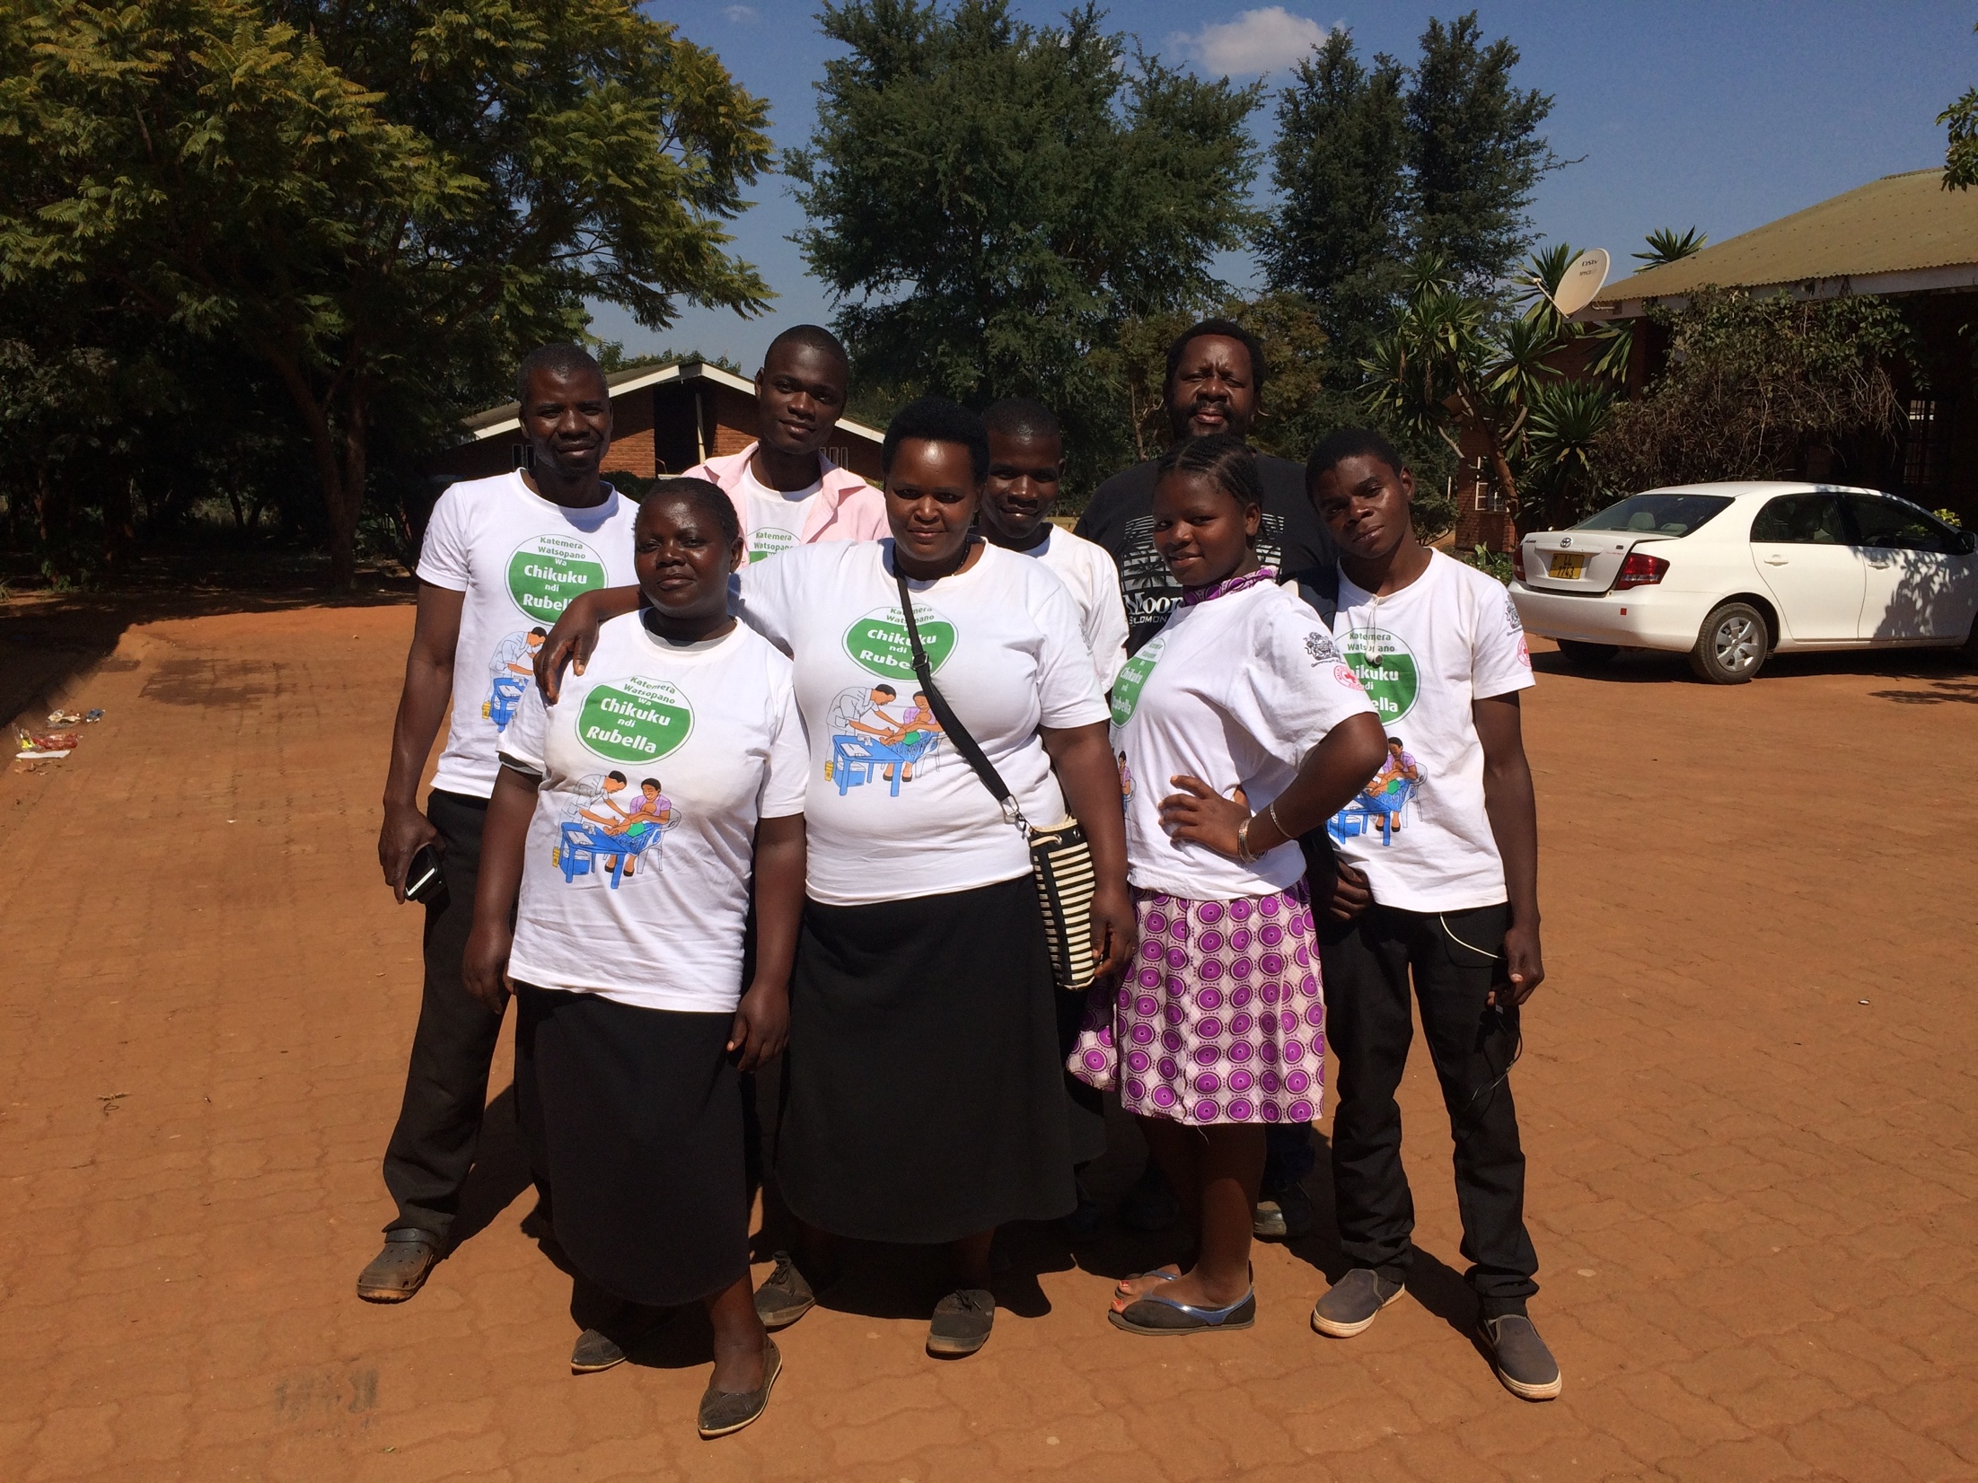
1. Red Cross role in the measles and rubella initiative

Slide 4
Malawi Red Cross Society: Profile
Has a membership of over 70,000 volunteers
33 divisions/branches across the nation
Has a secretariat with employees (145) of different technical backgrounds

Slide 5
Malawi Red Cross Society: Profile and comparative advantage
Knowledge and skills in social mobilization on a wide range of health and development in their respective communities
Established community drama groups and interpersonal message dissemination experience
Successfully supported MoH in social mobilization for increased vaccine coverage for target groups i.e. biannual child health days, 2015 measles campaign for flood-affected districts, 2013 measles campaign, and the recent 2017 measles/rubella campaign
Reliable member of the MR campaign national task force –which oversees the overall organization of the campaign
One of the lead members of the Communication & Social Mobilization technical subcommittee
Able to mobilize and orient volunteers very quickly

Slide 6
MRCS roles for SIA in Malawi:
Door-to-door social mobilization campaign
Collecting routine immunization info for households visited during social mobilization (paper- and digital methods)
Introducing Rapid Convenience Monitoring (RCM) during the campaign... with real-time results

Slide 7
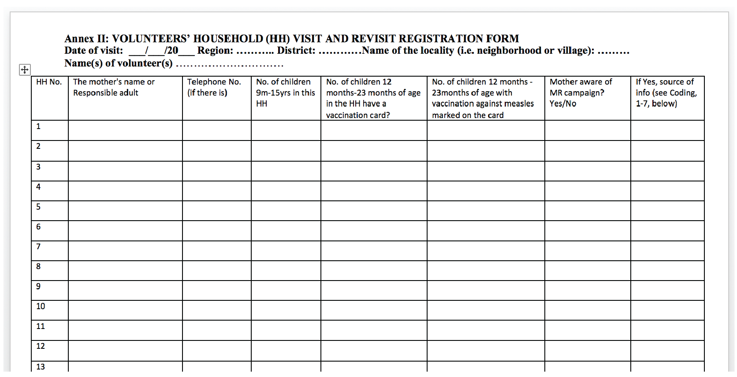
2. Social mobilization pilot
Example of paper form

Slide 8
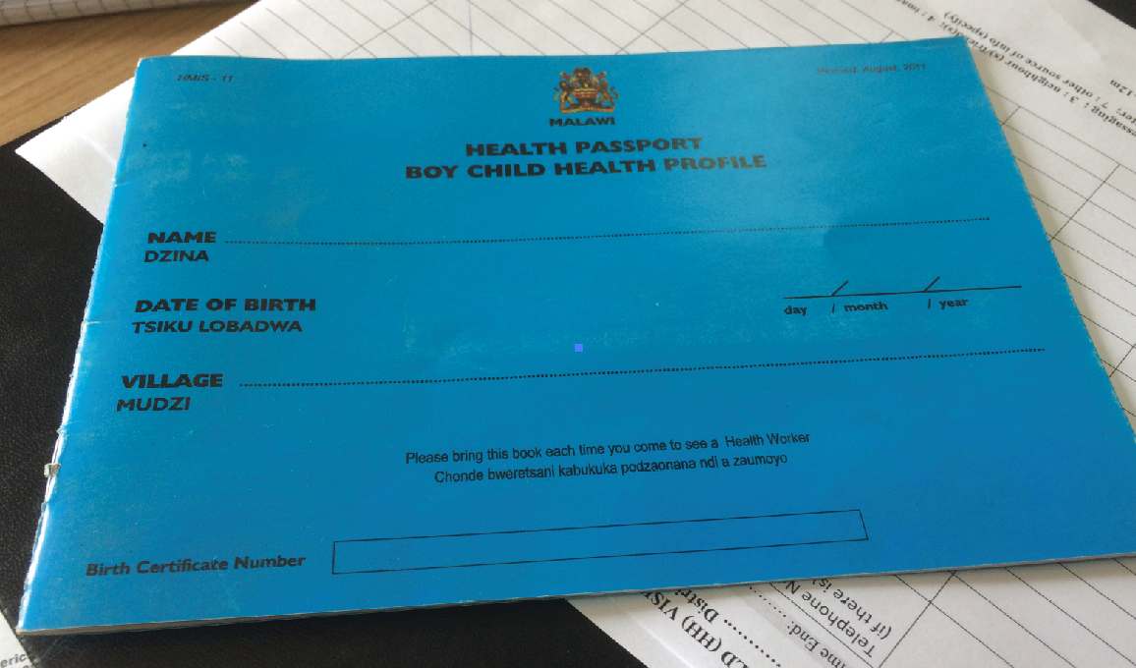
Routine immunization questions for children 12-23 months

Slide 9
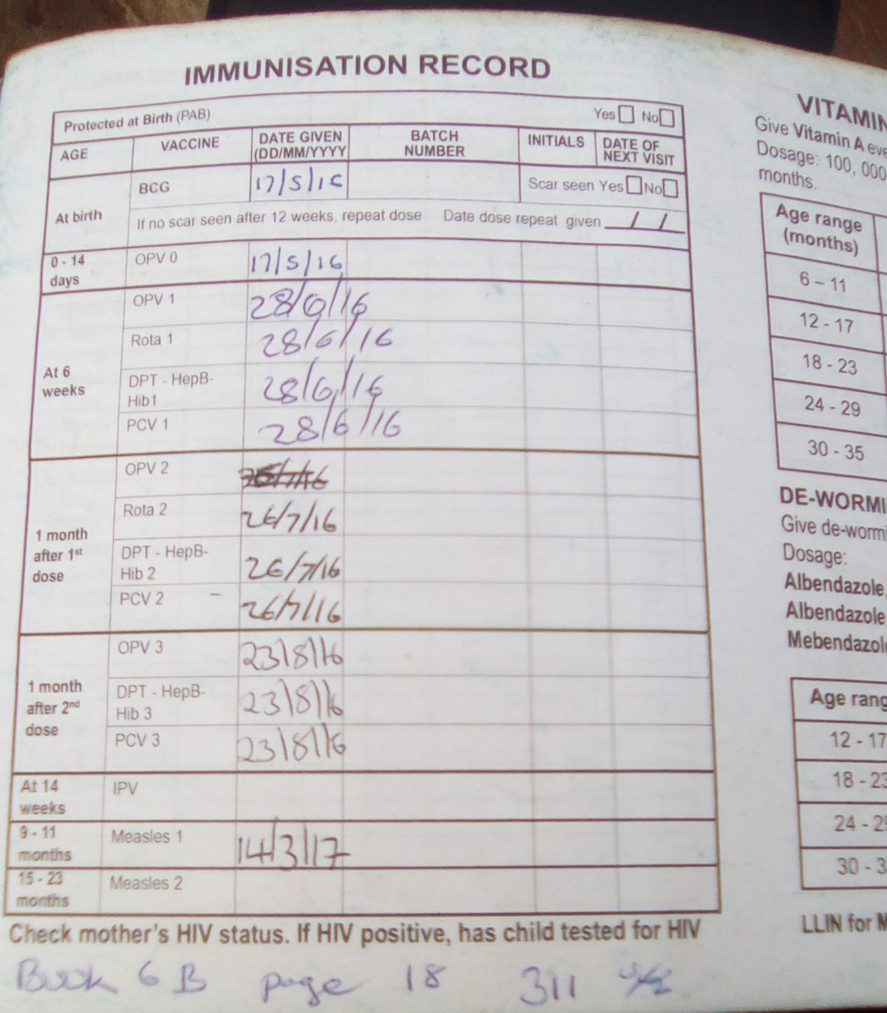
Completed immunization record

Slide 10
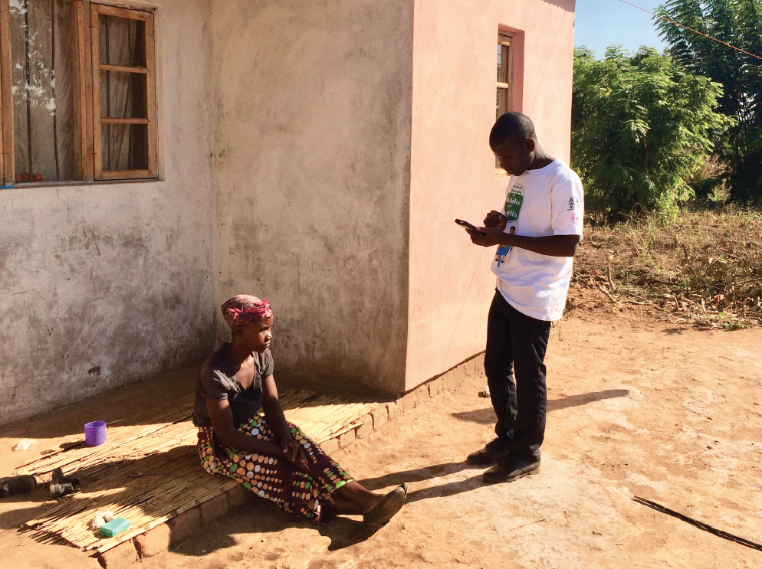

Slide 11
Data collected:
Name and contact number of mother
# of children aged 9 mo - 15 yrs
# of children 12-23 mo with health passport
# of children 12-23 mo with measles vaccination marked on health passport
Photo of immunization record
Awareness of current measles campaign
Means of awareness of campaign (ex. newspaper, health worker, friends, pastor/imam)

Slide 12
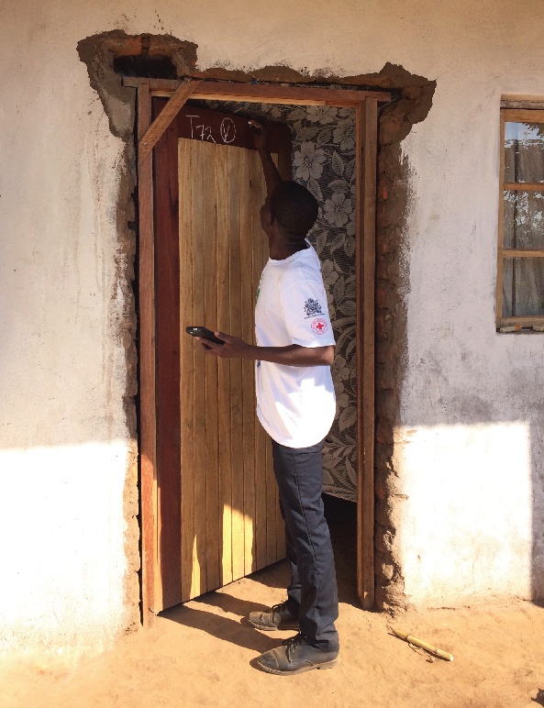
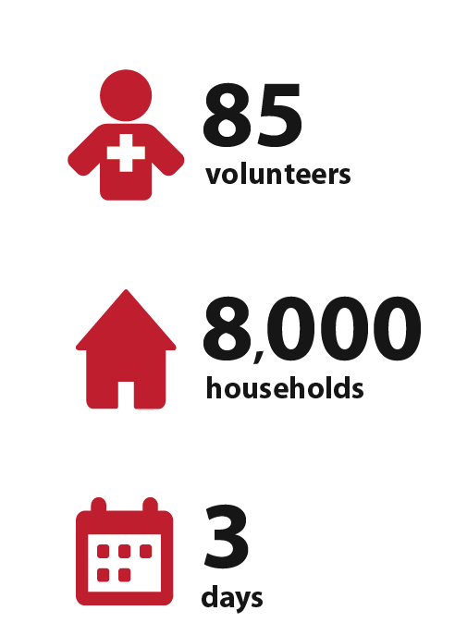
Lilongwe results
An MRCS volunteer in Lilongwe marks this household as having been visited (June 10, 2017)

Slide 13
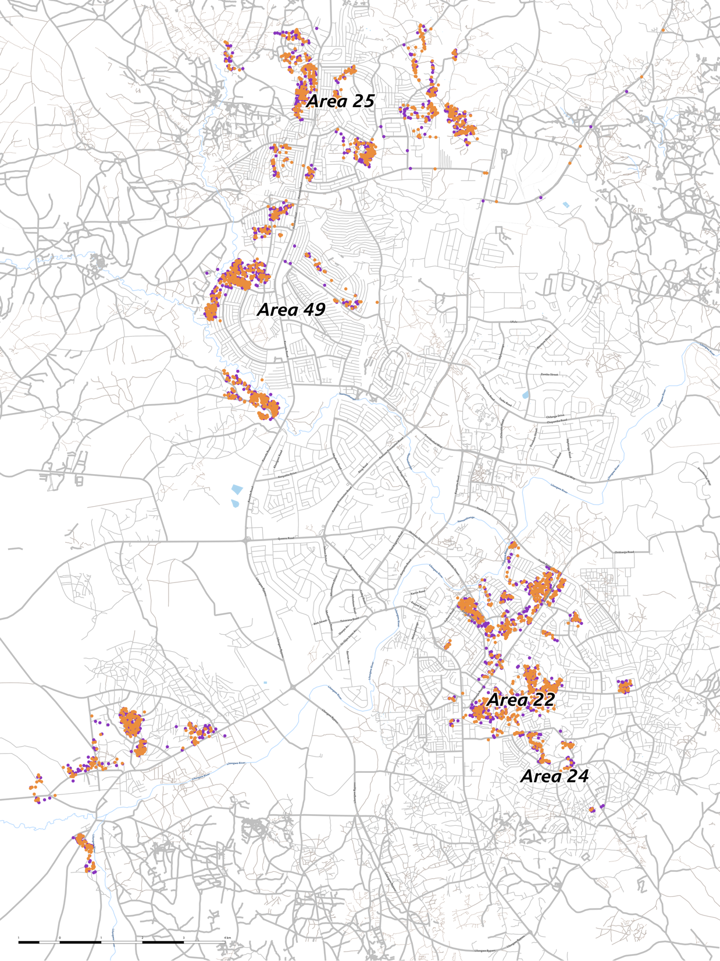
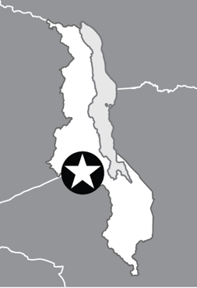
Results
3,857 households surveyed using regular form
Time: 2min45 average
Lilongwe
4,043 households surveyed with additional routine immunization questions
Time: 3min34 average
Time: 5min21 with passport

Slide 14
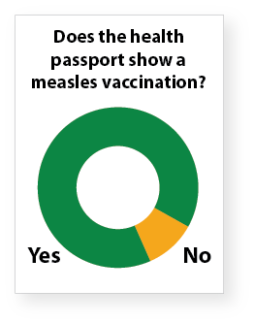
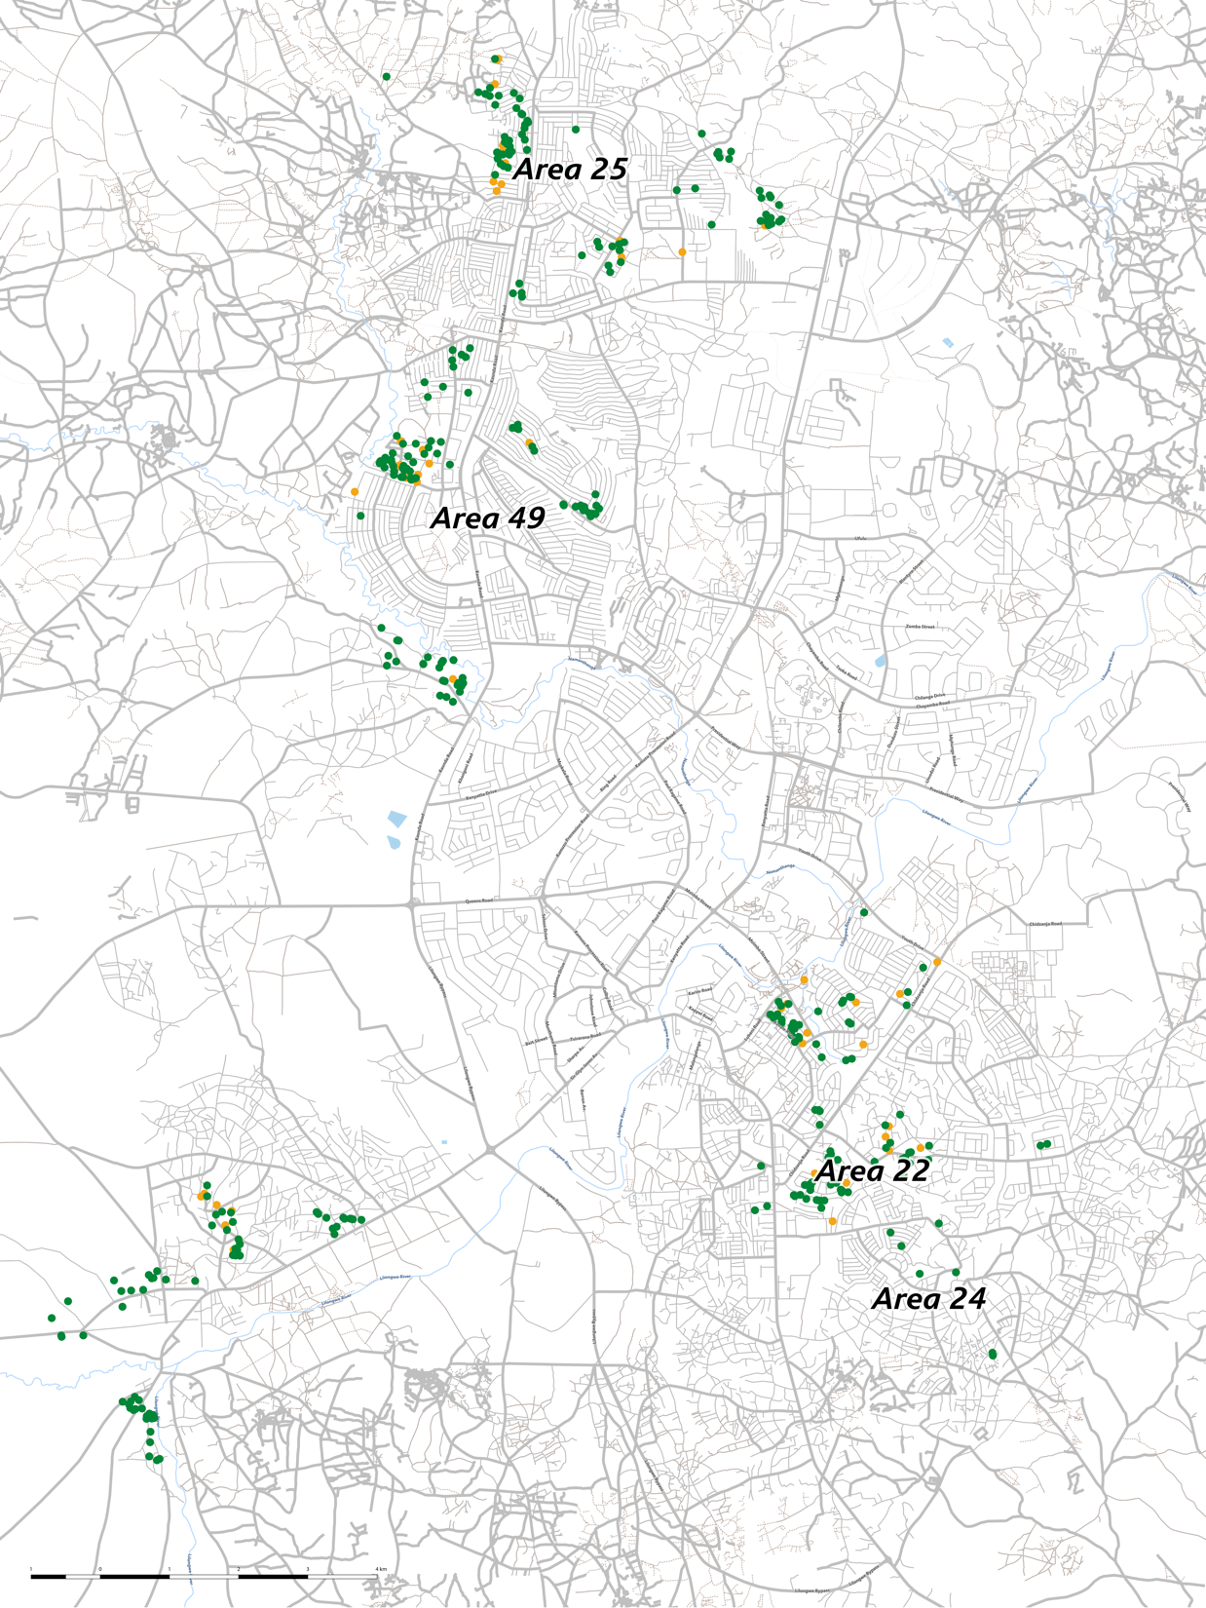
Children missing routine vaccinations
~10% of hhlds had a child in the 12-23 mo age range with a health passport. (We can’t disaggregate those with eligibly-aged children without a health passport.) Of those who had a health passport, 536 of 623 (85%) had a measles vacc marked. 87 of 623 (15%) did not.
*Potential issue with volunteers following instructions closely
Lilongwe

Slide 15
Children missing routine vaccinations
Lilongwe pilot results
Can’t disaggregate % of children 12-23 months without a health passport. Of those who had a health passport, 85% of children 12-23 months had at least one measles vaccination marked.
2015-2016 Malawi DHS data
73% of children aged 12-23 months had a vaccination card Of those who had a health passport, 78-79% of children 12-23 months had at least one measles vaccination marked
Full DHS data: http://dhsprogram.com/pubs/pdf/FR319/FR319.pdf

Slide 16
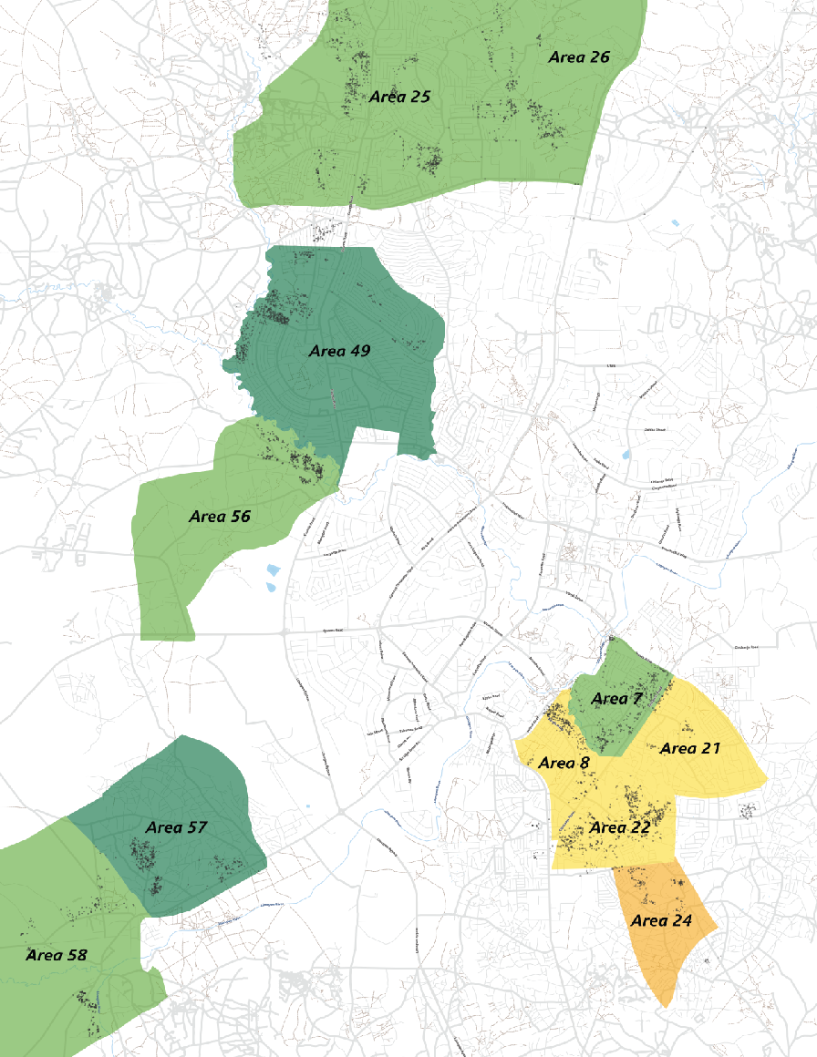
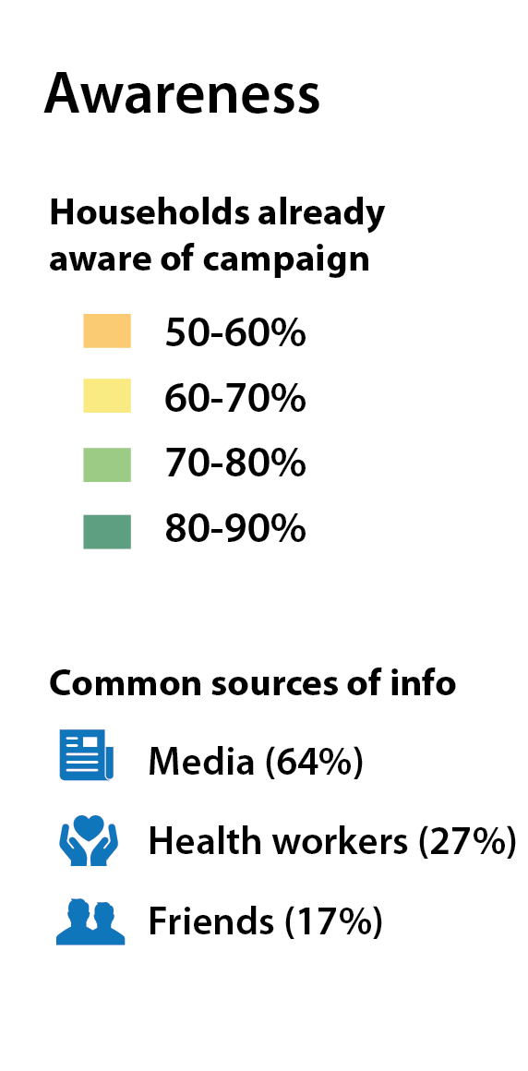
Lilongwe

Slide 17
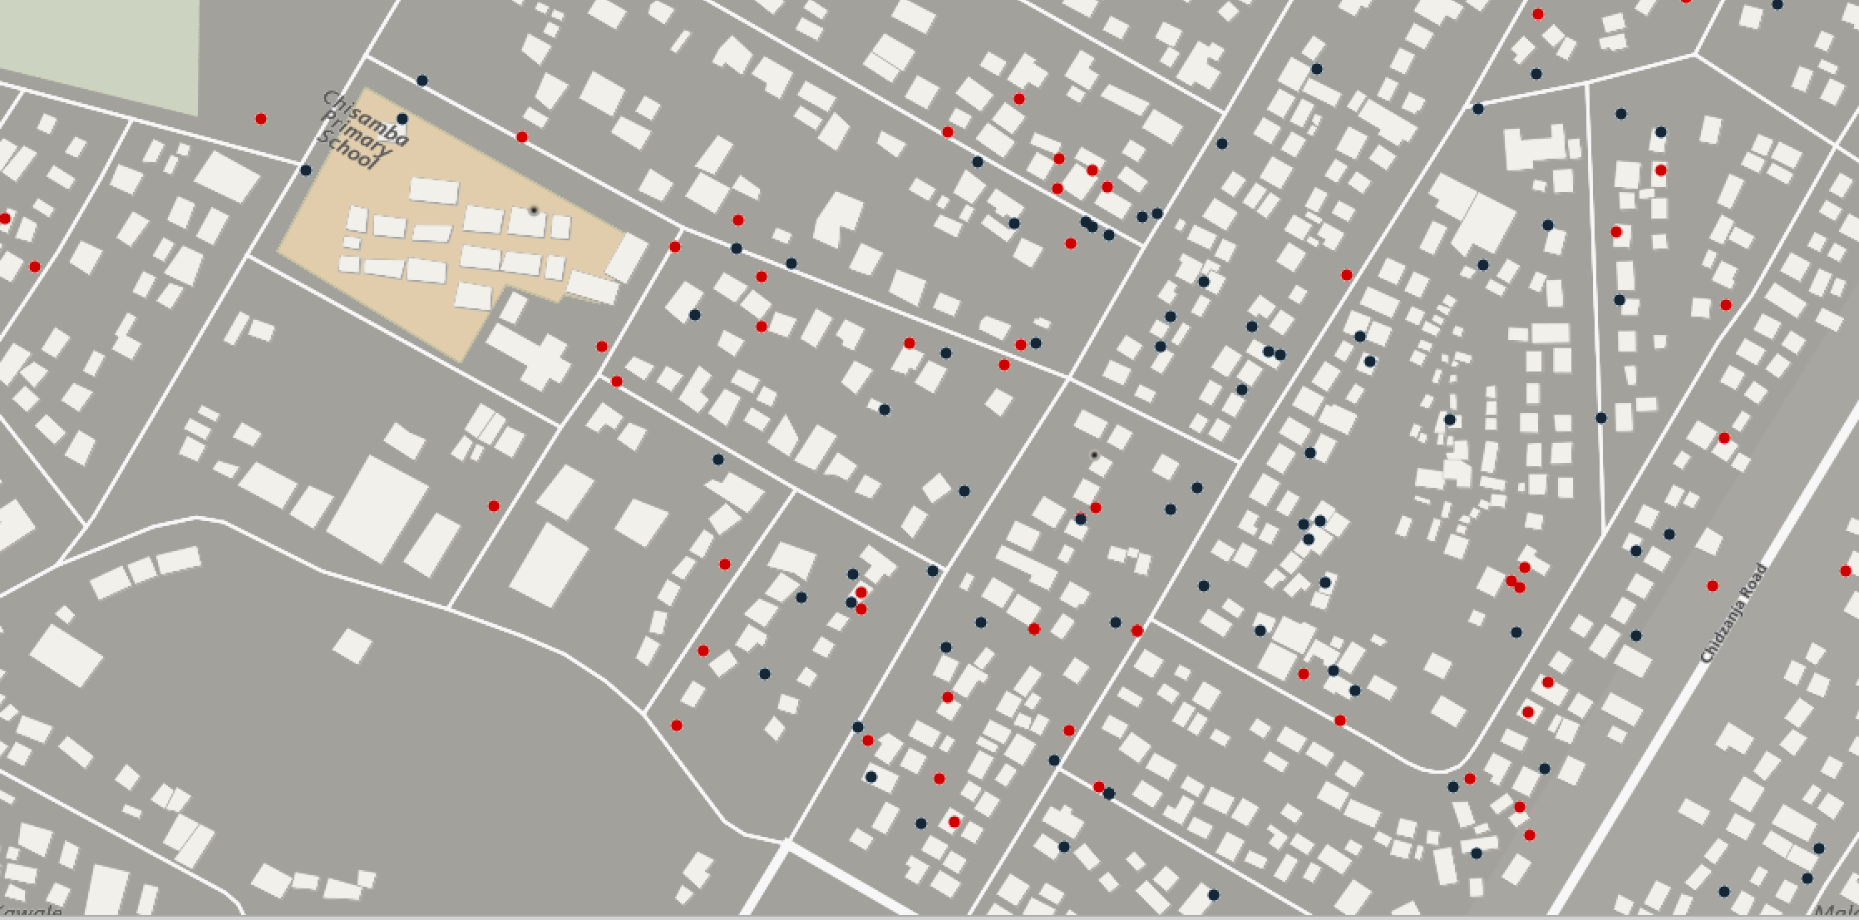
Detailed data resolution for identifying specific households
Building-level data was crowdsourced by volunteers for much of Malawi and is available and editable through OpenStreetMap (OSM)
OSM data for example area in Lilongwe, with household visit locations shown

Slide 18
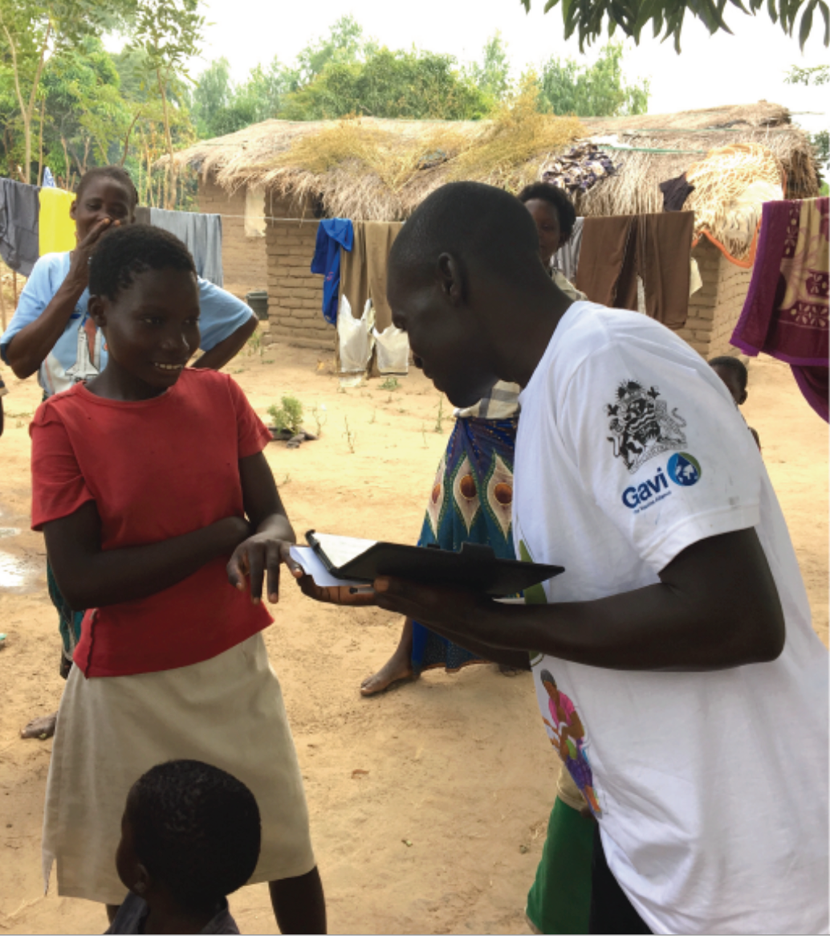
3. Rapid convenience monitoring (RCM)
Introduced into Malawi’s June 2017 campaign
Structure: 15 households and/or 10 children outside
Trained 58 Malawi Red Cross and Ministry of Health staff to use mobile data collection for RCM; they went on to train additional monitors. OpenDataKit (ODK) was used for data collection
Results fed into live, interactive dashboard

Slide 19
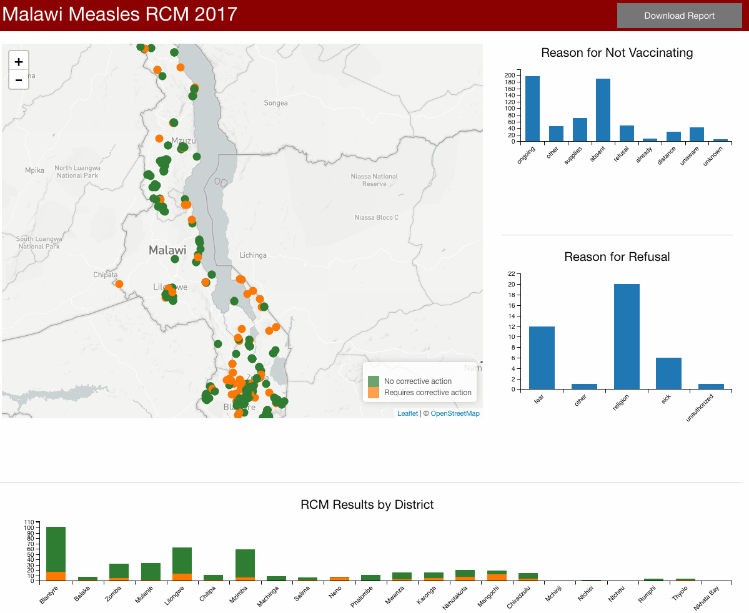
Dashboard screenshot:

Slide 20
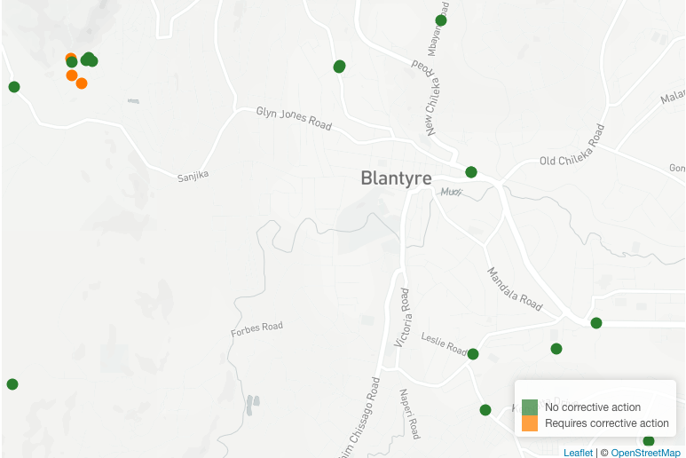
Dashboard components: Interactive map, charts, district summaries

Slide 21
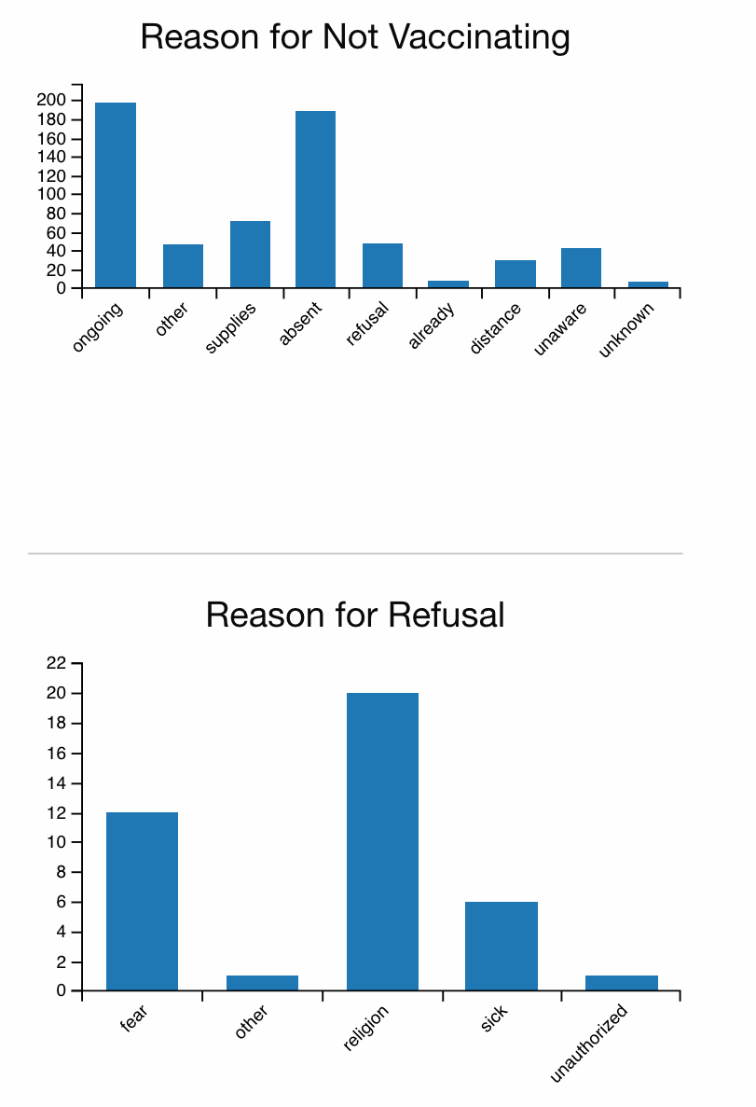
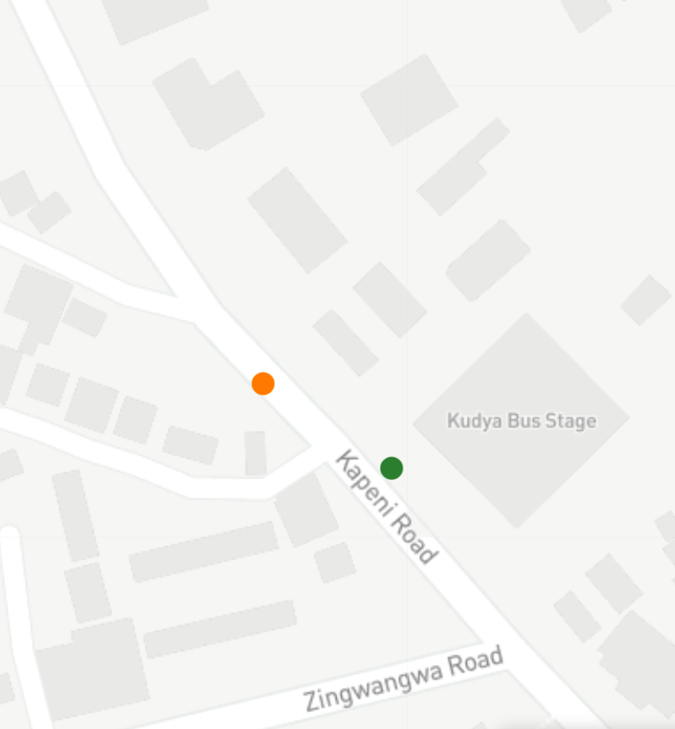
Dashboard components: Interactive map, charts, district summaries

Slide 22
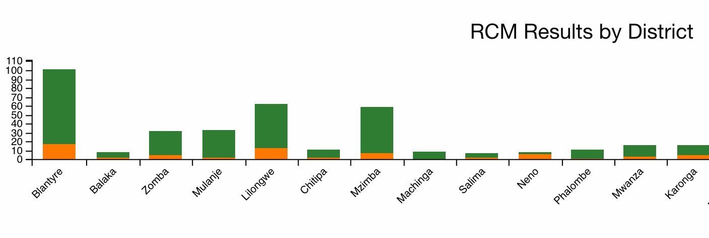
Dashboard components: Interactive map, charts, district summaries

Slide 23
3. Rapid convenience monitoring (RCM)
Results: 73 monitors in 22 districts conducted 440 RCM sets This included a cumulative total of 13,743 children
140/267 (52%) of inside-house RCMs did not require corrective action
153/173 (88%) of outside-house RCMs did not require corrective action

Slide 24
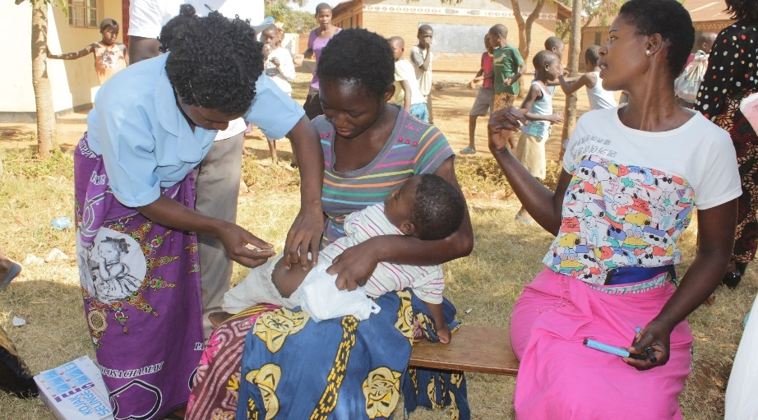
4. Challenges and lessons learned

Slide 25
Technical challenges
Developing methods and website in ~1 month was a tight timeline so there wasn’t as much time to spread awareness with partners; website info could be disseminated better
Training time was shorter than planned; needed additional trainers to help given the language barriers
Technical lessons learned
For RCM, staff had phones and could train themselves/each other using powerpoint instructions
Now that the tech tools are in place, we could spend more time doing prep with partners ahead of timez
Can integrate some additional features into website

Slide 26
MRCS challenges
Delay in disbursement funds led to delay in starting social mobilization; deployment of MR staff delayed
Low literacy levels among MRCS volunteers
In the cities MRCS volunteers were requested to produce valid MRCS identifications
The H2H social mobilization created demand for immunization but the coverage by the ministry of health could not meet the demand
Understaffing by ministry of health
Some areas had no existing subdivisions
Under utilization of real time data by MoH

Slide 27
MRCS lessons learned
Household visits during vaccination week gave room for follow up and wider reach, unlike the previous approach where volunteers were stationed at the immunization sites during vaccination week
There is need for coordination between different sectors as the measles campaign was running concurrently with anti-rabies vaccination campaign and this led to confusion in some communities
It is important to map low-coverage areas before the campaign in order to maximize resource use
There is need for proper planning and allocation of both human and material resources

Slide 28
Thanks!

